Slide 1
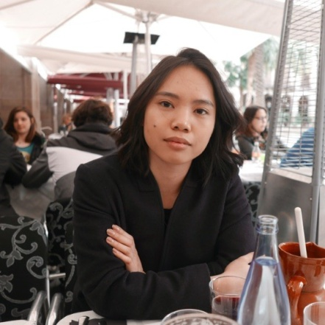
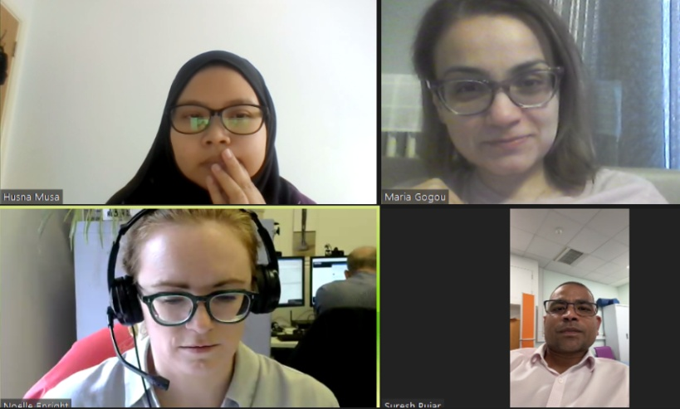
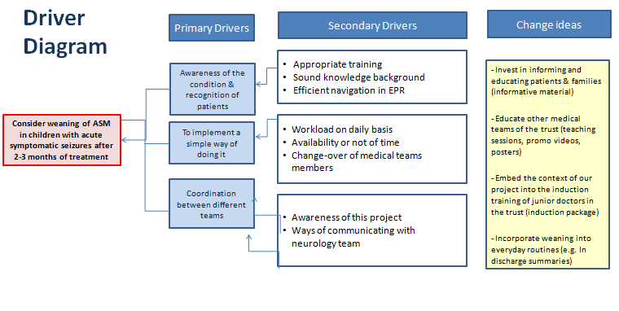
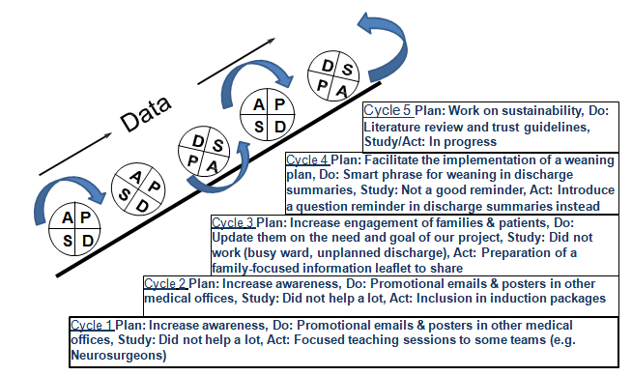
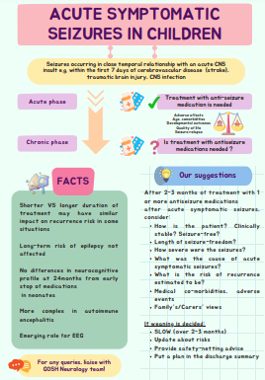
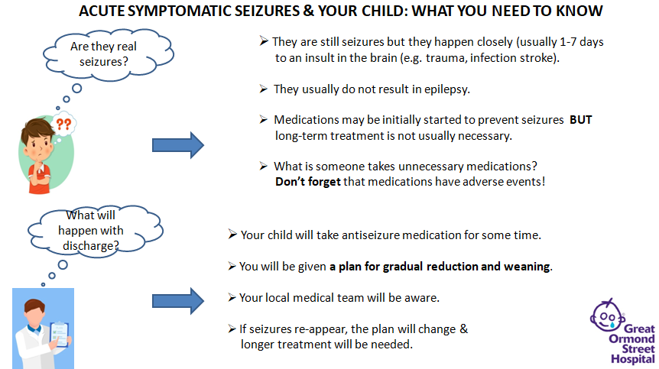
Weaning of antiseizure medications after acute symptomatic seizures: a quality improvement project Jahziel Darisan, Husna Musa, Noelle Enright, Suresh Pujar, Maria Gogou
Aim: To make sure that by May 2024 for all children (0-18 years) admitted to GOSH and started on antiseizure medications (ASM) after acute symptomatic seizures there will be a plan in their discharge summaries to start weaning ASM or consider weaning after a period of 2-3 months, if this is clinically appropriate.
What is the problem: Acute symptomatic seizures are seizures occurring in close temporal relationship with an acute CNS insult. Although treatment with ASM may be needed in the acute phase, they are usually not associated with future risk of epilepsy. However, there are no established guidelines about the duration of treatment with ASM and there is currently significant heterogeneity in daily practice, a fact which increases the risk of polypharmacy and associated adverse events.
Driver Diagram
Process map
Recruiting of patients
Engaging with other teams
Informative material, promo videos
Induction package, discharge summaries
November 2023
May 2024
PDSA cycles-example
What our tests revealed
Successful weaning requires collaboration of different teams & engagement of carers and local medical teams
Patients with acute symptomatic seizures: an heterogeneous group
Data/Results/Patient engagement feedback
Team personal learning/Team highlights
We have recruited and provided a written weaning medication plan for 16 out of 32 children initially identified.
We have learnt how to think in a sustainable way..
We have learnt how to improve quality without stopping working.
(Busy wards generate ideas!!!)
We have started to consider the practical benefits from
our research projects.
Projects ... build bonds!
Successes/Challenges
Next steps
Successes:
A reminder phrase in discharge summaries
A promotional video to increase awareness
Informative material for families and patients
Teaching sessions around the trust.
Part of our project will be included in the induction package
for junior doctors.
We will write a literature review and try to establish guidelines.
We will re-audit the practice in our trust
after completion of this project.
Challenges:
Changes in our team’s synthesis-how to keep team connected
Difficulties with engaging families & other teams:
The fragmented nature of our job
Workload, unpredicted discharges/transfers

