Slide 1

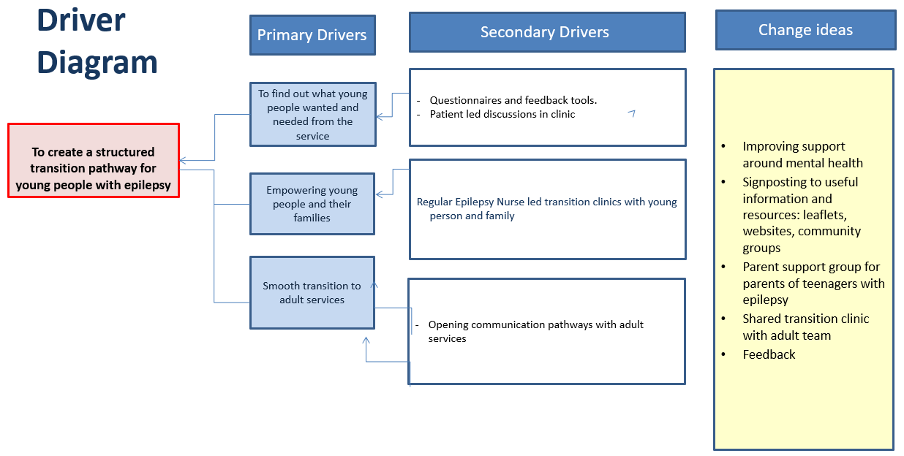
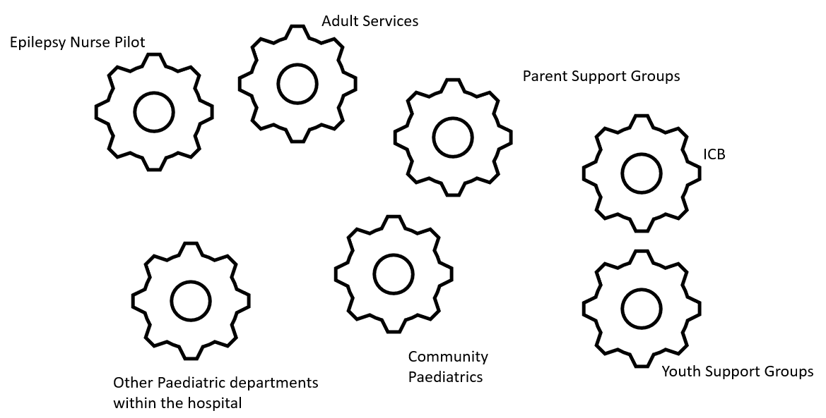
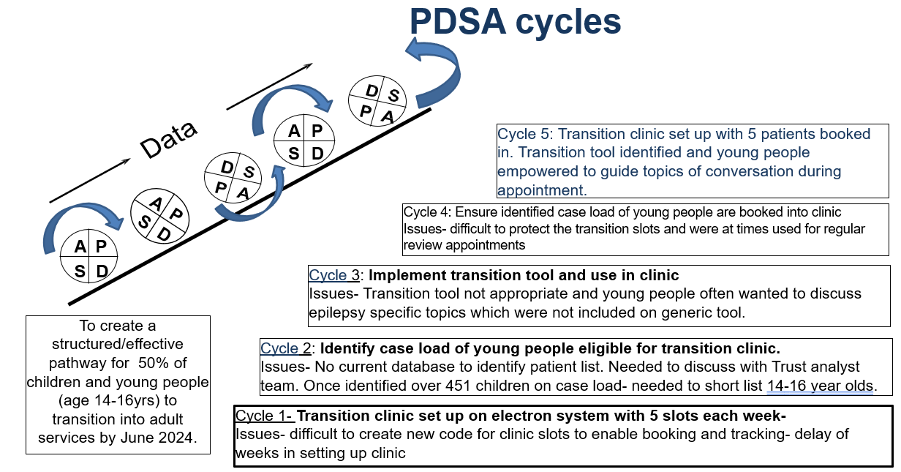
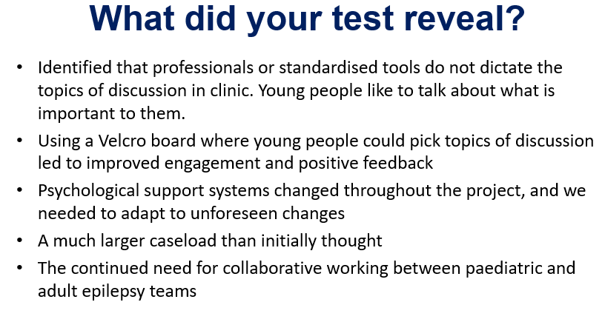
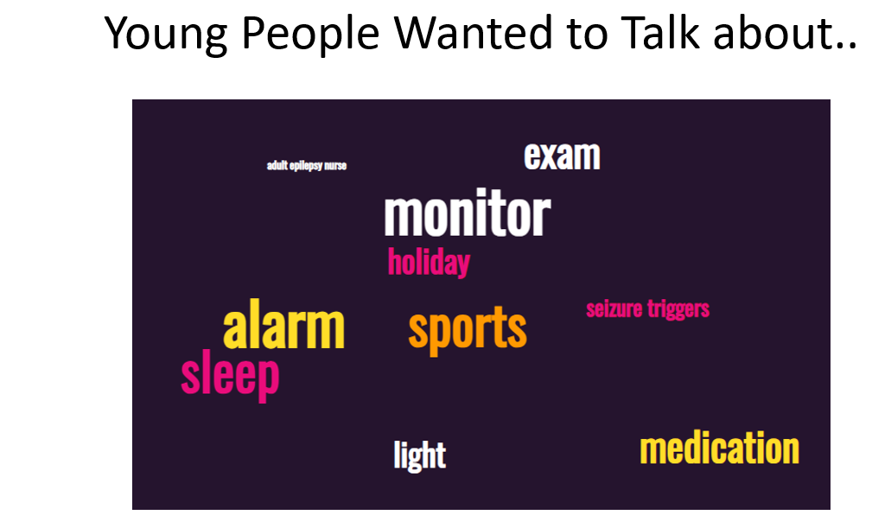
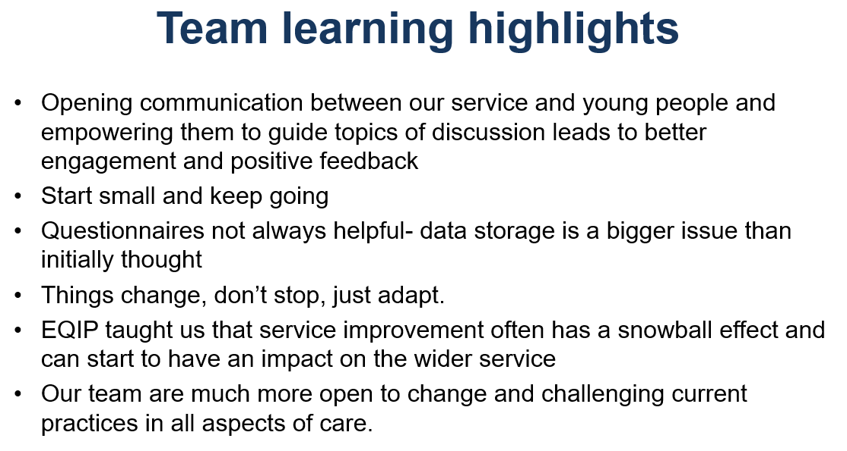
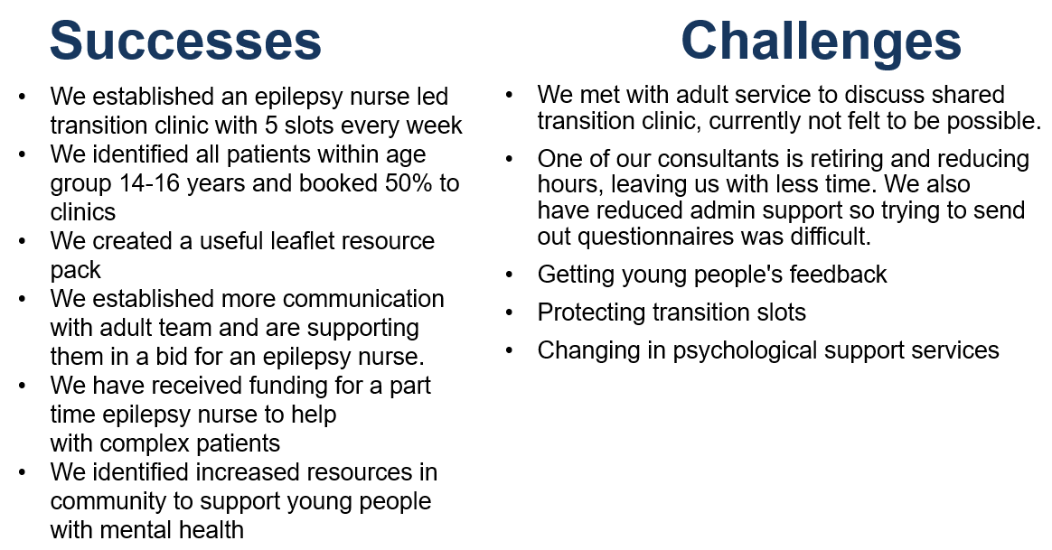
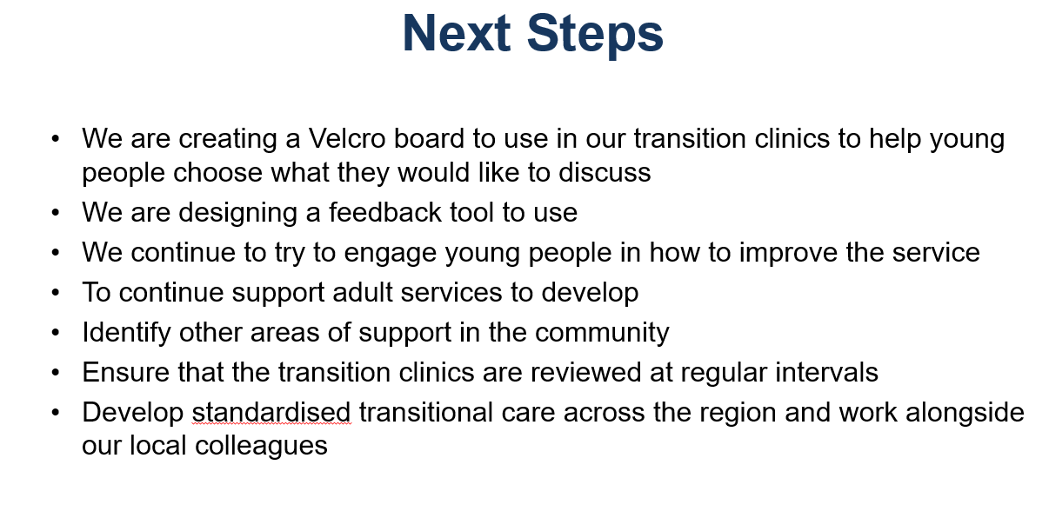
Transitional Care for Young People with Epilepsy
Dr Chaniyil Ramesh1: Paediatric Consultant with an interest in neurology and epilepsy
Dr Vanita Rasiah: Paediatric Consultant with an interest in neurology and epilepsy
Dan Kitchener: Epilepsy Specialist Nurse
Aim/purpose:
To create a structured/effective pathway for 50% of children and young people (age 14-16yrs) to transition into adult services by June 2024.
What is the problem:
There is currently no process to support the transition of young people with epilepsy to adult services.
Driver Diagram
Process map
PDSA cycles
What our tests revealed
Data/Results/Patient engagement feedback
Team personal learning/Team highlights
Successes/Challenges
Next steps

