Slide 1
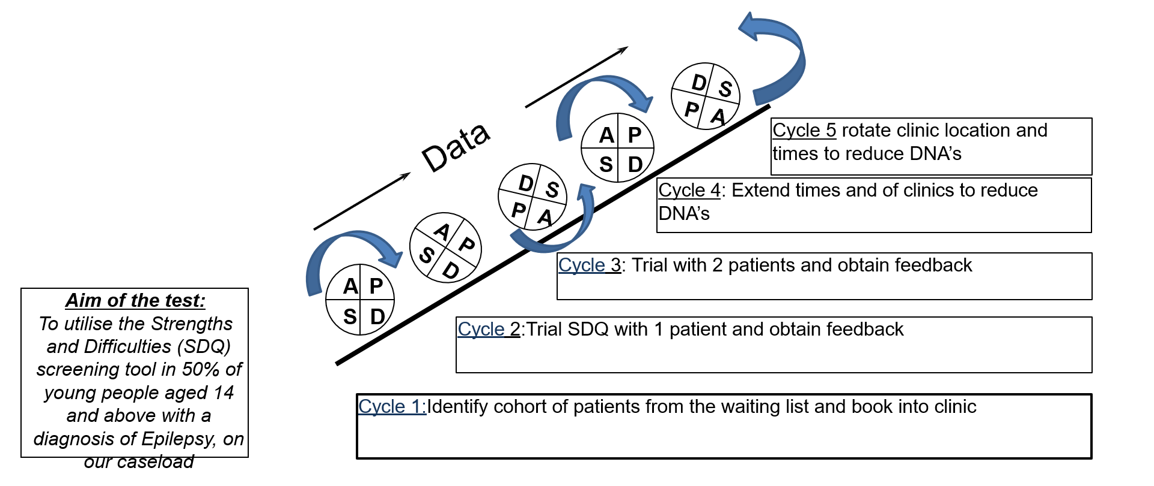
Dr Amy Wilson – Community Paediatrician and Epilepsy Lead, Debbie Garner- Paediatric Epilepsy Nurse Specialist
Sarah Charlson- Epilepsy Nurse, Angela Gardiner – Advanced Nurse Practitioner, Tahmina Haque – ST Registrar, Angela Palmer- Medical Secretary, Lois Faux – Clinic Bookings Admin
Northern Care Alliance (Salford Care Organisation)
Mental health screening
Aim/purpose:
To utilise the Strengths and Difficulties (SDQ) screening tool in 50% of young people aged 14 and above with a diagnosis of Epilepsy, on our caseload by May 2024
What is the problem:
The Epilepsy improvement project and bundle of care, focus on mental health screening.
We did not routinely use any mental health screening tools within our service
Our Epilepsy 12 data for mental health screening was 0%
We have had practical experience of using the SDQ tool and recognize that it can be used across other services
SDQ not specific to Epilepsy
Our learning could help/support other services
PDSA cycles
What did your tests reveal
Cycle 1: process worked smoothly (although time consuming on clinicians time). Difficulties: staffing numbers
Cycle 2: young person enjoyed completing the questionnaire and it opened up conversations during consultation
Cycle 3: young people gave feedback that the tool is long and ‘boring’. We had a large number of DNA’s for young people allocated to clinic
Cycle 4: Movement of clinic locations and times in attempt to reduce DNA’s. Some impact shown although too early to determine trend
Cycle 5: some improvement in DNA rates noted
Data/Results/Patient engagement feedback
Team personal learning/Team highlights
48 patients identified on the caseload aged 14+ years
Of these 48:
15 did not have the capacity to complete the questionnaire
6 did not have a formal diagnosis of Epilepsy (awaiting EEG results)
=27 identified as being eligible to complete the questionnaire
8 number of patients completed the SDQ
DNA rates for 11-16 years of age from Nov-March : Nov 13% Feb 20% -
DNA rates for 16 – 19 years of age: Dec 21.4% March 25%
New referrals to the service from Nov23-March24: 72 – required OPA within 2 weeks of referral to meet NICE guidance
Jan 24 time slots for clinic changed
Feb 24 location and time slots for clinics changed
Identified Gaps in service provision
Reflected on communication skills and clinicians agenda v young persons agenda
The SDQ itself wasn’t a problem. Other problems: DNA’s, limited clinic capacity with high referral rate
Team all embrace change and passionate about the project
EQIP- taught us we don’t have to solve everything all at once!
Successes Challenges
Next steps
SDQ implemented
Evaluated well
Opens up conversations in consultations
Continue to use SDQ
Offering later clinic slots and in different locations
SDQ to be rolled out with other services
Reduction of DNA rate
Manually identifying cohort of young people
Large cohort of young people with additional needs/communication difficulties
DNA rate
New referral numbers increased
Some patients had been seen a few weeks prior to the project starting for Transition work, therefore did not require an OPA within time scale of project
Signposting/resources – trust restrictions with printing
Initial DNA rate
Young persons event July 2024
Communication tools that can be adapted
Share learning across GM network
Devise a well being pack for young people

