Slide 1

Mental Health Screening
RCPCH EQIP QI Project

Slide 2
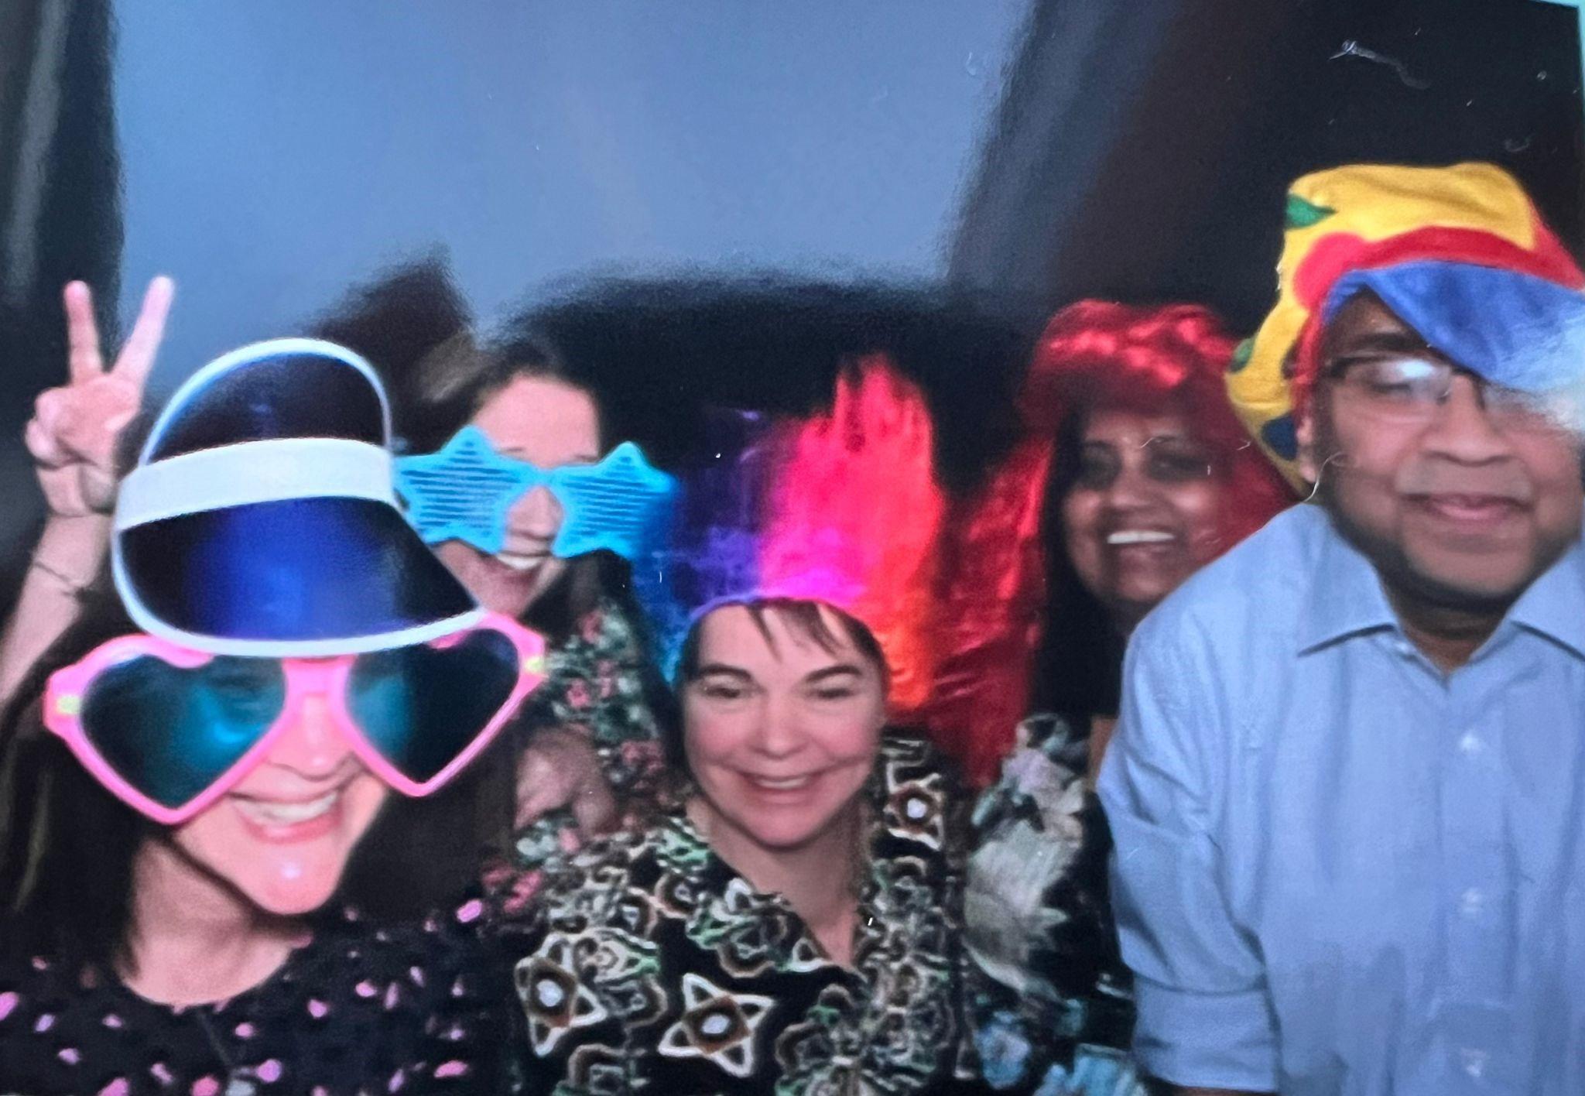
Our Team
Dr Lalani – Consultant Pediatrician with special interest in Epilepsy
Dr Kamal – Consultant Paediatrician with special interest in Epilepsy
Georgina Ward – Paediatric Epilepsy Specialist Nurse
Kari-Ann Croucher – Paediatric Epilepsy Specialist Nurse
Kerry Newall – Paediatric Epilepsy Specialist Nurse
Notes:
Say why you have selected the individuals and what influence they have on your project

Slide 3
Aim
By May 2024 all children / young people aged 13 – 18 attending our epilepsy clinic will have mental health screening, use patient feedback to identify service requirements.
Notes:
Remember how good my when within this project lifetime

Slide 4
Background Rationale
Describe….
Why did you choose this project?
In accordance with NICE standards of practice and epilepsy 12, all children should be screened for mental health issues
We had used Becks depression inventory and Strengths and difficulties questionnaires to screen mental health during epilepsy clinic consultations – this raised an ethical question since we had no pathway to any form of support / psychology services.
How did you identify the issue?
Patients previously had scores suggestive of Mild to Moderate Depression however they did not always meet the criteria for CAMHS intervention.
Hence they were left untreated, and we had no way to identity what form of intervention was needed..
What tools did you use to diagnose the problem?
We initially trailed the Revised Children’s Anxiety and Depression RCADS Questionnaire – We could not find a successful way to score this tool.
We identified the Peds QL epilepsy module – Paediatric Quality of Life Inventory – Epilepsy specific measure of Quality of Life
Which is applicable to all age groups.
How are the patients and families involved?
We explained the aim of our project – sought verbal consent
We asked our patients and their parents / carers attending clinic age 13 – 18 to complete the Peds QL tool
20 patients and parents / carers completed the tool

Slide 5
Results from Becks Depression Inventory

Slide 6
Driver Diagram
Primary Drivers
Secondary Drivers
Change ideas
Educate team on how to complete and score the screening tool accurately
Use appropriate mental health screening tool to identify key mental health issues and support the case for psychology support within our service.
Early screening of epileptic children using the designated tool during clinic visits
Early identification of young people at risk for developing issues that may require psychology support and provide a pathway to appropriate support.
Positive Feedback from patients and families regarding their satisfaction
Use appropriate screening tool
By May 2024 all children / young people aged 13 – 18 attending our epilepsy clinic will have mental health screening, use patient feedback to identify service requirements.
Incorporate the screening tool into routine clinical assessments for epileptic children during clinic visit
Integration of tool into workflow – Epilepsy 12 mandates this and best practice tariff (optional)
Patient and family engagement
Open communication between epilepsy team and patients, and families regarding the EQIP project

Slide 7
PDSA cycles
Cycle 5 PedsQL continue to use in clinic and use data to build case for psychology support
A P
S D
Cycle 4 PedsQL – specific to epilepsy - scoring system is clinically appropriate
Aim of the test
By May 2024 all children / young people aged 13 – 18 attending our epilepsy clinic will have mental health screening, use patient feedback to identify service requirements
A P
S D
Cycle 3: RCADS – Not specific to epilepsy - could not score
A P
S D
Cycle 2: Becks depression inventory – generic mental health measure for different client group – uncomfortable questions – not applicable to whole cohort – no licence agreement
Cycle 1 SDQ – results indicated behavioural issues – not epilepsy related distress
Notes:
You can insert text in the aim box and the cycle text boxes

Slide 8
PedsQL™ Epilepsy Module
Divided into 5 subsections:
Cognitive function
Executive Function
Fatigue
Mood and behavior
Impact
Existing versions:, for Toddlers (2-4 years of age), Young Children (5-7 years of age), Children (8-12 years of age), Teens (13-18 years of age), Young Adults (18-25 years of age)
Parent and Young person segments

Slide 9
Scoring system via database
Colour on database changes to indicate severity (higher scores indicate higher health related quality of life).
If the total score is below a certain level then this will flag it up in red – indicating a lower quality of life and that further discussions about support might be helpful.

Slide 10
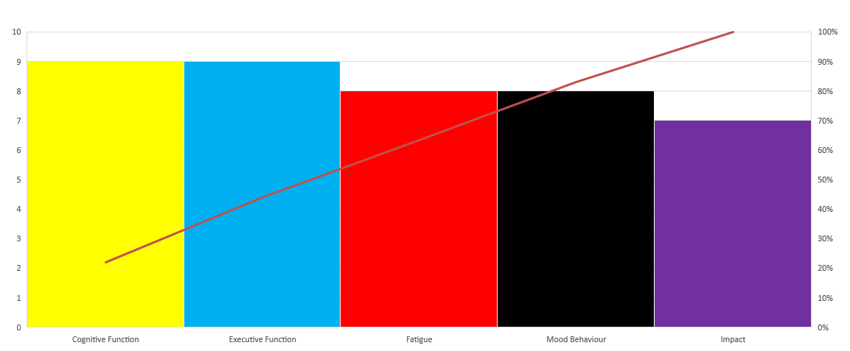
PedsQL™ Parent Report

Slide 11
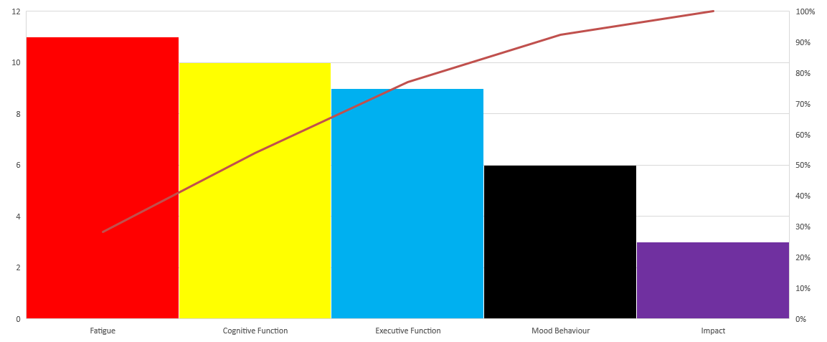
PedsQL™ Teen Report

Slide 12
Results
Cognitive function were identified as main problems by Parents and Young people.
Impact was identified as the least problem by both Young person and Parent.
Fatigue and Mood behaviour were also identified as being an issue.

Slide 13
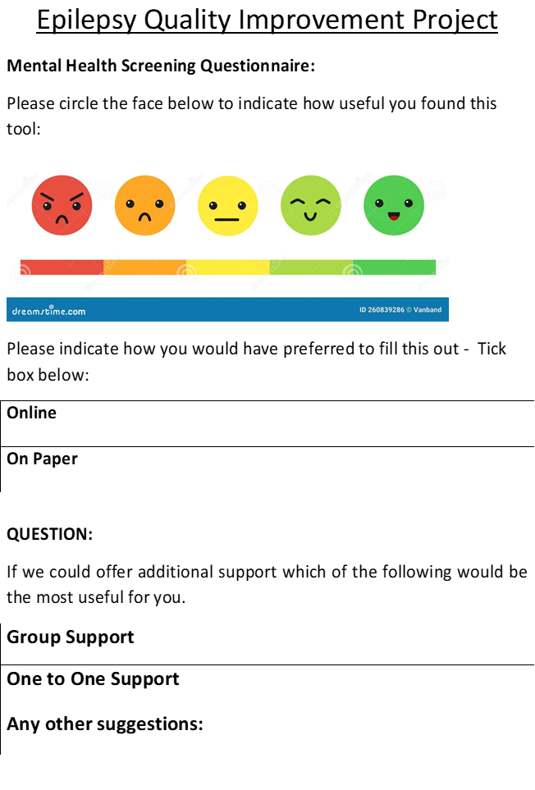
Patient and Family Engagement
Patients completing Peds QL attending epilepsy clinic age 13 – 18 were asked to complete feedback questionnaire

Slide 14
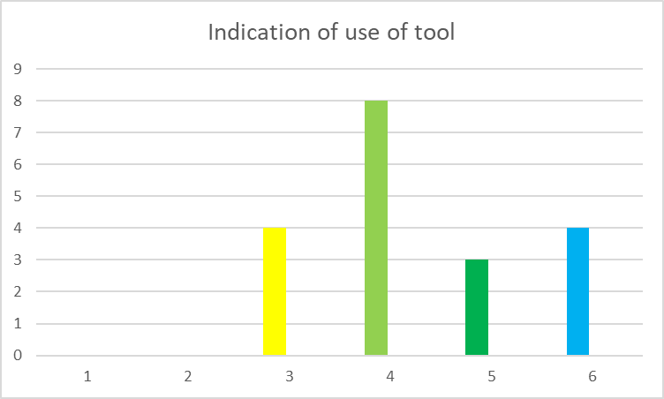
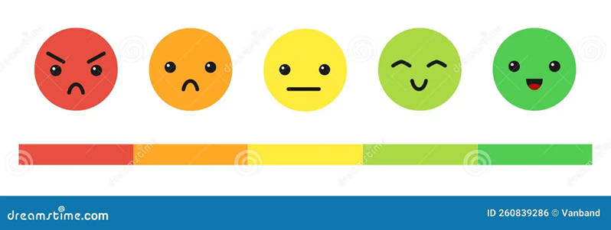
Mental Health Screening Questionnaire: Please circle the face below to indicate how useful you found this tool:

Slide 15
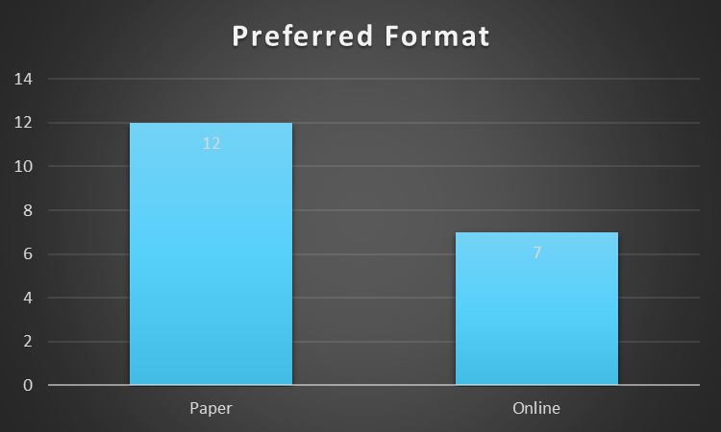
Please indicate how you would have preferred to fill this out - Tick box below:

Slide 16
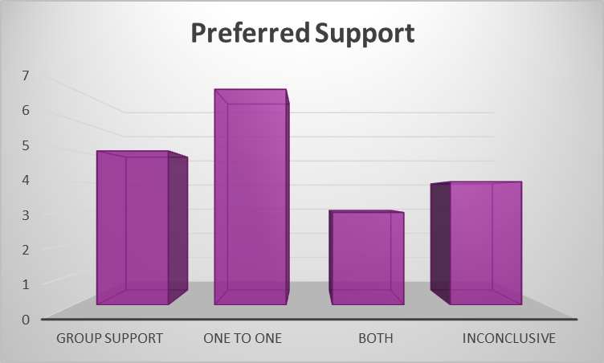
QUESTION:
If we could offer additional support which of the following would be the most useful for you.

Slide 17
What did your test reveal?
What did you learn?
The screening tools that we were previously using were not clinically effective – we had to find a tool that was more appropriate for our patients.
The majority of patients liked using the PedsQL and completing the form on paper
This is more convenient for us to use during consultation.
Often the tests either confirm your hunches or assumptions or you find out what does NOT work.
The assumption was that mood would be the main problem.
The sample size is small - we plan to continue using Peds QL to involve all our cohort – divide into 2 cohorts eg epilepsy and neurodiversity and epilepsy only.
What processes/systems/ideas did you abandon and what changes did you adopt from the tests
We abandoned Becks, SDQ and RCADS - we plan to continue using PedsQL and gather more data.
We will continue to gather feedback from our patients and their carer’s.

Slide 18
Successes
Challenges
We are now using PedsQL
We will start to use the tool on all age groups with the aim of early identification of problems.
Continue to gather data and use this as a case to direct service requirement.
Planning ongoing meetings with Psychologist working in our trust for case consultation if patients have identified a specific issues.
Peds QL was clinically useful.
Using Peds QL prior to clinic appointment can help direct questions during consultation.
No dedicated time for Project
Small team – big caseload.
Key issues that emerged?
Clinical cut off not yet identified for scoring Peds QL
Best practice tariff component for psychology is small – is not enough incentive
What would you have done differently?
We could use the PedsQL on wider population including younger age group for early identification/ intervention

Slide 19
Team learning highlights
Reflect on:
What did you learn as individuals and as a team –
We have a dedicated Team
We learnt how to get support from other services
What were the lessons learnt about your project?
The Impact of epilepsy – wider picture
Various tools that can be used
Changes don’t happen overnight – dedication and commitment is needed over time
What did the EQIP teach you that you will use tin the future?
How to implement changes
How to develop and implement an idea using the available resources
How to engage patients and their families
How have you changed as a team?
Satisfaction that we have made a positive change
Big goals can be achieved through small steps!

Slide 20
Next Steps
Based on your results what are you planning to do next?
Approach managers to build a business case for psychology support for epilepsy service.
Psychologist to join epilepsy meetings for case consultation – for signposting to other services or other specific suggestions.
what ideas do you have to inform your next and future improvement initiatives?
Develop a resource pack of services and signposting to support.
How will you share your project on a local level and beyond?
Present EQIP findings to audit and governance meeting locally.
Submission of poster presentation to Epilepsy 12 Open UK conference.

