Slide 1
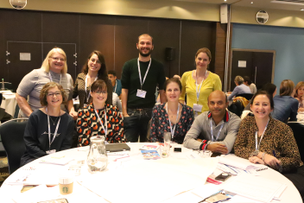
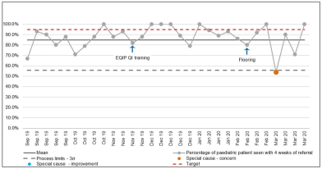
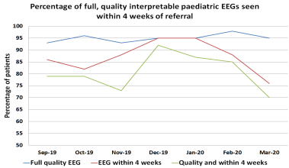
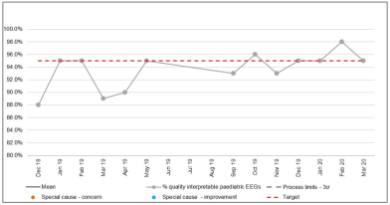
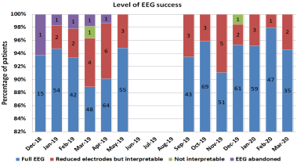
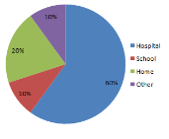
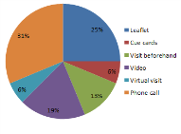
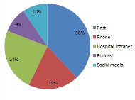
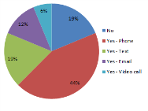
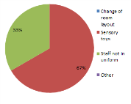
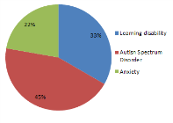
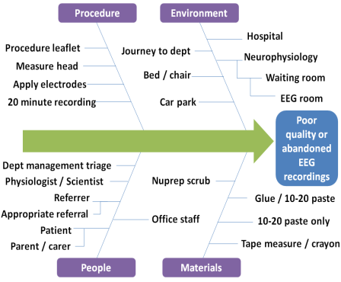
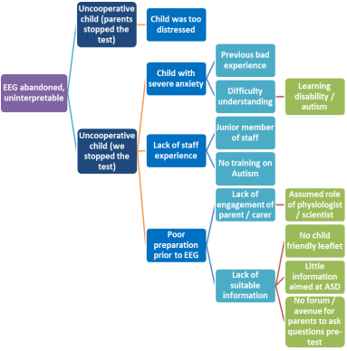
Laura Ashmore, James Baird, Ann Brown, Denise Crozier, Katherine Martin, Maria Moran, Francesca Napolitano, Manish Prasad & Helen Sneath
Quality and timely EEG recordings at Nottingham University Hospitals NHS Trust
Aim: Achieve a full, quality and interpretable routine EEG recording in 95% of all children and young
people for whom an EEG is requested, within 4 weeks of referral, by May 2020
Background: Many of the children and young people (CYP) referred for EEGs present with intellectual disability (ID), autism spectrum disorder (ASD) and / or anxiety. The recording of full, quality EEGs in this cohort can be challenging for all involved. By improving the preparation and experience of this group of CYP and their families, we hope to improve the quality of the recorded EEG to optimise the accuracy of epilepsy diagnosis within our service.
Additionally, by reducing our EEG waiting list time from 6 to 4 weeks, we aim to see CYP in a timely manner in line with NICE guidance (NICE CG137, 1.6.3).
Our improvement journey – the steps we took
Outcome Data
Bright spots
Great feedback from families about increased flexibility to tailor the EEG investigation – use of melatonin, pre-visit play-dates, non-uniform for staff etc.
Rewarding, collaborative links now formed to enable future dialogue and multidisciplinary working
Sharing of challenges and ideas
Inspiration for other QI ongoing within the team: further information and resources for young people in our teenage epilepsy clinic; ’ready-steady-go’ transition support; virtual consultation and phone triage of children and young people with a first seizure during Covid-19 pandemic.
Challenges
Time constraints to contact families / carers pre-EEG
Follow-up call if a CYP had been distressed / struggled with the EEG did not happen.
Project was EEG appointment based which paused during Covid-19 pandemic.
Personal learning
We had two, rather than one, improvement objectives. This meant that the good work in improving the quality of EEGs was masked by increases in our waiting times (Graph 3 Outcome Data)
Next steps
Plan for a service user forum to explore further ways of meeting the needs of CYP attending for EEG. We currently have five offers of involvement. Increased familiarity with and availability of online group video conferencing may increase the numbers able to participate.
Plan for interim amateur phone-video, with future charitable funds application for official Trust department video
Dec 2019
Signposting to on-line video of EEG (Evelina)
Nov 2019
Reduce breach date from 6 to 4 weeks
Nov 2019
Collect post-EEG feedback from families / carers - questionnaire
Dec 2019
Improved comm. pre-EEG between referrers and Neuro-physiology
Dec 2019
Pasta-poll for CYP feedback
Feb 2020
Addendum to CYP EEG leaflet with signposting
PLAN for family / carer forum meeting via Zoom.
Own dept. video
Nov 2019
Pre EEG discussion with families /carers about specific needs of CYP +/- 1 day prior to EEG
Jan 2020
Follow-up call to families / carers. How was the experience?
Percentage of CYP seen within 4 weeks of referral
1
3
Percentage of full, quality interpretable paediatric EEGs
2
4
Driver Diagram
Qualitative Feedback from Families / Colleagues
Primary Drivers
Secondary Drivers
Ideas for Change
Where would you have preferred the EEG test performed?
What information would you have liked before the EEG?
How would you like to access the information about the EEG?
COMMENTS
What a great idea! (phone call before visit)
What a great service!
This is 100% better than last time
The slow and gentle approach of the staff helped him relax and gain his confidence.
He was reluctant to attend, it’s not been done before ,but I think he would be happy to repeat the experience
Attending the appointment
Individual challenges - ID, ASD, anxiety
Staff expertise
Equipment and environment
Child or young person tolerating or cooperating with the EEG
Referred appropriately
Contact and booking of appointment
Reminder text, phone-call
Travel / attendance
Quiet / sensory etc.
Education, guidance, triage
CYP and families / carers fully informed – why EEG is important
Preparation and explanation – language and communication Pre-visit to department / use of melatonin Additional training – autism awareness etc.
Home or school EEG?
Would it be helpful to ask questions about the test before coming?
Are there any other changes that you would like to see?
I (child or young person) have…?
How did you diagnose the issue? (pareto, flowchart)
Bright Spots / Challenges
Your tests of change
Team personal learning / next steps
PDSA 1 Breach date reduced from 6 weeks to 4 weeks
PDSA 2 Families / carers of CYP with ID / ASD / anxiety receive a phone call the day before attending for an EEG. This allows a ‘heads-up’ and answers any queries or anxieties from the CYP / family / carer
PDSA 3 Feedback questionnaires issued post EEG. These allow CYP and families to reflect on the experience, helping to shape the service to better meet the needs of CYP with ID / ASD / anxiety
PDSA 4 Addendum added to CYP leaflet signposting useful links - ‘Having an EEG’

