Slide 1
RCPCH Epilepsy Quality Improvement Programme
August 2021 – April 2022
Transition pathways
East Lancashire NHS Foundation Trust
RCPCH Epilepsy Quality Improvement Programme project team:
Ms Lucy Miller, Children’s Epilepsy Specialist Nurse
Dr Rosemary Belderbos, Consultant paediatrician with a special interest in epilepsy
Ms Lucie Lord, Children’s epilepsy nurse
Dr Vanessa Holme, Consultant paediatrician with a special interest in epilepsy
Dr Poornima Nair, Consultant paediatrician with a special interest in epilepsy
Dr Summaya Valli, Consultant community paediatrician with a special interest in epilepsy
National audit results included within this case study acts as a guide only to performance standards. The service improvements made during the EQIP cannot be entirely attributed to the reported results in the Epilepsy12.

Slide 2
Transition pathways – East Lancashire NHS Foundation Trust
Project aim
To offer transition as a staged approach equitably from 19% to 100% of our patients aged 16 years and over by March 2022.
Background
East Lancashire Hospital Trust (ELHT) is passionate about providing a great service for our children, young people, and their families and carers. The team has recognised that transition is an area they would also like to improve by implementing a clinic with the children’s epilepsy nurses and the adult epilepsy nurses, but there is no preparation for the young people ahead of this clinic. This is an area where it is vitally important to equip young people with the skills they require to manage their epilepsy well into adulthood. The children and young people that are cared for by ELHT were recognised by the Epilepsy12 audit as being among the most deprived in the country; therefore, in response, the service strives to ensure they support patients in a way that is accessible and equitable to all children and young people that attend clinic.
Area of focus
Develop a clinic with the children’s epilepsy nurses and the adult epilepsy nurses through effective patient engagement that will be used to develop information packs to support newly diagnosed patients to help educate and better prepare children, young people, and their families and carers transferring to adult services.
.

Slide 3
Transition pathways– East Lancashire NHS Foundation Trust
Changes
The team created a nursing pro forma because they do not have access to a secretary or run nurse-led clinics. It was agreed to run clinics for patients aged 16 years old and work backwords instead of patients aged 12 years in the first instance due to team capacity.
Developed a five-question survey to capture feedback from young people and/or parents on their support needs.
Reviewed the current patient transition journey and feedback from the questionnaire.
Created a transition pathway, proforma, and leaflet, and reviewed the leaflet with young people and families.
Tested with young people in two clinic sessions.
The full transition pathway will be tested for one month.
The service transition clinic had a high DNA rate, so in co-design with CYP, the team created a leaflet to help combat high DNA rates that explains more about the importance of the clinic.
The leaflet was distributed with clinic letters to those patients who engaged and provided their feedback to obtain their opinions on what they thought and ideas on how the content could be improved before the final version was agreed.

Slide 4
Transition pathways – East Lancashire NHS Foundation Trust
Results
A nurse-led questionnaire included involvement from a junior doctor who contacted families to capture views via a questionnaire.
February 2021: Questionnaires were asked at clinics and over the phone. 27 families engaged in the questionnaire.
Questionnaire results mainly fell within the following topics:
Young people would like individual sessions.
Young people would like afternoon or evening clinics.
It was a split between virtual and face-to-face clinics.
Leaflets were preferred; a leaflet has been created.
The nursing proforma for clinics was produced to contain the information young people want to know during clinic appointments.
Analysed suggestions for clinic times, how to deliver clinics, and what to discuss.
The nursing proforma for clinics was created from feedback.
Information was gathered regarding topics requested to be discussed at clinics.

Slide 5
Transition pathways – East Lancashire NHS Foundation Trust
Challenges
Finding time as a team to work on the project.
Time restraints
Adult services are located within a different Trust, meaning it is difficult to share patient information easily.
Motivation.
Ensuring the improvements are sustainable.

Slide 6
Transition pathways – East Lancashire NHS Foundation Trust
Questionnaire

Slide 7
Transition pathways – East Lancashire NHS Foundation Trust
Questionnaire results

Slide 8
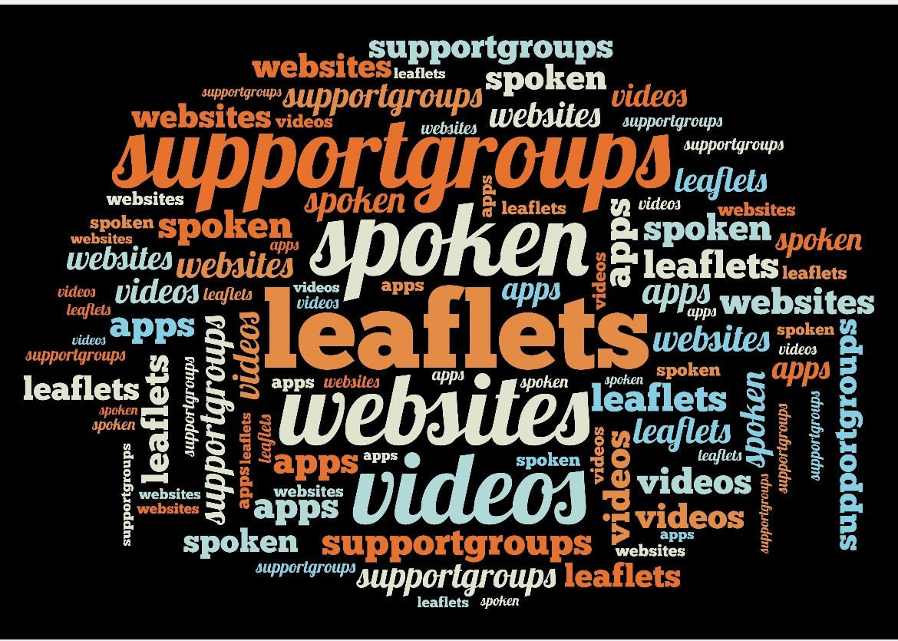
Transition pathways – East Lancashire NHS Foundation Trust
Questionnaire results
Transition as a staged process will be helpful
I was worried about transition, knowing there will be support makes me feel better
I am looking forward to learning how to manage my own epilepsy
The pre clinic leaflet is useful

Slide 9
Audit results cohort 3/4 - Professional input - East Lancashire NHS Foundation Trust
NICE guidelines (Quality statement5) state that children and young people with epilepsy are seen by an epilepsy specialist nurse who they can contact between scheduled reviews.
In 2021, 67% of CYP had input from an Epilepsy Specialist Nurse and 60% of CYP had input from an Epilepsy Specialist Nurse in 2022.
Percentage of CYP with input from: | 2019 | 2020 | 2021 | 2022 | 2021 – NWEIG | 2021 – England & Wales | 2022 – NWEIG | 2022 – England & Wales
Epilepsy Specialist Nurse | 50% | 76% | 67% | 60% | 87% | 80% | 82% | 80%
Paediatric neurologist | 42% | 31% | 50% | 40% | 21% | 25% | 22% | 20%
Paediatrician with expertise | 42% | 34% | 100% | 60% | 95% | 85% | 92% | 89%

Slide 10
Audit results cohort 3/4 - Professional input - East Lancashire NHS Foundation Trust
The percentage of CYP with input from an epilepsy specialist nurse in their first year of care has increased since 2019, but currently sits below the national and regional average.
The percentage of CYP with input from a paediatric neurologist in their first year of care has increased since 2019 and is consistently above the national and regional average. *RXR represents East Lancashire NHS Foundation Trust.

Slide 11
Audit results cohort 3/4 - Structured transition resources - East Lancashire NHS Foundation Trust
NICE Quality Standard 140 (Statement 1) – Young people who will move from children’s to adults’ services start planning their transition with health and social care practitioners by school year 9 (aged 13 to 14 years), or immediately if they enter children’s services after school year 9​.
From 2021, East Lancashire paediatric epilepsy service have continued to use structured resources to support CYP with transition.
 | 2018 | 2019 | 2020 | 2021 | 2022 | 2021 – NWEIG | 2021 – England & Wales | 2022 – NWEIG | 2022 – England & Wales
Does your paediatric service use structured resources to support transition (e.g. Ready Steady Go)? | No | No | - | Yes | Yes | 75% | 63% | 91% | 66%

Slide 12
Audit results cohort 3/4 - Professionals involved - East Lancashire NHS Foundation Trust
From 2021, East Lancashire Hospitals NHS Trust began to routinely involve an adult epilepsy specialist nurse and adult neurologist in transition to adult services.
Which adult professionals are routinely involved in transition or transfer to adult services? | 2018 | 2019 | 2020 | 2021 | 2022 | 2021 – NWEIG | 2021 – England & Wales | 2022 – NWEIG | 2022 – England & Wales
Adult epilepsy specialist nurse | Yes | Yes | - | Yes | Yes | 58% | 61% | 64% | 66%
Adult learning difficulty | No | No | - | No | No | 0% | 17% | 0% | 20%
Adult neurologist | No | No | - | Yes | Yes | 83% | 86% | 82% | 88%
Youth worker | No | No | - | No | No | 0% | 4% | 0% | 3%
Other | No | No | - | No | No | 0% | 17% | 0% | 20%

Slide 13
Audit results cohort 3/4 - Joint clinics - East Lancashire NHS Foundation Trust
East Lancashire Hospitals NHS Trust continues to provide CYP with an outpatient service for epilepsy where there is a presence of both adult and paediatric professionals via a single joint appointment. The estimated percentage of young people transitioned to adult services using a joint professional process has remained consistently high, achieving 100% in exceeding the national and regional average.
Graph showing Trust, regional and national results on Estimated percentage of young people transitioned to adult services using a joint professional process. *RXR represents East Lancashire NHS Foundation Trust.

Slide 14
Audit results cohort 3/4 - Transition age - East Lancashire NHS Foundation Trust
In 2022, East Lancashire Hospitals Trust continues to provide an outpatient clinic specifically for 16 year old ‘young people’ with epilepsies.
 | 2018 | 2019 | 2020 | 2021 | 2022 | 2021 – NWEIG | 2021 – England & Wales | 2022 – NWEIG | 2022 – England & Wales
Does your trust have an outpatient clinical specifically for ‘young people’ with epilepsies? | Yes | Yes | - | Yes | Yes | 42% | 40% | 55% | 45%
If yes, from what age does this young people’s clinic typically accept young people? | 16 | 16 | - | 16 | 16 | Mean: 14 Median: 14 | Mean: 15 Median: 14.5 | Mean: 14.2 Median: 14.0 | Mean 14.7 Median: 15.0

Slide 15
Transition pathways – East Lancashire NHS Foundation Trust
Outcomes
Some patients received a good transition service; however, this was not the case for all young people who attended clinics.
Young people, families, and carers are engaged in the thought process for improving transition and learning about independence. Increased engagement with young people, families, and carers, and have included their suggestions into the proforma content.
Achieved by creating a pathway, proforma, and leaflets.
Developed relationships with the adult epilepsy nursing team.
Beyond the programme, continue with running young people and transition clinics, implementing what they have learned to improve transition, and reviewing them in a year on their effectiveness. Plans are in place to continue to learn about young people and transition from relevant training sessions and e-learning to fully equip staff to be able to deliver clinics.
National audit results showed that from 2021, East Lancashire Hospitals NHS Trust began to routinely involve an adult epilepsy specialist nurse and an adult neurologist in transition to adult services.
The estimated percentage of young people transitioning to adult services using a joint professional process has remained consistently high, achieving 100% and exceeding the national and regional average.

Slide 16
Transition pathways – East Lancashire NHS Foundation Trust
Lessons learnt
Changing the project aim during the course of the programme was a process that helped the team focus on what was achievable.
Creating this new pathway has created a lot more work, and the team found they would need to explore efficient ways of working.
A new way of working is sometimes a challenge to approach; however, in spite of the challenges, the service worked well as a team.
Connecting to young people, families, and carers to access their opinions and knowledge was a major change.
Learning to take small steps results in a big change.
Achieved engaging with a wider multidisciplinary team.
The British Paediatric Neurology Association (BPNA) has information on moving away from using the word ‘transition' because young people quite often think that's related to gender reassignment; therefore, they may look into calling the transition clinic a different name.
Visual presentation of team project intervention
Video presentation

Slide 17
https://eqip.rcpch.ac.uk
eqip@rcpch.ac.uk
@RCPCHEQIP

