Slide 1
RCPCH Epilepsy Quality Improvement Programme
November 2019 – July 2020
Establishing a transition service
Aneurin Bevan University Health Board
RCPCH Epilepsy Quality Improvement Programme project team:
Dr M. Barber, Consultant Paediatrician
Dr J. Anderson, Consultant Neurologist
L. Capeling, Children’s Epilepsy Nurse Specialist
Dr Charlotte Lawthom, Consultant Neurologist
Dr Demetria Demetriou, Specialist Trainee,
National audit results included within this case study acts as a guide only to performance standards. The service improvements made during the EQIP cannot be entirely attributed to the reported results in the Epilepsy12.
J. Barber, Children’s Epilepsy Nurse Specialist
K. Spender, Children’s Epilepsy Nurse Specialist
J. Edwards, Children’s Epilepsy Nurse Specialist
Johnson, Consultant Paediatric Clinical Psychologist

Slide 2
Transition pathways – Aneurin Bevan University Health Board
Project aim
90% of all 14–16-year-old young people with epilepsy will have been sent “Ready, Steady, Go” forms to incrementally educate teenagers regarding their condition and help them develop the necessary skills required for managing their epilepsy independently as young adults by May 2020.
Background
Prior to March 2020, paediatric patients with a diagnosis of epilepsy approaching the transition stage from paediatric services to adult neurology were only offered one joint “handover clinic“. The patients and their families had little or no preparation at all for this transition. Likewise, there was little preparation by clinicians for the issues to be discussed. An urgent need for facilitating this and improving the transition of patients to adult neurology services was identified by both teams.
Area of focus
The widely known and nationally used transition model, “Ready, Steady, Go”, developed by the Southampton Children’s Hospital, was chosen to be tested with patients. This model uses three sets of questions designed for young people at different stages in their development or “readiness” for transition. Proving a guide for discussion at appointments and agenda setting for the next appointment.

Slide 3
Transition pathways – Aneurin Bevan University Health Board
Additionally, the team planned to manage expectations for how the adult epilepsy service functions, help patients engage with the adult healthcare team, and answer any remaining questions regarding the diagnosis, medications, or prognosis of their condition.
Changes
Established how patients and families would like to receive information about their healthcare, i.e., via surveys, in-person appointments, or using engagement methods such as pasta voting.
Dissemination of the “Ready, Steady, Go” questionnaires to patients of transition age by post to help build the team’s experience of using the forms while exploring email and internet link text delivery methods. Submitted questionnaires were collected during clinic appointments, including basic contact details from patients and their families.
Set-up of clinic space and availability for a joint consultant-led epilepsy transition clinic and a joint nurse-led clinic to occur simultaneously alongside the consultant clinic.
The team utilised the Health Board’s introduction of the “Attend Anywhere” video consultation software to pilot a virtual video transition clinic with clinicians (in separate locations) and patient/carers. This was used with a limited number of patients due to the newly implemented software.

Slide 4
Transition pathways – Aneurin Bevan University Health Board
Results
The engagement method of pasta voting, which began in December 2019, was successful and captured feedback from patients and families on their preferences for how they would like to receive information regarding their healthcare via electronic means of email or text. However, at the time, the team was unable to do this reliably and had to seek help and advice from internal IT services.
Pasta voting results – Clear Winner – EMAIL OR TEXT. Face-to-face: 17 votes; post: 28 votes; email or text: 56 votes.
While there was a preference for email or text message to share the online questionnaires, the spread of preferences shown in the pasta voting clearly demonstrated the need to maintain flexibility to be able to offer any mode of sending the forms to patients. This includes post, email, electronic online completion, and completion only in person at in-person appointments.
Of the 197 patients identified, 194 had received the “Ready, Steady, Go” transition questionnaire.

Slide 5
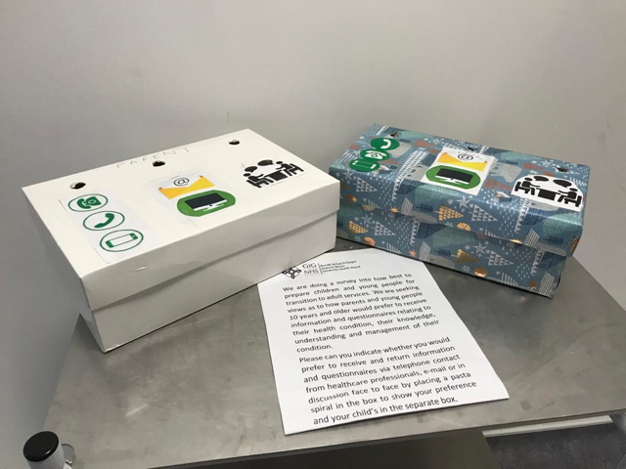
Transition pathways – Aneurin Bevan University Health Board
Pasta Voting Results – Clear Winner – EMAIL OR TEXT. Face-to-face: 17 votes; post: 28 votes; email or text: 56 votes.
Established how patients and families would like to receive information about their healthcare, i.e., surveys and appointments, using pasta voting.

Slide 6
Transition pathways– Aneurin Bevan University Health Board
Example of a transition questionnaire for patients with complex needs.

Slide 7
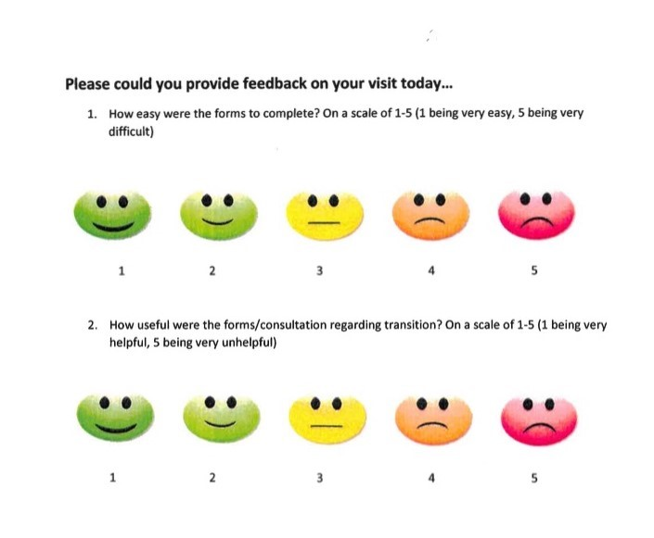
Transition pathways – Aneurin Bevan University Health Board
Example of feedback form shared with patients and families on using questionnaire.

Slide 8
Transition pathways – Aneurin Bevan University Health Board
“Ready, Steady, Go” transition model

Slide 9
Transition pathways – Aneurin Bevan University Health Board
Of the 197 patients identified, 194 have received the “Ready, Steady, Go” transition questionnaire.

Slide 10
Audit results cohort 3 – Transition referral pathway – Aneurin Bevan University Health Board
In 2021, Aneurin Bevan University Health Board re-established an agreed referral pathways to adult services for their children and young people with epilepsy.
Transition questions | 2019 | 2020 | 2021
Does your Health Board or Trust have agreed referral pathways to adult services? | Yes | - | Yes
Does your Health Board or Trust have an outpatient clinic specifically for 'young people' with epilepsies? | No | - | No
Does your Health Board or Trust have an outpatient service for epilepsy where there is a presence of both adult and paediatric professionals? | Yes | - | Yes
- If yes does this comprise of: A single joint appointment | Yes | - | Yes
Which adult professionals are routinely involved in transition or transfer to adult services? Adult epilepsy specialist nurse | Yes | - | Yes
Adult learning difficulty | Yes | - | Yes
Adult neurologist | Yes | - | Yes
Youth worker | No | - | No
Other | No | - | No
Does your paediatric service use structured resources to support transition (e.g. Ready Steady Go)? | Yes |  | Yes

Slide 11
Transition pathways – Aneurin Bevan University Health Board
Challenges
The impact of the COVID-19 pandemic on the service was immense. The plans to commence adjacent consultant-led and nurse-led transition clinics were hindered by the pandemic.
Time pressures meant the children’s epilepsy nurses completed only the final “green” phase of the “Go” form of the “Ready, Steady, Go” questionnaires with patients.
The team experienced difficulty obtaining completed forms of the “Ready, Steady, Go” questionnaire. The only method that seemed to work with patients completing their questionnaires was if they filled them out over the phone or in clinic.
Developing an electronic delivery method for questionnaires, including the collection of phone numbers and email addresses, to gain feedback on the process was challenging.
Finding an optimal way to maintain the watch list of all transition patients to track and send transition forms and receive completed forms when a patient reaches transition age was difficult and relied on ESNs confirming and checking the watch list.
Ascertaining a successful return rate for the “Ready, Steady, Go” forms.

Slide 12
Transition pathways – Aneurin Bevan University Health Board
Outcomes
Achieved 90% of all young people aged 14–16 years with epilepsy being sent the initial transition questionnaire by May 2020; managed to achieve 98%.
Increased patient engagement using tools and techniques learned by the CYP engagement team training on the EQIP.
Achieved closer teamwork with colleagues.
The set-up of transition clinics as planned – a nurse-led clinic and a consultant-led clinic running side by side in the same outpatient department – occurred temporarily (pre-pandemic). Each clinic had its own waiting list. These clinics worked well and will be revisited and planned to run on a Friday afternoon every 2 months, starting April 2020.
National audit results showed that in 2021
Aneurin Bevan University Health Board re-established an agreed referral pathways to adult services for their children and young people with epilepsy.
Re-established single joint appointments with adult professionals: adult epilepsy specialist nurse, adult neurologist and adult learning difficulty, who are routinely involved in transition or transfer to adult services.

Slide 13
Transition pathways – Aneurin Bevan University Health Board
Lessons learnt
The team found the pace of change in service delivery and the testing of new ways of working exciting and invigorating. The team agreed to pause and undertake a detailed review of the work during this time to see what can be taken forward and implemented more permanently in the service.
There is a potential to give young people and families more choice in the methods of interaction and advice, and encourage more active engagement with children and young people. The team would encourage others to try out different ways of service delivery and methods of interaction with their patients and families to test, evaluate, and re-evaluate the outcomes. Keeping young people and their families central is key to effective engagement and shaping the epilepsy service that works for them in the future.
Clinical nurse specialists are integral to service development and inter-disciplinary teamwork, with the sharing and development of roles within the team.

Slide 14
Transition pathways – Aneurin Bevan University Health Board
Lessons learnt
Transition of young epilepsy patients will always be a challenge, tailoring services to their very individual needs and addressing co-morbidity and how that impacts the transition. However, Epilepsy12 has been energising in the team’s endeavours to improve experiences for young people, as has the COVID-19 impact in shaping their use of technology, affording choice, and new ways of service delivery.
Visual presentation of team project intervention
Team poster PDF

Slide 15


https://eqip.rcpch.ac.uk
eqip@rcpch.ac.uk
@RCPCHEQIP

