Slide 1
RCPCH Epilepsy Quality Improvement Programme
August 2021 – April 2022
Improving patient engagement
Barts health NHS Foundation Trust
RCPCH Epilepsy Quality Improvement Programme project team:
Dr Maha Awadalla, Consultant Paediatric Neurologist
Dr Amit Bali, Consultant Paediatrician with special interest in epilepsy
Dr Michael Yoong, Consultant Paediatric Neurologist
Ms Joanne Edwards, Paediatric Neurology Specialist Nurse
Sidhra Mohiuddin, Paediatric Neurology Specialist Nurse
Dr Susan Liebeschuetz, Consultant Paediatrician
Joanne Mamode, Clinical Nurse Specialist

Slide 2
Improving patient engagement – Barts health NHS Foundation Trust
Project aim
To obtain meaningful feedback on our service from 50% of patients and families by March 2022, which will enable us to hear the voice of our patients and families and highlight areas of improvement within our service by March 2022.
Background
The Royal London Hospital's (RLH) paediatric epilepsy service reflects the hospital’s unique role as both a local and specialist hospital, providing care to the young, diverse population of Tower Hamlets, alongside being the specialist children’s hospital serving the East London and Essex regions. They provide a large secondary- and tertiary-level epilepsy service with an extremely large caseload of 900–1,000 patients, staffed by three consultants and one epilepsy specialist nurse (supported by two neurology specialist nurses).
The service at RLH faces some unique challenges, including socioeconomic challenges (the highest level of child poverty in the UK), a diverse community (with cultural and language barriers), and a large caseload that crosses boroughs and includes shared care with local hospitals, risking fragmented care.
Newham University Hospital Barts Health Trust is a new and small team. The consultant has taken over from a recently retired colleague and is getting to grips with a large and complex patient load with support from the tertiary specialist at Royal London.

Slide 3
Patient engagement – Barts health NHS Foundation Trust
Background continued
By participating in the programme, they would like to come up with some clear strategies for developing the service over the next 5 years. Both services were advised to team up and work as one Trust on the EQIP.
Area of focus
Through effective patient engagement methods, the cross-site team plans to capture the views of patients and families rather than assume on the areas of the service that require improvement to meet their needs.

Slide 4
Patient engagement – Barts health NHS Foundation Trust
Changes
The services are planned to obtain patient feedback from young people with learning disabilities and also from families in which English is not the first language.
Using methods learned in patient engagement training sessions by Emma Sparrow, Head of CYP Engagement, the team planned to trial the set-up of Post-it note display system in clinics in both Newham and RLH for patients and families attending clinics face-to-face to obtain feedback, with the aim of capturing meaningful feedback and initiating patient engagement.
Newham directed families to provide one good point and one improvement point, which had been quite successful.
RLH asked for thoughts and feedback, with some success. This has been trialled in all epilepsy clinics.

Slide 5
Patient engagement – Barts health NHS Foundation Trust
Results
Devised a questionnaire with 10 questions regarding service satisfaction, which was sent via email to one family at RLH and one family in Newham. Both chose families that had proactive and frequent contact, so the expectation was that both families would be likely to return questionnaires.
Oct 21: 0% return on the test questionnaire. No response was received for over a one month period. Possibly because the questionnaire was lengthy, there were language barrier issues, it was time-consuming, there was a cost for posting back the form, and there was a delay in receiving it since last contact with the service.
Dec: Post-it display was implemented, responses received from some families via the notice board increased engagement, and the quality of feedback varied and was possibly not that useful. The team reviewed the percentage of patients per clinic by the number of Post-it notes received.
Introduced a QR code, and a link to an online feedback form was generated and sent out to patients, used alongside Post-it note collection.
Feedback captured had been more about the appointment and less about service needs for the patient.
After liaising with the Trust Youth Panel, it was agreed they would review the questions used for the message boards on 16 Jan and help to co-design questions to obtain meaningful responses.

Slide 6
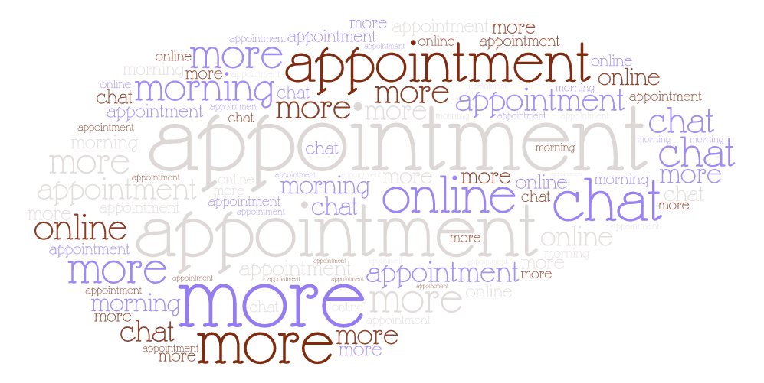
Patient engagement – Barts health NHS Foundation Trust
Results
Positive feedback Feedback on improvement

Slide 7
Patient engagement – Barts health NHS Foundation Trust
Challenges
The beginning of this journey was quite challenging for the cross-site team because they had not previously had a conversation as a group about what to focus on as a QI project. MS Teams meetings were arranged to reflect on and agree on their project aim.
Preparing the survey to be ready in a short time frame.
Working across two sites as one team to establish effective team working practices that would overcome any potential barriers. Recognising the need to share the load amongst team members and have roles within the project.
Preparation for using the board in terms of infection control, safety, not using pins, blue tack, and permission to use the existing notice at both sites. Post-it note display board was limited to only face-to-face clinics.
Methods to reach the patients that were reviewed virtually.
Time and team capacity.
The display boards were only available in English, which meant some patients were not able to complete feedback.
Due to the varying way data was collected, not all families had been able to give as much feedback as others.
Mostly only received parent/carer feedback.

Slide 8
Patient engagement – Barts health NHS Foundation Trust
Outcomes
Using Post-it notes generated increased feedback by keeping questions simple, such as:
“What went well?”, "What could have been better?”
Using multichannel methods such as:
Feedback board
Post-it notes
Online (via QR code and text message with link)
Beyond the programme, the services will:
Continue to work on the project regarding engagement to achieve their aim.
Continue to adapt methods for CYPF to share meaningful feedback (especially with young people).
Look at the data from feedback to identify themes and make necessary improvements.

Slide 9
Patient engagement – Barts health NHS Foundation Trust
Lessons learnt
Families from both sites that often engaged with their teams when asked to participate in the questionnaire did not complete it despite reminders. This highlighted that questionnaires were an inefficient way to obtain feedback from families, and they needed to be involved in voicing their preferences on how they would like to receive feedback.
The team admitted to feeling a sense of failure that the questionnaire was not completed by the two families selected, particularly as they were selected due to the high probability that they would engage and complete the survey, which was a huge lesson learnt.
Multiple types of feedback methods are required to capture the views of patients and their families.
Keep questions short and simple. Families, children and young people did not engage with a long paper feedback form.
Methods that offer a quick way to capture feedback provide better engagement from patients and families.
Visual presentation of team project intervention
Team poster
Video presentation

Slide 10
https://eqip.rcpch.ac.uk
eqip@rcpch.ac.uk
@RCPCHEQIP

