Slide 1
RCPCH Epilepsy Quality Improvement Programme
August 2021 – April 2022
Mental health screening pathways
Epsom and St Helier University NHS Trust
RCPCH Epilepsy Quality Improvement Programme project team:
Dr Maria Garcia, Consultant Paediatrician
Naomi Hodges, Specialist Paediatric Epilepsy Nurse
Florence Kennard, Specialist Paediatric Epilepsy Nurse
National audit results included within this case study acts as a guide only to performance standards. The service improvements made during the EQIP cannot be entirely attributed to the reported results in the Epilepsy12.

Slide 2
Mental health screening – Epsom and St Helier University NHS Trust
Project aim
To develop a standardised screening tool to identify the mental health status of our patients.
Background
The Epsom and St Helier University NHS Trust would like to improve the way mental health conditions, including learning and educational support for children and young people with epilepsy, are detected and cared for, and to optimise the currently available resources with a view to improving the service for the patients and families and demonstrate the need for additional or a different form of service or resource. The team has devised a method of assessing all patients with epilepsy, or presumed and diagnosed epilepsy, for issues of mental health and learning difficulties.
Area of focus
Find or devise a screening tool that is easily administered within the time and personnel resource constraints we have.
Devise a method of referring to and applying the support tool or treatment delivery.
Devise a method of measuring the efficacy of the tool.
Quantify and cost the shortfall in services, the additional cost, and the risk if not available.

Slide 3
Mental health screening – Epsom and St Helier University NHS Trust
Changes
The team researched the screening tools already in place within the epilepsy community to ascertain which would be most suitable to use for their patients and identified the Strengths and Difficulties Questionnaire (SDQ) and HEADS-ED as potential screening tools.
Research was conducted on local mental health services available within the area, including those within schools and CAMHS. It was important that the team feel they can offer suitable support for the children and young people who need it based on their screening tool results.
The team planned to engage with their patients and families to capture their thoughts on the need for a screening tool and their preference for how it is completed, i.e., a conversation with a member of the team outside of the clinic, an online form they can fill out in their own time, or a paper form.
The team kept track of how many patients were being captured using the screening tool; this will also have information on the results of their score.
Using the screening tool (i.e., a single piece of paper) and clinic lists (which were already being used for other things) to keep track of patient scores. We’re trying not to add much admin to already busy clinic slots.
Initially, only new patients were screened to pilot the tool, but it was discovered that this offered only low numbers to trial and track.

Slide 4
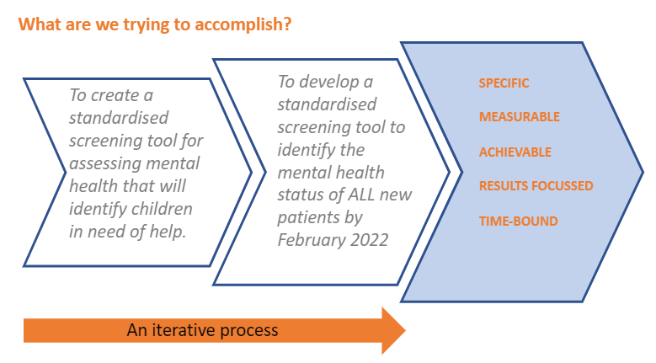
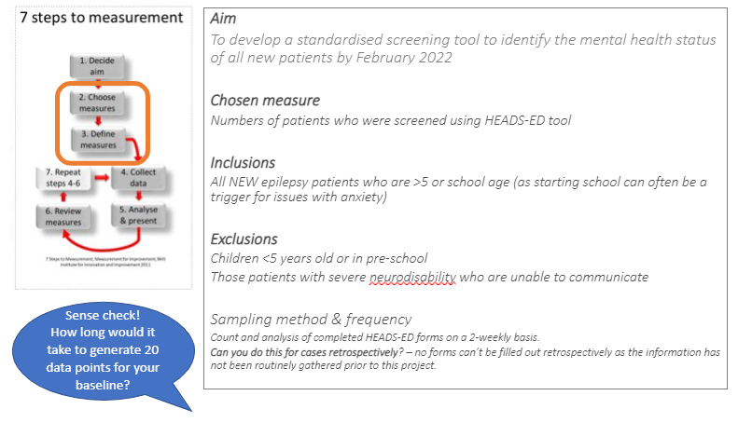
Mental health screening – Epsom and St Helier University NHS Trust
Aim status
Baseline measures

Slide 5
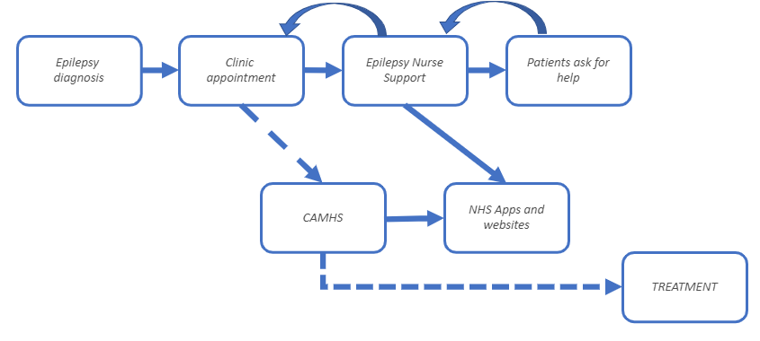
Mental health screening – Epsom and St Helier University NHS Trust
Process map of pathway

Slide 6
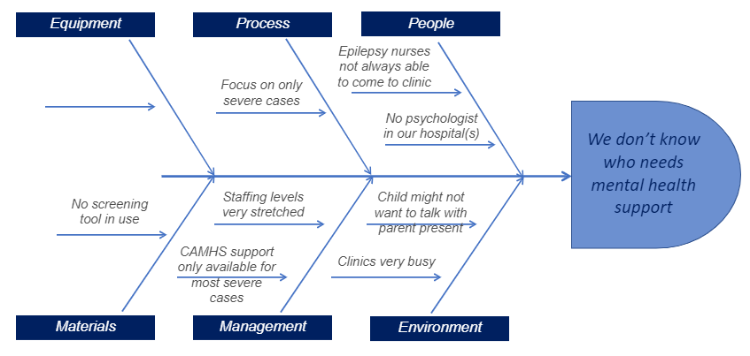
Mental health screening – Epsom and St Helier University NHS Trust
Cause and effect diagram of barriers within pathway

Slide 7
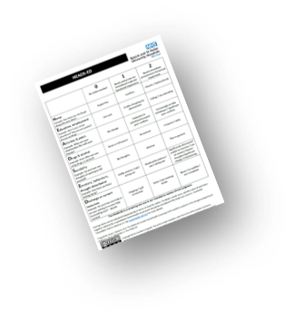
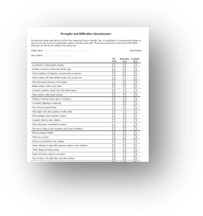
Mental health screening – Epsom and St Helier University NHS Trust
Results of local data collected was not available at the time completion of the project

Slide 8
Audit results cohort 3/4 – ability to refer ​– Epsom and St Helier University NHS Trust
NICE Clinical Guideline 137 states that children and young people should have access to​ written and visual information​, counselling services​, information about voluntary organisations​, and epilepsy specialist nurses​.
In 2022, Epsom and St Helier paediatric epilepsy service were able to refer children and young people for clinical psychology assessment​ either within or outside their Trust.​
Can your trust refer to any of the following where required, either within or outside of your trust?​ | 2018​ | 2019​ | 2020​ | 2021​ | 2022​ | 2021 –SWTPEG​ | 2021 – England & Wales​ | 2022 –SWTPEG​ | 2022 – England & Wales​
Clinical psychology assessment​ | No​ | No​ | No​ | No​ | Yes​ | 25%​ | 78%​ | 50%​ | 80%​
Psychiatric assessment​ | Yes​ | Yes​ | Yes​ | Yes​ | Yes​ | 75%​ | 90%​ | 75%​ | 90%​
Educational psychology assessment​ | No​ | No​ | No​ | No​ | No​ | 12%​ | 44%​ | 13%​ | 45%​
Neuropsychology assessment​ | No​ | No​ | No​ | No​ | No​ | 25%​ | 51%​ | 25%​ | 50%​
Formal developmental assessment​ | Yes​ | Yes​ | Yes​ | Yes​ | Yes​ | 62%​ | 85%​ | 75%​ | 87%​
None​ | No​ | No​ | No​ | No​ | No​ | 25%​ | 7%​ | 13%​ | 5%​

Slide 9
Audit results cohort 3/4 – ability to screen – Epsom and St Helier University NHS Trust
The Epsom and St Helier paediatric epilepsy service routinely formally screened for mental health disorders using screening questionnaires in 2022.
Does your paediatric service routinely, formally screen for any of the listed diagnoses related to epilepsy? | 2018 | 2019 | 2020 | 2021 | 2022 | 2021 – SWTPEG | 2021 – England & Wales | 2022 –SWTPEG | 2022 – England & Wales
Attention deficit hyperactivity disorder (ADHD) | No | No | No | No | No | 25% | 17% | 38% | 16%
Autism spectrum disorder (ASD) | No | No | No | No | No | 25% | 16% | 38% | 17%
Mental health disorders | No | No | No | No | Yes | 25% | 17% | 50% | 20%
None | Yes | Yes | Yes | Yes | No | 62% | 76% | 38% | 74%
Are any particular screening questionnaires used? | 2019 | 2020 | 2021 | 2022 | 2021 – SWTPEG | 2021 – England & Wales | 2022 –SWTPEG | 2022 – England & Wales
Strengths & Difficulties Questionnaire (SDQ) | No | No | No | No | 25% | 10% | 25% | 12%
Other | No | No | No | Yes | 7% | 6% | 38% | 9%
None | No | No | Yes | No | 38% | 53% | 25% | 60%

Slide 10
Audit results cohort 3/4 – referral pathways – Epsom and St Helier University NHS Trust
The Epsom and St Helier paediatric epilepsy service continues to provide agreed referral pathways for children with anxiety, depression, and mood disorder mental health concerns.
Does the trust have agreed referral pathways for children with mental health concerns? | 2019 | 2020 | 2021 | 2022 | 2021 – SWTPEG | 2021 – England & Wales | 2022 –SWTPEG | 2022 – England & Wales
Anxiety | Yes | Yes | Yes | Yes | 75% | 60% | 75% | 64%
Depression | Yes | Yes | Yes | Yes | 75% | 60% | 75% | 65%
Mood Disorder | Yes | Yes | Yes | Yes | 75% | 59% | 75% | 63%
Non-epileptic attack disorder | Yes | Yes | Yes | Yes | 62% | 44% | 50% | 52%
Other | No | No | No | No | 0% | 5% | 13% | 7%
None | No | No | No | No | 12% | 34% | 13% | 30%

Slide 11
Audit results cohort 3/4 – agreed referral criteria – Epsom and St Helier University NHS Trust
The Epsom and St Helier paediatric epilepsy service continues to provide agreed referral criteria for children with ADHD, ASD, developmental coordination disorder and intellectual disability neurodevelopmental problems.
Does your trust have agreed referral criteria for children with neurodevelopmental problems? | 2019 | 2020 | 2021 | 2022 | 2021 –SWTPEG | 2021 – England & Wales | 2022 –SWTPEG | 2022 – England & Wales
Attention deficit hyperactivity disorder (ADHD) | Yes | Yes | Yes | Yes | 75% | 77% | 88% | 82%
Autism spectrum disorder (ASD) | Yes | Yes | Yes | Yes | 75% | 81% | 88% | 86%
Behaviour difficulties | No | No | No | No | 62% | 60% | 75% | 68%
Developmental Coordination Disorder | Yes | Yes | Yes | Yes | 38% | 60% | 38% | 65%
Intellectual disability | Yes | Yes | Yes | Yes | 50% | 58% | 50% | 61%
Other | No | No | No | No | 0% | 8% | 0% | 8%
None | No | No | No | No | 12% | 15% | 13% | 12%

Slide 12
Audit results cohort 3/4 – appropriate assessment – Epsom and St Helier University NHS Trust
The percentage of children and young people with evidence of the following at first paediatric assessment for neurological examination increased from 89% in 2021 to 91% in 2022, meeting national average results.
Percentage of CYP with evidence of the following at first paediatric assessment: | 2019 | 2020 | 2021 | 2022 | 2021 – SWTPEG | 2021 – England & Wales | 2022 –SWTPEG | 2022 – England & Wales
Neurological examination | - | 93% | 89% | 91% | 93% | 89% | 97% | 91%
Description of developmental, learning, or schooling progress | - | 40% | 49% | 89% | 81% | 85% | 89% | 84%
Consideration of emotional or behavioural problems (aged 3 yrs+) | - | 33% | 34% | 55% | 67% | 73% | 71% | 70%

Slide 13
Mental health screening – Epsom and St Helier University NHS Trust​
Challenges
The team found the two potential screening tools challenging to use. The HEADS-ED tool allows for open conversation but will be time-consuming and relies on a safe space for children to talk. The SDQ can be completed outside of the clinic and the results sent automatically to the team, but there is a cost implication, and it would be difficult to complete for children with neurodisabilities.
It has been challenging for the team to meet together in one place during the EQIP because they are a cross-site team, partly due to annual leave work patterns and clinical demands. However, the team felt progressing their project was really important and continued to communicate as a team where possible.
Cross-site working has been challenging when trying to figure out what will work best at each site and keep it consistent so that the measures are the same.
The team was used to producing run charts but was unsure of how to demonstrate their progress, i.e., before zero patients were screened. The result is all patients over 5 being screened.
The team began thinking about what they can offer to those who do have problems and how they can find a way of capturing ongoing patients. However, the issue they have discovered is that these patients are offered much shorter appointments, and the team does not have the allocated time for them.

Slide 14
Mental health screening – Epsom and St Helier University NHS Trust
Outcomes
The team previously experienced being unable to collate information on the mental health needs of their patients. Since the EQIP, the service has gained a better understanding of their patients’ support needs.
Despite the challenges experienced by the team on the programme, they were still able to provide strong teamwork and enthusiasm from all working on their project.
The team has continued to fill out Heads ED forms every time a new patient is seen.
Eight patients have been captured, and two of those have significant mental health problems. One or two had minor mental health problems, and the rest had no identified mental health conditions.
National audit results in 2022 showed they were able to refer children and young people for clinical psychology assessments either within or outside their Trust.​
In 2022, routinely formally screened for mental health disorders using screening questionnaires.
The percentage of children and young people with evidence at first paediatric assessment for neurological examination increased from 89% in 2021 to 91% in 2022, meeting national average results.

Slide 15
Mental health screening – Epsom and St Helier University NHS Trust
Lessons learnt
QI can be performed in short, quick cycles, and information that may appear negative can still be useful.
Adjust or abandon project aims or goals quickly if something is not working and save time. ​
As you begin to progress your interventions, you might receive results you didn’t expect – and some you might not want.
Don’t reinvent the wheel; use what’s already available.
Different teams in different hospitals work differently, so communication is key, as is being flexible where possible.
Improving areas of mental health is a can of worms that needs opening.

Slide 16
https://eqip.rcpch.ac.uk
eqip@rcpch.ac.uk
@RCPCHEQIP

