Slide 1
​
RCPCH Epilepsy Quality Improvement Programme
August 2021 – April 2022
Mental health referral pathways
Warrington and Halton Teaching Hospitals NHS Foundation Trust​ RCPCH Epilepsy Quality Improvement Programme project team:
Dr Kate Hunter, Consultant Paediatrician, Epilepsy Interest
Dr Rachael Sutton, Paediatric Consultant, Epilepsy Interest
Dr Aarti Sridharan, Paediatric Consultant, Epilepsy Interest
Claire Charleston, Epilepsy Specialist Nurse
Sue Jones, Epilepsy Specialist Nurse
National audit results included within this case study acts as a guide only to performance standards. The service improvements made during the EQIP cannot be entirely attributed to the reported results in the Epilepsy12.

Slide 2
Mental health referral pathways – Warrington and Halton Teaching Hospitals NHS Foundation Trust​ ​
Project aim
To engage with children and young people to improve the mental health referral pathways and create a mental health care package for children aged 11-17 years. All new patients in this age group will receive the package from March 2022​.
Background
Warrington and Halton Teaching Hospitals NHS Foundation Trust are a small team based in a district general hospital and are supported by tertiary neurologists and the Trust’s management team. They have two very experienced specialist nurses and three paediatric consultants. The initial project aim was influenced by Epilepsy12 audit data, which showed the Trust was underperforming in the documentation of comprehensive care planning. However, during the process of being on the RCPCH Epilepsy Quality Improvement Programme, the team gained insights from increased patient engagement, which led to an understanding of patients wanting more support in areas of mental health and wellbeing. This resulted in the team adjusting their project aim to improve upon current mental health pathways to meet the needs of their patients and families.
Area of focus
Using patient engagement methods to capture the views of their current needs and mental health support to co‑produce a care package with relevant information and useful signposted links to local and national organisations.

Slide 3
Mental health referral pathways – Warrington and Halton Teaching Hospitals NHS Foundation Trust​ ​
Driver diagram

Slide 4
Mental health referral pathways – Warrington and Halton Teaching Hospitals NHS Foundation Trust​ ​
Changes
Following the EQIP initial training launch in September 2021, the team decided to initially focus their QI project on improving the documentation of clinic letters by producing standardised clinic letters. The overall aim was to develop a pro forma that could achieve the majority of this as a tick-box response or shorthand recording of a small narrative, which would then provide a wealth of information meeting Epilepsy12 standards, but in a personalised manner and by reducing the administration workload for the secretaries.
However, over the course of the EQIP, the team decided to change their project aim based on insights from the views captured through patient engagement, which resulted in patients reporting back that they wanted more support in areas of mental health and wellbeing, which led to the idea of developing a mental health pathway/package for their epilepsy patients.
In October 2021, the team engaged with the CAMHS department and had a productive meeting that discussed the following:
Negotiated an agreed pathway with CAMHS service for children with epilepsy who had significant mental health symptoms would be accepted by CAMHS for assessment.

Slide 5
Mental health referral pathways – Warrington and Halton Teaching Hospitals NHS Foundation Trust​ ​
Changes
Discussed the children who did not meet the criteria but still required some support.
Shared info on the PHE pilot to have Children and Young People Wellbeing Practitioners (CYWP) based in schools and how this may be an additional source of help.
Provided information on the 40 schools within the area that have an allocated CYWP, so that can be signposted to their patients where possible as an additional level of support.
Explored the current support in the area and the support that can be targeted for the package. The CAMHS representative helped with identifying age-appropriate wellbeing information for the packages.
In terms of data collection, the team developed four questions using jars.
>1-year-old children were identified, without learning needs, to contribute to their data collection.
Changes to communications to patients by letter were tested and standardised.
Local data identified information and support for mental health issues that was lacking.
Patient journeys were mapped and examined.
Reviewed and revised the current assessment tools with three consultants.

Slide 6
Mental health referral pathways – Warrington and Halton Teaching Hospitals NHS Foundation Trust​ ​
Results
Feedback from interaction with the jar display included the following:
>50% of patients do have worries and anxieties about having epilepsy; they worry about being lonely or getting a job, and, generally, patients seek help from friends and family.
This helped the team develop and shape their mental health package to focus more on maintaining wellbeing and not just on signposting for support. Through engagement with the epilepsy charity Epilepsy Action, the CAMHS team, and Sophie Bennett, a psychologist involved with the MICE project developed by GOSH, the team gained support and advice on the content provided within the pack.
Both Sophie Bennett and the CAMHS team provided guidance and reading support on wellbeing resources to go alongside the research completed by the team.

Slide 7
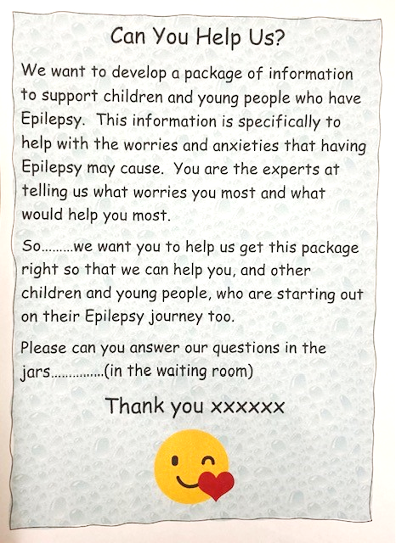
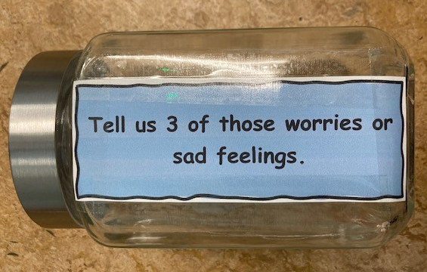
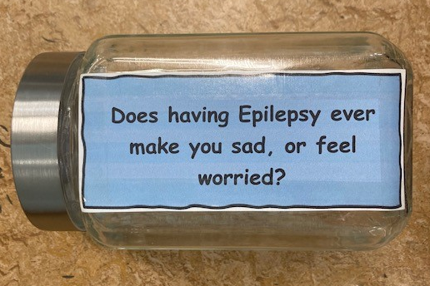
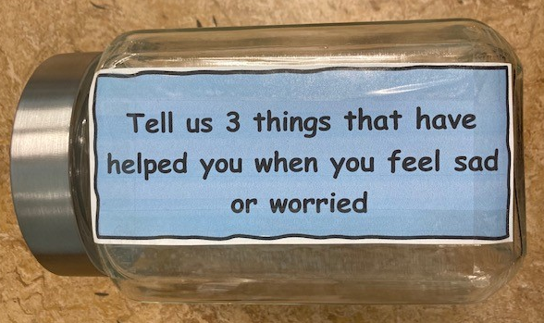
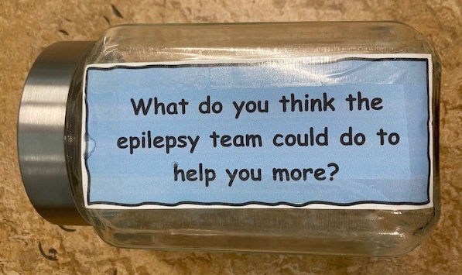
Mental health referral pathways – Warrington and Halton Teaching Hospitals NHS Foundation Trust​ ​

Slide 8
Mental health referral pathways – Warrington and Halton Teaching Hospitals NHS Foundation Trust​ ​
Examples of patient feedback​
Top Worry
Fear of having a seizure.
People not knowing what to do.
Things that help?
Talking to family/friends
Listening to music
Playing with my dog
Do you ever feel sad or worried?
Yes 54%
No 46%
Other Worries……
Feeling embarrassed, feeling self-conscious, People judging me
Fear of being alone
Unable to do normal activities
What more can the epilepsy team do?
Get a psychologist
You do enough
You don’t know how it feels if you don’t have epilepsy

Slide 9
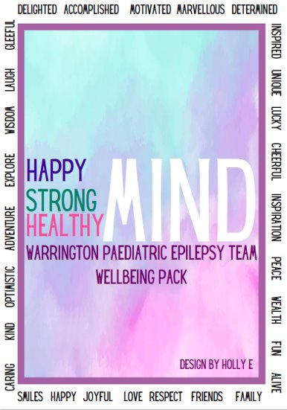
Mental health referral pathways – Warrington and Halton Teaching Hospitals NHS Foundation Trust​ ​
Co-designing support pack with patients and families

Slide 10
Mental health referral pathways – Warrington and Halton Teaching Hospitals NHS Foundation Trust​ ​
Co-designing support pack with support organisations
Mental Health Support package
CAMHS
Wellbeing Pack
Epilepsy Action
Sophie Bennett GOSH
Google!

Slide 11
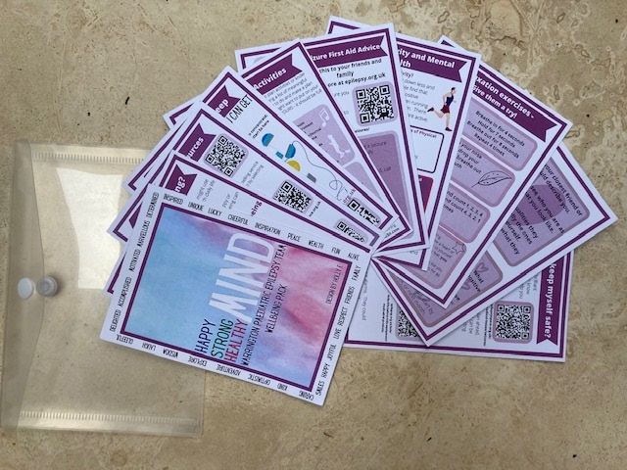
Mental health referral pathways – Warrington and Halton Teaching Hospitals NHS Foundation Trust​ ​
“No changes needed, it’s really helpful, especially the 1st aid advice”.
“I really like it! I would recommend it! Useful information and wellbeing advice. I like the emergency card. I will be pinning the ‘5 ways to feel better’ and ‘Do more to feel better’ on my notice board! Thank you for the pack”.
“It’s really good!
Some cards are brilliant!
I really like the 1st aid one – I’ll keep it in my blazer.
I’m impressed with the relaxation exercises”.
“Typo in the sleep section, other than that – all good!”
Implementation of support pack and patient feedback

Slide 12
Audit results cohort 3/4 – ability to refer – Warrington and Halton Teaching Hospitals NHS Foundation Trust​
Warrington and Halton Teaching Hospitals service are able to continue to refer patients for a clinical psychology assessment and have neuropsychology assessment either within or outside of their Trust.
Can your trust refer to any of the following where required, either within or outside of your trust?​ | 2018​ | 2019​ | 2020​ | 2021​ | 2022​ | 2021 – EPIC​ | 2021 – England & Wales​ | 2022 – EPIC​ | 2022 – England & Wales​
Clinical psychology assessment​ | Yes​ | Yes​ | Yes​ | Yes​ | Yes​ | 62%​ | 78%​ | 63%​ | 80%​
Psychiatric assessment​ | Yes​ | Yes​ | Yes​ | No​ | No​ | 88%​ | 90%​ | 88%​ | 90%​
Educational psychology assessment​ | No​ | No​ | No​ | No​ | No​ | 12%​ | 44%​ | 25%​ | 45%​
Neuropsychology assessment​ | Yes​ | Yes​ | Yes​ | Yes​ | Yes​ | 50%​ | 51%​ | 75%​ | 50%​
Formal developmental assessment​ | Yes​ | Yes​ | Yes​ | Yes​ | Yes​ | 100%​ | 85%​ | 100%​ | 87%​
None​ | No​ | No​ | No​ | No​ | No​ | 0%​ | 7%​ | 0%​ | 5%​

Slide 13
Audit results cohort 3/4 – referral pathways​ – Warrington and Halton Teaching Hospitals NHS Foundation Trust​
Warrington and Halton Teaching Hospitals have continued to have agreed referral pathways for children with anxiety, depression and mood disorder mental health concerns​.
Does the trust have agreed referral pathways for children with mental health concerns?​ | 2019​ | 2020​ | 2021​ | 2022​ | 2021 – EPIC​ | 2021 – England & Wales​ | 2022 – EPIC​ | 2022 – England & Wales​
Anxiety​ | No​ | Yes​ | Yes​ | Yes​ | 62%​ | 60%​ | 63%​ | 64%​
Depression​ | Yes​ | Yes​ | Yes​ | Yes​ | 62%​ | 60%​ | 63%​ | 65%​
Mood disorder​ | Yes​ | Yes​ | Yes​ | Yes​ | 62%​ | 59%​ | 63%​ | 63%​
Non-epileptic attack disorder​ | Yes​ | Yes​ | No​ | No​ | 38%​ | 44%​ | 50%​ | 52%​
Other​ | No​ | No​ | No​ | No​ | 25%​ | 5%​ | 25%​ | 7%​
None​ | No​ | No​ | No​ | No​ | 38%​ | 34%​ | 38%​ | 30%​

Slide 14
Audit results cohort 3/4 – appropriate first assessment​ – Warrington and Halton Teaching Hospitals NHS Foundation Trust​
The percentage of children and young people with evidence of description of consideration of emotional or behavioural problems​ and developmental, learning, or schooling progress​, increased to 87% in 2021 and 75% in 2022; however, both percentages remained above regional and national averages.
Percentage of CYP with evidence of description of:​ | 2019​ | 2020​ | 2021​ | 2022​ | 2021 – EPIC​ | 2021 – England & Wales​ | 2022 – EPIC​ | 2022 – England & Wales​
Appropriate first paediatric clinical assessment (PI.4)​ | 64%​ | 81%​ | 87%​ | 57%​ | 76%​ | 63%​ | 66%​ | 63%​
Episode​ | 100%​ | 100%​ | 100%​ | 96%​ | 99%​ | 99%​ | 99%​ | 99%​
Age/timing of first episode​ | 82%​ | 92%​ | 100%​ | 75%​ | 90%​ | 83%​ | 86%​ | 81%​
Frequency​ | 100%​ | 100%​ | 0%​ | 89%​ | 98%​ | 95%​ | 96%​ | 95%​
General examination​ | 100%​ | 100%​ | 100%​ | 96%​ | 93%​ | 92%​ | 93%​ | 93%​
Neurological examination​ | 82%​ | 96%​ | 97%​ | 96%​ | 91%​ | 89%​ | 91%​ | 91%​
Developmental, learning, or schooling progress​ | 100%​ | 88%​ | 87%​ | 75%​ | 89%​ | 85%​ | 82%​ | 84%​
Consideration of emotional or behavioural problems​ | 82%​ | 81%​ | 87%​ | 75%​ | 78%​ | 72%​ | 62%​ | 70%​

Slide 15
Mental health referral pathways – Warrington and Halton Teaching Hospitals NHS Foundation Trust​ ​
Challenges
A significant number of follow-up appointments were offered via telephone appointments, which made obtaining face-to-face input and feedback from our children and young people difficult.
The Trust's Children’s Outpatient Department was relocated for redevelopment, which meant clinic appointments were also being switched to telephone clinics. However, the relocated service at the outpatient site allowed for some face-to-face appointments. Patients aged 11 and older were selected to see if they would attend face-to-face appointments to contribute to their project.
Teamwork proved challenging due to team absences.
Feedback from patients was limited due to issues with clinic relocation, phone follow-ups, cancelled clinics (holiday/duty weeks), age of patients in the clinic, and COVID patients.
The team implemented a psychology referral pathway with CAMHS, but their service plans to recruit a psychologist for the team did not progress because no one had applied for the position. In the interim, senior management offered the following:
To employ a CYWP.
To refer patients on an individual basis for 6 sessions of psychological support via a private company as needed.

Slide 16
Mental health referral pathways – Warrington and Halton Teaching Hospitals NHS Foundation Trust​ ​
Outcomes
Implemented a new Happy Strong Healthy Mind support package in co-design with patients and advice from mental health agencies. The package is designed to support the wellbeing of patients via 10 wallet-sized cards that provide resources for help, advice, and signposting to children over 11 years old. This was achieved and implemented by March 2022.
Successful conversations with senior Trust members have resulted in repurposing funds to appoint CYWPs.
Through an established new pathway with CAMHS, the service was able to signpost patients to schools within the area that have allocated CYWPs that offer additional support.
The wellbeing pack had received positive feedback from patients and families on that content, which offered support and signposting for the main worries about their condition. Surprisingly, for the team, the areas on first aid, safety, and “what people around them could do if they had a seizure” were very popular with the children and young people.
The wallet-style pack has gained interest amongst other epilepsy paediatric services within their region, and the EQIP team at West Yorkshire ICS plans to adopt and tailor a similar package for their patients and families.

Slide 17
Mental health referral pathways – Warrington and Halton Teaching Hospitals NHS Foundation Trust​ ​
Lessons learnt
Taking small steps using QI tools was easy, fast, and effective.
The team changed the way feedback is gathered and actioned by no longer creating long questionnaires and has learned new ways of engaging that are fun and effective for children and families.
Staff absences within the service team became a challenge, as did the rise in COVID, which meant telephone appointments limited patient input, compounded by the Children’s Outpatient Department being relocated for redevelopment.
Patients and families have the driving force behind making the required changes, which demonstrates the power of feedback that can help deliver what service users want.
If everyone gives a little, a lot can be achieved.
Shared learning of their EQIP QI journey and outcomes continues by presenting at network meetings attended by regional and local teams.
Visual presentation of team project intervention
Team poster
Team video presentation

Slide 18
https://eqip.rcpch.ac.uk
eqip@rcpch.ac.uk
@RCPCHEQIP

