Slide 1
RCPCH Epilepsy Quality Improvement Programme
November 2019 – July 2020
Improving the quality of ketogenic diet therapy clinics
Manchester University NHS Foundation Trust
RCPCH Epilepsy Quality Improvement Programme project team:
Dr Jeen Tan, Paediatric Neurologist
Dr Muthugovindan, Paediatric Neurologist
Rebecca Soponski, Epilepsy Specialist Nurse
Victoria Whiteley, Advanced Clinical Practitioner
Amy Skelton, Ketogenic Dietitian
Verity Burt, Ketogenic Dietitian
Debrah Amoah, Ketogenic Dietitian
Nicola Nelson, Ketogenic Diet Assistant

Slide 2
Ketogenic diet therapy clinic – Manchester University NHS Foundation Trust
Project aim
To improve patient experience and reduce clinic waiting times in outpatient MDT ketogenic diet clinic.
Background
Families were spending an average of 2 hours in clinic, which often led to complaints about the long wait times and families leaving before investigations were completed, impacting patient care. The clinics often ran behind, and staff felt under pressure to work faster and felt they were not doing a good job. Additionally, staff felt unprepared prior to clinics and sometimes did not have complete or accurate information about a patient to provide the required advice and support.
Area of focus
Reduce the 2 hour clinic wait time for patients through service review and mapping of the patient journey. Reduce the number of complaints by engaging patients and families and capturing their experiences, and reduce staff stress by improving patient experience in the outpatient MDT ketogenic diet clinic.

Slide 3
Ketogenic diet therapy clinic – Manchester University NHS Foundation Trust
Changes
The current clinic slot times are 30 minutes, and 6 patients were seen within a clinic session. The data captured showed that, on average, 2-3 patients took longer than 30 minutes.
Plans were made to adjust the clinic slot times to allow 45 minute slots for new patients and extra time for complex patients.
Created a pre-clinic questionnaire to promote agenda setting and the collation of relevant data (ketone results and seizure diaries).
Trialled patients and their families attended 30 minutes prior to their appointment to be weighed and measured, as well as other investigations.
The idea to ask patients and their families to attend clinic 30 minutes prior to their appointment was abandoned because patients and their families either did not attend or having the investigations prior to the appointment caused a delay and therefore they were not available at their appointment time.
Created a weekly huddle with the whole team in attendance to discuss patients with difficulties or complex needs and those seen prior to clinic to identify any missing information in preparation for clinic.
Appointment letter templates were adjusted with the new times to send out to families.

Slide 4
Ketogenic diet therapy clinic – Manchester University NHS Foundation Trust
Changes
Trialled an ESN telephone contact service for patients and families to improve engagement with the local team 2‑4 weeks prior to the clinic to discuss any concerns or queries.
Introduced a registrar to join the clinics to see patients with complex needs that require more than the 30 minute allocated slot. Baseline assessments were used to review stable follow-up patients.
The team adjusted their project aim in January 2020 to focus on standardising clinic processes to reduce the time spent in clinic to no more than 90 minutes for 75% of patients and to improve the team’s perception of clinic processes.
By the end of April 2020, 80% of the team were satisfied with the clinic process.

Slide 5
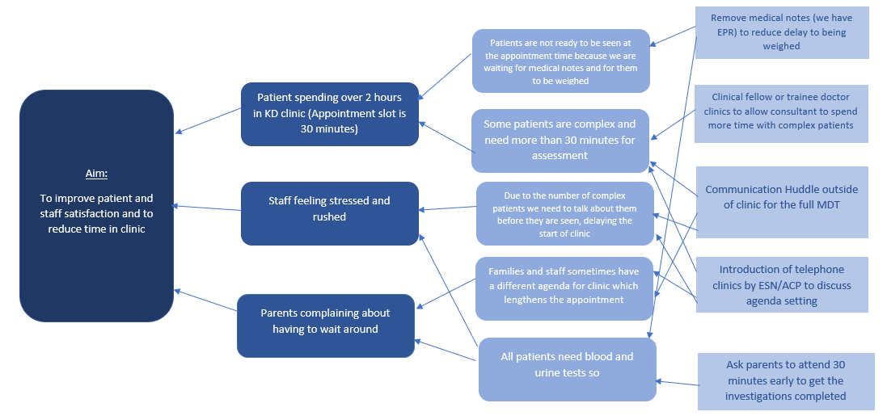
Ketogenic diet therapy clinic – Manchester University NHS Foundation Trust
Project driver diagram

Slide 6
Ketogenic diet therapy clinic – Manchester University NHS Foundation Trust

Slide 7
Ketogenic diet therapy clinic – Manchester University NHS Foundation Trust
Results
December 2020: From a clinic waiting time perspective, improving this is part of the overall aim. The results of the December data collection really helped to motivate the team.
The average time in the clinic was reduced by 29 minutes. Implementing the team huddles resulted in improving clinic preparation.
Time taken to weigh patients was reduced by 50% as a direct result of removing the use of paper medical notes and using the electronic system.
Patients were seen 10 minutes sooner in clinic, reducing the time previously spent on average of 22 minutes after their appointment.
Improved patient feedback while addressing complaints received, which helped to prepare the team and added to the huddle discussions. This was a valuable addition to service improvements to address any potential issues in advance.
February 2020: Telephone contact service with the ESN has improved the family’s relationship with the ESN. Some of the less urgent queries are dealt with over the phone, reducing the time required with the consultant in the clinic.

Slide 8
Ketogenic diet therapy clinic – Manchester University NHS Foundation Trust
Results
Initially planned to introduce patients attending earlier for their appointment as one of the first tests of change, but incurred difficulties getting the appointment letters adjusted in time because these are automatically generated.
Plans to provide some training to outpatient department (OPD) staff were suggested, but finding suitable times proved challenging, so this had to be delayed.
March 2020: Planned to adjust clinic slot times to allow 45 minutes for new patients, but due to COVID, we were unable to implement this change.
Developed more electronic resources for ketogenic diet education, and there are plans to create video resources to support patients.

Slide 9
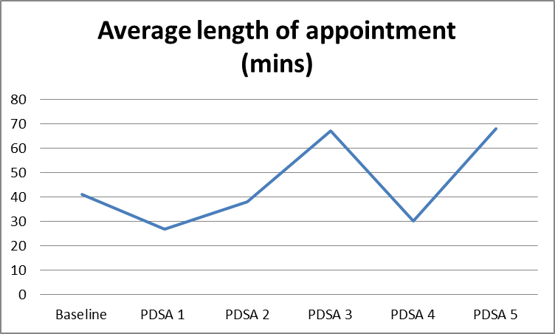
Ketogenic diet therapy clinic – Manchester University NHS Foundation Trust
The results of the December data collection really helped to motivate the team. Even at baseline, patients and families provided 100% positive feedback, which helped to keep us motivated.

Slide 10
Ketogenic diet therapy clinic – Manchester University NHS Foundation Trust
This table provides the feedback collated from patients and their families
Patient feedback | Satisfaction with clinic | What went well? | What didn’t go well? | How could we improve?
Baseline | 100% positive | I was happy with the appointment and discussions Attitude of staff Supportive to patients Quick service from start to finish Waiting time – very quick today They weren’t worrying and didn’t make me anxious Very efficient, no issues and no waiting Familiar staff Flexible approach to treating our child who is needle phobic Very good care and support No waiting and straight into the appointment The play workers gave me a united top and everyone knows my name and who I am | Delays Had to wait for ages Weighing, very difficult, the room is too small The lift in car park has broken and I had to carry my child down 3 flights | Timing of appointments – we always have to wait Better weighing facilities for disabled patients Make it quicker and easier for children with severe disabilities to prevent agitation and upset May help to get bloods and urine done locally Previous visits we have waited 5 hours Took 40 minutes to find a parking space
PDSA 1 | 100% positive | Everything went well Friendly staff I value the Team approach Clinic was on time Everything ran smoothly I was seen very quickly Everyone was calm and understanding of my sons behaviour The clinic was helpful We were very happy |  | I would like to take the prescriptions to my own pharmacy rather than here at the hospital No improvement needed, it's always a good experience You can’t

Slide 11
Ketogenic diet therapy clinic – Manchester University NHS Foundation Trust
Patient feedback | Satisfaction with clinic | What went well? | What didn’t go well? | How could we improve?
PDSA 2 | 100% positive | Good in-depth chat about our daughter and different options to try Felt happy with outcome We were seen promptly All staff were friendly and professional Large disabled changing facility Explained the plan well Staff care about my daughters well-being | Parking! Inadequate parking for blue badge holders Difficult to get a wheelchair bound child out of a multi-storey car park | More blue badge bays
PDSA 3 | 100% positive | Well explained Friendly team Good discussion of points I raised Good in-depth conversation Answered all my questions Everything Rebecca and Amy are SUPERSTARS! Everything went well today We are very satisfied with the service | We didn’t get to see our usual consultant which we would have preferred Parking was really difficult
PDSA 4 | 100% positive | Team really care for my daughter They all know us so well | No need to change | Nothing
PDSA 5 | 100% positive | Able to see the dietitian as well as the doctor and nurse All my questions were answered I am always happy with my appointments | We had to wait a long time to see the consultant We had to wait to have our bloods taken We had to arrange to have bloods locally as clinic just took so long | I would like to see my usual consultant We always have to sit and wait a long time Clinic felt unorganised and it was busy

Slide 12
Ketogenic diet therapy clinic – Manchester University NHS Foundation Trust
Challenges
The plan to adjust clinic slot times to allow 45 minutes for new patients was abandoned due to the COVID pandemic, and they were therefore unable to put this plan into place.
It has been challenging to create buy-in from the OPD team, but some progress has been made.
Experienced reduced staff numbers due to illness.
Received feedback concerning parking issues and facilities in OPD that, although outside the team’s control, was discussed with the relevant team or department.
Some patients have challenging or complex needs, which sometimes leads to clinics overrunning and impacts the whole clinic.
Including a registrar in the clinic did not help because the clinic ran over by 2 hours and patients reported being dissatisfied. The decision to include the registrar in clinics was made by one of the consultants, but due to their lack of experience and confidence in running a ketogenic diet clinic, it did not work out.
The COVID-19 pandemic impacted the service in relation to face-to-face clinics. Clinics were cancelled, and consultants were moved onto an emergency rota.
The introduction of video calls was agreed upon by the Trust.

Slide 13
Ketogenic diet therapy clinic – Manchester University NHS Foundation Trust
Outcomes
Achieved 100% satisfaction with clinic experience on baseline assessment.
Achieved the aim of reducing clinic times by an average of 29 minutes.
Time taken to weigh the patient was reduced by 50%.
Patients were seen 10 minutes earlier in the clinic.
Team communication improved via the introduction of weekly huddles with the whole team to reduce staff stress by discussing patients who were having difficulties and those due in clinic to identify any missing information, increasing clinic preparation.
The implementation of a telephone contact service with an ESN prior to clinic appointments led to increased patient and family satisfaction and increased engagement with the local team.
Implemented ACP-led consultant replacement clinics.
Developed a patient satisfaction survey with an option to provide information on what we do well and identified areas for improvement.
Developed a template for the team to record data on identified issues around clinic wait times, which included: arrival time, appointment time, time to get anthropometry, time to see the consultant, time the appointment ended, time when blood was taken, and time the patient left the clinic.

Slide 14
Ketogenic diet therapy clinic – Manchester University NHS Foundation Trust
Lessons learnt
Communication is key; the team experienced improved interactions with families, which made the clinic appointments more useful.
The team no longer uses paper medical notes in the clinic and now uses the electronic system, reducing time and improving the experience of patients being weighed.
Working as a team, acknowledging the different roles within the team, and considering how best these can be used has enabled the team to continue to successfully provide the service within the COVID restrictions.
The huddles that were introduced following EQIP have been essential to improving communication. Team morale has improved overall; they feel stress-free prior to running clinics because they are more prepared for clinics.
The team learned that the introduction of registrars to help run the clinics was not well planned, and communication within the team could have been improved around this, which meant the registrars were unprepared and the time spent in clinics became considerably longer than normal.
The team acknowledges that the registrars had little knowledge of the ketogenic diet and a lack of consideration of which patients would have been more suitable for them to see in clinic.
The most important thing is that patients and families are happy with the care provided, and the service improvements have contributed to that fact.
Visual presentation of team project intervention: Video presentation Team poster

Slide 15
https://eqip.rcpch.ac.uk
eqip@rcpch.ac.uk
@RCPCHEQIP

