Slide 1
RCPCH Epilepsy Quality Improvement Programme
November 2019 – July 2020
Improving the quality of EEG clinic
Nottingham University Hospitals NHS Trust
RCPCH Epilepsy Quality Improvement Programme project team:
Helen Sneath, Trainee Consultant Scientist
Clinical Neurophysiology
Dr Maria Moran, Consultant Paediatrician
James Baird, Trainee Consultant Scientist
Clinical Neurophysiology
Dr Laura Ashmore, Consultant Paediatrician
Dr Manish Prasad, Consultant Paediatric Neurologist
National audit results included within this case study acts as a guide only to performance standards. The service improvements made during the EQIP cannot be entirely attributed to the reported results in the Epilepsy12.
Dr Katherine Martin, Consultant Neurodisability Paediatrician
Dr Jane Williams, Consultant Neurodisability Paediatrician
Dr Denise Crozier, ST8 Paediatric Trainee
Ann Brown, Epilepsy Specialist Nurse

Slide 2
Improving the quality of EEG clinic – Nottingham University Hospitals NHS Trust
Project aim
Achieve a full, quality and interpretable routine EEG recording in 95% of all paediatric patients referred within 4 weeks from referral by May 2020.
Background
The neurophysiology team identified opportunities for improvement in EEG services which would involve collaborative work within the whole epilepsy team. This would provide opportunities to better meet the needs of our children and young people with a learning disability, autism spectrum disorder or anxiety undergoing an EEG by seeking innovation and input from patients, families and carers and the wider team. Whilst the aim of the project applies to all paediatric patients, many patients present with learning disability and/or anxiety. The recording of full, quality EEGs in this cohort can be challenging for all involved.
Area of focus
By improving the preparation and experience for patients and families through effective patient engagement, resulting in improving the quality of the recorded EEG to aid in epilepsy diagnosis. Simultaneously, the team plan to reduce the waiting list time from 6 to 4 weeks in line with NICE guidelines.

Slide 3
Improving the quality of EEG clinic – Nottingham University Hospitals NHS Trust
Changes
The team trialled calling parents and carers of patients with autism or a learning disability the day before they attended their EEG appointment to provide advance patient information and the ability to answer any queries or address their concerns.
Patients and their families were signposted to a video produced by Evelina hospital, in London, which explains what to expect at their EEG appointment.
The team designed a questionnaire that was given to parents and carers after their child's EEG appointment to gain feedback on their experience. This allowed families to reflect on their experience and feedback was used to shape the service to better meet the needs of patients. The questionnaires were also available in recording rooms for staff to distribute.
Used patient engagement techniques to capture patient views through the pasta voting method.
Introduced a follow-up call service to the parent/carer if a child found the appointment upsetting to gain feedback on what could have been done better. Staff were encouraged to capture patient experiences.
Created an additional leaflet to accompany the existing patient leaflet that includes links to online resources and directs patients to the online video made by Evelina London Hospital (YouTube).

Slide 4
Improving the quality of EEG clinic – Nottingham University Hospitals NHS Trust
Results
Reduced breach date from 6 weeks to 4 weeks.
There has been very positive feedback from parents and carers so far. Appreciated the call before their appointment to discuss their needs or concerns.
December 2019: Received questionnaires back with feedback requests for a pre-EEG phone call, visits to the department beforehand, and an EEG video of what the test involves.
January 2020: Continued to receive positive feedback during the call. The team observed that follow-up calls were relieving the anxiety of parents and carers as well as the patient!
January 2020: Results from the questionnaire confirmed the need for pre-EEG phone calls and possible play-date visits to the department for especially anxious patients.
Jan 2020: 4-week breach date is still manageable, with 95% of patients seen within 4 weeks.
Feb 2020: Eight questionnaires have been returned so far. When asked where they would like the EEG test to be performed, half confirmed they wanted to come to the hospital.

Slide 5
Improving the quality of EEG clinic – Nottingham University Hospitals NHS Trust
Process map

Slide 6
Improving the quality of EEG clinic – Nottingham University Hospitals NHS Trust
Parent/carers were given questionnaires after their EEG appointment to gain feedback on their experience.

Slide 7
Improving the quality of EEG clinic – Nottingham University Hospitals NHS Trust
Results
Many patients and their families wanted a phone call to discuss their needs and anxieties, coupled with a leaflet or online video. This was also reflected in how patients wanted to access information by post, phone call, and internet as top scorers.
February 2020: Similar results for the 4 week breach date as seen in January. Additionally, the service is experiencing an increase in staff on annual leave before the end of the financial year.
February 2020: Pasta voting is underway and actively seeking feedback from the patients rather than their parents/carers. Received 27 happy faces and 4 not sure. No sad faces.
Mar 2020: Had a successful patient aged 11 years old with severe autism who came for a repeat EEG after struggling on the first occasion. Parents feedback: “This is 100% better than last time; thank you so much”.

Slide 8
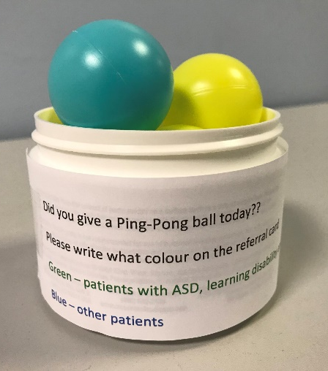
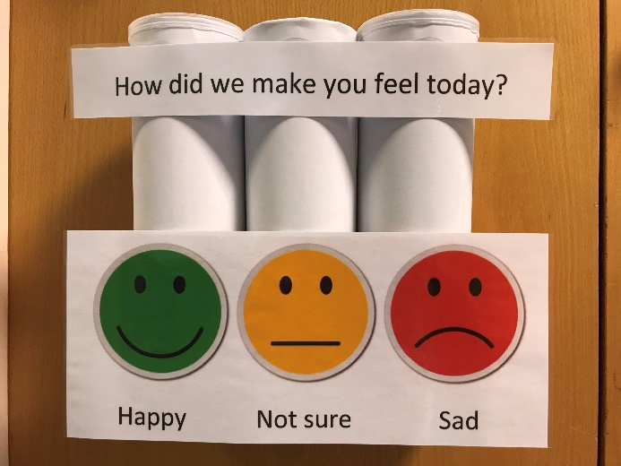
Improving the quality of EEG clinic – Nottingham University Hospitals NHS Trust
Created a “pasta poll” to gain feedback direct from patients rather than parents/carers.
Asked the question: “How did we make you feel today?”
Used two different coloured ping-pong balls to differentiate between routine neurotypical patients and those with a learning difficulty, ASD, etc.
Voting options were happy, not sure or sad.
Patients seemed happy to get involved.
There were concerns that children can be eager to please and will always select the “happy” tube.
Would be good to follow-up on patients who weren’t happy with a keep-in-touch/follow-up phone call, to see how their experience could be improved.

Slide 9
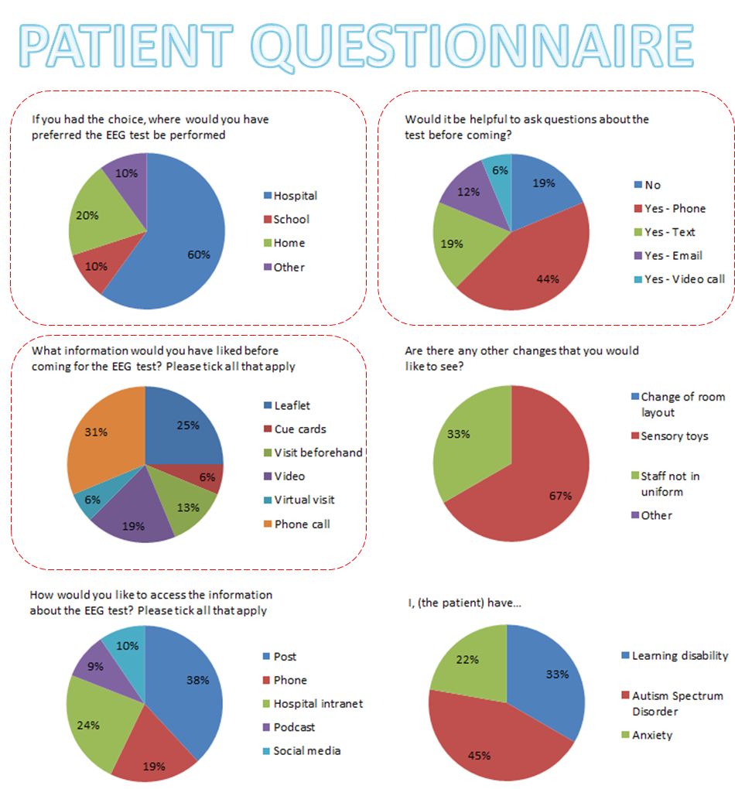
Improving the quality of EEG clinic – Nottingham University Hospitals NHS Trust

Slide 10
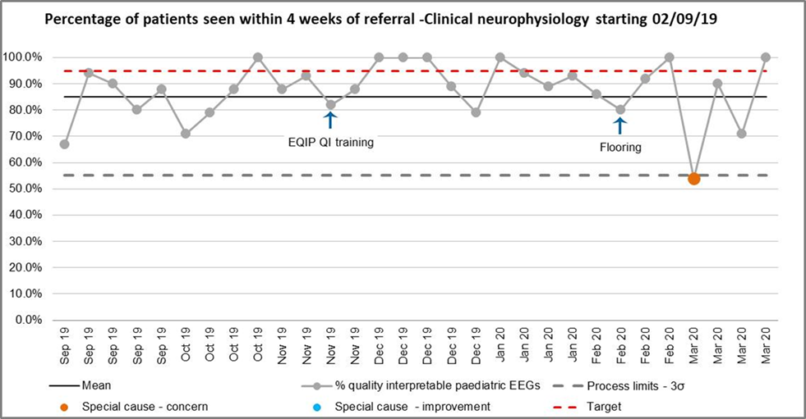
Improving the quality of EEG clinic – Nottingham University Hospitals NHS Trust
Graph 1, April 2020, shows how the team were initially able to improve wait times.
Unfortunately, due to the knock-on effect of Christmas annual leave, COVID and staff using their annual leave before the end of the financial year, waiting times increased.

Slide 11
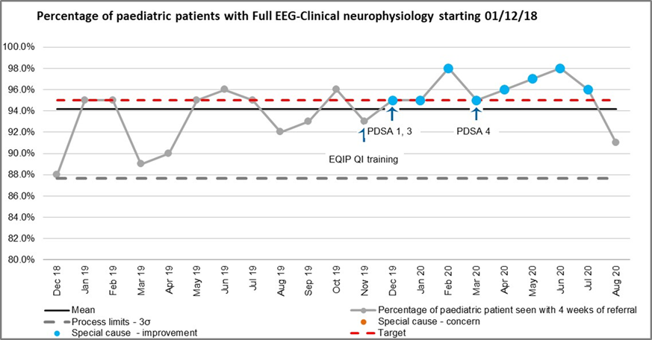
Improving the quality of EEG clinic – Nottingham University Hospitals NHS Trust
Graph 2 shows an increase in the percentage of patients who have been able to record a full, quality EEG.
The team have hit target of over 95% since the EQIP training.

Slide 12
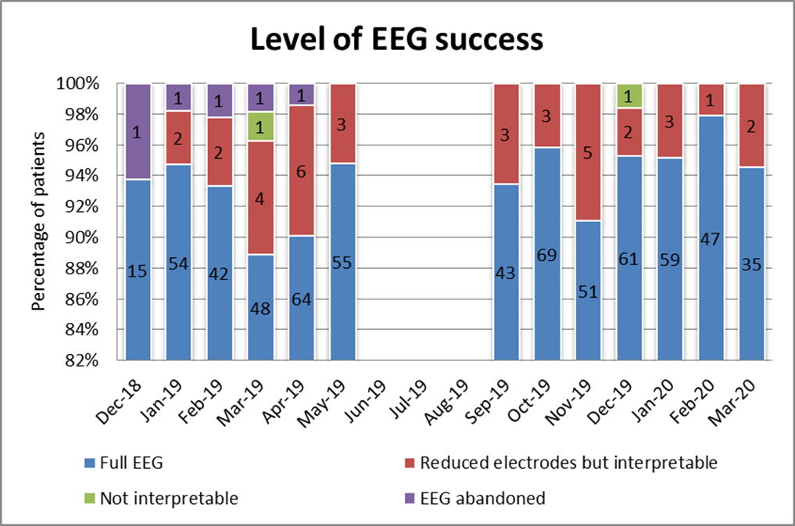
Improving the quality of EEG clinic – Nottingham University Hospitals NHS Trust
Additionally, the team have not had to abandon any recordings since starting the project (Graph 3).

Slide 13
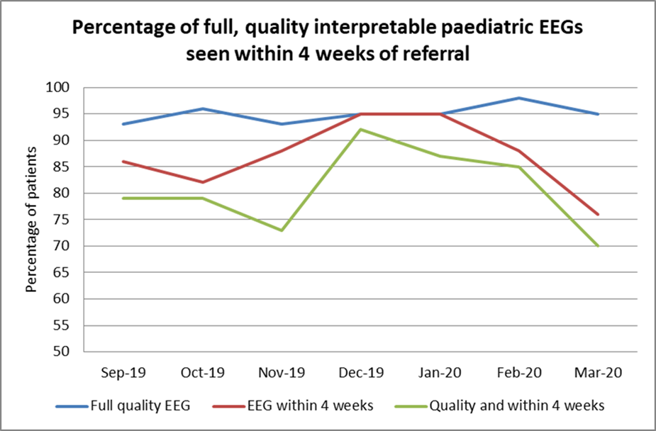
Improving the quality of EEG clinic – Nottingham University Hospitals NHS Trust
Plotting both these together in graph 4 shows us that it is the wait times that have affected the overall ability to meet the project aim, but there has been a considerable improvement in communication within the team and families to improve quality and hopefully experience for our patients.

Slide 14
Audit results for cohort 3 – First EEG – Nottingham University Hospitals NHS Trust
​ | 2019​ | 2020​ | 2021​ | 2021 –CEWT​ | 2021 –England & Wales​
Percentage of CYP who obtained a first EEG​ | 100%​ | 100%​ | 100%​ | 97%​ | 98%​
In 2021, Nottingham University Hospitals NHS Trust has continued to maintain 100% of CYP obtaining a first EEG, above the regional and national average.
COVID emergency planning for their Children’s Hospital involved suspension of usual outpatient clinics, with very limited provision of emergency face-to-face clinic slots for both general and community paediatric clinics, and neurology/ neurodisability clinics.
Time since first request for EEG​ | 2019​ | 2020​ | 2021​ | 2021 –CEWT​ | 2021 –England & Wales​
0-4 weeks​ | 79%​ | 54%​ | 45%​ | 54%​ | 54%​
4-8 weeks​ | 13%​ | 35%​ | 29%​ | 18%​ | 23%​
8-12 weeks​ | 0%​ | 9%​ | 13%​ | 5%​ | 7%​
12-16 weeks​ | 8%​ | 1%​ | 10%​ | 7%​ | 4%​
>16 weeks​ | 0%​ | 1%​ | 3%​ | 13%​ | 10%​

Slide 15
Audit results for cohort 3 – EEG wait times – Nottingham University Hospitals NHS Trust
In 2021, there was a greater proportion of children and young people waiting less than 4 weeks for a first EEG.
During the early stages of lockdown, referrals for new possible diagnoses of epilepsy were reduced, in line with general reduction in GP and ED attendance; the referral rate was starting to increase back to usual levels but the impact of these lower numbers previously was not clear at this stage.

Slide 16
Improving the quality of EEG clinic – Nottingham University Hospitals NHS Trust
Challenges
Emailing staff to ask for patient experience proved difficult due to staff forgetting or being unwilling to capture feedback on difficult appointments for fear of unfavourable feedback.
COVID emergency planning for their Children’s Hospital involved the suspension of usual outpatient clinics, with very limited provision of emergency face-to-face clinic slots for both general and community paediatric clinics and neurology/neurodisability clinics.
The leaflet that was created to be sent out with all paediatric appointments was put on hold due to the COVID-19 pandemic.
Continuous issues around time resourcing to make phone calls to patients and their families.
The quote sourced to create a departmental video was approximately £1,200; due to the cost, it may become a long-term goal or project.
The issue of physiologists and scientists not passing on information continues.
No formal feedback had been collected from patients and families regarding their experience of the service during the pandemic. Informal verbal feedback from families highlighted the advantages of epilepsy clinic remote consultation (more convenient, avoids the hassle of travelling and parking).

Slide 17
Improving the quality of EEG clinic – Nottingham University Hospitals NHS Trust
Outcomes
April 2020: The team temporarily achieved their target of over 95% pre-pandemic while participating in the EQIP.
Increased patient and engagement, and the theme of feedback coming through from parents and carers was the request to talk the visit through with staff before they attended their appointment.
Improved preparation prior to the EEG.
Contacted parents and carers and signposting them to relevant videos and information.
Increased team communication between the epilepsy and neurophysiology teams.
National audit data showed that in 2021:
Nottingham University Hospitals NHS Trust has continued to maintain 100% of CYP obtaining a first EEG above regional and national average.
In 2021, there was a greater proportion of children and young people waiting less than 4 weeks for a first EEG.
National audit data showed that in 2021, Nottingham University Hospitals NHS Trust has continued to maintain 100% of CYP obtaining a first EEG above regional and national average.
In 2021, there was a greater proportion of children and young people waiting less than 4 weeks for a first EEG.

Slide 18
Improving the quality of EEG clinic – Nottingham University Hospitals NHS Trust
Lessons learnt
It helped form a more cohesive team of professionals interested in epilepsy QI; the most valuable thing was that it strengthened communication with EEG colleagues and with each other to share challenges and ideas.
Keeping a weekly meeting going for both clinical care teams to discuss service needs was significantly positive too.
Other quality improvement projects that have been undertaken simultaneously from the EEG project have led to working on implementing a teenage clinic (led by ESN), including the youth team at the clinic each month, with the aim of working on further information and resources for young people.
Visual presentation of team project intervention
Video presentation
Team poster

Slide 19
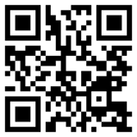
Improving the quality of EEG clinic – Nottingham University Hospitals NHS Trust
Team update in 2024
The team successfully created their own EEG appointment video using mobile phone and computer software, saving the Trust the cost of £1,200. The video is accessible via the QR code below which is now sent to all children and young people and their families.

Slide 20
https://eqip.rcpch.ac.uk
eqip@rcpch.ac.uk
@RCPCHEQIP

