Slide 1
RCPCH Epilepsy Quality Improvement Programme
November 2019 – July 2020
Improving patient engagement
Southport and Ormskirk Hospital NHS Trust
RCPCH Epilepsy Quality Improvement Programme project team:
Dr Shyam Mariguddi, Paediatrician with specialist Epilepsy interest
Dr Usha Natarajan, A&E Doctor / Epilepsy 12 audit participant
Fiona Short, Paediatric Epilepsy Nurse
Andrew Bowness, Physician Associate

Slide 2
Improving patient engagement – Southport and Ormskirk Hospital NHS Trust
Project aim
To develop a feedback tool to obtain 50 pieces of feedback from children, young people and families by May 2020.
Background
The initial and overarching aim was to develop a valid feedback tool and offer a service that is person-centred. The implementation of an efficient ongoing feedback loop that incorporates a feedback forum would be ideal. What matters most is being able to deliver a continuously improving service that is guided by and responsive to children, young people, and their families. The team felt that the clinic needed to reflect the needs and expectations of patients and their families.
Area of focus
The service team plans to reflect on the needs and expectations of children and their families by using effective engagement methods in collecting their feedback, reviewing responses, and acting upon what needs to be changed. There are a number of ideas to help improve the service, but it is important to first understand the needs of their patients.

Slide 3
Improving the quality of EEG clinic – Southport and Ormskirk Hospital NHS Trust
Changes
Developed a questionnaire that was given to follow-up patients who would be attending clinic again.
The following were excluded: new patients (not all of them had epilepsy), patients who were being discharged (and unlikely to be seen again).
Patients and families who were offered follow-up appointments were asked if they were happy to take part in providing feedback. This was done on an individual basis after the clinic.
The questionnaire was designed to be completed by parents/carers and young people over the age of 12 and was designed to look at the holistic aspects of the service and their experience attending clinics for patients and their families.
Agenda-setting sheets were given to patients and families prior to the clinic as an opportunity for them to highlight areas they would like to discuss.
The pandemic led to service changes such as the installation of the Attend Anywhere digital platform in all outpatient areas.
Clinic appointments were offered either as a telephone appointment or using Attend Anywhere, giving patients and families a choice and flexibility.

Slide 4
Improving the quality of EEG clinic – Southport and Ormskirk Hospital NHS Trust
Changes
The team liaised with Emma Sparrow, Head of CYP Engagement, RCPCH&US, which led to a number of iterations before agreeing on a final version of the questionnaire.
The team engaged with their IT department to set up a team email, which encouraged team communication and ensured that messages were seen and dealt with contemporaneously.

Slide 5
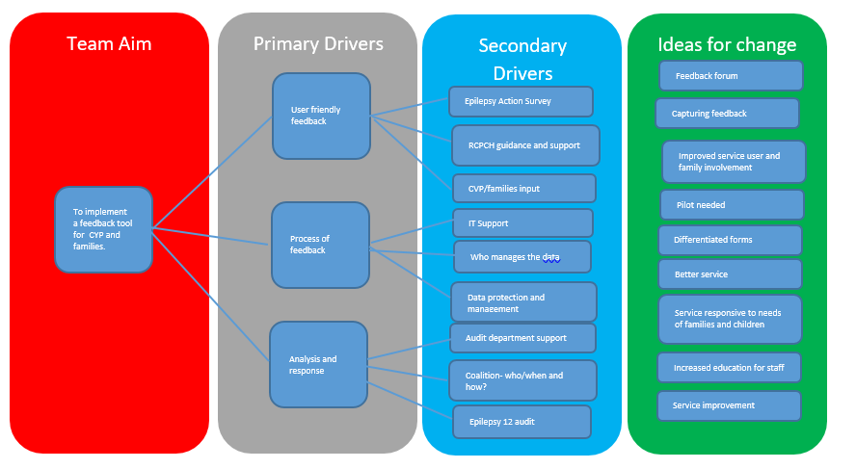
Improving the quality of EEG clinic – Southport and Ormskirk Hospital NHS Trust
Project driver diagram

Slide 6
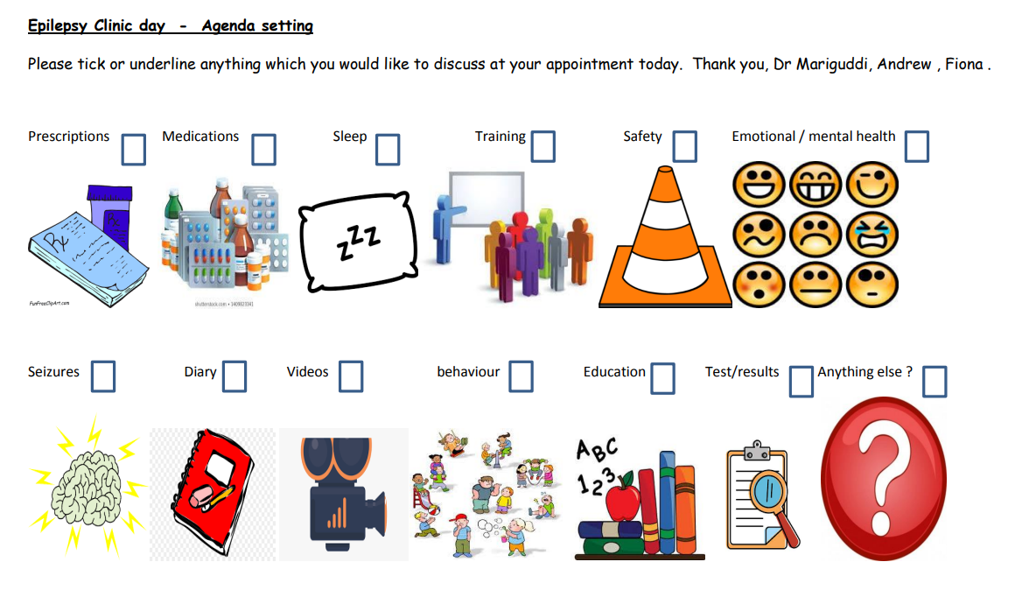
Improving the quality of EEG clinic – Southport and Ormskirk Hospital NHS Trust
Agenda-setting sheets were given to families as they arrived for their outpatient appointment to be complete prior to their appointment in order to lead the discussion.

Slide 7
Improving the quality of EEG clinic – Southport and Ormskirk Hospital NHS Trust
Results
Distribution of questionnaires based on their caseload resulted in receiving 22 completed questionnaires from patients and families.
A number of the teenage population were asked if they would be willing to join a young persons’ feedback group – response was good overall.
Clinic 1 – 7 patients scheduled, 6 attended, 1 DNA. Of these:
  1 patient was excluded because they had been given a general paediatric appointment incorrectly.
  1 patient was excluded because they were under another hospital and was only seen by the team sporadically.
  1 patient was excluded because they were a new patient. This meant 3 forms were given out and 3 completed.
  Clinic 2 – 8 patients scheduled.
  1 DNA, 1 cancelled due to illness, 1 new patient, and 5 follow-up patients.
  Clinic 3 – 8 patients scheduled.
  1 DNA, 1 cancelled due to illness, 1 new patient, and 5 follow-up patients. Of these, only 5 children were included; all 5 families completed the forms.
Clinic 4 – 2 patients were booked, 2 patients attended both follow-up appointments, 2 responses received.
  2 inpatients at the time who were asked the question and agreed to be part of the feedback exercise.
Good results. Feedback over a 2 week period suggests that all families find the agenda-setting sheet useful and feel that they are involved in the direction of discussion.

Slide 8
Improving the quality of EEG clinic – Southport and Ormskirk Hospital NHS Trust
Feedback over a 2 week period suggests that all families find the agenda-setting sheet useful and feel that they are involved in the direction of discussion.
Families accessing the agenda-setting tool felt it acted as a prompt for them to remember things that they may have forgotten to ask previously. PDSA cycle completed.
Verbal feedback from patients and families, revealed they were happy to use them and felt that it acted as a prompt in some cases to remind them of the questions they may have had.
The older children and young people mostly helped their parents to fill them in.

Slide 9
Improving the quality of EEG clinic – Southport and Ormskirk Hospital NHS Trust
Results
The team learned that families perceive their clinic time slots to be just right, but they vary when it comes to preferred clinic times.
Some families forgot to do the other side of the questionnaire – included “PTO” at the bottom of the form.
2 families mentioned that Sefton is not covered by the epilepsy nurse.
1 parent commented that they would like referrals for additional help to be made for them rather than asking school / GP.
1 family wanted general health information on viruses.
1 family mentioned that although they have always felt included and respected the team, they would like to see more consideration and communication to help them engage.
Skype / video consultations were popular with 3 families and telephone consultations with 2 families.
Good results.
Distributed 11 questionnaires, all of which have been completed.

Slide 10
Improving the quality of EEG clinic – Southport and Ormskirk Hospital NHS Trust
Results
In total 42 completed questionnaires were received.
  20 were posted out with stamped addressed envelopes – only 3 were returned.
The overall theme from the feedback received was that the clinic times are “just right”, with 2 comments of “it depends what for”.
  30 out of 42 people preferred morning time slots.
  7 preferred evening time slots.
  2 people ticked all 3 time slots.
When asked about telephone and skype consultations:
  18 respondents wanted telephone consultations.
  4 wanted skype / video consultations.
  4 said both.
  2 people were unsure.
  The rest did not complete this question as they did not turn the page.

Slide 11
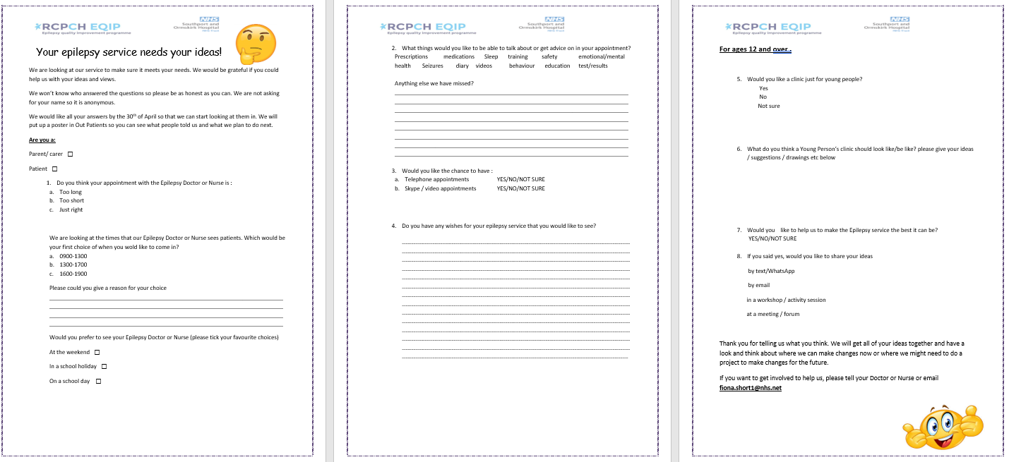
Improving the quality of EEG clinic – Southport and Ormskirk Hospital NHS Trust
Patient questionnaire

Slide 12
Improving the quality of EEG clinic – Southport and Ormskirk Hospital NHS Trust
Challenges
Developing and agreeing on suitable questions for the questionnaire was challenging.
Staff annual leave and finding suitable dates/times to meet as a team every week were challenging.
It was difficult to obtain representation from families who were not due to attend clinic.
Some families only filled out one side of the questionnaire until “PTO” was added to the form.

Slide 13
Improving the quality of EEG clinic – Southport and Ormskirk Hospital NHS Trust
Outcomes
Increased engagement with patients and families who have been happy to have received the support.
Overall, based on the feedback received, patients were happy with the service.
Created and tested questionnaires that can be disseminated either electronically or by post prior to clinics.
Created and tested an agenda-setting document that can be disseminated either electronically or by post prior to clinics.
Collated all the evidence from the questionnaires to better understand what improvements or changes may be needed and what can be offered in the “new” way of working.
Compiled feedback from parents and families and created a “you said, we did” board or poster.

Slide 14
Improving the quality of EEG clinic – Southport and Ormskirk Hospital NHS Trust
Lessons learnt
The team has learned to employ a risk-sensible approach to individual cases and has had to think about different approaches to working with children and their families.
As a team, communication is a lot more efficient. The team is acutely aware of the benefits of having good lines of communication and the importance of regular meetings and catch-ups.
There are multiple ways to communicate with children and their families.
Be risk sensible not risk averse.
The team has come a long way despite the ongoing pressures of the pandemic and participation in the EQIP process. However, the team has strived to continue improving in order to offer patients and families the best possible service with the resources and restrictions available.
QI does not have to be complicated and does not involve a large objective. Make sure the project objectives are SMART but also seemingly “small” or “simple” ideas.
It is particularly humbling to work with families and support them rather than lead them. Once you have built a good relationship with your patients and families, it is good to encourage them to lead discussions and consultations.

Slide 15
Improving the quality of EEG clinic – Southport and Ormskirk Hospital NHS Trust
Lessons learnt
Only try to offer what is “in your gift” to offer. And if it’s not in your gift, why not? Could it be? How will you know unless you test it?
Learn from others.
You do not need to reinvent things if they already exist.
Drawing on the experiences and knowledge of others keeps you informed and helps grow your service.
Using data in conjunction with patient, family, and carer feedback feeds into continuous improvement to help adapt and meet the needs of our patients and families.
Visual presentation of team project intervention
Video presentations
Team project poster

Slide 16


https://eqip.rcpch.ac.uk
eqip@rcpch.ac.uk
@RCPCHEQIP

