Slide 1
RCPCH Epilepsy Quality Improvement Programme
August 2021 – April 2022
Improving emergency care
University Hospitals of Morecambe Bay NHS Foundation Trust
RCPCH Epilepsy Quality Improvement Programme project team:
Dr Anas Olabi, Consultant paediatrician with special interest in epilepsy
Emily Brice, Children outpatient lead/previous community epilepsy liaison nurse
National audit results included within this case study acts as a guide only to performance standards. The service improvements made during the EQIP cannot be entirely attributed to the reported results in the Epilepsy12.

Slide 2
Improving emergency care – University Hospitals of Morecambe Bay NHS Foundation Trust
Project aim
To improve patient outcomes in management and emergency care for 10% of children and young people (CYP) with complex epilepsy by testing and developing the rescue plan and epilepsy passport by March 2022.
Background
Many of the Morecambe Bay Investigation recommendations by Bill Kirkup focused on the importance of integrated patient care and safety, improved teamwork, and better communication between professional disciplines. The service has for many years undertaken the Epilepsy12 audit and recognises the need to improve their epilepsy services. The rurality of their Trust is quite challenging, and delivering services across a wide patch requires a coherent team working across boundaries to improve care for CYP with epilepsy and their families.
Several members of the team work across many localities, and their aim is to provide families with core epilepsy services that incorporate a named paediatrician, an epilepsy nurse, a community liaison nurse, and a clinical psychologist. This will enable the service to develop more cohesive teams with clearly defined roles and a shared sense of mission and responsibility. They will be able to identify areas for improvement in care delivery and design sustainable interventions to address these areas that are manageable within their existing set-up. The Trust’s CYP epilepsy service runs across a wide patch and multiple providers.

Slide 3
Improving emergency care – University Hospitals of Morecambe Bay NHS Foundation Trust​
Area of focus
Feedback from families, colleagues, and different providers identified:
  Lack of consistency in accessible information about individual patients and their care plan/emergency care plan.
  Safety concerns in the use of rescue medication, seizure types, medicine reconciliation, and treatment.
  Patients experience issues because of the informational continuity to be shared with healthcare and educational settings.
  Communication about the epilepsy condition was out of date, fragmented, and unavailable to some professionals, with implications for the quality of care provided to families and CYP.
The team plans to explore and measure working towards safer and better outcomes and patient experience, and to establish a unified, standardised communication platform between professionals, service users, emergency services, and education. This will be in the form of an epilepsy passport or portfolio located on the EPR system, which is multisite and accessible to all professionals involved in the care of the child/family.

Slide 4
Improving emergency care – University Hospitals of Morecambe Bay NHS Foundation Trust
Changes
With the help of the EQIP team, the team liaised with the RCPCH epilepsy passport team to obtain an update on the actions described within the 2018 evaluation report and permission to adapt a Trust version of the passport.
Increased engagement with the Trust CYP department that works with local families and has access to Patient and Public Involvement to support the co-design of the project with the team via the nurses who lead a youth forum and help with feedback from young people with epilepsy.
Increased engagement with Trust IT supports updating the EPR system to help finalise the digital format. Developed a “passport” in an epilepsy tab in a specific area of the Trust EPR system and made it accessible to everyone managing the care of children with epilepsy.
Draft forms (a variation of the RCPCH form) for passports were shared with healthcare professionals, young people, and their parents/carers to obtain feedback.
Achieved an editable digital draft of the passport on their EPR system. Feedback was collected from patients and professionals, which was continuously fed into the draft passport and led to actionable improvements.

Slide 5
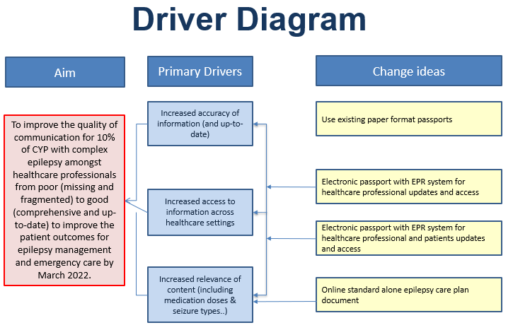
Improving emergency care – University Hospitals of Morecambe Bay NHS Foundation Trust

Slide 6
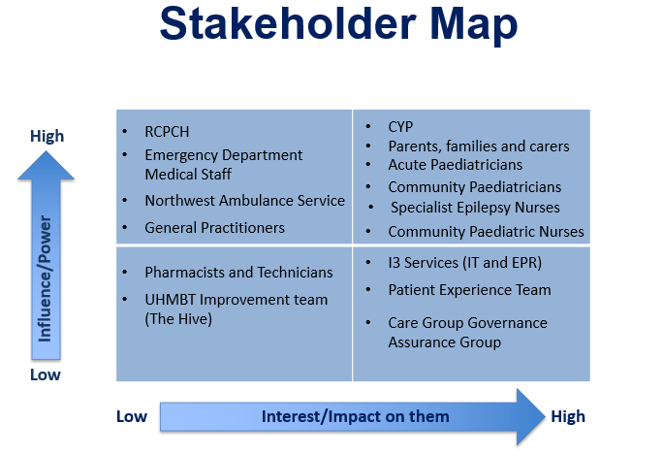
Improving emergency care – University Hospitals of Morecambe Bay NHS Foundation Trust

Slide 7
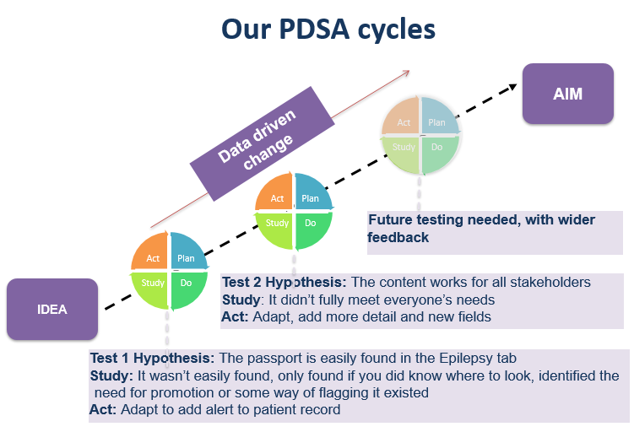
Improving emergency care – University Hospitals of Morecambe Bay NHS Foundation Trust

Slide 8
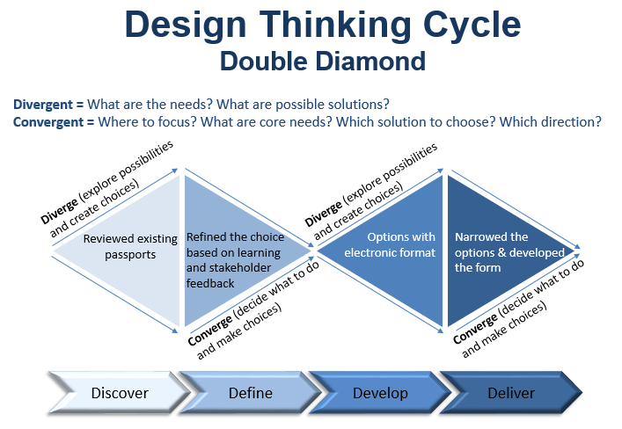
Improving emergency care – University Hospitals of Morecambe Bay NHS Foundation Trust

Slide 9
Improving emergency care – University Hospitals of Morecambe Bay NHS Foundation Trust
Results
Despite COVID restrictions, the team collected feedback from four families with CYP with complex epilepsy. Feedback showed that the areas important to them were as follows:
  Medication
  Types of seizures (how to recognise them and what triggers them)
  Adjustments required in the hospital (inpatient and outpatient)

Slide 10
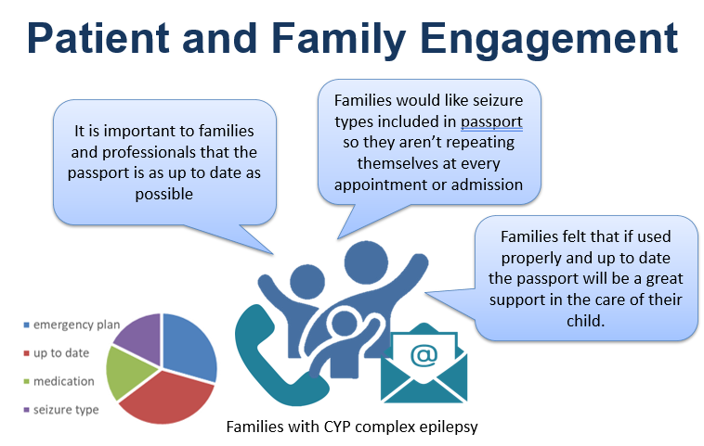
Improving emergency care – University Hospitals of Morecambe Bay NHS Foundation Trust
Feedback results

Slide 11
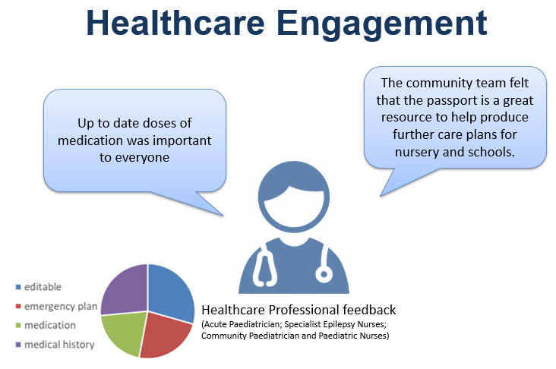
Improving emergency care – University Hospitals of Morecambe Bay NHS Foundation Trust
Feedback results

Slide 12
Audit results for cohort 3 – comprehensive care planning content – University Hospitals of Morecambe Bay
NICE recommends that CYP with epilepsy have an agreed and comprehensive care plan (Quality statement 4).
The percentage of CYP with documented evidence of communication regarding each core element of care planning has increased in University Hospitals of Morecambe Bay NHS Foundation Trust since 2019. The percentage of CYP receiving all five core elements has risen above the national and regional levels.

Slide 13
Audit results for cohort 3 – comprehensive care planning content – University Hospitals of Morecambe Bay
100% of CYP diagnosed with epilepsy in University Hospitals of Morecambe Bay NHS Foundation Trust had documented evidence of communication regarding relevant core elements of care planning.
No CYP required a prolonged seizures care plan in 2021; the rate was 100% in 2020.
Percentage of children with documented evidence of discussion of: | 2019 | 2020 | 2021 | 2022 | 2021 – NWEIG | 2021 – England & Wales
Core elements of care planning | 33% | 50% | 100% | NA | 90% | 75%
Parental prolonged seizures care plan | 67% | 100% | N/A | NA | 93% | 92%
Water safety | 67% | 100% | 100% | NA | 92% | 84%
First aid | 100% | 100% | 100% | NA | 98% | 87%
General participation and risk | 33% | 50% | 100% | NA | 97% | 85%
Service contact details | 33% | 100% | 100% | NA | 97% | 93%

Slide 14
Improving emergency care – University Hospitals of Morecambe Bay NHS Foundation Trust
Challenges
The team's initial project aim was to target 50% of children with complex epilepsy and comorbidities, then roll it out to the rest of our epilepsy cohort. However, after some reflection, the team reduced their scope to a more achievable project aim.
Previously, some clinicians had used passports and had issues regularly updating them.
Multisite service covering a large area can be challenging, working across boundaries and teams (acute, community, or education).
The final document or passport will need to go through the Trust procedural documents team for approval.
The team plans to ensure the document is editable so it can be edited regularly, requiring IT support for this project.
Liaising with patients and their families has been hard due to the fact that most clinic appointments are still not face-to-face. The youth forum has not been able to meet as regularly, and feedback has shown that the CYP are happier to discuss their care in a group of peers or face-to-face.
Time to dedicate to a team project due to a lack of full-time dedicated paediatric epilepsy specialist nurse.
Winter and COVID pressures are affecting priorities.

Slide 15
Improving emergency care – University Hospitals of Morecambe Bay NHS Foundation Trust​
Challenges
The team found writing up progress reports challenging due to capacity but understood the importance of them in tracking their achievements and what they had learned.
COVID pandemic restrictions minimised face-to-face contact.
Time frame for full testing and measurement of success.

Slide 16
Improving emergency care – University Hospitals of Morecambe Bay NHS Foundation Trust
Outcomes
The team has created a draft electronic editable version of the passport that has been integrated within the Trust EPR system and can be used by all healthcare professionals.
The team has increased their engagement with other healthcare professionals, patients, and families to trial the use of the new digital passport/emergency care plan and make changes using feedback received as an ongoing process.
The team plans to present their project intervention to the wider Trust paediatricians and the Trust ED staff to raise awareness of the digital format of the passport and to trial using it with CYP with epilepsy that present within A&E. The team presentation will demonstrate that by creating a digital passport format, it will continue to change patient care to improve patient outcomes.
The digital passport will be reviewed and approved by governance with the aim of changing the current process and embedding it into practice.

Slide 17
Improving emergency care – University Hospitals of Morecambe Bay NHS Foundation Trust
Outcomes
National audit results confirmed:
100% of CYP diagnosed with epilepsy in the University Hospitals of Morecambe Bay NHS Foundation Trust had documented evidence of communication regarding relevant core elements of care planning.
The percentage of CYP with evidence of communication regarding each element of care planning continued to increase in 2021, with most core elements achieving 100%, above regional and national average results.
The percentage of CYP with evidence of communication regarding core elements of care planning continued to increase in 2021 and has risen above national and regional levels.
0% of CYP diagnosed with epilepsy in the University Hospitals of Morecambe Bay NHS Foundation Trust were prescribed rescue medication in 2021.
Visual presentation of team project intervention
Video presentation
Team poster

Slide 18
Improving emergency care – University Hospitals of Morecambe Bay NHS Foundation Trust
Lessons learnt
Reaching out to the prior participant EQIP team based in Yorkshire provided shared learning from their quality improvement intervention with improving individualised emergency seizure plans.
The team learned how they could adapt a tool previously not fit for purpose by using quality improvement methods and engaging colleagues and patients to collaboratively implement changes.
Stakeholders' engagement was key for the project.
Working in partnership with the IT team really supported this project.
Design developments can take longer than expected.
Using measurement for improvement helps demonstrate impact.
The team understood that quality improvement is continuous and will continue to refine the electronic passport as part of the patient EPR system with a future view to developing a secure portal to enable the passport to be editable by professionals, young people, and families. This makes the passport accessible, up-to-date and accurate, with a single copy available.

Slide 19


https://eqip.rcpch.ac.uk
eqip@rcpch.ac.uk
@RCPCHEQIP

