Slide 1
RCPCH Epilepsy Quality Improvement Programme
November 2019 – July 2020
Improving clinic booking system
Guy’s and St Thomas’ NHS Foundation Trust
RCPCH Epilepsy Quality Improvement Programme project team:
Dr Ruth Williams, Consultant Paediatric Neurologist
Ms Amanda Tomalin, Epilepsy Nurse Specialist
Dr Shan Tang, Consultant Paediatric Neurologist
Mr Martin Smith, Epilepsy Nurse Specialist
Ms Peri Gershoni, Ketogenic Dietician
Dr My Lac, Paediatric Epilepsy Clinical Fellow
Mr Edward Harvey, Assistant Service Manager

Slide 2
Improving clinic booking system – Guy’s and St Thomas’ NHS Foundation Trust
Project aim
To obtain feedback from 50% of patient/families seen in tertiary epilepsy clinic regarding their perceived appropriateness of the time interval between follow-up appointments by March 2020.
Background
There was a perception within the team that the current booking system was inefficient. Clinics were underbooked and encountered late cancellations. Parents/carers were contacting the hospital to chase appointments (as they were not being made within the correct time intervals). This project will provide baseline data to identify any current problems within clinic booking services and implement standardised processes for improvement. Additionally, the team plans to incorporate the views of the patient and parent/carer regarding the possibility of patient-led initiatives to improve follow-up appointments (time and date of next clinic appointment) and allow more patient involvement and increased flexibility.
Area of focus
Increase engagement with patients and families by collating feedback that will feed into identifying and mapping the current problems of the clinic booking service and making the necessary improvements when issuing follow-up appointments.

Slide 3
Improving clinic booking system – Guy’s and St Thomas’ NHS Foundation Trust
Changes
In March, due to the COVID-19 pandemic, all epilepsy clinic appointments were changed from in-person to virtual video clinics or telephone consultations. This impacted the dissemination and completion of feedback surveys.
The team experienced new ways of working and training using virtual platforms in a digital environment for virtual consultations and team meetings (e.g., Attend Anywhere, Microsoft Teams, Blue Jeans, etc).
Results
Dec 19 – drafted a survey of 10 questions regarding the appropriateness of questions which were tested with two families.
The survey was approved and distributed to patients and families that attended follow-up appointments for epilepsy clinics at the Evelina Children’s Hospital (ELCH). The trial period was a 2 week period: 22 January until 4 February. The number of surveys completed was 15.
Surveys completed over a total 7 week period, offered face to face epilepsy clinic appointments at ELCH.
Dates: Pilot 22 January until 4 February (n=15), 10 February until 15 March (n=31).
Total number of surveys completed was 46.

Slide 4
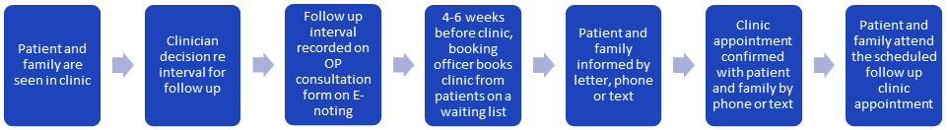
Improving clinic booking system – Guy’s and St Thomas’ NHS Foundation Trust
Process map of the clinic booking system pathway pre-pandemic in detail:

Slide 5
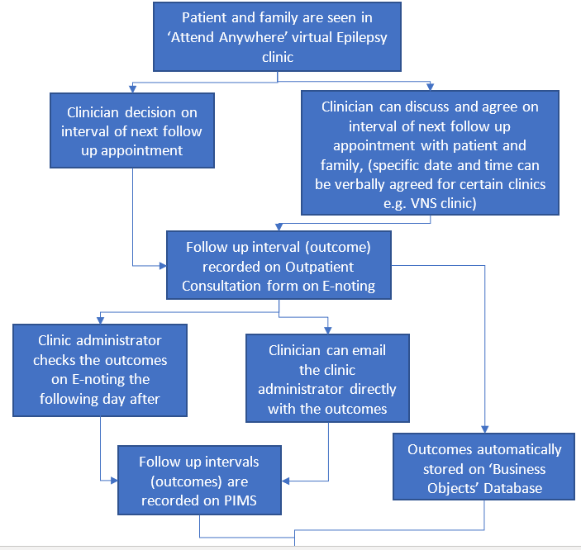
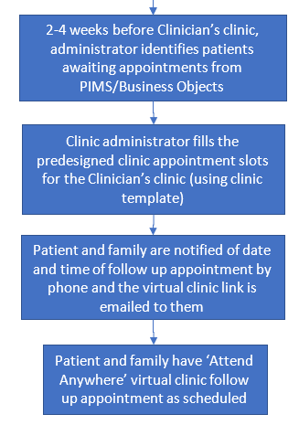
Improving clinic booking system – Guy’s and St Thomas’ NHS Foundation Trust
Process map of the clinic booking system pathway post-pandemic in detail:

Slide 6
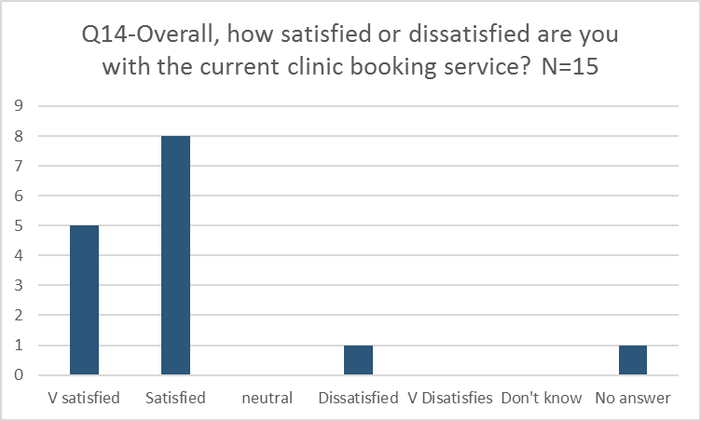
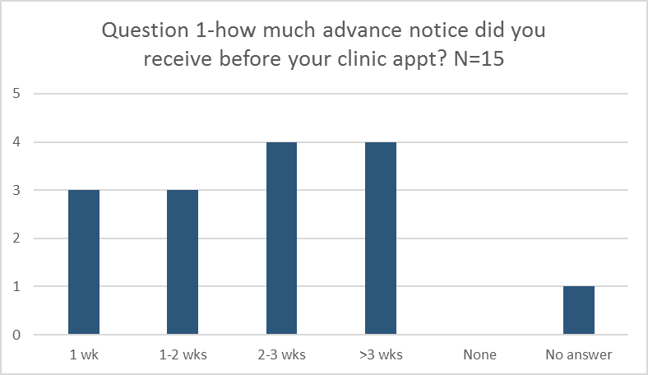
Improving clinic booking system – Guy’s and St Thomas’ NHS Foundation Trust
The 2 week trial period was 22 January until 4 February. The number of surveys completed was 15. The survey received a 100% response rate during the trial period, but it was not offered to all follow-up patients due to the survey being forgotten during busy clinics. The data was collected and analysed during the trial period, and the main findings revealed that patients and their families were generally satisfied with the clinic booking service, but that the majority of patients and their families did not receive enough notice before the clinic appointment. However, there was also a discrepancy in the method by which people were informed about their appointment (e.g., by letter, text, or phone call).

Slide 7
Improving clinic booking system – Guy’s and St Thomas’ NHS Foundation Trust
Examples of April 2020 patient engagement survey results

Slide 8
Improving clinic booking system – Guy’s and St Thomas’ NHS Foundation Trust
April 2020
Survey results: Overall satisfaction with the clinic booking service was good – 84% very satisfied or satisfied.
Causes of dissatisfaction:
Difficulty contacting appointments team to chase and change appointments
Not enough notice before clinic appointment (only 52% >3 week notice before clinic date)
15% had to contact the hospital themselves
The perceived appropriateness of the time interval between follow-up appointments was reasonable (80%), but there is room to improve. It showed that there are inconsistences in the way that patients and their families are informed of the appointment and re-confirming appointments.
It shows that some patient and families wish to have a personal choice when booking date/time of next appointment (58%) and wish to verbally agree and book provisionally next appointment with clinician in clinic (36%).

Slide 9
Improving clinic booking system – Guy’s and St Thomas’ NHS Foundation Trust
Challenges
Strategies were discussed as a team on how to increase engagement with the survey by mentioning it at the beginning of consultations, but it continued to be a challenge.
Patients and their families were reluctant to attend hospital and A&E out of fear of contracting the Coronavirus.
The teams EQIP champion was re-deployed from 30 March until 8 June to a different role (to cover acute service paediatric specialities), which meant they were no longer working with the Complex Epilepsy Team during this time.
Keeping open communication with the epilepsy team via virtual meetings became difficult due to changes in shift work patterns.
Feb 20 – Due to the delays in preparing the survey, the data collection period was amended (initially supposed to be January and February 2020) to a 6 week period extending until 31 March.
March 20 – Unable to offer surveys in March because all face-to-face epilepsy clinics were replaced with telephone or virtual clinics due to the impact of the pandemic.

Slide 10
Improving clinic booking system – Guy’s and St Thomas’ NHS Foundation Trust
Outcomes
The results of the survey were shown to service managers, who informed the team that there is no official standard operating procedure for the clinic booking process. The team was advised to continue to gather as much information about the current process from their clinic administrative team before supporting the implementation of a new pathway to address the issues identified from the survey results.
The team experienced improved communication amongst the team through regular, short, but directed virtual meetings.
Improved communication within neurosciences helped raise the epilepsy service profile within the Trust.
Further discussion was required with managers and administrative staff to decide on how to implement specific interventions, which was delayed due to the pandemic.
The team aims to provide patients and their families with increased notice before their appointment (>3 weeks).
The team also plans to standardise the methods of how appointments are confirmed and how patients and their families are informed.

Slide 11
Improving clinic booking system – Guy’s and St Thomas’ NHS Foundation Trust
Lessons learnt
More teaching and meeting opportunities were made available using virtual platforms within the Trust, e.g., weekly neurology consultant teaching and journal club meetings outside the Trust, e.g., London School of Paediatrics, BPNA webinars, virtual epilepsy surgery meetings at Great Ormond Street Hospital.
Ability for more multidisciplinary working, allowing the team to dip in and out of clinics and when patients were being seen.
Epilepsy CNS were able to increase their attendance in clinics with different clinicians in a more purposeful manner (improved discussions with the lead consultant in the clinic).
The team increased regular communication within the team and MDT discussions involving admins, managers, and neuroscience leads, which is important when planning service improvement.
It is also important to have good clinical leadership within the team and for all team members to embrace flexible working.
Visual presentation of team project intervention
Team poster

Slide 12


https://eqip.rcpch.ac.uk
eqip@rcpch.ac.uk
@RCPCHEQIP

