Slide 1
RCPCH Epilepsy Quality Improvement Programme
October 2022 – May 2023
Improving mental health pathways
South Yorkshire Children & Young People’s Alliance​ ICB
RCPCH Epilepsy Quality Improvement Programme project team:
Dr Suhail Habib, Consultant Paediatrician Epilepsy Interest
Dr Hasan Hasan, ST4
Dr Karim Shebani, Consultant Paediatrician Epilepsy Interest
Dr Archana Desurkar, Consultant Paediatric Neurologist
Dr Fharhad Motaleb, Consultant Paediatrician Epilepsy Interest
Dr Michael Moussa, Consultant Paediatrician Epilepsy Interest
Carys Amies, ICB Clinical Lead
Jozia Sadiq, ICB Project Manager
Epilepsy12 national audit results will be included in this case study when cohort 5 is published in September 2024.

Slide 2
Improving mental health pathways – South Yorkshire Children & Young People’s Alliance​ ICB
Project aim
By 31 May 2023, 60% of 9–18-year-old epilepsy patients in South Yorkshire ICS will have access to mental health screening supported with a referral pathway, as per local trust pathway.
Background
South Yorkshire ICS covers a large geographical area and includes three DGHs: Doncaster and Bassetlaw NHS Foundation Trust, Rotherham NHS Foundation Trust and Barnsley NHS Foundation Trust. Sheffield Children’s Hospital is their tertiary centre for neurology, although it also provides a separate secondary care epilepsy service for the City of Sheffield. Community support is provided by the well-established and coordinated Rotherham, Doncaster and South Humber NHS Foundation Trust.
The ICB has identified some key areas for transformation and improvement, which include:
Mental health support
Transition services
There is a need for mental health screening within CYP epilepsy clinics. National drive to enhance transition, mental health, variations in care, and referral to tertiary care/CESS. Not always appropriate or accepted by CAMHS/IAPT for over 18s.
Area of focus
The team plans to develop a mental health screening tool with the engagement of patients and their families that can easily be used in clinics, both medical and nurse-led. The aim is also to develop a support pathway depending on the available local and regional resources.

Slide 3
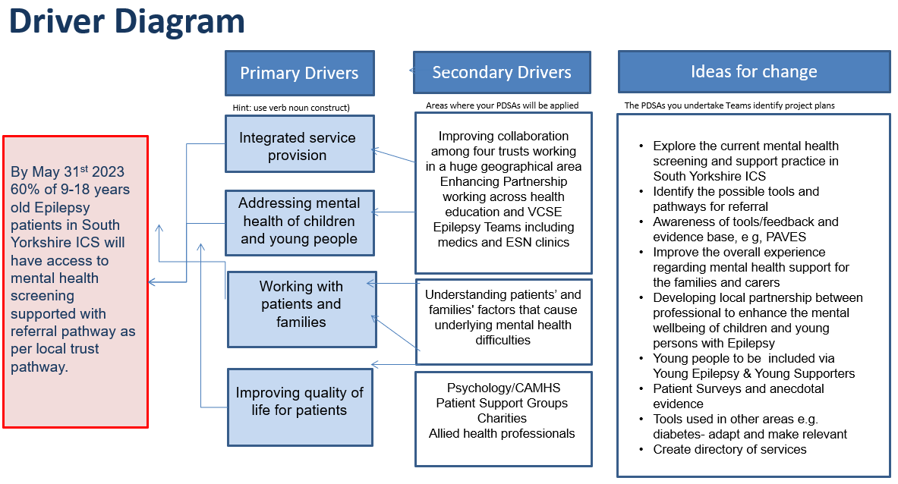
Improving mental health pathways – South Yorkshire Children & Young People’s Alliance​ ICB

Slide 4
Improving mental health pathways – South Yorkshire Children & Young People’s Alliance​ ICB

Slide 5
Improving mental health pathways – South Yorkshire Children & Young People’s Alliance​ ICB
Changes
The change idea will be to initially explore the current mental health screening and support currently available and then identify areas requiring improved tools and pathways for referral. Developing local partnerships with healthcare professionals to enhance the mental health and wellbeing of children and young people with epilepsy.
The ICS is in the discovery stage of trying to understand the current processes in place at each Trust that offers patients regular mental health check-ups and the standardised tools that are used. The ICS is collecting this information via a simple survey of four questions to be filled in by their colleagues in each Trust. The questions are:
How often would you screen for mental health?
Do you have any standardised tools for mental health screening?
Have you got access to a psychologist directly?
Do you have access to a local charity or support group to send postings to parents or patients for mental health support?
The ICS have received up to four survey replies so far and have agreed the next steps would be to engage and work with the patients and families to improve the experience and quality of care in this area for both the patients and the families.
Other areas of focus
Working with Improving Access to Psychological Therapies (IAPT) has raised an issue with access for patients under 18 years old who have high-risk mental health conditions but do not meet the age standard for referral to IAPT services. Therefore, there is a need to address the problem with GPs and local services to refer these patients who require much-needed support from younger age groups.

Slide 6
Improving mental health pathways – South Yorkshire Children & Young People’s Alliance​ ICB
Changes
Other areas of focus
Improving upon a casual pathway by offering better quality that can be measured via patient experience and satisfaction that a level of care is being received from local services and patients are signposted to less complex mental health conditions.
Creating a process that updates care plans and reasons for discharge from these agencies via a communication pathway that loops back to the acute service.
Lack of clinical psychologist support for children with chronic mental illness is evident within the ICB, and a job role is currently vacant, requiring alternative referral pathways that may not be of the same standard.
Bassetlaw’s lead epilepsy consultants and nurses have completed a baseline questionnaire on the current service provision for mental health.
Barnsley plans to adopt the Global Mental Health Assessment Tool (GMHAT) to identify the number of patients who require mental health support and build a business case for mental health support offers.
Sheffield plans to expand the scope of mental health support services available to epilepsy patients (e.g., Sheffield IAPT, SCFT Lucy Project).
SYB ICB epilepsy leads met with the Young Epilepsy charity’s Young Supporter, who is a 20-year-old university student with epilepsy, who would be happy to engage with the epilepsy transformation programme, including EQIP.
Chilypep (Children and Young People's Empowerment Project) has successfully been awarded the tender for CYP Voice from the ICB CYP Alliance to collate the views of CYP across South Yorkshire to input into CYP Transformation Programme workstreams, including epilepsy.
As an ICB, each Trust team came to an agreement that they would work on the same area of topic (mental health) but would work on components that led to achieving the project's aim. They planned to revisit their aim and make tweaks to some of the wording to make it more achievable for everyone. They would then plan to present their improvements as a whole.

Slide 7
Improving mental health pathways – South Yorkshire Children & Young People’s Alliance​ ICB
Changes
From an ICB national transformation perspective, the team began a process of identification of services that offer mental health support that was previously unknown to the teams, and approached these services in terms of access to psychological support or access to wellbeing support.
EQIP has provided the team space to look for these opportunities, open those doors, and spread that knowledge to clinicians within the ICB.
The team received an RCPCH &US patient engagement box, which has been used in clinics and received a positive response from patients.
Patients and their families provided photographic permission to the team to be used within their project poster.
Doncaster and Bassetlaw NHSFT – ICB
Created a patient and family survey using baseline data that showed discrepancies in what access is available for mental health support. The local team will focus on this for the next 4 months and then include it as part of their EQIP project.
Tested a few questions with patients, including signposting to local charities. Requested feedback in a month or two on their experience. Additionally, plans are in progress to assess the available support with mental health screening tools.
Began engaging patients and families with regards to using a screening tool that has been developed over the last 2–3 weeks. This intervention will be in place until a formal pathway has been established.

Slide 8
Improving mental health pathways – South Yorkshire Children & Young People’s Alliance​ ICB
Changes
Rotherham Hospital NHSFT – ICB​
Began collecting feedback by engaging with patients on how they find the current pathway and their experience to feed into future changes.
Attempting to develop a short tool using a few questions that is used in diabetes and implemented within epilepsy clinics. However, the first step is to gather information about the available resources and design a signposting package to share with patients.
Still in the process of securing a psychologist for the epilepsy team.
Developing a leaflet containing information about how to approach CAMHS.
Sheffield Children’s Hospital – ICB
Progress with the support in engaging a psychologist that was a part of the Lucy Project and had a helpful discussion regarding access to support with mental health for children and young people younger than 18 years old. This resulted in gaining access to a pilot of the Lucy Project that was created by UCL Great Ormond Street, which they have now utilised in Sheffield, where the children can self-refer and access low-level support.
Engaged with IAPT and had a meaningful conversation that resulted in providing signposted self-referral leaflets with QR codes to patients who require support.
Identifying patients who are appropriate for the Lucy Project is a form of screening, and the wording was reviewed so it did not sound too formal.

Slide 9
Improving mental health pathways – South Yorkshire Children & Young People’s Alliance​ ICB
Changes
Barnsley Hospital NHSFT – ICB​
Plans to implement the GMHAT, a computerised clinical assessment tool developed to rapidly assess and identify mental health problems in a range of settings, identify patients who require mental health support, and build a business case.
Attempting to develop an app that is a mental health assessment by mental health-trained medics. Meanwhile, patients are being signposted.
Patients with behavioural conditions such as autism or ADHD are being supported by community services in the area; this reduces the time taken for the ASD assessment, which is associated with the elaborate mental health assessment. ADHD patients are also supported by CAMHS, although there is a long waiting list.
Building relations with a school team or school nurses to support children and young people with anxiety, stress, or low self-esteem because these conditions are not supported by CAMHS.
In the process of making a business case for an assured psychologist to support both the epilepsy and diabetes services.

Slide 10
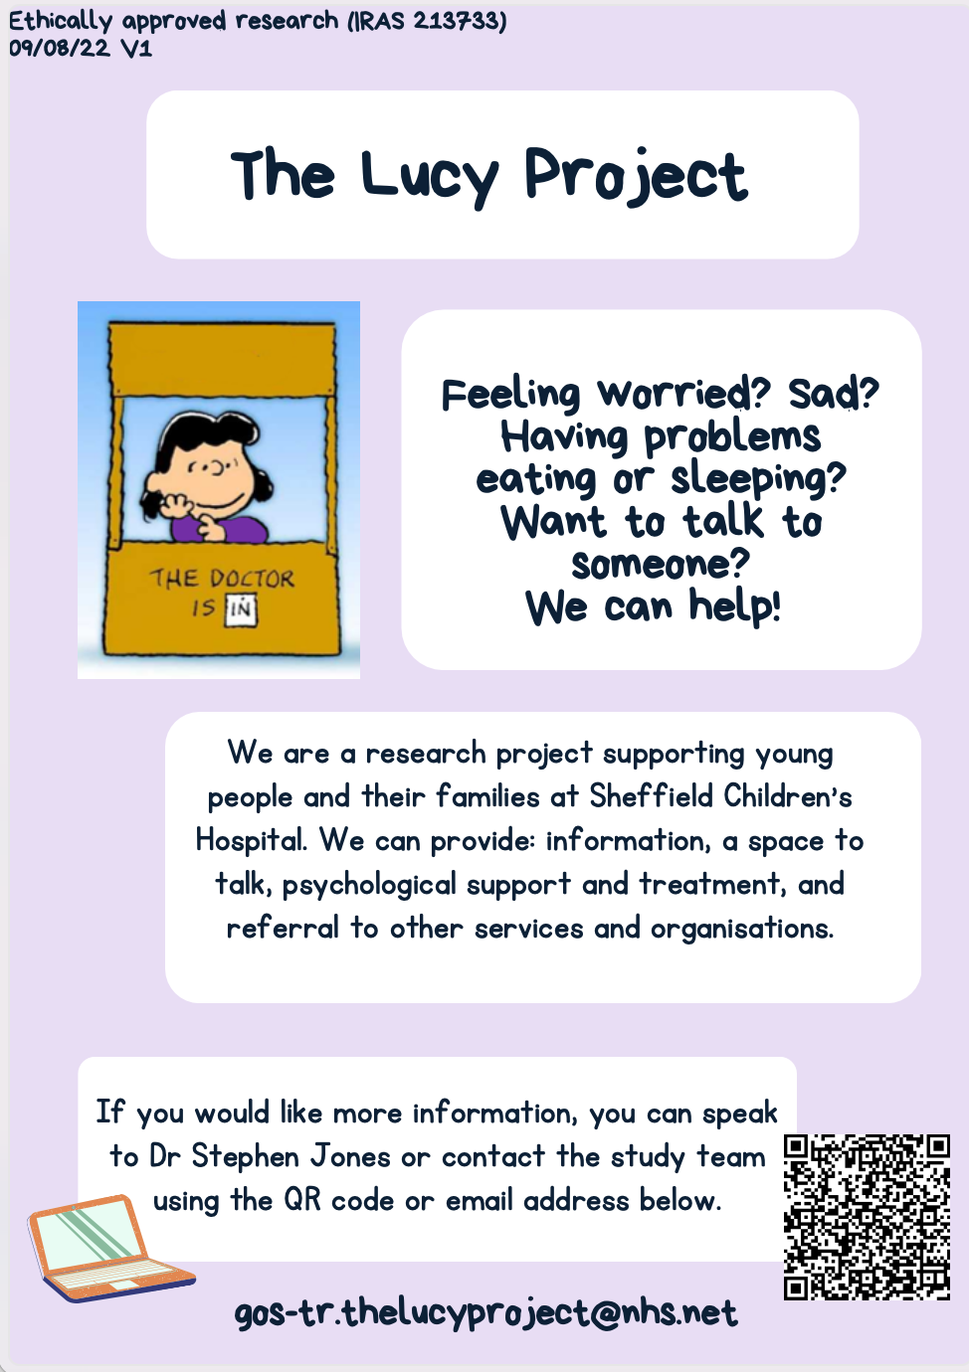
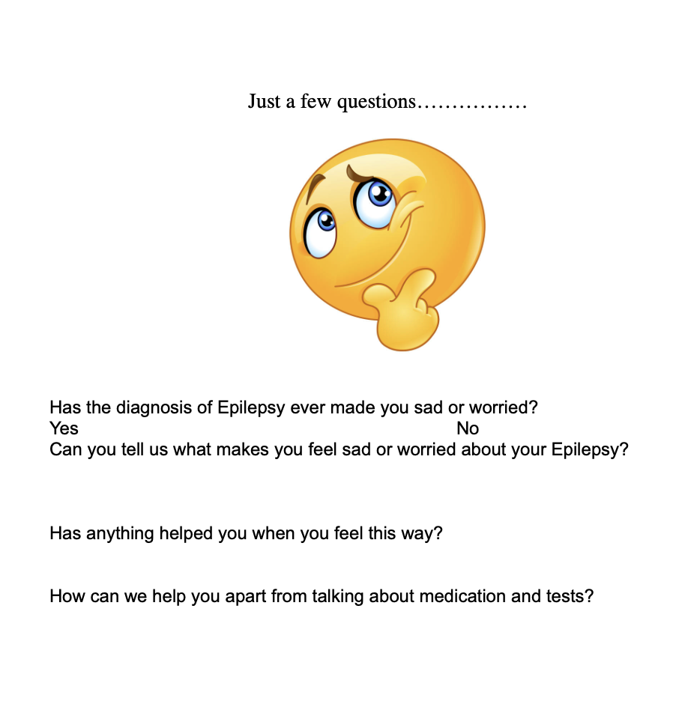
Improving mental health pathways – South Yorkshire Children & Young People’s Alliance​ ICB
Patient engagement skills and techniques used to capture feedback on their needs
Patient’s questionnaire
Wellbeing in Epilepsy questionnaire
Lucy Project leaflet
Information leaflet
App-based program

Slide 11
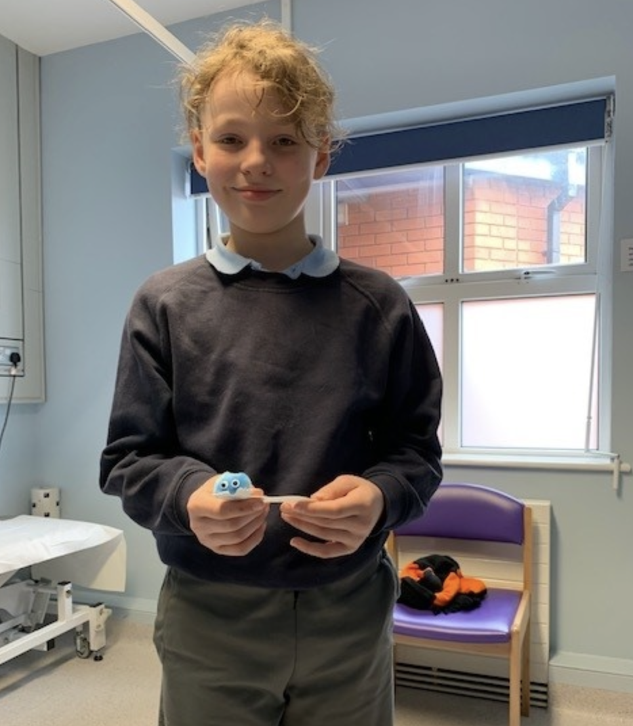
Improving mental health pathways – South Yorkshire Children & Young People’s Alliance​ ICB
Patient experience during engagement
This is Travis, whose engagement was to give a resounding “No” when asked if he would be happy to complete a quick patient survey 😊 but he was very happy with his bug!

Slide 12
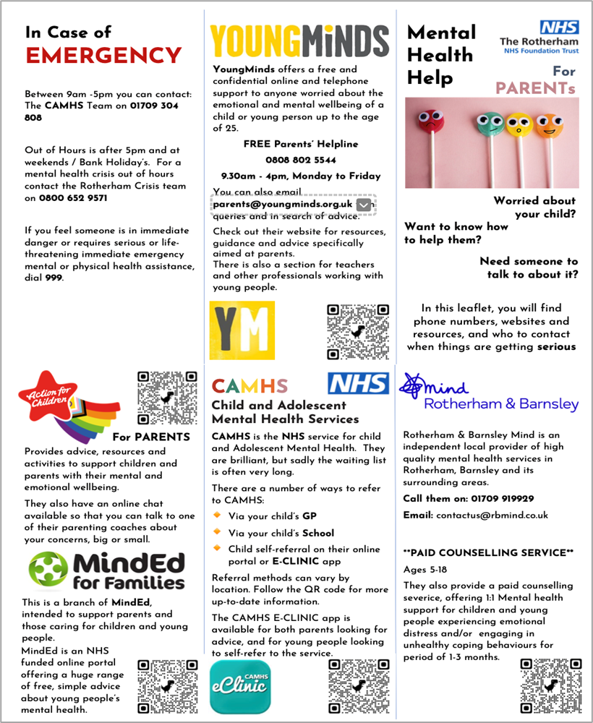
Improving mental health pathways – South Yorkshire Children & Young People’s Alliance​ ICB
Patient and family signposting leaflet for mental health support organisations

Slide 13
Improving mental health pathways – South Yorkshire Children & Young People’s Alliance​ ICB
Results
Test outcomes
Mental health screening is an overall average of 25% in all areas; there is no standardised tool and no access to psychologists in the whole South Yorkshire region.
Guide to further steps
Each trust will complete separate tests.
Explore local services.
Manage local expectations.
Keep sharing your experience via bimonthly meetings.
The ultimate aim is the implementation of a care package.
Data/results
6 leaflets were given to patients about the Lucy Project by the consultant.
3 self-referrals.
1 patient has access to cognitive behavioural therapy.
16 patient questionnaires were handed out to patients.
9 patient questionnaires were given to patients by a consultant
7 patient questionnaires were given to patients by the nurse.
More than 60% offered screening within 7 clinics in total.
Patient information leaflet for DIY support and introduction of the questionnaire.
Development of a questionnaire app.

Slide 14
Improving mental health pathways – South Yorkshire Children & Young People’s Alliance​ ICB
Results
Results from patients who responded “yes” to experiencing worries and anxieties.
A follow-up question was: “What are your particular worries?”, which uncovered important learning from one patient, who wrote, “I'm worried about dying because I know that patients with epilepsy can die”. This patient also indicated preferring to speak with the ESN alone about this particular concern without their parents present.
This has been a success for the team in providing a better understanding of concerns from their patients by using one or two questions and the engagement pack.
Another example is a patient being worried about having a seizure in the middle of the school and what would happen, creating heightened anxiety. This was uncovered by simply asking, “How do you feel?”

Slide 15
Improving mental health pathways – South Yorkshire Children & Young People’s Alliance​ ICB
Challenges
Increasing and improving communication between the ICB Trust’s service teams.
Methods to capture and monitor project progress.
Overlapping areas between the work being completed on the EQIP and the epilepsy transformation that is dictated by national priorities.
Increased ESN involvement.
Support from the CAMHS team and different support groups or charities that are available.
Change in EQIP leadership and approach.
Limited non-clinical capacity of ICB members.
Making a business case for psychologists at Barnsley Hospital Trust to support both epilepsy and diabetes services.
That post is not very attractive for a psychologist role; therefore, expand the role to include more than one long-term condition, such as mental health support or psychology support, which would be a more attractive proposition.
The consultant at Barnsley service was concerned about whether the psychologist role would be used as an integral part of every epileptic assessment for the patient or just for selected people.
The majority of children and young people seen in Barnsley do not require psychologist support; around 20% could have mental health issues; a minority of patients have severe behavioural problems or autism; or severe learning difficulties related to their epilepsy, so the second group could be addressed by community services or by CAMHS. Therefore, the assumption is that the psychologist would support the patients identified with complex needs.
The team confirmed there would be exclusion criteria, for example, those cases that have already been identified.
Lost ICB project lead in February.
Working across wide geographic area (ICS area).
Limited non-clinical capacity of SYB ICB members/unexpected staff sickness.

Slide 16
Improving mental health pathways – South Yorkshire Children & Young People’s Alliance​ ICB
Outcomes
More than 60% offered screening within 7 clinics in total.
Patient information leaflet for DIY support and introduction of the questionnaire.
Development of a questionnaire app.
Cross-collaboration among different teams.
Engagement with the psychology service.
Identification of available resources, e.g., support groups and the Lucy Project.
Success comes from increased patient engagement and improved patient satisfaction.
Strengthened communication among different teams.
Service improvement to support CYP mental health.
Information leaflets are directed towards patients' needs rather than the perceptions of professionals.
Access to voluntary organisations and support groups.
DIY support provision.

Slide 17
Improving mental health pathways – South Yorkshire Children & Young People’s Alliance​ ICB
Lessons learnt
There was an overall increase in service team engagement and enthusiasm to improve the care provided.
Communication and a willingness to share information are key.
Sharing good practice and experience feeds teamwork and facilitates discussions.
Arranging regular meetings attended by services within the ICB is difficult but crucial to get right to foster communication and engagement.
More work is required for ICB leads to develop measurement mechanisms that accesses both local service data and national data on performance that can be reviewed collectively as an ICB.

Slide 18
https://eqip.rcpch.ac.uk
eqip@rcpch.ac.uk
@RCPCHEQIP

