Slide 1
RCPCH Epilepsy Quality Improvement Programme
October 2022 – May 2023
Reducing variation in quality referrals for EEG
Royal Free London NHS Foundation Trust​
RCPCH Epilepsy Quality Improvement Programme project team:
Dr Juliet Pearce, Paediatric Consultant
Mandy Green, Paediatric Epilepsy Nurse
Dr Elliot Cheng, Paediatric Consultant
Dr Kiran Nijabat , Psychiatrist
Dr Abinaya Seenivasan, Paediatric Registrar
Epilepsy12 national audit results are not yet included within this case study until the publication of cohort 5 in September 2024.

Slide 2
Reducing variation in quality referrals for EEG – Royal Free London NHS Foundation Trust​
Project aim
To develop and implement a pathway for melatonin EEGs in co-production with neurophysiology and pharmacy at the Royal Free site by May 2023.
Background
400 children and young people are seen across two DGH sites under the Royal Free London NHS Foundation Trust. The paediatric epilepsy service has two consultants and one WTE ESN covering Barnet and Chase Farm hospitals. Patients have expressed how unhappy they are with the referral process for melatonin EEGs. The inefficient pathway increases the ESN's workload, making it unmanageable, and the service has experienced a number of failed investigations and tests and a waste of resources. There is no clear process in place due to working with too many variables, inconsistent information available, and varied prescription and dispensing practices.
Area of focus
The team has accessed the resources on the EQIP website to help with using diagnostic QI methodologies to begin mapping the referral pathway, which involves collaborating with pharmacy and neurophysiology department colleagues. There are plans to gain a better understanding of the barriers and issues experienced by patients and families and provide suitable solutions, providing a more efficient pathway.

Slide 3
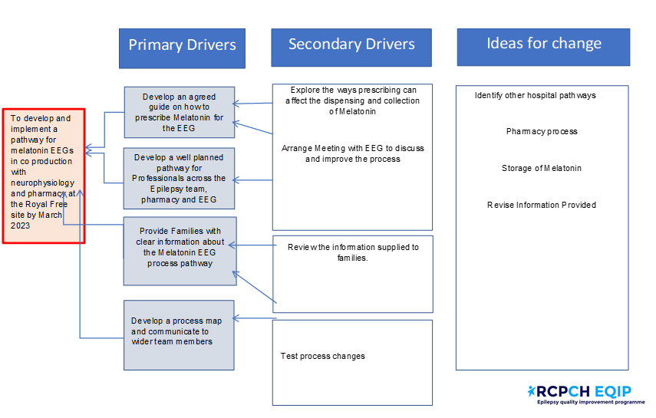
Reducing variation in quality referrals for EEG – Royal Free London NHS Foundation Trust
Driver diagram

Slide 4
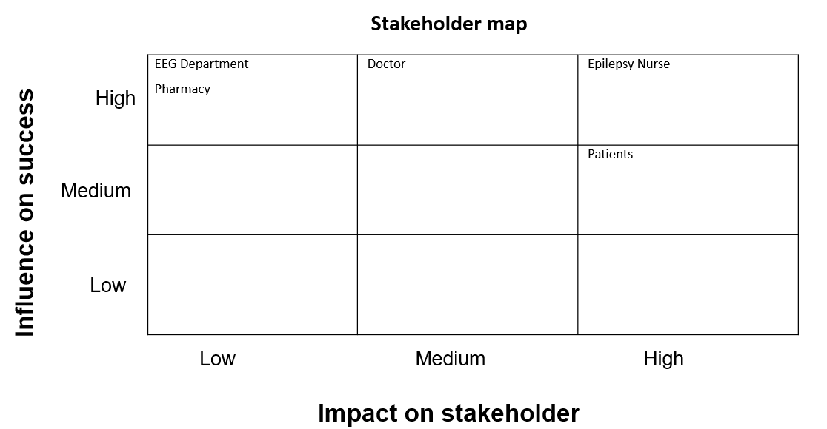
Reducing variation in quality referrals for EEG – Royal Free London NHS Foundation Trust

Slide 5
Reducing variation in quality referrals for EEG – Royal Free London NHS Foundation Trust
Changes
In terms of patient engagement, the team received feedback from parents and families, who expressed their frustration and disappointment with the EEG referral process. Based on the responses received, the team began engaging patients and colleagues about their experience using the current pathway, then began making small changes to each area of the pathway, creating a much more standardised process.
The team first explored the melatonin EEG referral pathway by reviewing what was written within the referral form guidance when ordered using the internal electronic system. They looked for similarities in the process and engaged with the two consultants who ordered the investigations within their service.
The team found considerable variation within the referral pathway and decided to include the details of the pharmacy on the order form within this process to reduce the ESN time used to follow up with the pharmacy on whether the melatonin had been prescribed and if the parents or carer had been informed.

Slide 6
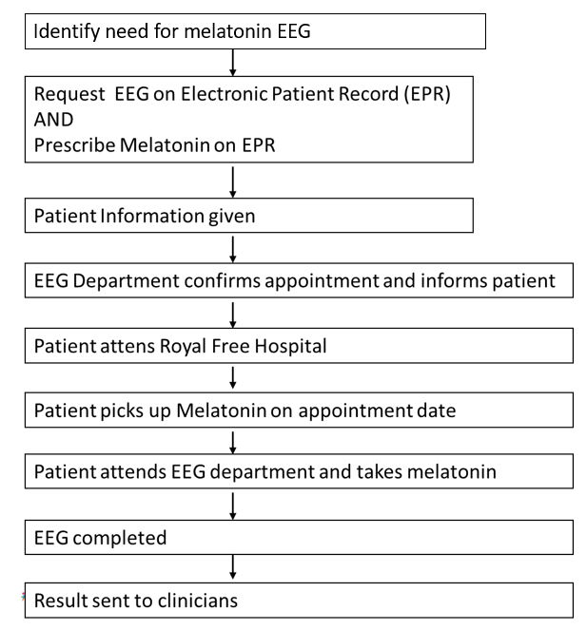
Reducing variation in quality referrals for EEG – Royal Free London NHS Foundation Trust
Process mapping of pathway
Patient attends Royal Free Hospital

Slide 7
Reducing variation in quality referrals for EEG – Royal Free London NHS Foundation Trust
Process mapping of pathway – barriers and bottlenecks uncovered
Identify need for melatonin EEG
No agreed process
Request EEG on Electronic Patient Record (EPR)
AND
Prescribe Melatonin on EPR
Inconsistencies in request
Not always completed in clinic
Difficult to be dispensed at a different site
2 journeys for patient
Dispensing issues:
Out of date
Not ready
Patient Information given
EEG Department confirms appointment and informs patient
No liaison with pharmacy
Nurse needing to coordinate
Patient attends Royal Free Hospital
Told not to crush
Long waits
Had to collect from Barnet/Enfield site
Patient picks up Melatonin on appointment date
Patient attends EEG department and takes melatonin
Inadequate information
Delays and cancellations
EEG completed
Or cancelled/inadequate
Result sent to clinicians
Not informed

Slide 8
Reducing variation in quality referrals for EEG – Royal Free London NHS Foundation Trust
Results
In terms of patient engagement, the team discovered through their feedback that if there is no pre-explanation to the patient and their family about the referral pathway, the EEG experience was reported as poor, and if they did not receive the melatonin medication, the investigation would not take place.
The team investigated how their service ordered the melatonin and uncovered that the melatonin affects the end result of the patient receiving the EEG. Therefore, the team engaged the in-house pharmacy to better understand what the correct process should be, which led to a change in process that now includes prescription details and adds pharmacy contact details on the order form. Through testing these changes, the team found that they have resulted in improvements in reducing ESN time and no longer having to be the point of contact for this specific area of the pathway.
When the service team prescribed melatonin using the new internal EPR system, they discovered that if they didn't check a specific box, the order would be sent to the pharmacy to be dispensed at the time of referral. The system then moves on to the next screen page without prompting the user of this outcome, resulting in the melatonin being prescribed earlier than the time of the EEG. The patient attending the appointment will then be told on arrival that the prescription was out of date, leading to the appointment being rescheduled.
Additionally, the team learned that patients and families were not being told that dispensed melatonin tablets can be crushed for patients unable to swallow tablets. This missing guidance meant that EEGs were being cancelled because the melatonin was not taken in time. This highlighted a significant issue because not all patients can swallow tablets, especially a child with autism who has specific needs when taking their medication. At no point along this pathway were the families informed of being able to crush the tablets.
Increased engagement with pharmacy staff and EEG service colleagues resulted in an agreement that the medicine would be available for collection 1 hour before their EEG appointment. It was also agreed that the EEG service, moving forward, would liaise directly with the pharmacy regarding the appointment date.

Slide 9
Reducing variation in quality referrals for EEG – Royal Free London NHS Foundation Trust
Results
Other areas of concern that were highlighted and discussed included:
Instances where sleep had not effectively been initiated.
Patients and families found the environment unsuitable, specifically for children with neurodiversity.
Long wait times (parents arrived for EEG without the melatonin and had to queue for medication, which resulted in a late arrival for EEG, and EEG was then cancelled).
Lack of information for patients and their families.
Initial patient engagement results using a questionnaire revealed:
The first 5 patients attempted the questionnaire: who, how, and change.
Engagement from 2/5 with persistence.
Engagement tools and techniques learned from the Head of CYP Engagement, RCPCH &US helped to increase their knowledge and led to a change in engagement practices that now capture feedback from patients and families after attending their test or investigation. The team achieved engagement from 5/5. In total, they assessed information from 16 patient events.
Feedback results informed the required changes in the information provided, and they shared their findings with the EEG management to highlight concerns and their need to increase stakeholder engagement.
Family feedback enabled additional changes to the pathway, and information was provided on the following topics:
Confirmation received that tablets can be crushed.
Include useful video links.
Map of the appointment pathway.
Assigning a measure of resource allocation to the ESN input.

Slide 10
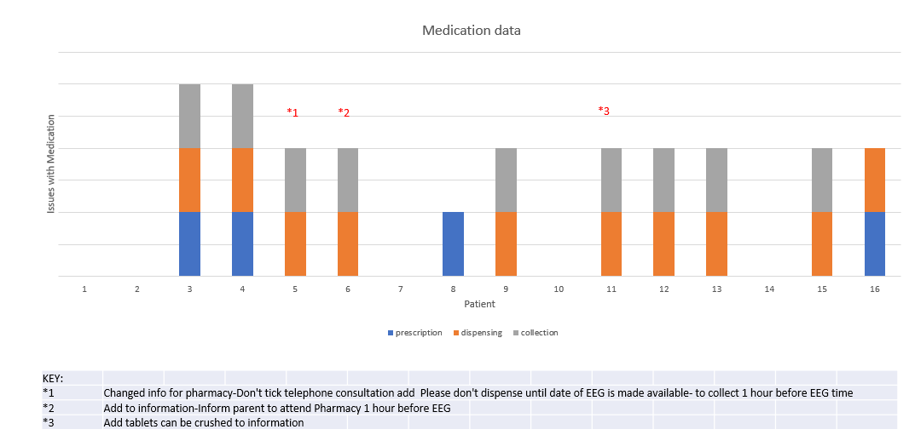
Reducing variation in quality referrals for EEG – Royal Free London NHS Foundation Trust
Data on issues uncovered with prescribing, dispensing, and collection of medication – barriers and bottlenecks uncovered

Slide 11
Reducing variation in quality referrals for EEG – Royal Free London NHS Foundation Trust
Data captured on ESN time spent supporting patients moving through pathway

Slide 12
Reducing variation in quality referrals for EEG – Royal Free London NHS Foundation Trust
Patient and family feedback on their experience
Before review of information
After review of information
Was not told to crush tablets
Didn’t know where to go
Advice
brilliant
Nothing else to add
Know nothing about what to expect
No instructions
to give medicine
Sufficient
Well prepared
A bit unprepared
Good

Slide 13
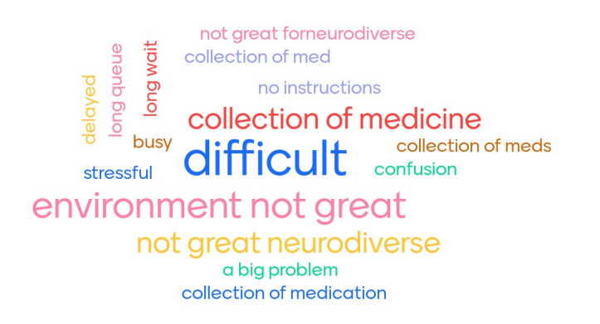
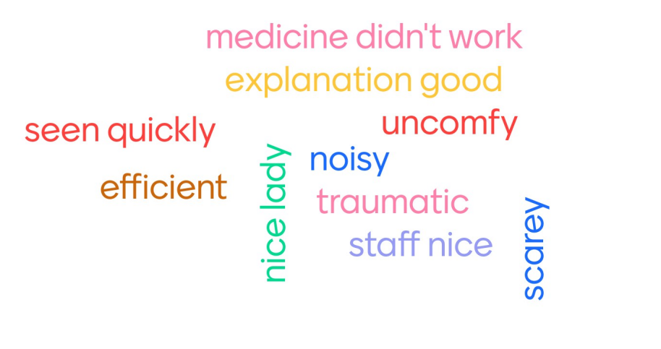
Reducing variation in quality referrals for EEG – Royal Free London NHS Foundation Trust
Patient and family feedback on their experience
EEG responses
Pharmacy responses

Slide 14
Reducing variation in quality referrals for EEG – Royal Free London NHS Foundation Trust
Patient and family feedback on their experience
Information
Before changes
Didn’t know where to go
A bit unprepared
Video Would've helped
Was told not to crush tablets
After changes
Well Prepared
Advice from ESN brilliant
Nothing else to add
Sufficient information given
Pharmacy
Collection of Medication difficult
Long wait
Confusing
Busy
Delayed
A big problem
Environment difficult for neurodiverse
Stressful
No instructions given

Slide 15
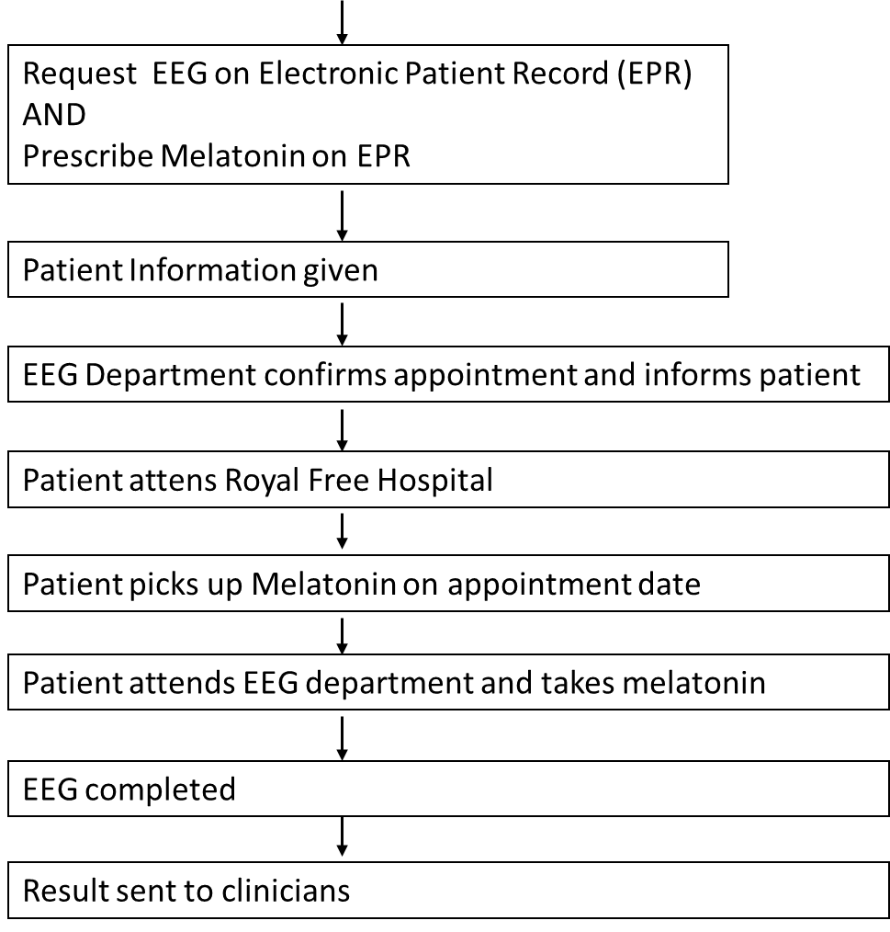
Reducing variation in quality referrals for EEG – Royal Free London NHS Foundation Trust
Process map of pathway after interventions
Identify need for melatonin
With additional comment to inform pharmacy when date confirmed
With additional comments to dispense when date is confirmed
AND
Tablet formation can be crushed
AND
Not a telephone consultation
Trust agreed
And pharmacy
Patient attends Royal Free Hospital
One hour before appointment

Slide 16
Reducing variation in quality referrals for EEG – Royal Free London NHS Foundation Trust​
Challenges
Reducing the scope of the project helped to avoid the team feeling overwhelmed.
Initially, they experienced a low level of engagement and input from EEG colleagues due to the significant backlog they are currently experiencing.
Collaboration with the EEG department took time, which increased the time for change to be implemented due to the lead being on leave.
The EEG waiting time was very long and initially provided low numbers for the team to analyse.
The EEG department is not located onsite within the same hospital as the paediatric epilepsy service; therefore, some of the issues experienced were when patients and families were required to travel to a different hospital to have the EEG done, which also meant working across multiple sites, and presented challenges with stakeholder engagement and patient information.
The team initially struggled with choosing an effective patient engagement activity to capture useful feedback when engaging with children and young people due to the number of issues experienced within all areas of the referral process, such as the lack of information leaflets provided, the process of collecting or taking medicine, and the EEG itself.
Incorporating input from the EEG department and seeking approval through the Trust policy process.
Deciding on the most appropriate method to present the qualitative and quantitative data captured for the project.

Slide 17
Reducing variation in quality referrals for EEG – Royal Free London NHS Foundation Trust​
Outcomes
The project aim was achieved, and progress is ongoing, awaiting approval for the leaflet.
Achieved agreement to prescribe an EPR system to be collected at the site of the EEG department.
Achieved a process change in how to order or prescribe melatonin EEGs.
Increased stakeholder engagement with EEG and pharmacy services and initiated improved communication between EEG and pharmacy services.
Changes in processes have led to overall happier families who are better informed and prepared for their appointments.
The team has a better understanding of the process and how to improve the pathway.
Achieved a significant reduction in ESN time when compared to the previous inefficient process.
Lessons learnt
The team learned to keep the scope of the project improvements small and focus on the group of patients they are most concerned about in terms of improving the processes and care provided.
Keep your tests for change small, recording what worked, what didn’t, what to abandon, and what to adopt. One change per patient.
Recording failed or abandoned tests is one of the greatest lessons you will learn during your QI journey.
The team learned that every PDSA cycle completed should lead to a change.
Team assumptions were envisioning the project as one process and later acknowledging that it involves lots of little areas of activities going on at the same time, which has provided a better understanding of QI methodology.
Limit the many unsuitable choices until you achieve the most efficient process.
QI is not an audit.
Engagement with other healthcare teams was important in how it would help with other aspects of their service.
Quality improvement needs to be done as a whole team.
Quality improvement should be incorporated as a part of your routine day; devote 1 hour per week.

Slide 18
https://eqip.rcpch.ac.uk
eqip@rcpch.ac.uk
@RCPCHEQIP

