Slide 1
RCPCH Epilepsy Quality Improvement Programme
October 2022 – May 2023
Mental health support pathways
Great Western Hospital NHS Foundation Trust​
RCPCH Epilepsy Quality Improvement Programme project team:
Dr Pradeesh Mappa, Consultant Paediatrician
Susan Mulhall, Paediatric Epilepsy Nurse Specialist
Natasha Thomas, Paediatric Epilepsy Nurse Specialist
Dr Ravi Chinthapalli, Consultant Paediatrician
Epilepsy12 national audit results are not yet included within this case study until the publication of cohort 5 in September 2024.

Slide 2
Mental health support pathways – Great Western Hospital NHS Foundation Trust​
Project aim
To optimise mental health support pathways for 10–16-year-olds with mental health difficulties and epilepsy by June 2023.
Background
A DGH paediatric epilepsy team with 1.5 WTE equivalent consultants, 0.5 staff grade, and 2 ENS. Mental health is a significant comorbidity with epilepsy. Mental health services are under significant pressure, resulting in long wait times for patients to access mental health support. Epilepsy12 audit results show local and national problems, and a large proportion of services, such as consultations and phone calls, are related to mental health issues and how patients do not have access to these services. Currently, referrals to CAMHS incur long waiting times, and their engagement with patients is very minimal. Patients and families who had been seen by CAMHS fed back that they had either been discharged without a sufficient reason or that they did not find the service useful enough to meet their needs. Therefore, the team would like to improve mental health referral pathways to CAMHS for only a select group of patients who need mental health support with the comorbidity of epilepsy.
Area of focus
Improve mental health support pathways in adolescents with epilepsy by increasing engagement with patients and mental health services. To try and create a direct referral pathway to CAMHS for patients to receive mental health interventions in a timely manner. The team has thought about devising appropriate mental health questionnaires that implement a triage system for patients who need support from specialist teams and a separate self-help pathway that is supported by empowering patients, providing information to them and their families about mental health support, and creating a mental health wellbeing resource pack for patients.
The team plans to engage CYP and families to obtain feedback on what information matters to them and explore the options of running late-evening clinics to increase engagement with teenagers and reduce the number of DNA appointments, resulting in providing the opportunity to be seen outside of school hours rather than miss school.

Slide 3
Mental health support pathways – Great Western Hospital NHS Foundation Trust​

Slide 4
Mental health support pathways – Great Western Hospital NHS Foundation Trust​
Driver diagram

Slide 5
Mental health support pathways – Great Western Hospital NHS Foundation Trust​
Changes
The team changed their patient engagement from a questionnaire method to a more direct and interactive activity, using the skills and techniques learned from the Head of CYP Engagement, RCPCH&US. The team developed four questions that were asked of children and young people who attended two nurse-led clinics.
Planned tests involve asking patients the four questions using an interactive display of sparkly jars and plastic shapes to capture feedback on each question anonymously. The age of the child was included on the jar, and patients could use cut-out shapes to go into the jar against each question.
Met with the CAMHS team to provide feedback and discuss the need to develop a questionnaire or other means to screen epilepsy patients for mental health issues and develop a referral pathway.
The team has begun engaging with local schools and GP surgeries, collating information in terms of the available support they can offer their patients, and exploring how they can ensure they receive the support that they need.
Other referral pathways explored were the signposting of information on wellbeing support.
The team had parallel activities take place, including exploring various local mental health support in school and local GP surgeries:
Primary school: ELSA for emotional support.
Secondary school: councillors and school nurses.
Primary care: nothing much; they direct patients to Kooth and LIFT.

Slide 6
Mental health support pathways – Great Western Hospital NHS Foundation Trust​
Results
Initial patient engagement results using the questionnaire method had multiple questions, which made it difficult to delineate how children felt, and had a scoring system that they did not have access to.
Included emoji questions, which one patient filled in and showed that they were not happy with the diagnosis of epilepsy. The other questionnaire results showed that patients were sometimes feeling sad about the epilepsy.
Changed engagement methods to become more direct and interactive and reduced questions to capture feedback:
The responses from patients were quite mixed in terms of whether some of the younger patients possibly enjoyed the experience more than some of the older patients.
The team identified that the question display was aimed at a younger demographic of children and will make some changes to incorporate engaging older children.
Feedback results reported that only 60% understood what they meant by epilepsy, which was surprising for the team because of the time taken to explain the condition to all patients and their families.
Other findings reported that only a small percentage wanted support for their epilepsy.
Overall, the team felt the actual process of doing the test was successful and was able to collate some results that they can work on to begin making service changes.
Feedback from round 2 of testing with the incorporation of QR codes saw an increase in patients gaining a better understanding of their epilepsy condition.

Slide 7
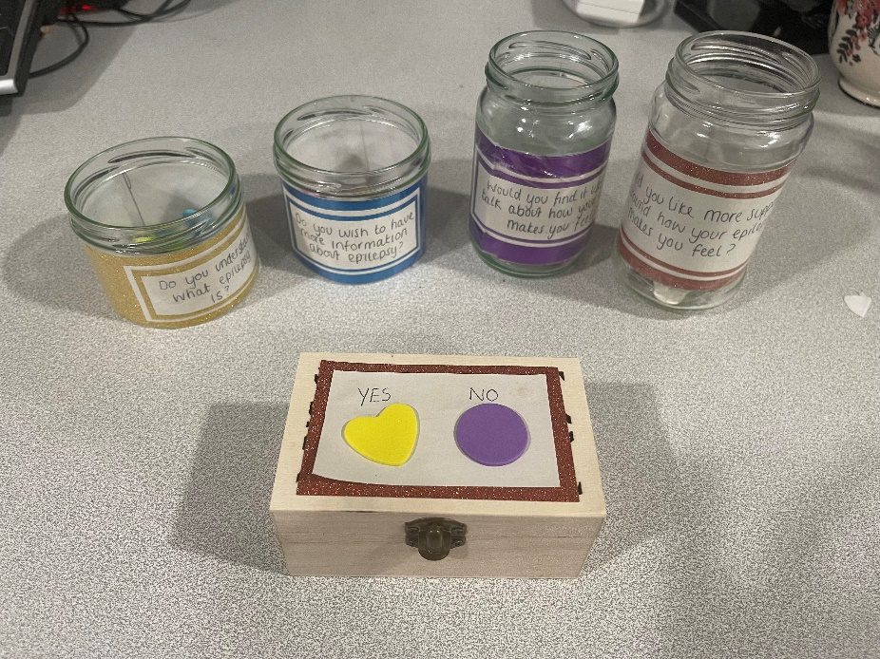
Mental health support pathways – Great Western Hospital NHS Foundation Trust​
Round 1 data/results after change of engagement methods using jars and counters and reducing questions asked
 | Do you understand what epilepsy is? | Do you wish to have more information about epilepsy? | Would you find it useful to talk about how your epilepsy makes you feel? | Would you like more support around how your epilepsy makes you feel?
Yes | 6 (60%) | 7 (70%) | 4 (40%) | 3 (30%)
No | 4 (40%) | 2 (20%) | 5 (50%) | 6 (60%)
Maybe |  | 1 (10%) | 1 (10%) | 1 (10%)

Slide 8
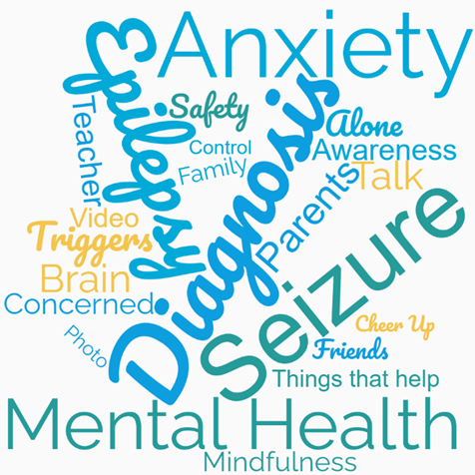
Mental health support pathways – Great Western Hospital NHS Foundation Trust​
Patient engagement results after development of questions to increase engagement methods
Involved patients (11-16 years) who attended outpatient clinics and their parents.
Surprised to learn that the majority of patients weren’t aware of what their epilepsy diagnosis meant.
Stopped assuming things and focused the subsequent cycles on what patients needed.

Slide 9
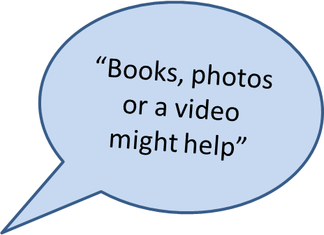
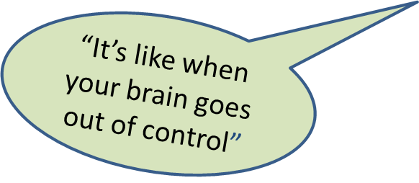
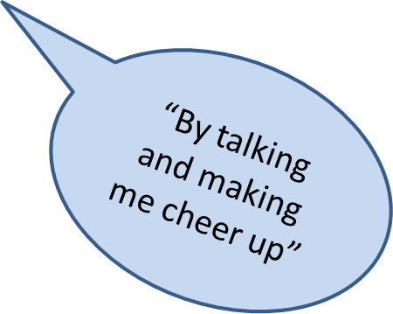
Mental health support pathways – Great Western Hospital NHS Foundation Trust​
Round 2 data/results after development of questions to increase engagement methods

Slide 10
Mental health support pathways – Great Western Hospital NHS Foundation Trust​
Created a booklet on epilepsy with information around mental health support and links to supportive services

Slide 11
Mental health support pathways – Great Western Hospital NHS Foundation Trust​
Challenges
Improving the direct referral pathway to CAMHS was challenging and is ongoing.
Acceptance of a business case for psychology support, which is similar to the support provided for their Trust’s diabetes team.
Initially, using the questionnaire method was difficult for interacting with patients and was as ineffective as expected.
Had initial engagement from Oxford CAMHS, but communication lessened over time. Experienced barriers to changing the pathway for comorbidity patients, as this is primarily managed by mental health service teams.
Having age and diagnosis-appropriate patients in the clinic to be involved in the project depended on follow-up time restrictions and bookings made by the Trust appointments team.
Time!

Slide 12
Mental health support pathways – Great Western Hospital NHS Foundation Trust​
Outcomes
Achieving the project aim is ongoing and the first steps were being able to increase the team’s understanding of their patient needs and address their concerns by ensuring they understood their epilepsy condition, which more than likely had impacted on their mental health.
Increased patient engagement skills, which captured feedback on concerns that the team were able to action and address.
Able to create a booklet on epilepsy with information around mental health and links to supportive services which includes information on epilepsy and mental health support. The team hope to implement this in practice imminently and act as a first line of support for children who present with mental health comorbidities in clinic with links to apps and websites.
Gained an understanding of what adolescents would find useful.
Good integrated working with other epilepsy teams. Good interprofessional working with both CAMHS, TAMHS and School nursing team.
Based on the feedback received, arranged the first parent support group for parents of children with epilepsy to provide peer support and expand this in the future to children with epilepsy.
The parent support group will continue to provide feedback on the booklet which will be actioned to make appropriate improvements when required.
Increased team working together.

Slide 13
Mental health support pathways – Great Western Hospital NHS Foundation Trust​
Lessons learnt
The team learned the difference between a task and a test, for example:
A task is arranging a meeting with CAMHS.
A test is where the meeting led to a change, such as discussions resulting in agreeing on an appropriate referral pathway or discussions leading to a change in process or delivery.
The team was surprised to learn that the majority of their patients were not aware of what their epilepsy diagnosis meant or wanted more information. The team felt that by addressing their concerns, they may also positively impact their mental health.
There is limited to no immediate support for children who present with mental health concerns, unless in crisis. Research suggests that early intervention may prevent crises later on.
The majority of adolescents reported they did not want face-to-face support for their mental health.
The initial round of questions wasn’t necessarily age-appropriate for all the children; therefore, the team defined an age group and created age-appropriate questions.
Don’t assume we know what children and young people want.
Continue to access the EQIP web platform to plan future QI interventions.

Slide 14
https://eqip.rcpch.ac.uk
eqip@rcpch.ac.uk
@RCPCHEQIP

