Slide 1
RCPCH Epilepsy Quality Improvement Programme
October 2022 – May 2023
Develop a first seizure referral pathway
Medway NHS Foundation Trust
RCPCH Epilepsy Quality Improvement Programme project team:
Teresa McIntyre, Paediatric Epilepsy Nurse Specialist
Dr Mercedes Munteanu, Lead Consultant Paediatrician
Dr Faisz Mohamed, Consultant Paediatrician with a special interest in Epilepsy
Epilepsy12 national audit results are not yet included within this case study until the publication of cohort 6 in 2025.

Slide 2
Develop a first seizure referral pathway – Medway NHS Foundation Trust​
Project aim
60% of first seizure referrals are seen within 2 weeks by May 2023.
Background
The newly created paediatric epilepsy service team consists of a consultant paediatrician with a specialist interest in epilepsy and a clinical nurse specialist appointed in April 2022. Many patients are seen via joint care with Evelina, London, and King’s College Hospitals, as well as community input. The estimated number of children that fall under their care is approximately 400–500. Capacity and process issues emerge as services evolve:
No first seizure clinics or slots.
Increasing wait times as caseload grew.
Referring and triaging are too complicated.
There is huge variation in practice for in-hospital referrals.
The current referral pathway is twofold. One pathway uses an electronic format to send through referrals from the Children’s Emergency Department, while the other pathway uses a paper format (with a master copy available on a shared database) for referrals from the Children’s Ward and Children’s Assessment Unit. Change is necessary in order to improve the patient journey and comply with national guidance.
Area of focus
Develop a first seizure referral pathway for children and young people with first seizure presentations and increase patient engagement. The team is currently looking at adopting a pathway that is used by Kings College Hospital and adapting it for their service. The electronic version of the referral will be easier to set up compared to the biggest challenge of managing the referrals received in paper format (e.g., securely handling patient information). As a way forward, the team has set up meetings with the EPR team to present their referral ideas to the consultant group in December and capture their feedback.

Slide 3
Develop a first seizure referral pathway – Medway NHS Foundation Trust​
Driver diagram
Primary Drivers
Secondary Drivers
Change ideas
Simplify referral process
Develop First seizure referral pathway
SOP to clarify process
Create electronic referral form
1.First seizure pathway and SOP with clear instructions on how to refer
2.Easy/quick referring: email EDN, EPR form
3.Visual prompts in clinical areas
1.Reduce time to triage – daily review/ common end-point for All referrals
2.Dedicated Epilepsy Pathway Coordinator
3.One Consultant to action All referrals in 24-48h
1.‘Reserve’ 2 week wait appt., only fill 1-2 weeks before each clinic
2.Weekly reviews of available slots
3.Fill in all cancellations
4.Ad-hoc New two week appt./ move some follow-up patients in PENS led clinics
Patients & Families feedback
Involve Management
Education and training for all staff (ED & Paed teams/ Admin staff)
60% first seizure referrals to be seen within two weeks by
May 2023
Streamline triage
Revise clinic capacity
Re-design triage process
New clinic template
Monitor demand/ capacity
Maximise capacity

Slide 4
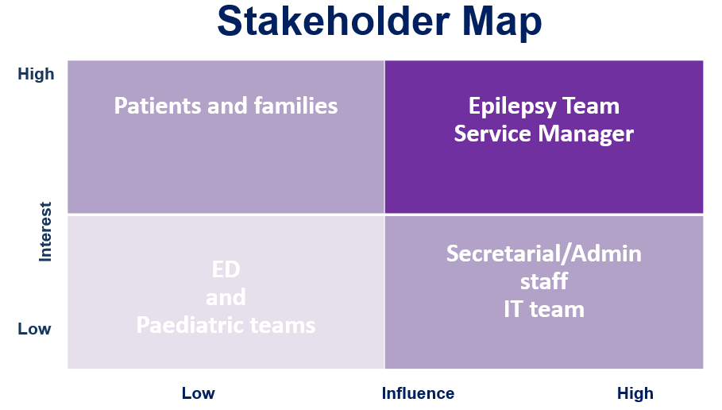
Develop a first seizure referral pathway – Medway NHS Foundation Trust​

Slide 5
Develop a first seizure referral pathway – Medway NHS Foundation Trust​
Changes
GP referrals are received by the secretaries and distributed to all the general paediatricians. This process is also currently inefficient because it often relies on consultants to spot referrals that should be sent to the paediatric epilepsy service team.
The team is working on developing a linkage process where the EPR system generates a generic email when an electronic referral is entered into the system, which is then automatically sent to the team. The team plans to focus on improving the in-house referral pathways first before working on improving GP referrals.
The team plans on auditing their referrals once the system is in place to review the effectiveness of the new pathway and its usefulness. The team is hoping to provide some training to ED staff in relation to the new pathway.
Both the electronic and paper referral versions will be shared with the governance department for review, comments, and questions from team members. The form has been approved, and comments have been submitted by colleagues within the Trust.
The team presented their proposal to the Trust Consultant Body in December and asked for comments and questions for feedback, which would help shape progress moving forward.
The team will explore providing teaching sessions with all staff to go through the referral forms and include the reason why certain criteria are on the form (for example, the rationale to perform an ECG).
There are plans to audit the referrals that are received via the new system and to continually do so in order to see if the form needs to be changed in any way to ensure appropriate referrals are sent to the service.
It was agreed to narrow the scope of the project to developing the electronic version of a referral pathway and the new process for use in hospitals. Initially, the pathway will be used in the Children’s Emergency Department and will then be rolled out to the rest of the paediatric services. The purpose of the pathway is to see all referred children and young people with a first seizure within 2 weeks or close to this time within the paediatric epilepsy service.

Slide 6
Develop a first seizure referral pathway – Medway NHS Foundation Trust​
Process mapping: “Before” referral/triage pathway

Slide 7
Develop a first seizure referral pathway – Medway NHS Foundation Trust​
Changes
Referrals are still being made via different methods (email, verbal) and to different members of the team.
There are two parts to the final aim: one is developing a referral pathway, and the second is achieving 100% of referrals using this pathway.
The team reduced the scope of project aim to developing and implementing an electronic referral pathway for children and young people with a first seizure presentation and ensuring more than 60% of patients are seen in an epilepsy clinical within 2 weeks of referral by May 2023.
The team developed a questionnaire to capture feedback. The idea of the questionnaire was to give a baseline that shows the current average referral timeframe. This will also give the team an indication of the journey through the referral pathway for families, children, and young people.
Key ED staff have been engaged to capture their views on the new referral process, resulting in a positive response. The team has also agreed to begin educating the ED department on the new electronic referral process.
The electronic form itself is straightforward, easy to use, and ensures only completed forms can be submitted to the team on the system. A re-evaluation of the process will take place to identify any changes to be made and ensure the accuracy and appropriateness of the information entered into the system.

Slide 8
Develop a first seizure referral pathway – Medway NHS Foundation Trust​
Results
The team reviewed one month of data from children and young people seen in clinics, and easily identified that the current referral process was inadequate and inconsistent. They did not meet NICE Guidelines (i.e., those presenting with a first seizure should be seen in clinic within a 2 week time frame).
Looking at the numbers, it is unclear whether they will achieve more than 60%, but compared to last year, it is a good step forward because over 50% were waiting months to be seen from referral.
The team have been reviewing patient notes to obtain a rough idea of wait times and discovered they are getting closer to 2 weeks for 60-70% of patients, which makes it easier for the team to sustain the improvement.
Before EQIP, new and follow-up appointments were not split into new patients and routine appointments because they were a new service; therefore, the team worked on developing a new pathway that books patients within the right appointment slots.
Additionally, the team discovered that patients who had multiple presentations with seizures were not seen soon enough and waited weeks or even months for an appointment. To resolve the issue, the team plans to incorporate one emergency slot out of three for each clinic, then later increase it to two emergency slots per clinic.
Referral process tests
First seizure pathway, the EPR referral form, and guidance – all took longer than expected.
Education sessions are time-consuming.
Once up and running, working well!
Visual prompts in clinical areas are helpful.

Slide 9
Develop a first seizure referral pathway – Medway NHS Foundation Trust​
Results
Triaging process tests
Triaging by both epilepsy consultants: variation in practice, duplications.
One secretary to deal with epilepsy referrals: workload too high.
Two secretaries: variation in practice and duplications.
What worked well?
One end point for all referrals and record-keeping (one Epilepsy Pathway Coordinator, one triaging consultant)
24-48 hour review and acting on all referrals.
Clinic tests
Introducing first seizure slots using prior clinic templates only worked when slots were reserved.
A waiting list of all first seizure referrals only works when done by one person.
Match capacity to demand: only worked once per daily review of referrals by Pathway Coordinator and Triage Consultant.
Weekly reviews of available slots helped.
By completing the newly constructed referral pathway, a message will now be generated and sent to the team on the day the referral is made. The newly appointed Pathway Coordinator has been enlisted to book the patient into the first available “first seizure” slot. This initial step is essential as it sets the tone for the rest of the patient journey.

Slide 10
Develop a first seizure referral pathway – Medway NHS Foundation Trust​
Results
The questionnaire method was not meeting the expected outcomes or level of engagement; therefore, the team changed their methods of patient engagement to be more conversational and captured feedback by making notes afterwards. Learning from the process highlighted that some families were short on time; therefore, it was decided to reduce the seven questions to three. The three questions were:
  How have you been referred?
  When were you referred?
  How long was the wait time as well?
Having spoken to families now under their care, the team recognised the need to streamline the referral process to improve the patient journey and meet national guidelines.
Auditing family responses regarding appointment wait times and looking at the sources of referrals in conjunction with this has again highlighted the need for a standardised referral pathway that can be used by all healthcare professionals wishing to refer to their service in the future.

Slide 11
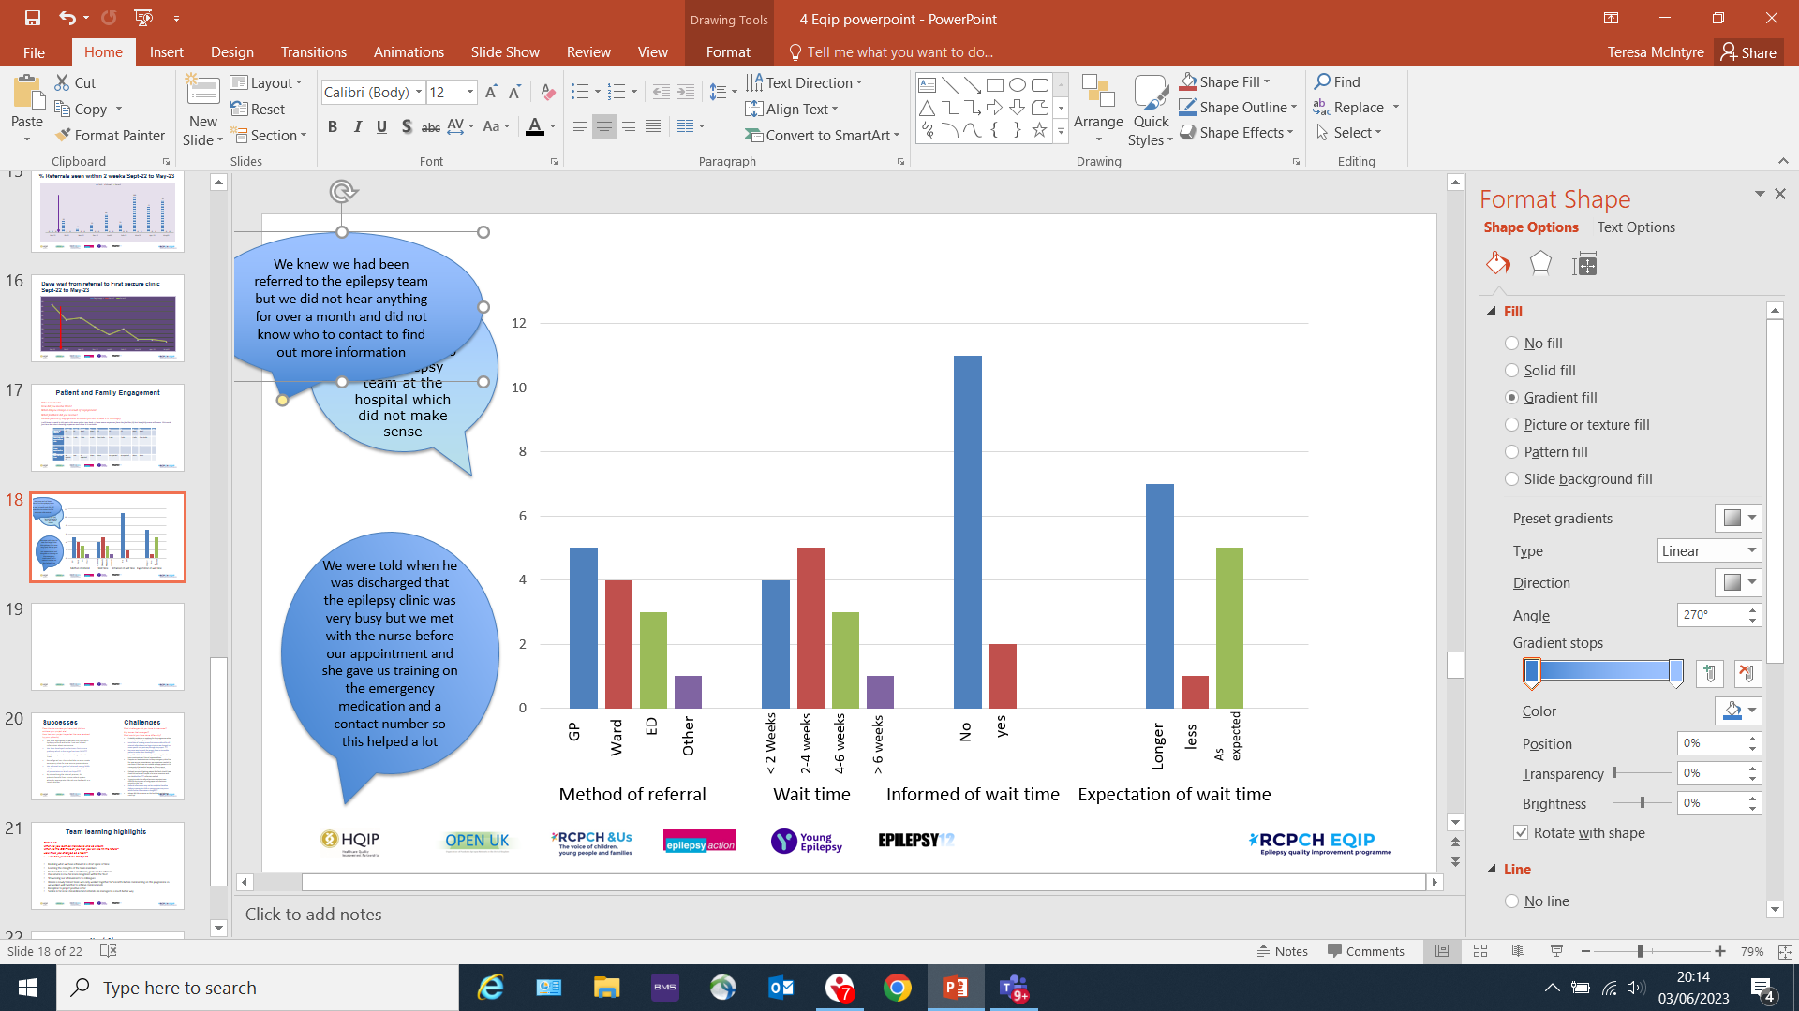
Develop a first seizure referral pathway – Medway NHS Foundation Trust​
Patient and family engagement methods used to capture feedback on their experience
Total number of patient and family responses
Two methods used:
Questionnaires for patients and families (wait time, who referred)
Patients and families asked about their experience of waiting to be seen by the epilepsy team

Slide 12
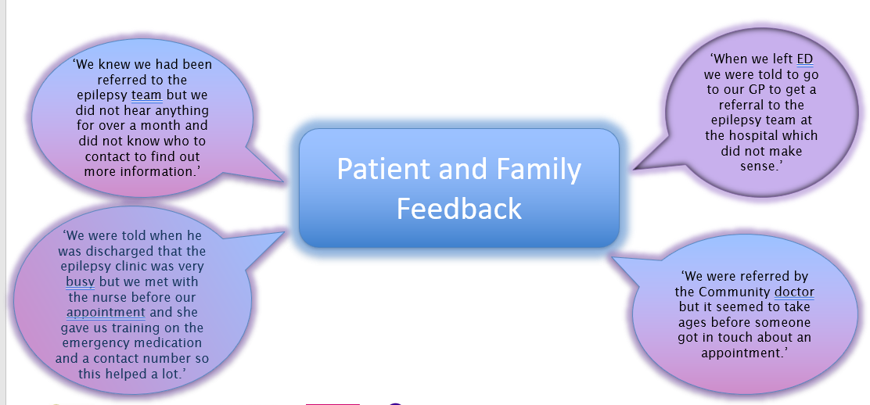
Develop a first seizure referral pathway – Medway NHS Foundation Trust​
Patient and family engagement methods used to capture feedback on their experience

Slide 13
Develop a first seizure referral pathway – Medway NHS Foundation Trust​
Process mapping: “After” referring/triage pathway
1
All referrals
2
3
First seizure clinic
One entry point

Slide 14
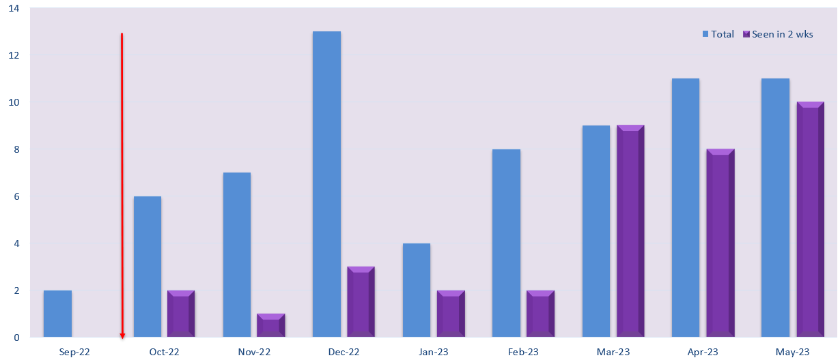
Develop a first seizure referral pathway – Medway NHS Foundation Trust​
Number of first seizure referrals seen in 2 weeks, Sep-22 to May-23

Slide 15
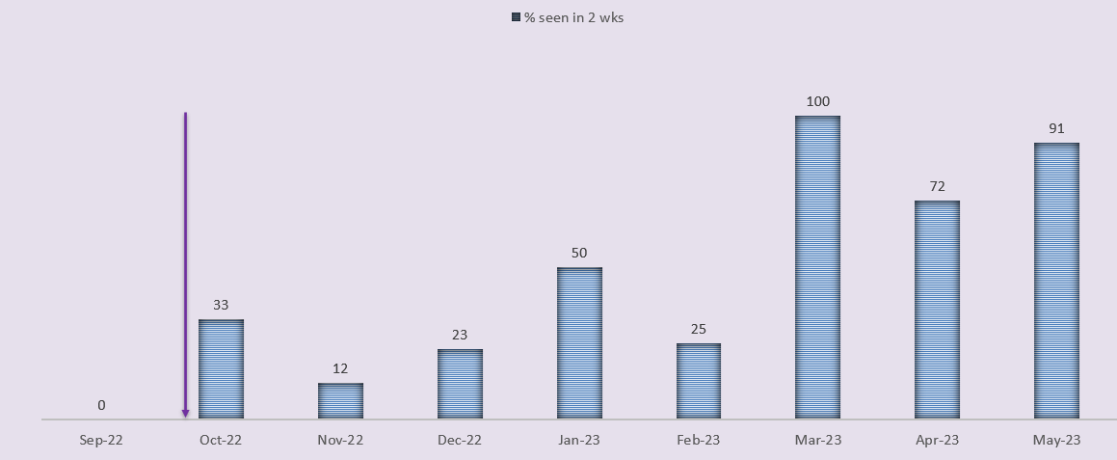
Develop a first seizure referral pathway – Medway NHS Foundation Trust​
% referrals seen in 2 weeks, Sept-22 to May-23

Slide 16
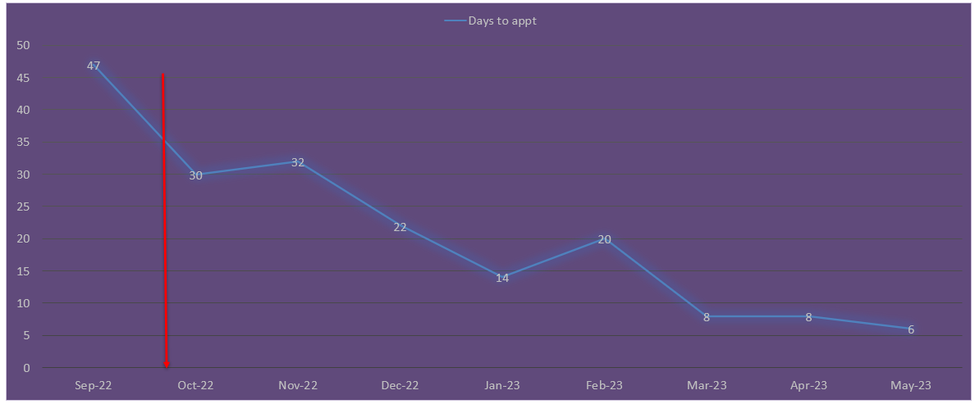
Develop a first seizure referral pathway – Medway NHS Foundation Trust​
Days wait from referral to first seizure clinic, Sept-22 to May-23

Slide 17
Develop a first seizure referral pathway – Medway NHS Foundation Trust​
Challenges
Process mapping of the referral and triage systems showed they were ineffective where the team received inappropriate or incomplete referrals from members of the hospital team, which either did not provide sufficient patient information on the referral or referred patients who were not suitable to be seen in the first seizure clinic (for example, typical febrile seizures).
  The team is unaware of actual caseload numbers due to systems that are incompatible with each other across sites.
  Receiving random emails via the emergency department to see patients without following any clear referral processes and providing inaccurate or missing information.
  Half of the hospital's children’s ED uses electronic records, which are recorded on the Trust EPR records; however, inpatient wards and assessment units use paper referrals.
  The team receives referrals from three separate departments within the Trust, but it is difficult to keep track of the referrals received by their service.
At times, it was challenging to meet as a full team due to annual leave and sickness.
The team found it challenging to define their project's aim due to the volume of issues uncovered and the multiple methods of referrals received.
Clinic data shows an increase in waiting times and patient and family feedback on the difficulties of being seen. There was no baseline data initially available to capture the number of GP or internal ward referrals received by the service.
The team was initially unsure which pathway to focus on due to the low number of referrals received from the ED.
Once the new pathway is in place, the team anticipates that appointment slots may not meet demand.

Slide 18
Develop a first seizure referral pathway – Medway NHS Foundation Trust​
Challenges
Their project aim had changed slightly from the beginning of the programme, where they hoped to develop a paper version of the electronic referral form. Although this is something they still aim to do, they decided to concentrate on one aim that is more achievable and will be transferable when the Trust moves solely to electronic record-keeping.
The lack of clinic slots available makes it difficult to meet the 2 week wait target all the time.
It had been a time-consuming process to review all referrals individually. The amount of information given can vary hugely between one referrer and the next; therefore, time was often spent going through clinical records to get more information about the child or young person being referred.
Annual leave and covering during industrial action led to the cancellation of some clinics.
It was an ambitious undertaking to implement project interventions while setting up a new service.

Slide 19
Develop a first seizure referral pathway – Medway NHS Foundation Trust​
Outcomes
The team achieved their goal by implementing a robust referral pathway to ensure all children and young people experiencing a first seizure are seen in a timely and appropriate manner.
Referral pathways have been written and are ready for implementation. Other members of the paediatric team are now aware of the plan with regards to new referrals and are therefore adopting more uniform approaches in referring to their team.
Improved safety measures at discharge.
Listened to and addressed patients and their families concerns through increased engagement.
Enlisted Service Manager’s support early on within the project.
Consulted and collaborated well with other teams and kept everybody updated and informed.
Consolidated service processes and showcased success within the Trust.
Continue to see the benefit from a bespoke first seizure referral pathway to benefit all those with a first seizure presentation.
Gained ongoing feedback from those using the referral form to ensure it meets all expectations.
Ensured that patient lists are an easy-to-use system for monitoring the number of referrals to our service and capture all relevant data.
Plans to continue to audit the referrals that are received via the new system and make any changes necessary to ensure it is fit for purpose.
A pathway coordinator has been recruited and will be dedicated to the epilepsy service to provide significant help and consistency with appointment booking processes. Additionally, they will keep contemporaneous referral information and update internal databases to ensure all patients referred to the service are monitored and not lost to follow-up.
Contacted the Epilepsy12 audit team to be considered for participation moving forward.

Slide 20
Develop a first seizure referral pathway – Medway NHS Foundation Trust​
Lessons learnt
One of the best ways to capture the length of referral time is to ask the patient and their family.
A newly formed team, the EQIP project brought the team together quicker and gained insight into the team's strengths, which helped with teamwork to complete the project.
Wide consultation at the beginning and close collaboration with all the interested parties throughout the project were key.
Breaking down tasks into manageable pieces using a structured framework, setting specific timelines to review changes, and being disciplined helped the team achieve their goal.
Invaluable feedback from patients and their families and witnessing the changes making a difference helped to motivate the team and keep them going.

Slide 21


https://eqip.rcpch.ac.uk
eqip@rcpch.ac.uk
@RCPCHEQIP

