Slide 1
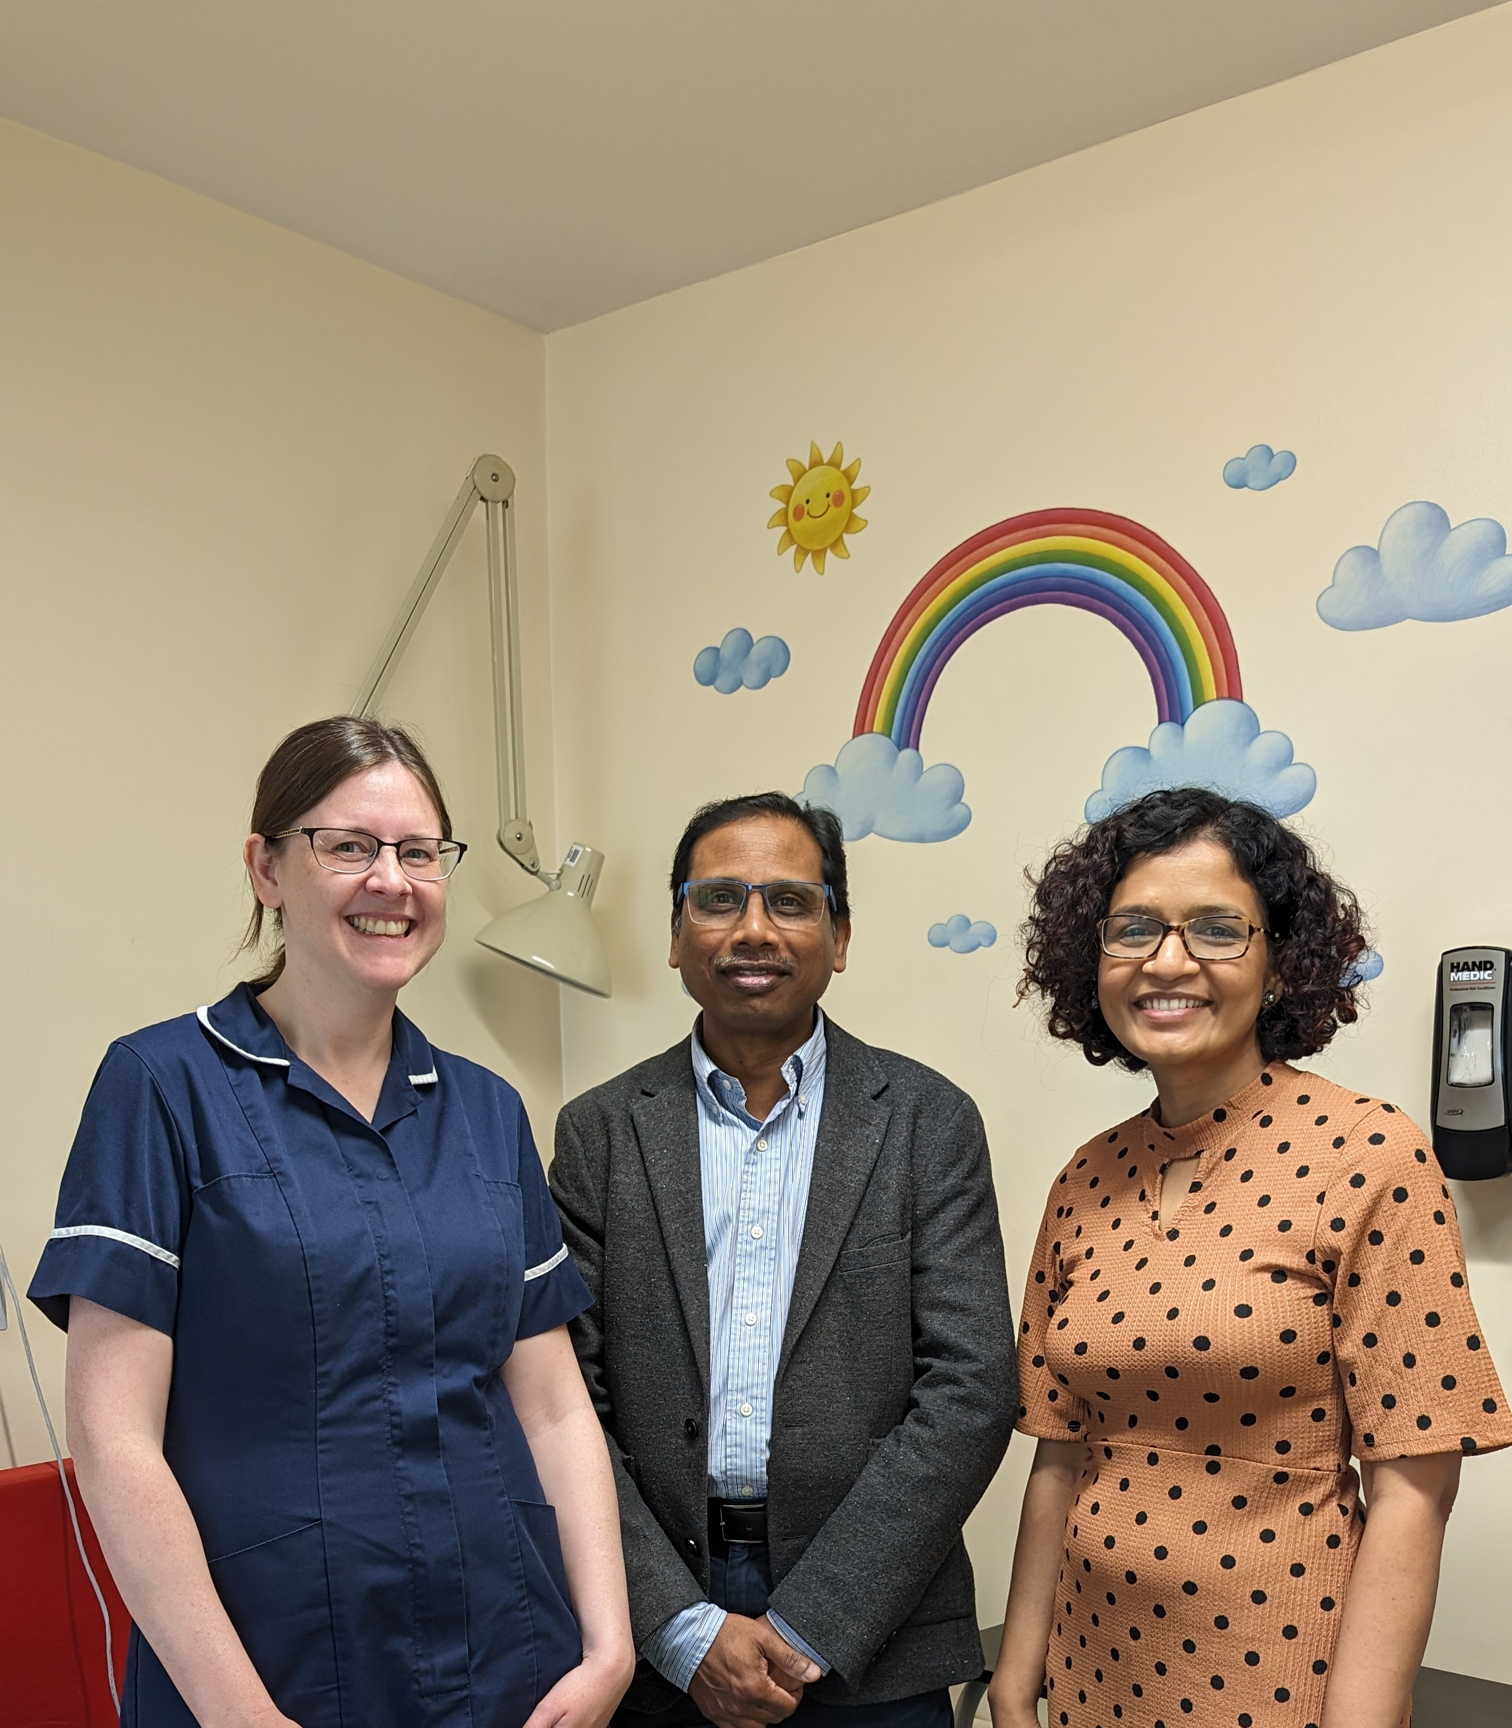
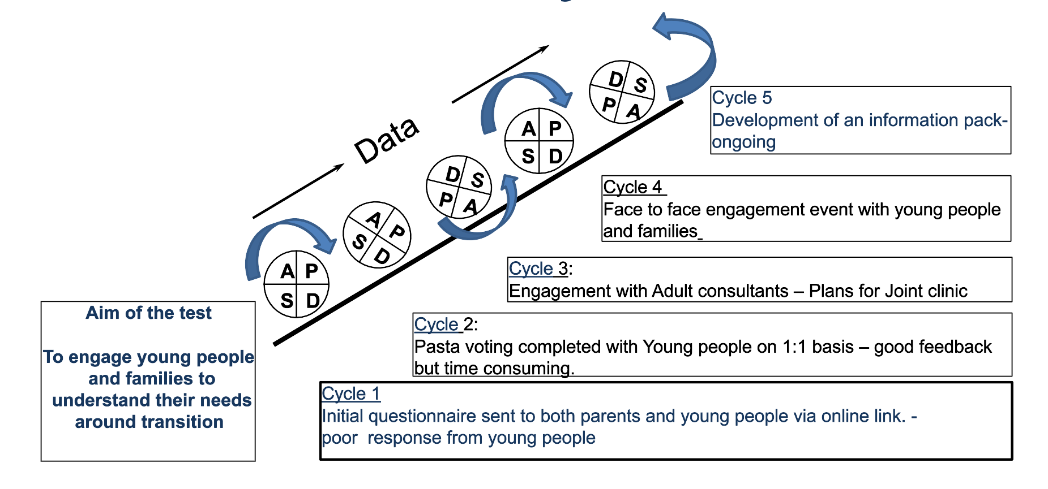
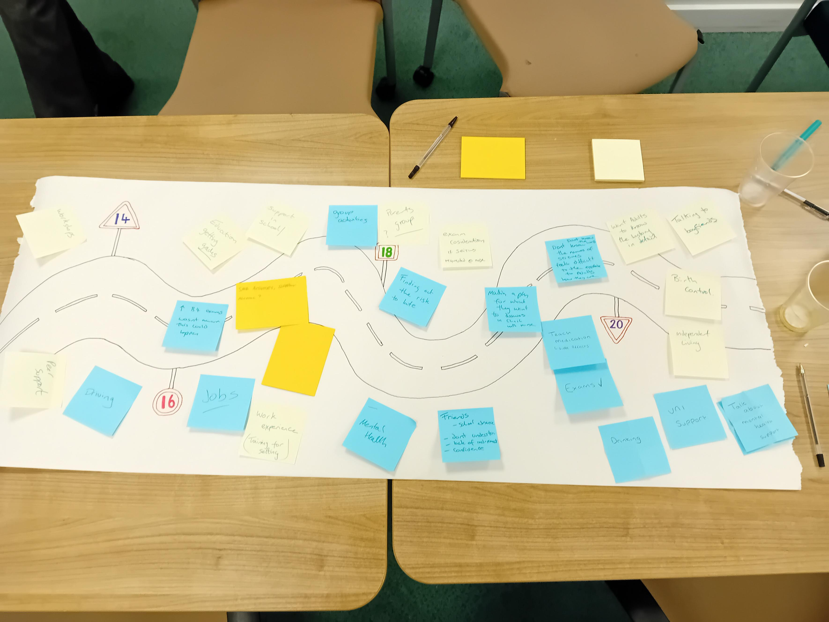
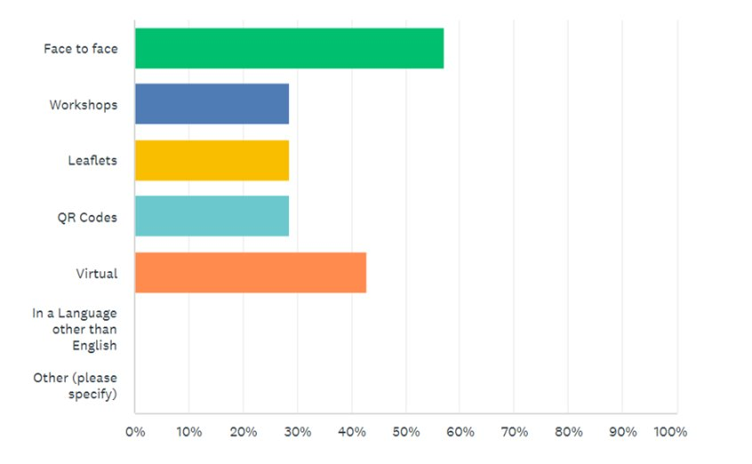
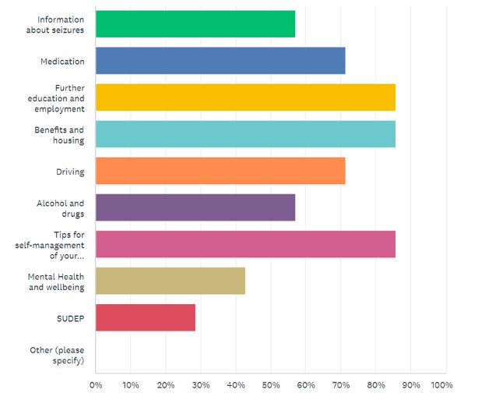
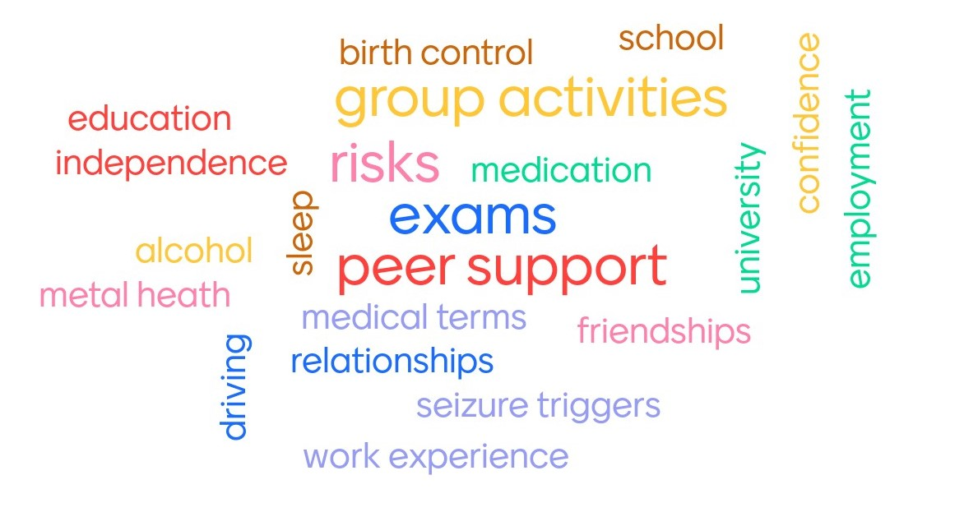
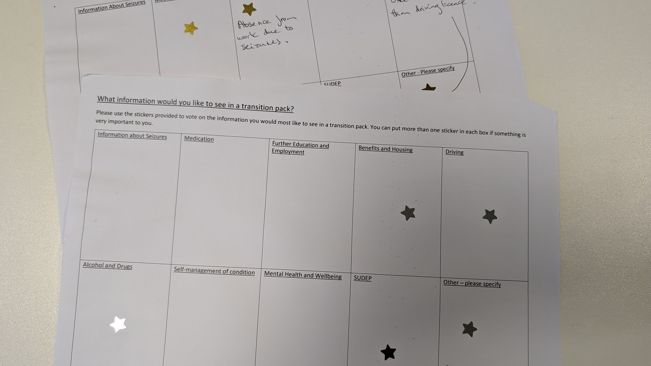
Improving the transition processes for children and young people with epilepsy in Oldham. Dr Sri Nagesh Panasa & Dr Vandana Prasad
Joanne Holdaway (ESN), Lisa Fern (service lead) , Lucy Lees (ADNS) and Evelyn Wild (Assistant Directorate Manger Pediatrics)
Aim/purpose:
Design and implement a Transition Package for Children and Young People from 16 years that enables them to understand and manage their epilepsy by May 2024
What is the problem:
We know that transition is a national priority for all children with long term conditions
There was a lot of variation across the service in relation to the transition process and the timing of transition and little communication between the pediatric and adult services.
Most importantly Patients and family often express worry about the transition process.
Driver Diagram
Primary Drivers
Secondary Drivers
Change ideas
Collaborate approach between Children’s Epilepsy service (acute & community)
*Implementation of a Task and finish group
*Identify patients for participation
*Staff knowledge and understanding of transition issues for young people
*Senior management support
What information is already available? (young epilepsy/epilepsy action)
Review local/regional packages of support
Obtain age group data
Draft basic transition pack
Questionnaires pre/post implementation
Focus group with CYP, Parent, Adult services.
Youth Worker- implement workshops, training, marketplace.
Stepwise/structured approach to development of the support pack
Design and Implement a Transition Package for Children and Young People from 16 that enables them to understand and manage their epilepsy by May 2024
Patient engagement (CYP and family) is demonstrable across the project
*Focus groups for CYP
*Co-Production/youth informed with CYP
*Patient engagement tools are used for feedback and informing next steps/stages
New Children’s Epilepsy Youth Worker
*Focus group
*identification of key Contacts in Adult Service
*Understanding of services and opportunities available for young people in local area
Engagement with adult health and care/education services
PDSA cycles
What our tests revealed
Young people did not engage well with questionnaires. ​
Both parents and young people felt isolated and wanted more peer support from other families. ​
Parents and young people had different concerns. ​
There was a preference for face-to-face appointments and information sharing.
Young People's Concerns ​
​
How to talk to the adult team ​
Not understanding the terminology ​
Friends and relationships ​
Exams ​
Driving ​
Peer support
Parents Concerns ​
​
Adult Neurologists not understanding the history ​
No epilepsy specialist nurses ​
How to support their child in gaining independence
higher education and employment​
SUDEP
Data/Results/Patient engagement feedback
Team personal learning/Team highlights
Changed the way we engage with children and young people.​
Making quality improvement part of our everyday work.​
Start small, one patient.​
Different methods for data collection​
Don’t make assumptions. ​
Lots of feedback to inform our new youth workers role​
We now have a pathway for transition to adult services
Continued improvement of the joint transition clinic through feedback from patients
Development of Nurse Led young person's clinic
Development of the Youth Worker role and peer suport networks
Share learning with local networks and other NCA services
Successes/Challenges
Next steps
Successes
Challenges
Engagement with Families and young people.
Joint transition clinic set up.
Appointment of a youth worker to support young people with epilepsy
Support and training From the EQIP Team.
Complexity of the service.
Team communication was difficult as nurses and consultants are based in separate sites
Timing of the first joint clinic due to GCSE and A Leval exams

