Slide 1
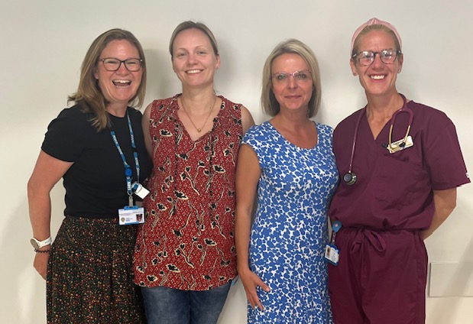
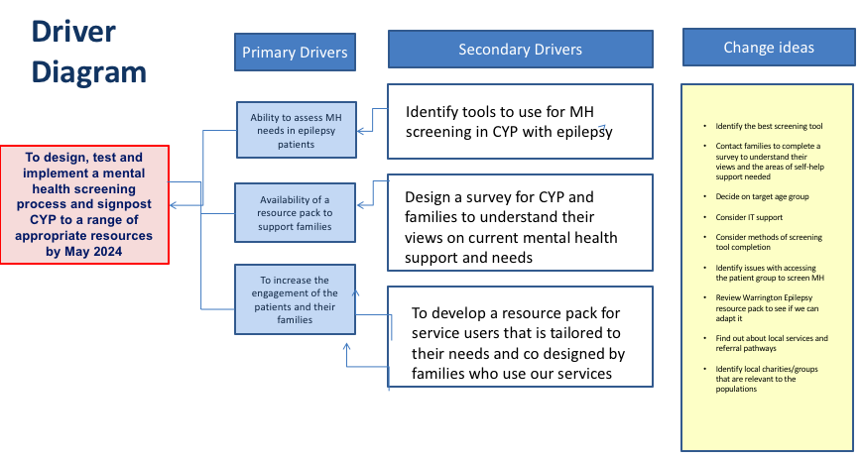
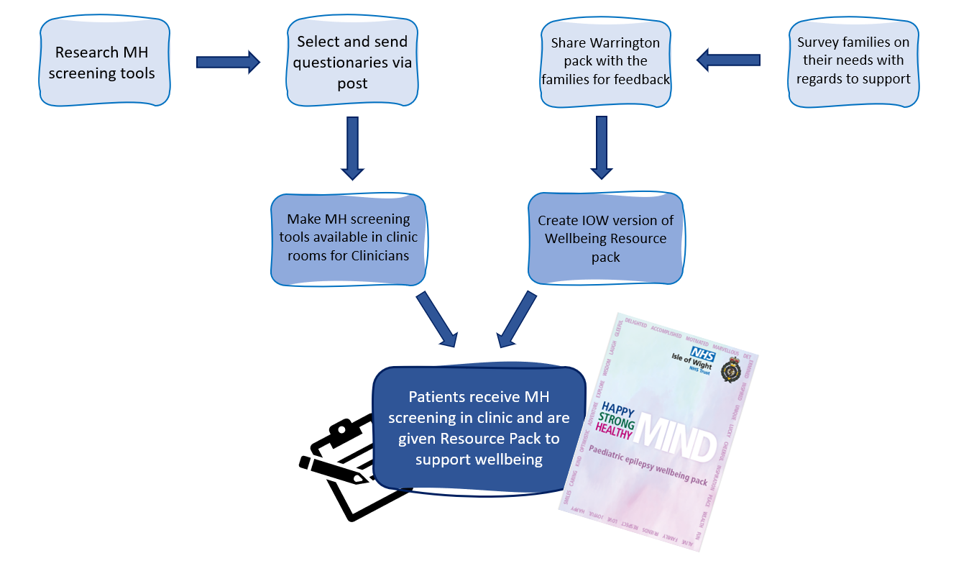
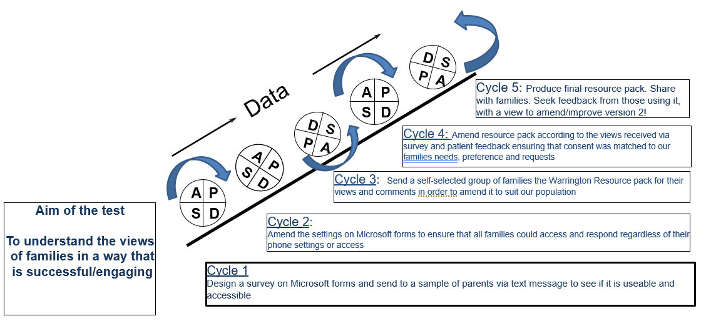
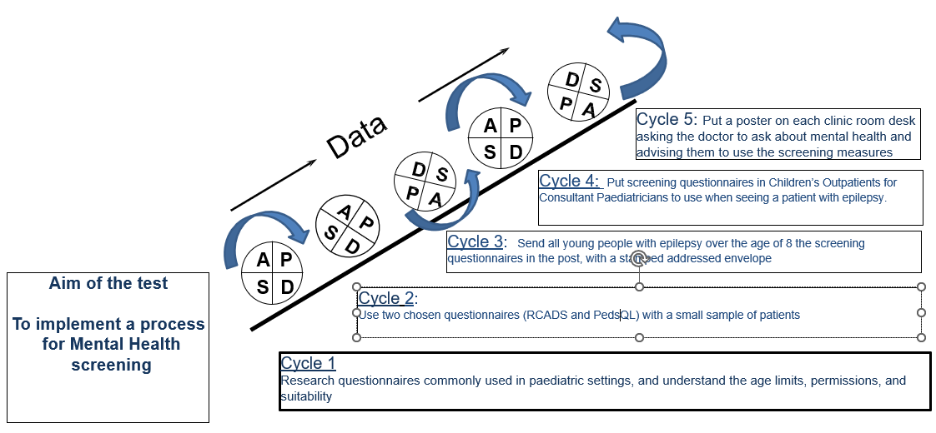
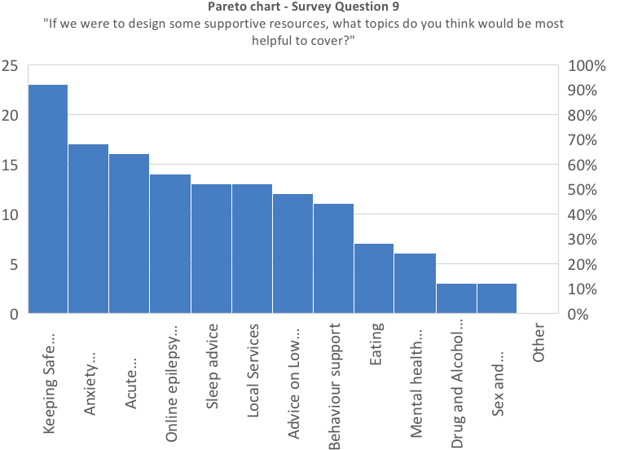
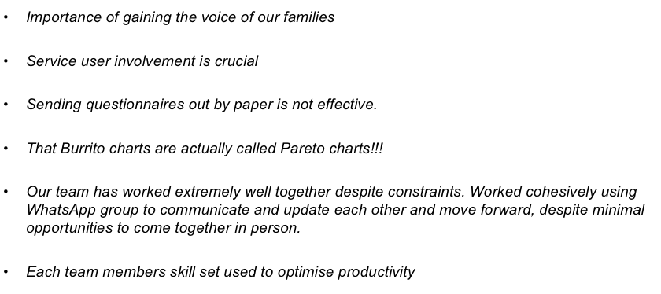
Mental Health in Paediatric Epilepsy: Prioritising the needs of the Children and Young People Isle of Wight NHS Trust “Epilepsy Fighters” Dr. Ewa Szynaka, Ruth Dubyk, Dr., Martyna Enser, Dr. Laura Bohane
Aim/purpose: To design, test and implement a mental health screening process and signpost CYP to a range of appropriate resources by May 2024.
What is the problem: A number of gaps exist in the current IOW service. There is no dedicated epilepsy clinic and no Epilepsy Nurse Specialist, which causes a number of challenges. Our Epilepsy 12 audit highlighted that there was no Mental health screening process in place, and there was no access to tailored emotional well-being support or resources for our families.
Driver Diagram
Process map
PDSA cycles
What our tests revealed
Families reported that their CYP’s MH was not routinely asked about. Families told us that they did not reliably know where to access resources to support their knowledge and understanding about epilepsy and mental health. Of the families that did respond a number told us that their CYP needed more MH support but that they struggled to access this.
Families responded well to a brief survey sent via text/QR code, however the return rate for paper questionnaires in the post was very poor.
From the screening questionnaires returned, we found poor mental health amongst some, and variable levels of Quality of Life, requiring support and input.
A very high number of respondents highlighted the lack of Epilepsy Specialist Nurse and challenges related to this, for example when seeking further advice or having urgent questions requiring a timely response.
Data/Results/Patient engagement feedback
Team personal learning/Team highlights
Successes/Challenges
Next steps
Dedicated team brought together with a shared goal
All CYP have access to good quality resources reviewed by professionals
Better understanding of the MH needs of our patients
We have been able to capture the parents and young people's voices to help push our other agendas and ongoing service developments
Continuity and uniformity in patient experience and equity of care
No dedicated epilepsy clinic presented challenges in accessing patients
No epilepsy service which meant that identifying patients had to be done by coding
This in itself identified the need for a service revision
Poor return rate of screening tools which may have been improved if we were able to approach families as part of a dedicated clinic
Our agenda has always been and continues to be the development of a robust epilepsy service for children and young people on the Isle of Wight. There needs to be continuity in service provision and the information provided to families at diagnosis and for on-going access to experienced professionals.
The information collected as part of this project will be used to continue to push that agenda while also continually improving the resource pack developed. This will improve the experiences for patients and families while ensuring our trust is compliant with national recommendations.
We know that the Island has a high volume of young people with reported neurodiversity and that also applies to the epilepsy population and that these cohorts are at increased risk to suffer from poor mental health which further increased our drive to provide families with some resource that can support them and signpost them to services.

