Slide 1
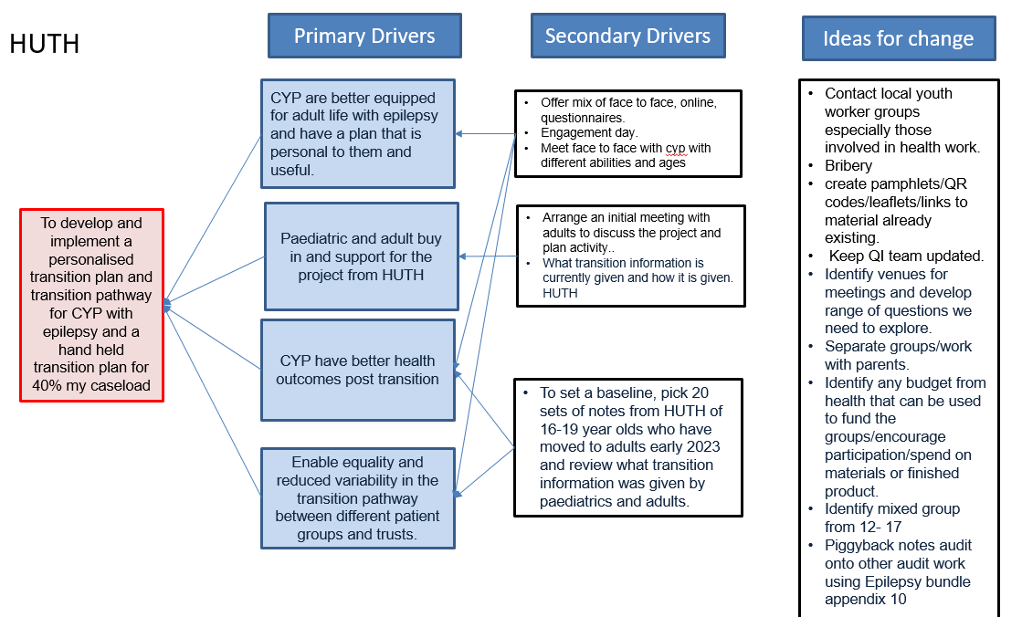
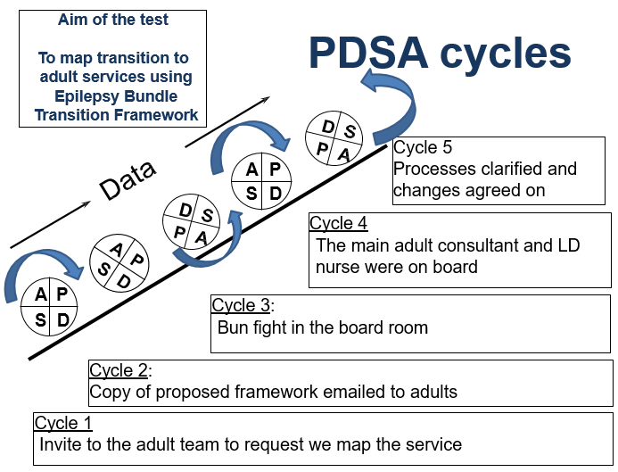
Handheld Transition Notes and Mapping Transition Fiona Lead, Sandhya Jose, Emma Smith (Chris Bennett)
Aim/purpose: To develop and implement a personalised transition plan for CYP with epilepsy for 40% of my caseload and map pathway in line with the Epilepsy Bundle
What is the problem: Aware information was not always developmentally appropriate.
The transition pathway to adults needed updating and formalizing as we were aware of gaps in holistic service.
Driver Diagram
Process map
NCEPOD recommendation
Questionnaires
Focus group
Bundle framework shared with adults
Meeting date agreed
Meeting
Feedback to focus group
Draft pathway
Hand held plan developed
Pathways complete
PDSA cycles
What our tests revealed
WHAT WAS LEARNT:
65% had a hand held transition plan in the form of a GP letter, but plans were not SMART
25% had not made a first appointment with adult neurology and had no FU
0% had consent documented for sharing information
0% CYP with LD/ASD had hospital passport completed
17% of those in the questionnaire round wanted a transition plan written to the YP
100% of those in the focus group wanted a CYP specific written transition plan.
WHAT DIDN’T WORK:
Trying to organise a half day meeting with adults and families/YP
WHAT WAS ABANDONED:
Working with another trust did not work
Be prepared that the best plans (adult meeting) may need adapting to keep the momentum going
Data/Results/Patient engagement feedback
Team personal learning/Team highlights
Developing newsletter to feedback and give updates
Reaching out to other people and discussing transition made us much more aware of wider support network.
Collation of resources for signposting for CYP with diverse needs( heath, lifestyle, education, employment, community inclusion)
Better understanding adult service delivery
Mapped special arrangements for CYP with SEND
Transition letters to be addressed to CYP and include domains in the National Epilepsy Care Bundle
Amend letter templates to make it user and CYP friendly
Booking rules in adult services and adult clinic letter templates
Widen focus of adult LD and Epilepsy service
What did you learn as individuals/ team
Transition is much bigger and complex than we had originally anticipated
We though we were doing better than we were
There is a lot of community resources that were underutilised
Herding sheep is a tough job
What were the lessons learnt about your project?
We need a structured approach
Any improvement needs to leave an audit trail so it can be captured
We have to personalise care to CYP be mindful of their aspirations
What did the EQIP teach you that you will use in the future?
Working more closely with young people
How have you changed as a team?
We are engaging more with the wider network
We have also increased focus on to transition within the organisation
Share learning within ICB and YPEN
Prepare CYP and families for adult services better
Engaging people with different skillset in QIP
Successes/Challenges
Next steps
SUCCESSES
Networking – Joint working with QI, youth workers, utilising community resources
Joint working with a different colleague on the YP focus group
YP focus group – got more answers and ideas that we were asking.
Adults Time out mapping session
CHALLENGES
Adults time out day – went from half a day with their senior management and parents to 1.5 hours with everyone talking at once.
Working with a separate authority – no buy in
Driver diagram – struggled to make it fit my working style
Timing of invites to 1st F2F session badly timed and follow up session abandoned
Doing the YP focus group slowed the project down, but was worth the time spent to get involvement and ideas moving forward
SUSTAINABILITY AND NEXT STEPS
Better equipped at developing individual personalised transition plan (develop SMART goals consistently)
Develop transition specific clinics with longer appointments to maintain focus
Re-audit (2024 - 2025)
Continue with youth engagement
News letter with feedback loop

