Slide 1
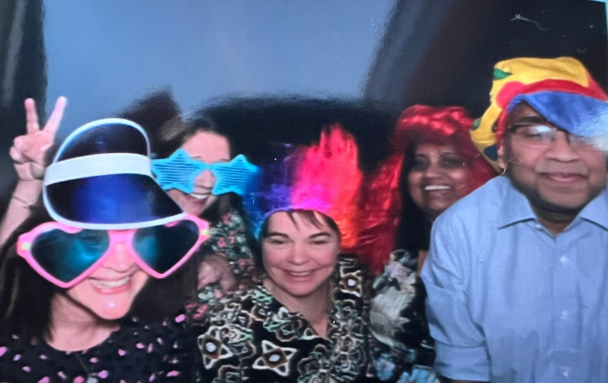
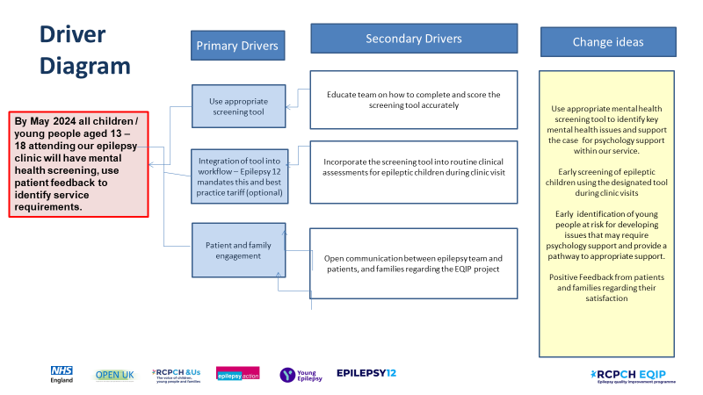
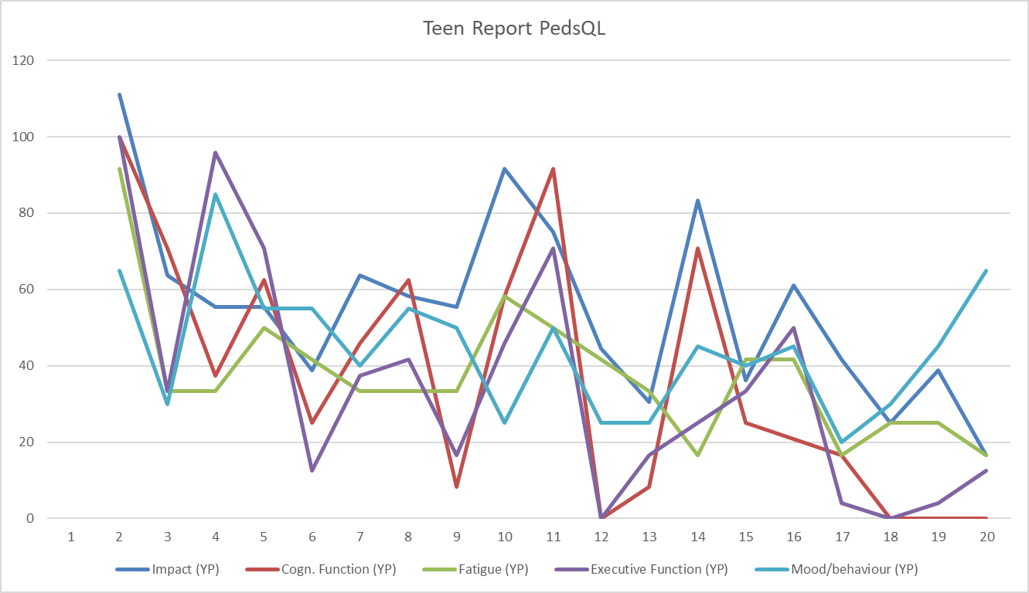
Mental Health Screening [Dr Lalani – Consultant Pediatrician with special interest in Epilepsy Dr Kamal – Consultant Paediatrician with special interest in Epilepsy Georgina Ward – Paediatric Epilepsy Specialist Nurse Kari-Ann Croucher – Paediatric Epilepsy Specialist Nurse Kerry Newall – Paediatric Epilepsy Specialist Nurse
[]
Aim/purpose:
By May 2024 all children / young people aged 13 – 18 attending our epilepsy clinic will have mental health screening, use patient feedback to identify service requirements.
What is the problem:
Mental Health / Psychology support is not provided by our service.
Driver Diagram
What did your tests reveal
PDSA cycles
Team highlights
Data/Results/Patient engagement feedback
Successes/Challenges
Next steps

