Slide 1

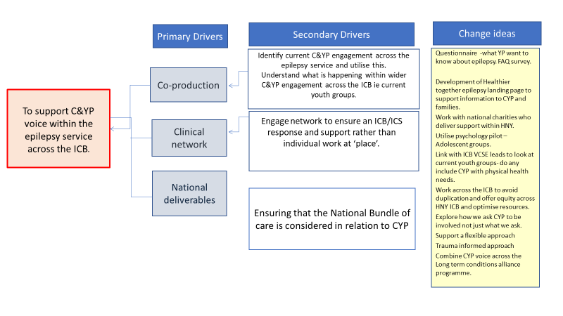
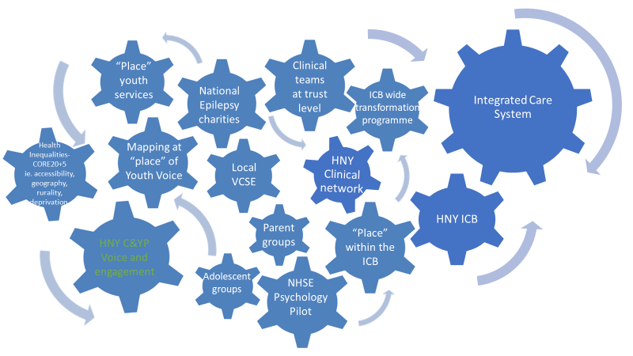
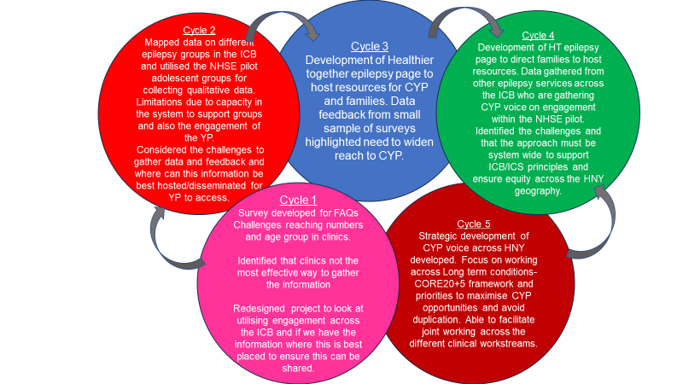
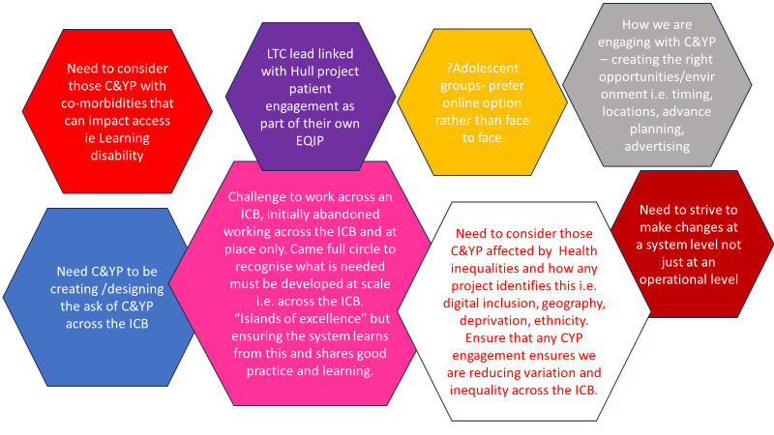
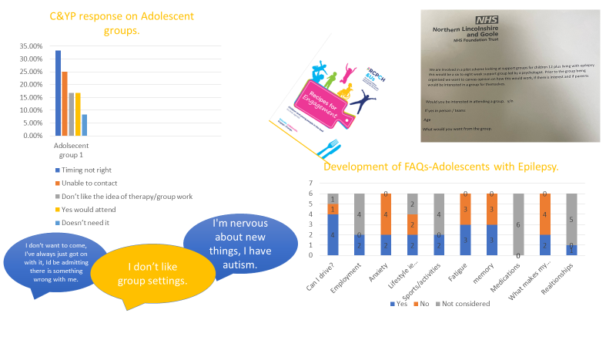
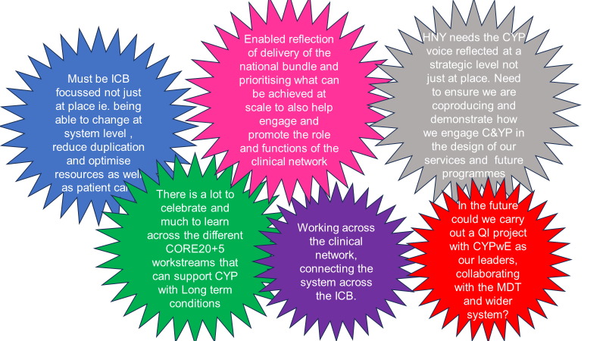
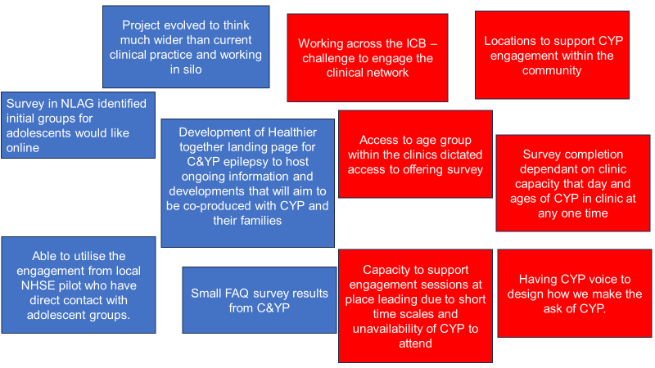
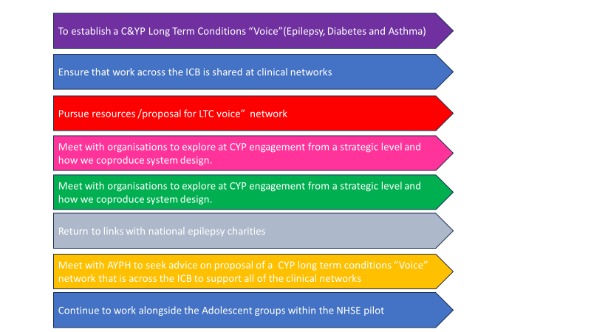
Improving C&YP engagement- An ICB journey of reaching C&YP Voice
York And Scarborough Teaching Hospitals Trust, Ruchi Gulati and Katie Ward
Aim/purpose: To develop a strategic framework for C&YP engagement across the ICB by May 2024
What is the problem:The national bundle of care sets out many standards of care, the golden thread that must run throughout addressing and implementing the standards should be the co-production with C&YP and their families. C&YP voice within local epilepsy services is limited nor has the platform to be recognised and be influential at system levels. We want the voice of C&YP to be able to represent the unique celebrations and challenges of C&YP living within Humber and North Yorkshire
Driver Diagram
Process map
PDSA cycles
What our tests revealed
Data/Results/Patient engagement feedback
Team personal learning/Team highlights
Successes/Challenges
Next steps

