Slide 1
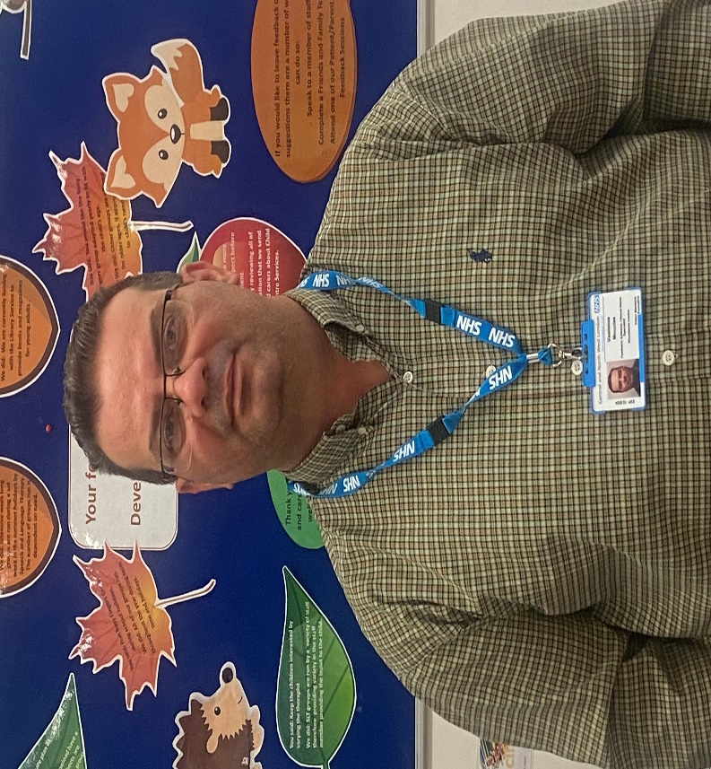
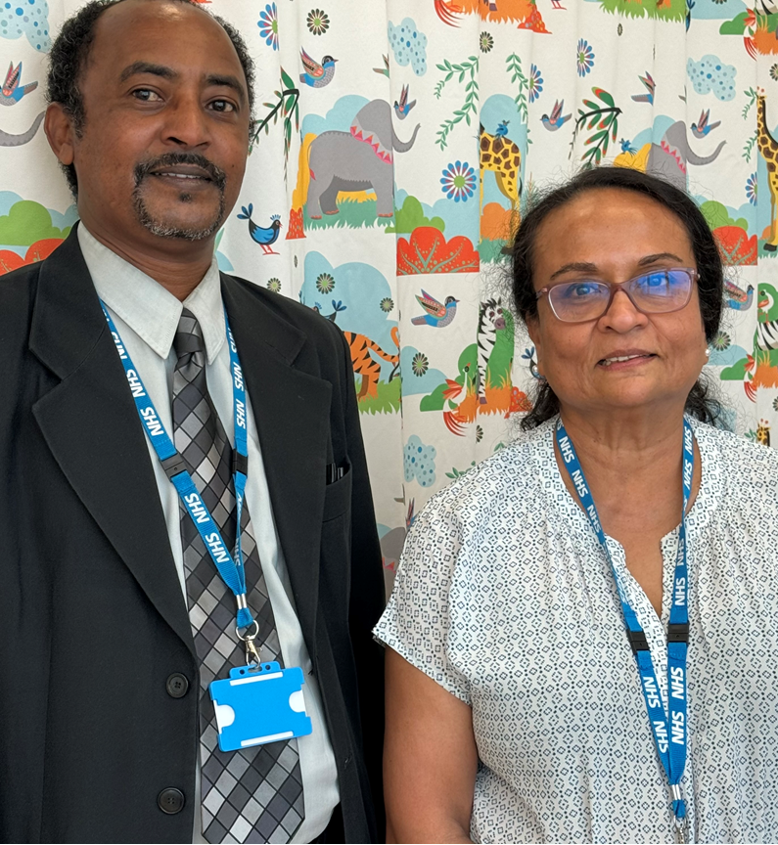
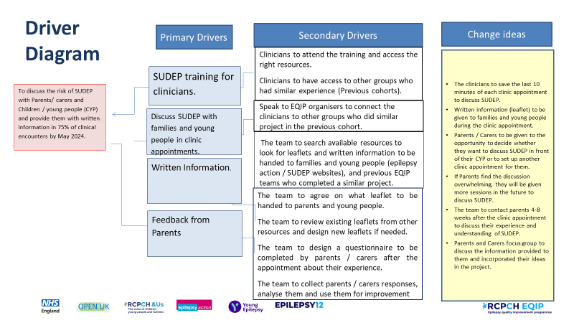
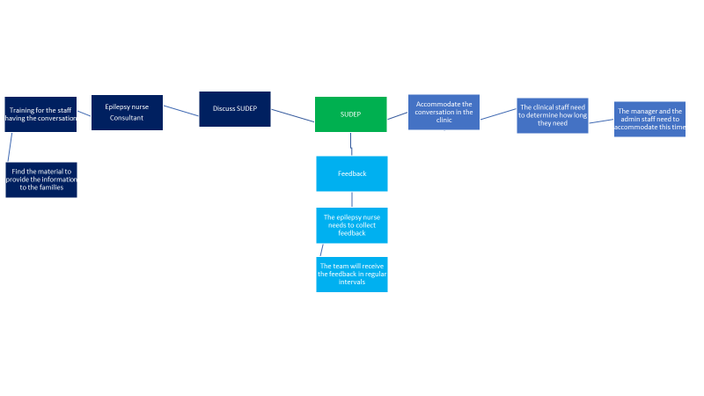
Sudden Unexpected Death in Epilepsy (SUDEP) Discussion with Parents / carers and Children / young people (CYP). A. Ahmed, C. Kukendra, K. Barker, V. Mouzias
Aim/purpose:
To discuss the risk of SUDEP with Parents/ carers and Children / young people (CYP) and provide them with written information in 75% of clinical encounters by May 2024.
What is the problem:
SUDEP is the leading cause of epilepsy related mortality in children and adults living with epilepsy.
The CYPs looked after by the team are those with epilepsy and associated developmental delay / disorder and intellectual disability, which are well known risk factors for SUDEP in children. SUDEP Discussion was inconsistent within the team’s practice.
Driver Diagram
Process map
PDSA cycles
What our tests revealed
Discussion of SUDEP is possible within routine epilepsy clinic.
Although interpreters were provided to the families, they were not able to access the SUDEP action resources, which were mainly available in English.
Further meetings are needed with some parents who wants more information, do not want to discuss SUDEP in front of their children or found the discussion overwhelming.
Families feedback is essential in improving the service.
The whole team became a part of the project (admin staff, doctors, nurse, manager)
Data/Results/Patient engagement feedback
Team personal learning/Team highlights
We have learnt that even small changes take time.
We have gained knowledge of QI principles.
The project will be sustained within the day to day practice.
The project will be extended to include other aspects of epilepsy care.
Successes/Challenges
Next steps
Successes:
The majority of the clinical encounters agreed to discuss the SUDEP at their consultation
The team was able to discuss SUDEP at every consultation, and collect feedback.
There is a significant improvement in discussing SUDEP within the clinical encounters
The majority found that leaflet easy to read and understand
Challenges:
Difficulty in conducting the parents’ focus group.
Language issues due to diverse population.
Most families are not accessing the information (63%).
Families felt uncomfortable discussing SUDEP in front of the children, and they need further follow-up phone consultation by the Epilepsy nurse specialist.
• Present in Governance meetings.
• SUDEP checklist SUDEP action in each consultation.
• Enhance the use of updating clinical encounters via electronic communication.
• Application of this project’s principles to more project addressing various aspects of epilepsy care.
• We are starting to organise social events in order to train the families and give them the chance to provide feedback on our services (First event July 2024)

