Slide 1

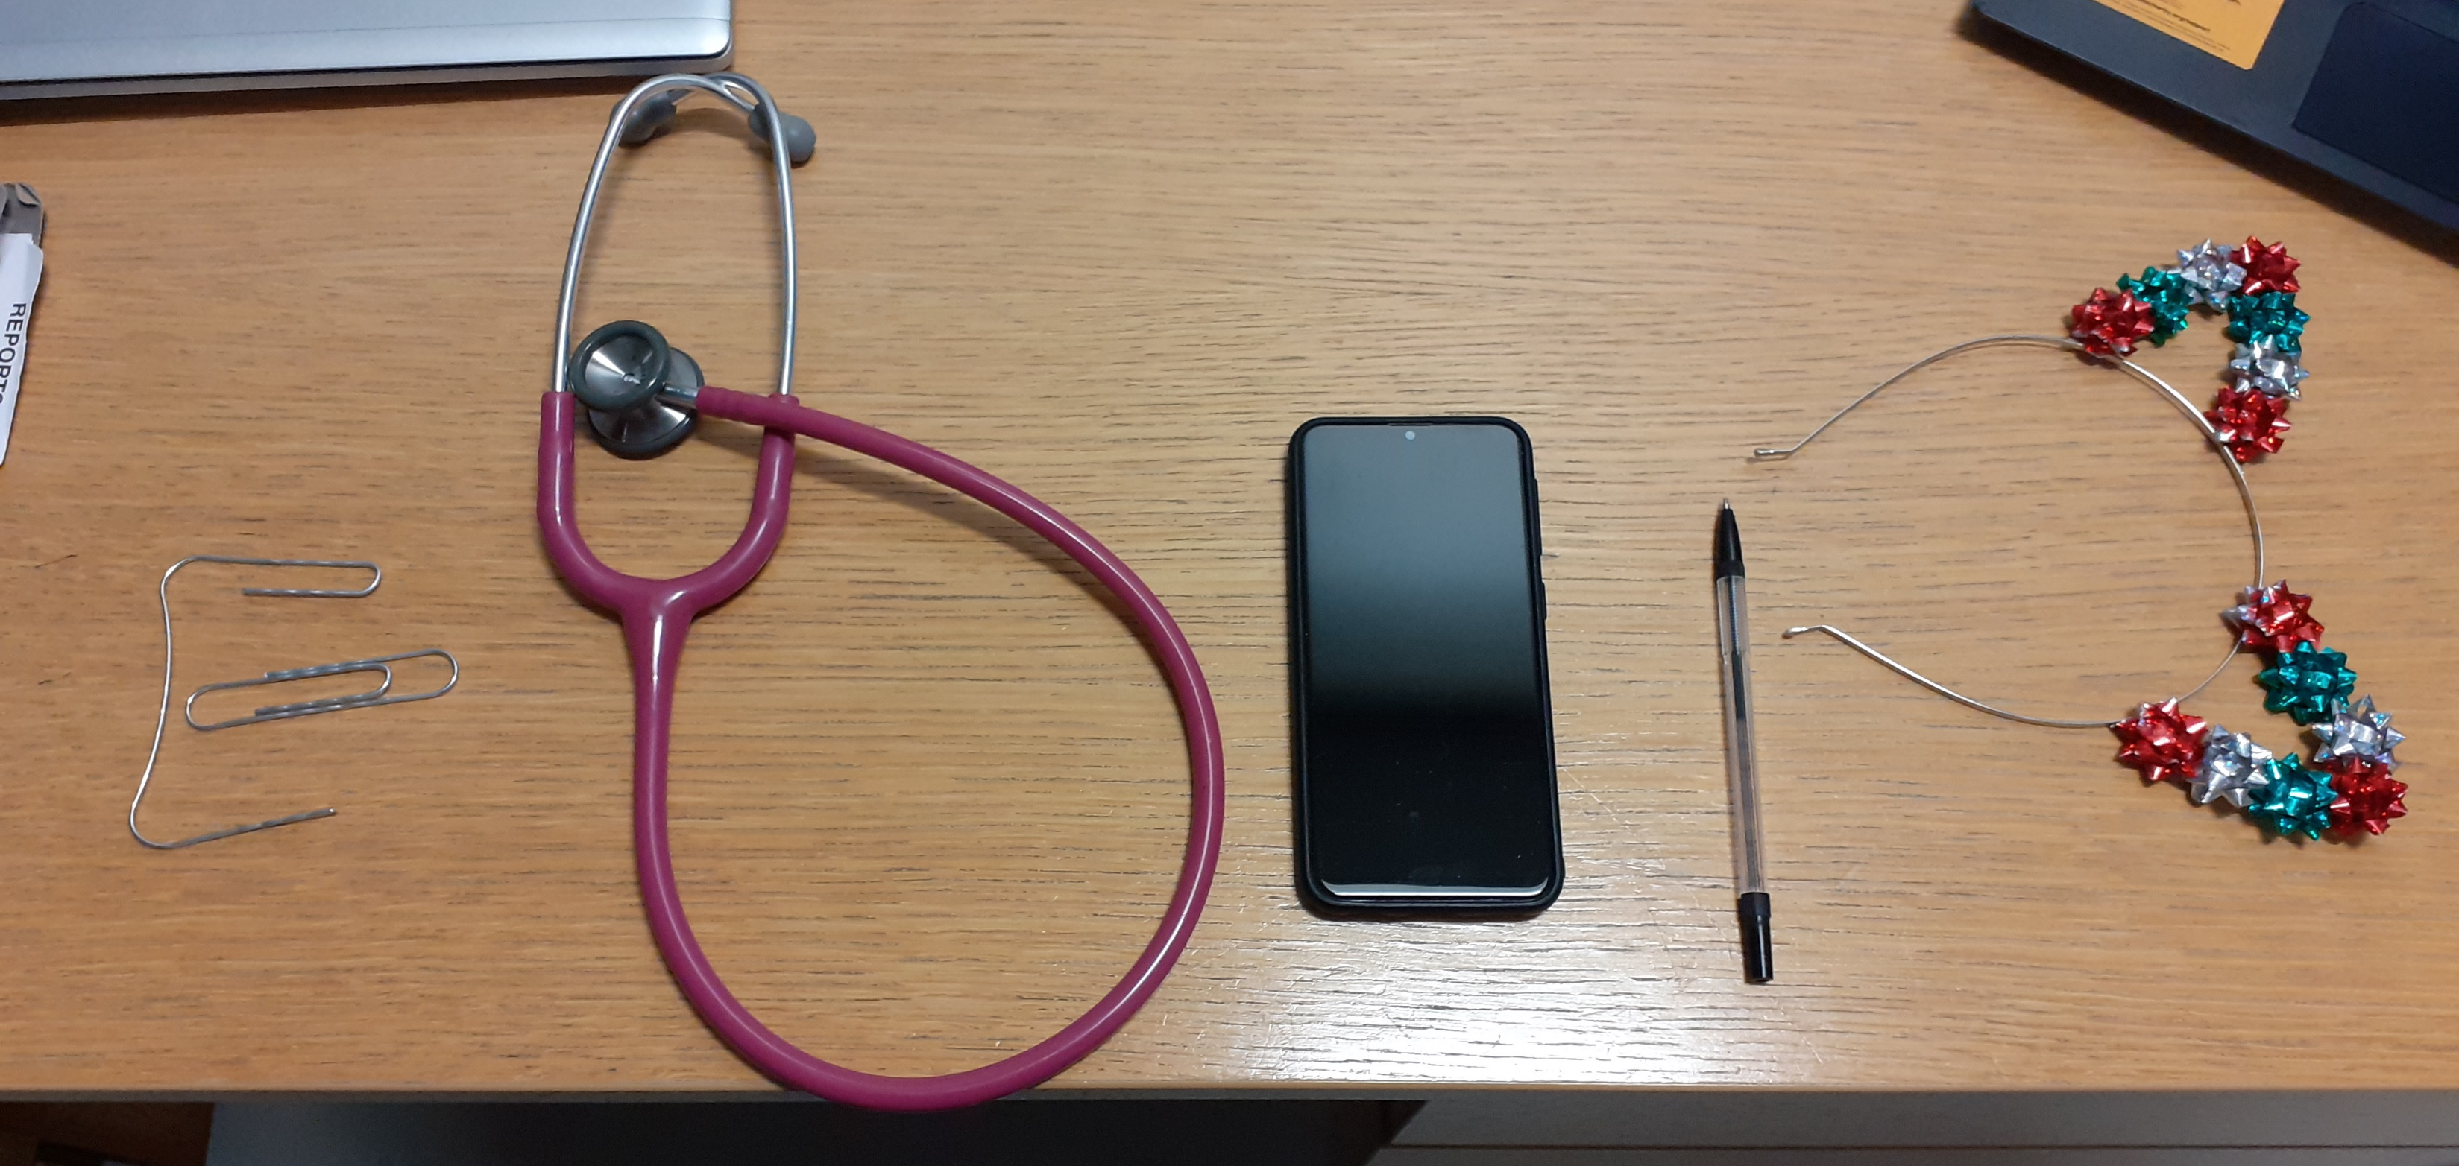
Improving National Outcomes in Paediatric Epilepsy
The Finale

Slide 2
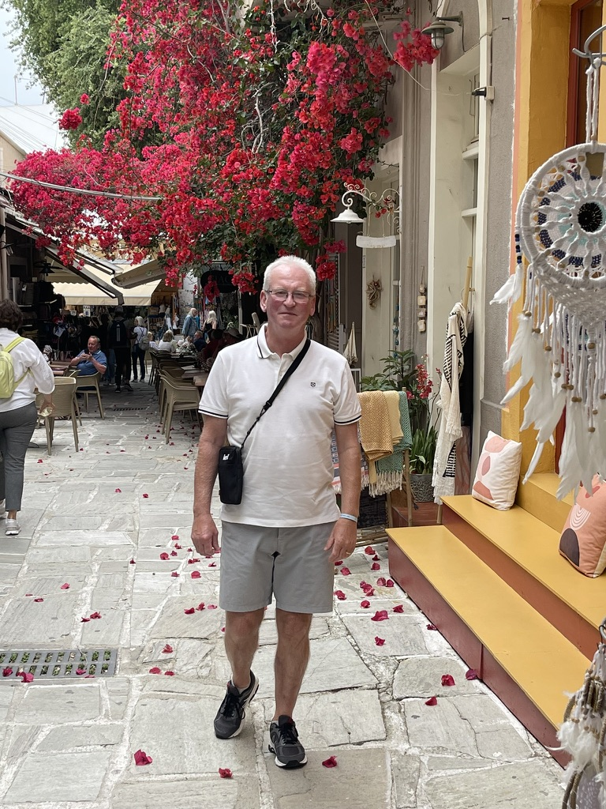


Family centered -My People

Slide 3
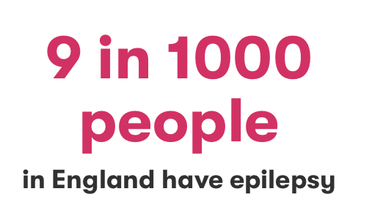
Why did we do this?
Prevalence
1 in every 220 children in the UK will have a diagnosis of epilepsy.
That’s an average of 1 child with epilepsy in every primary school and 5 in every secondary school.
The total number of under 18-year-olds with epilepsy in the UK is around 63,400, according to the Joint Epilepsy Council (JEC).
Epilepsy Action 2020

Slide 4
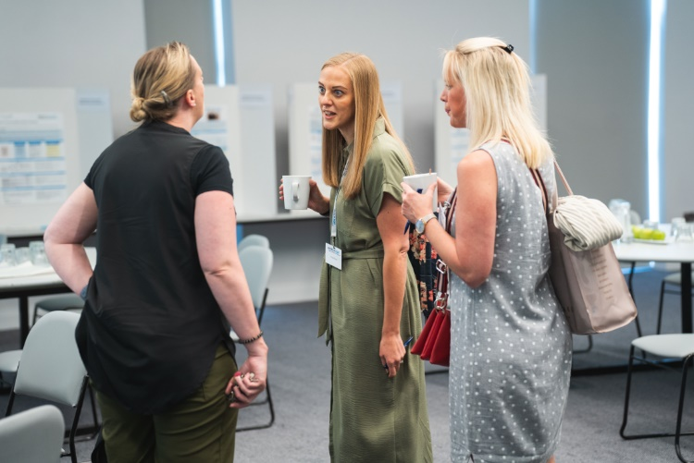
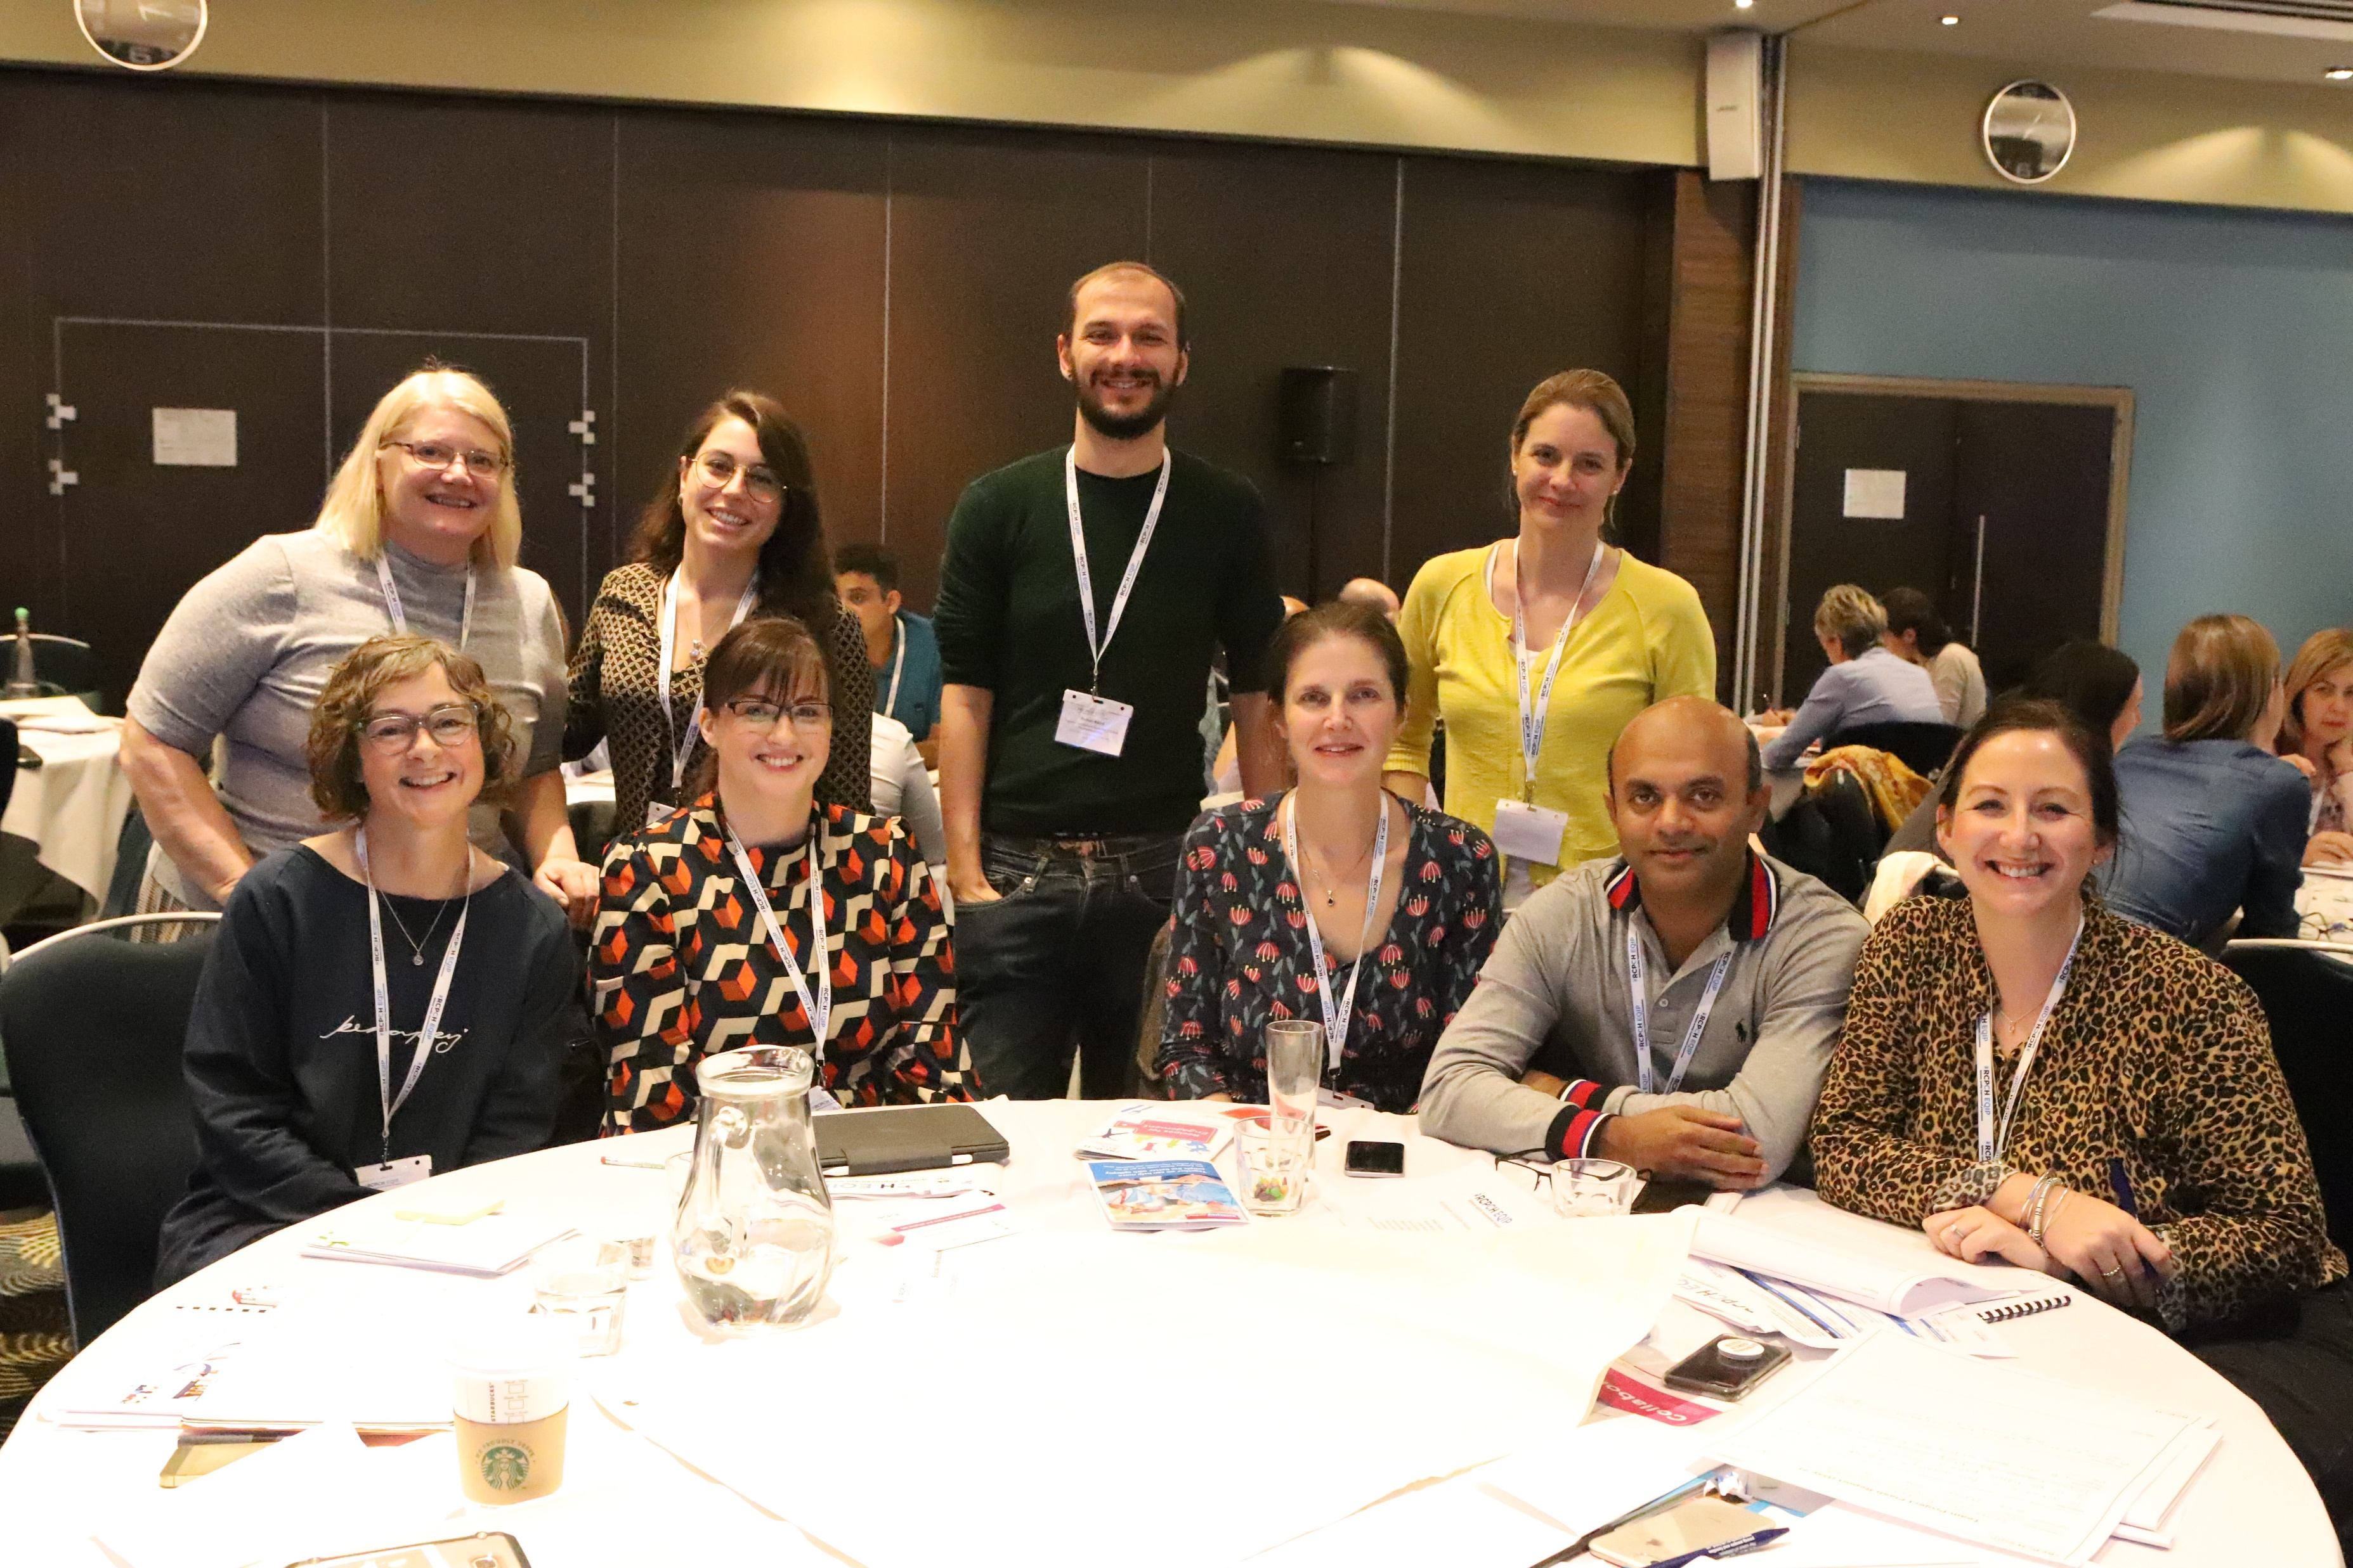
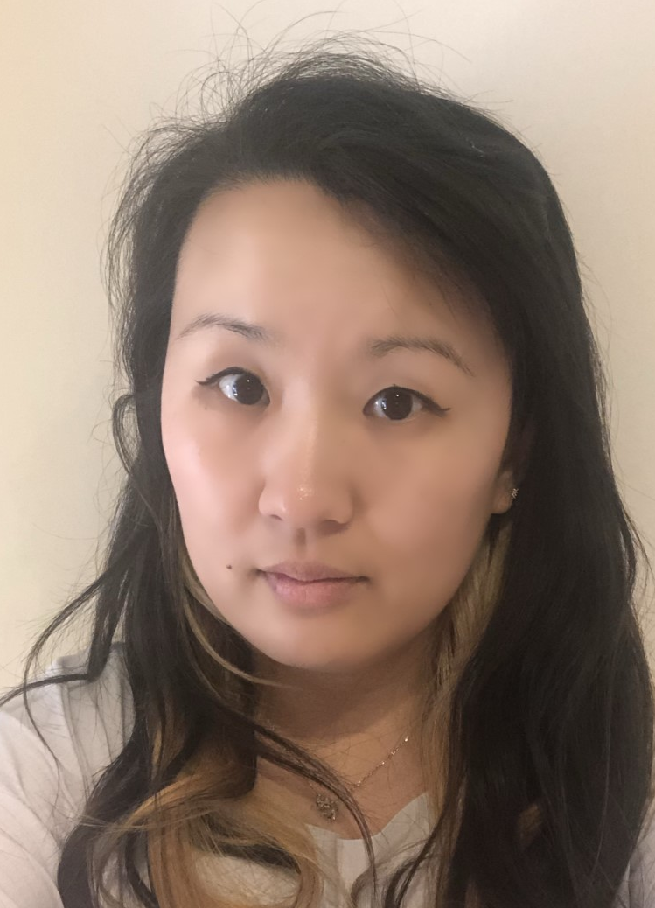
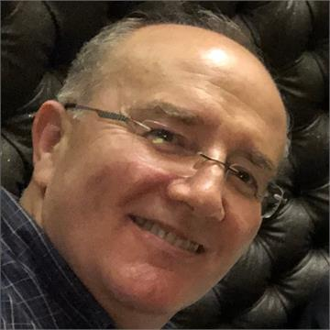
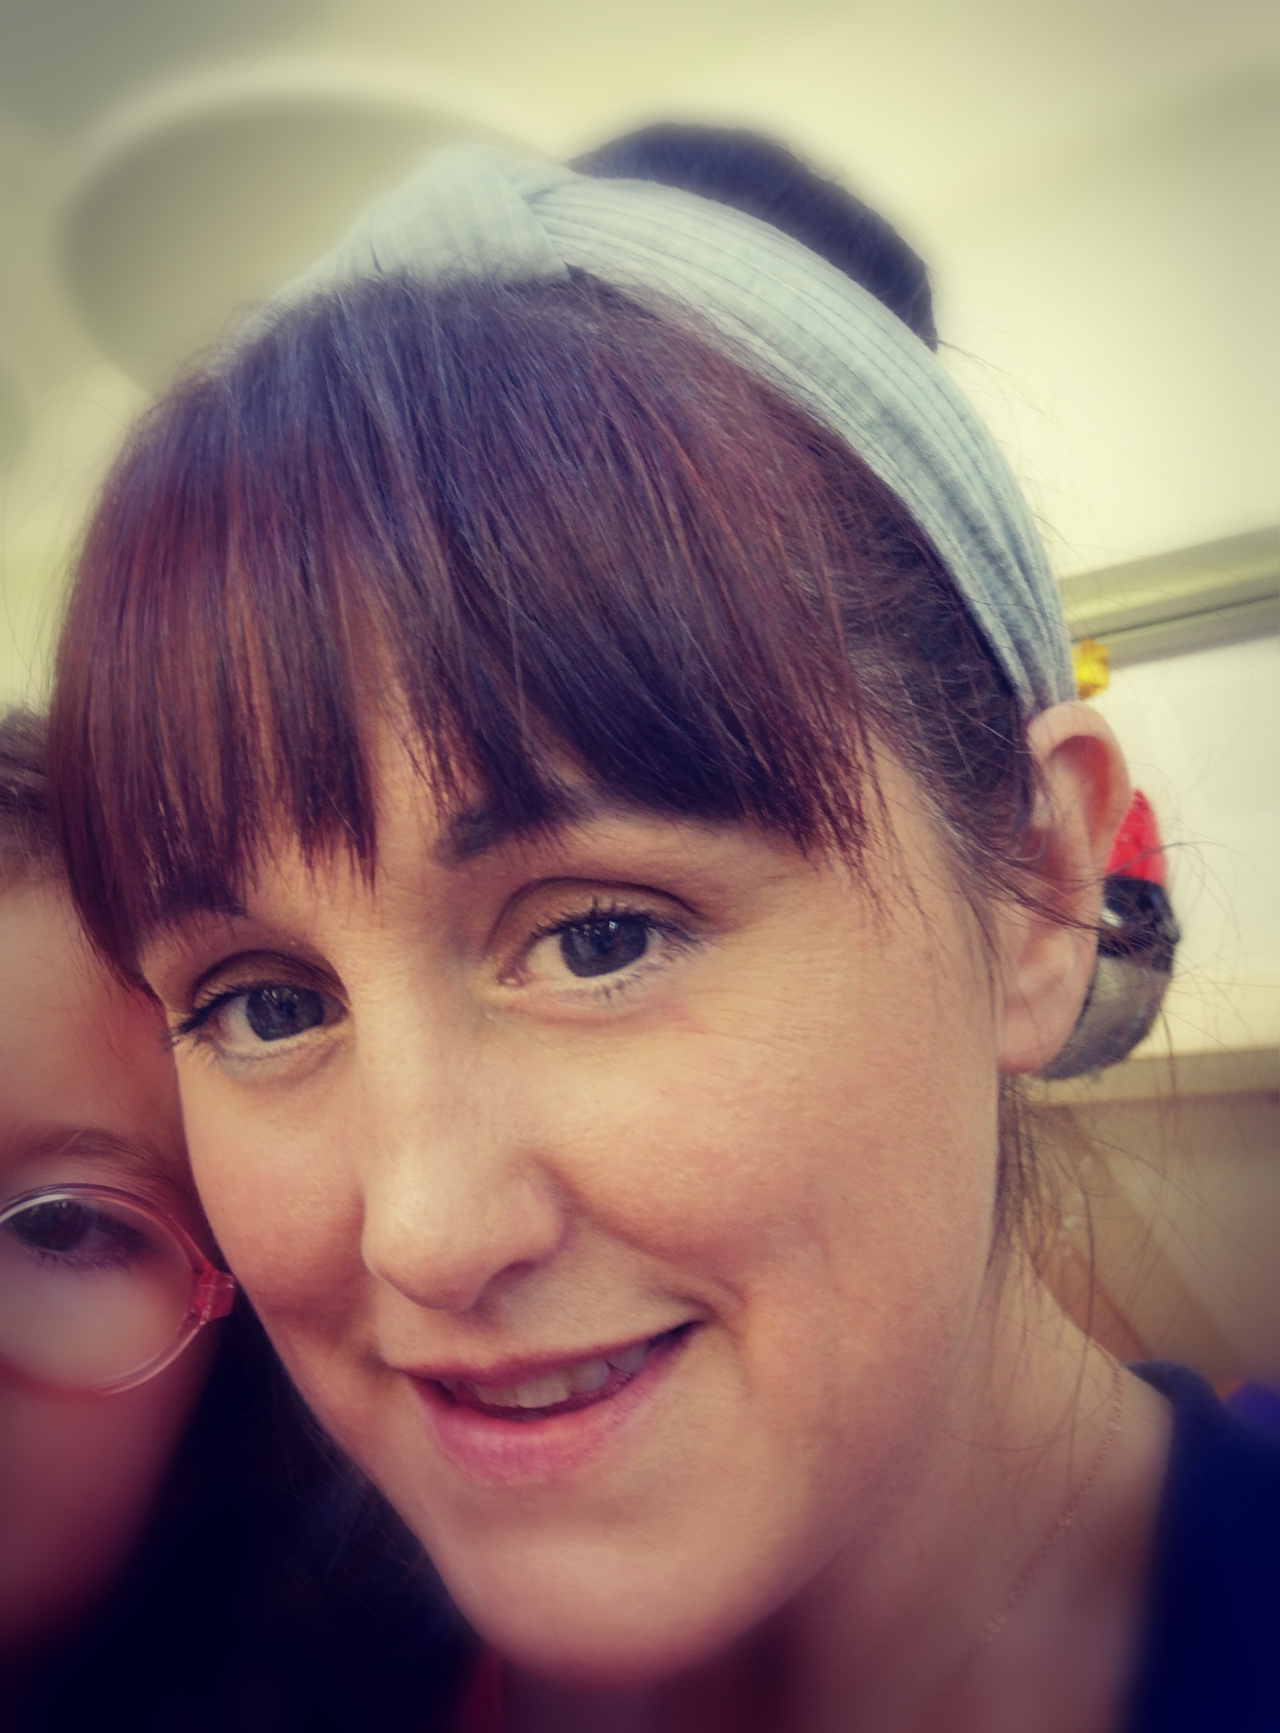
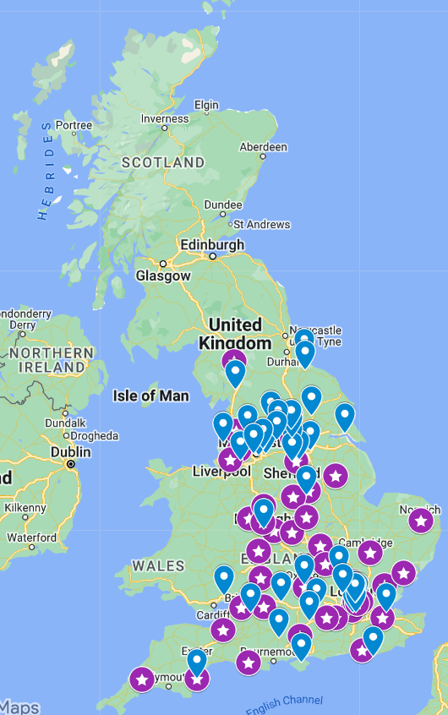
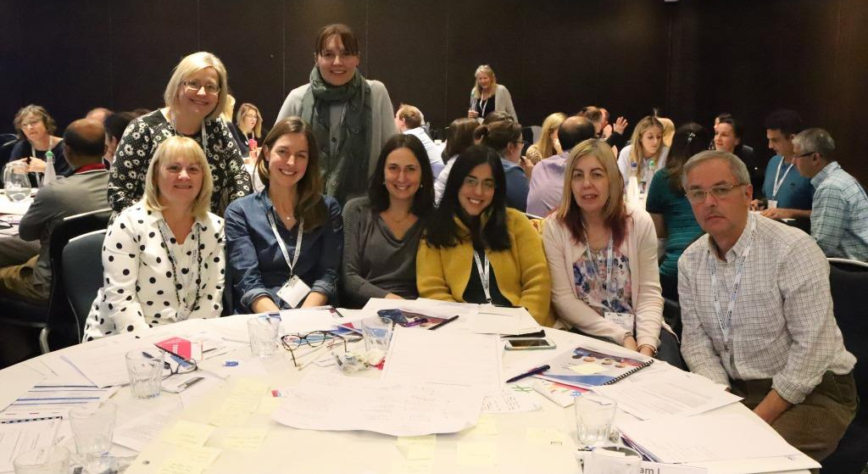

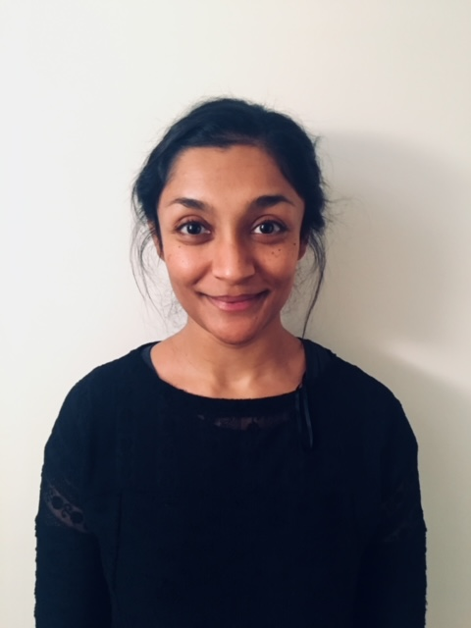
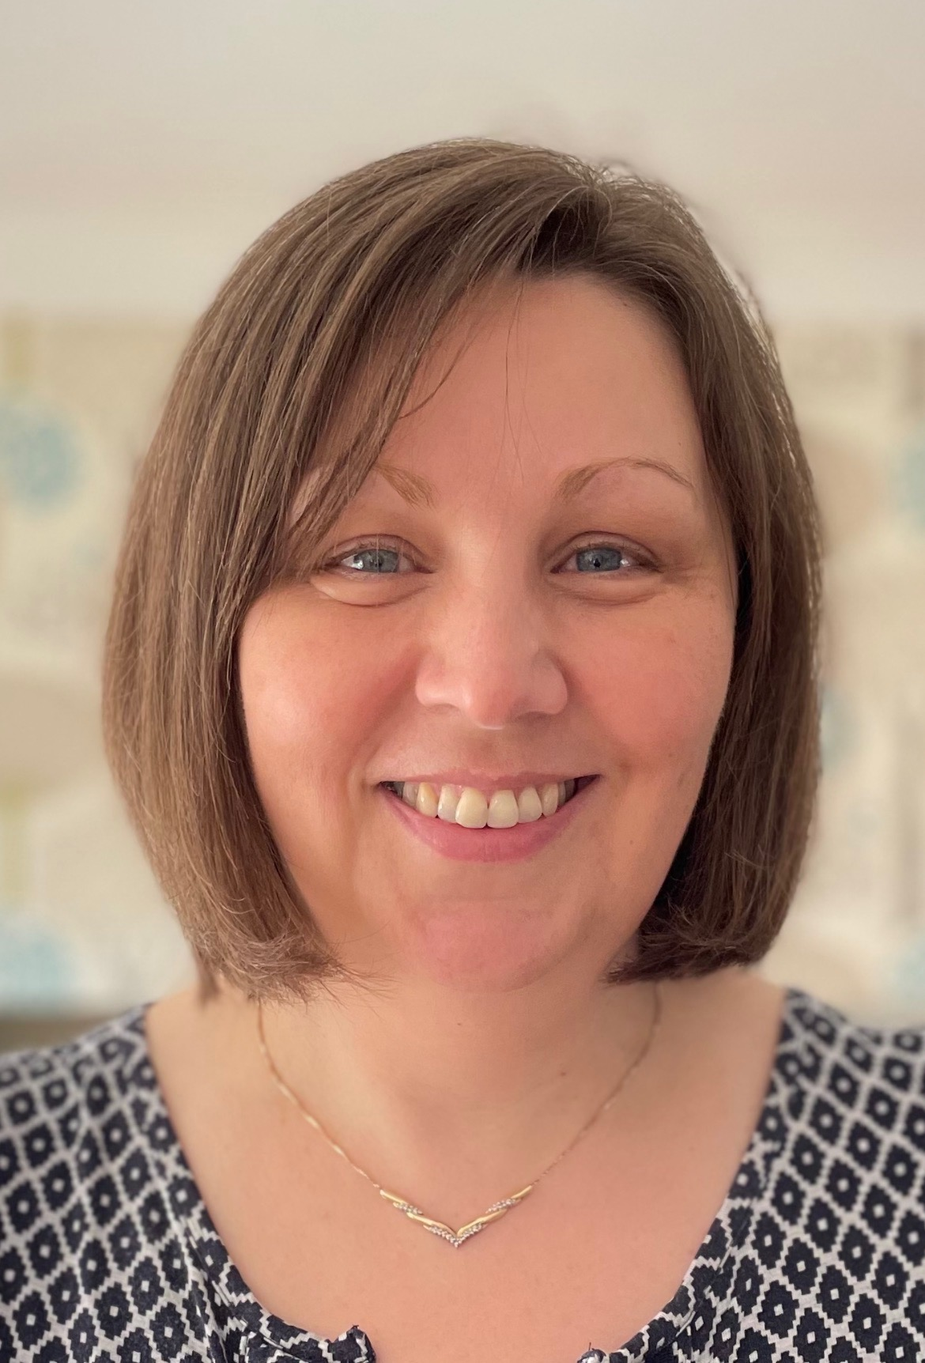
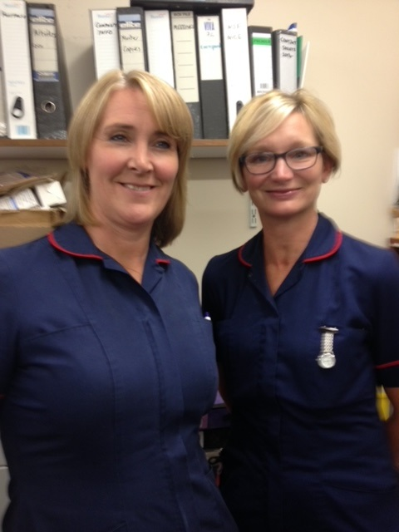

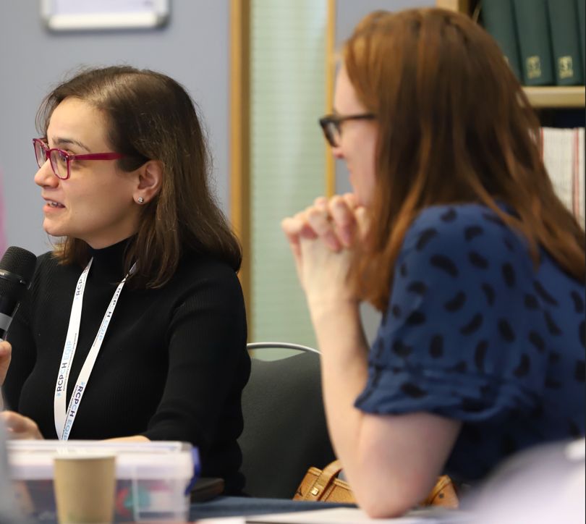
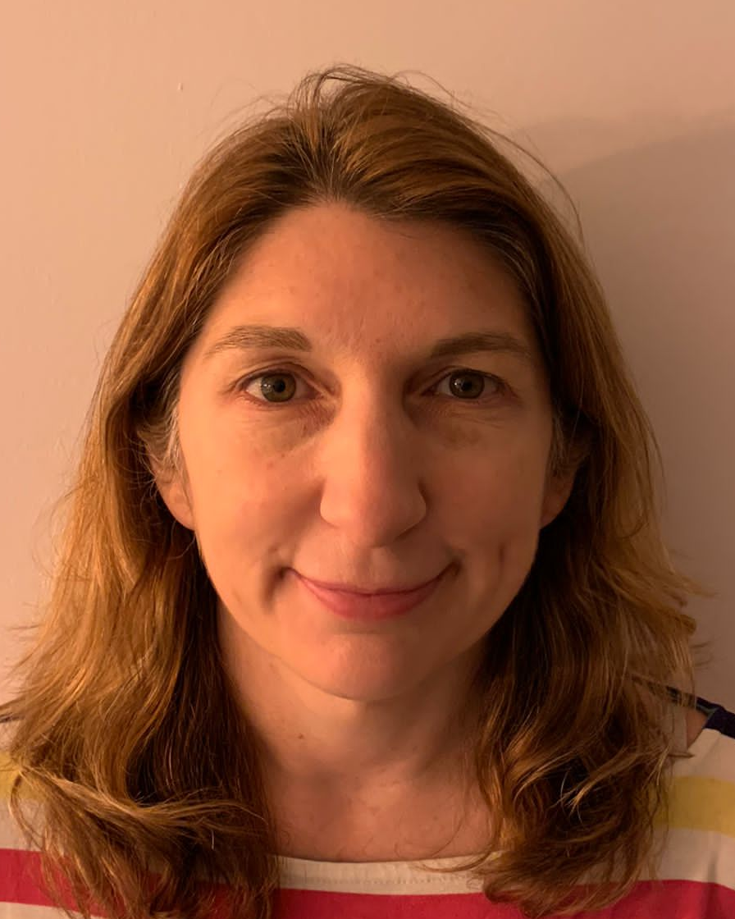
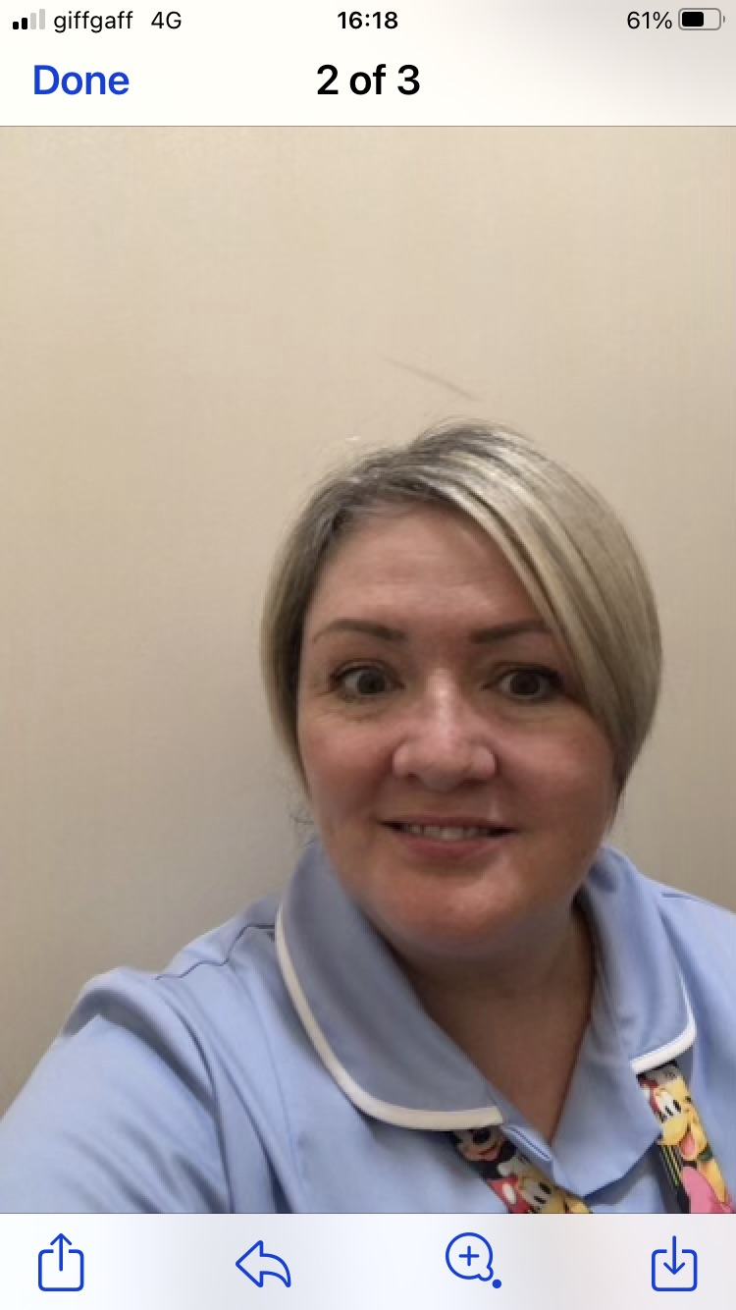
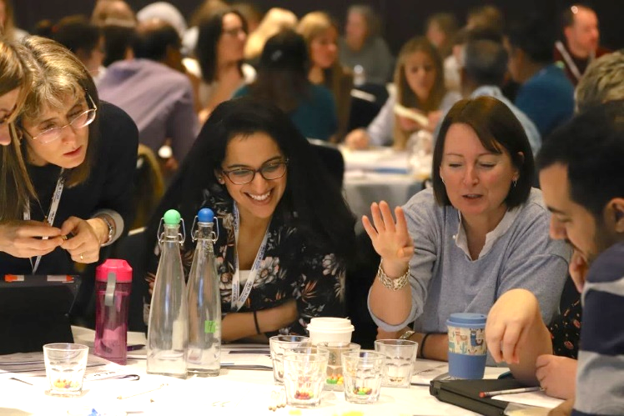
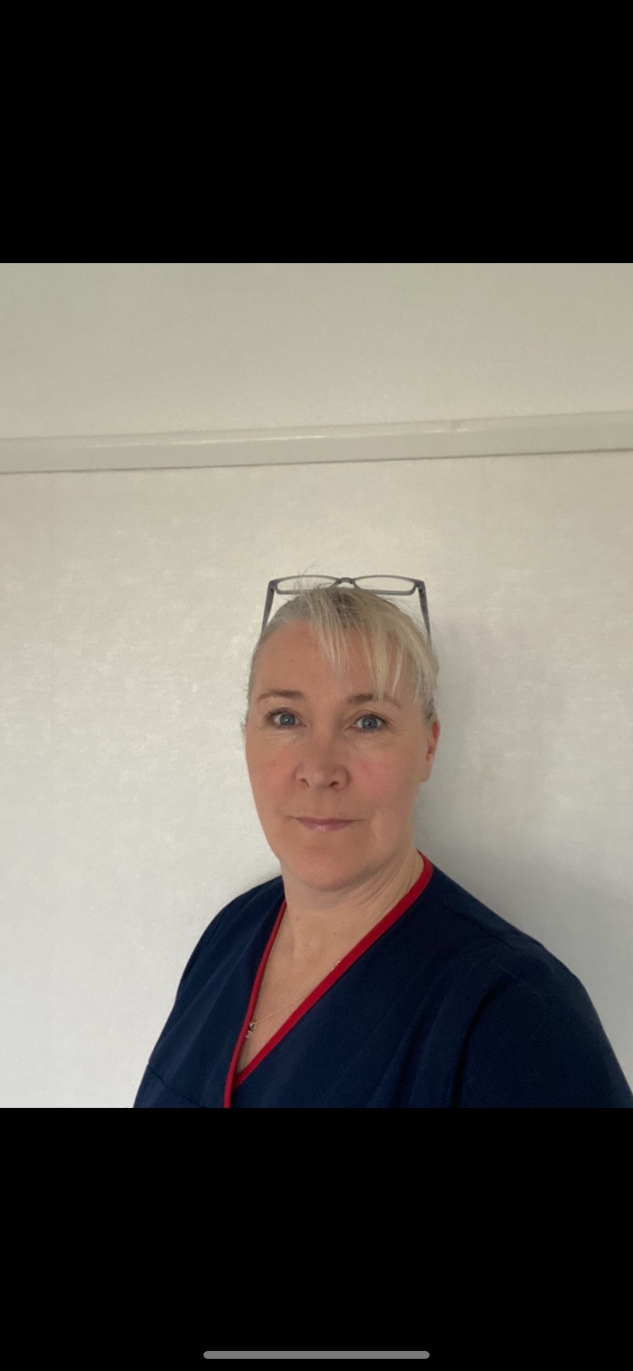
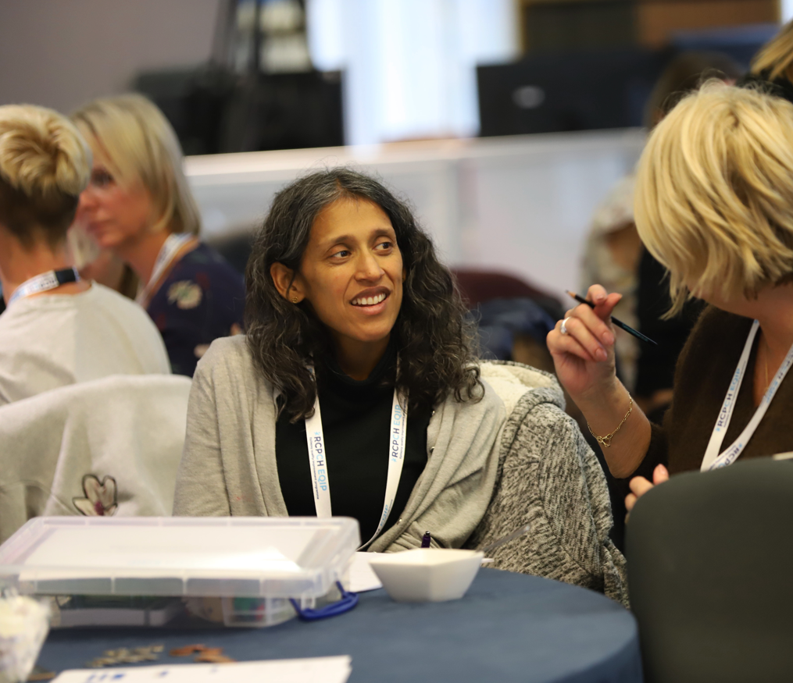

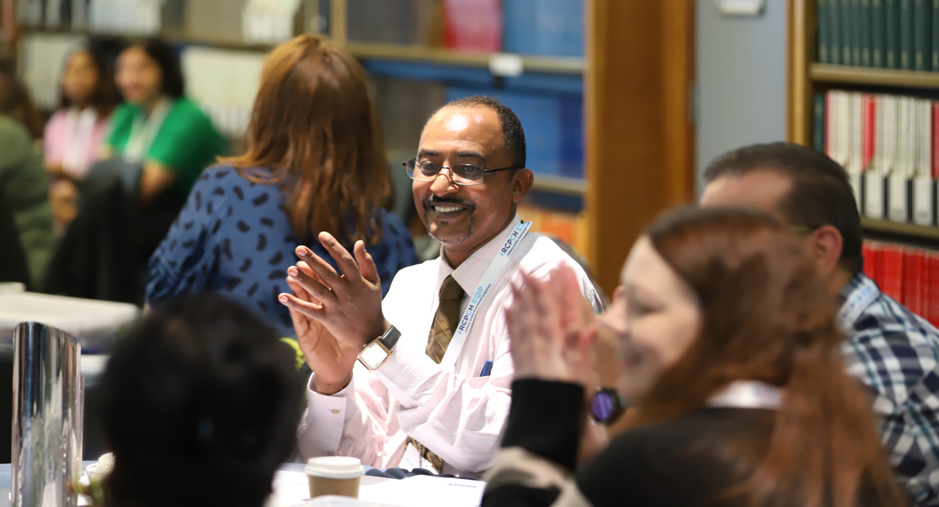
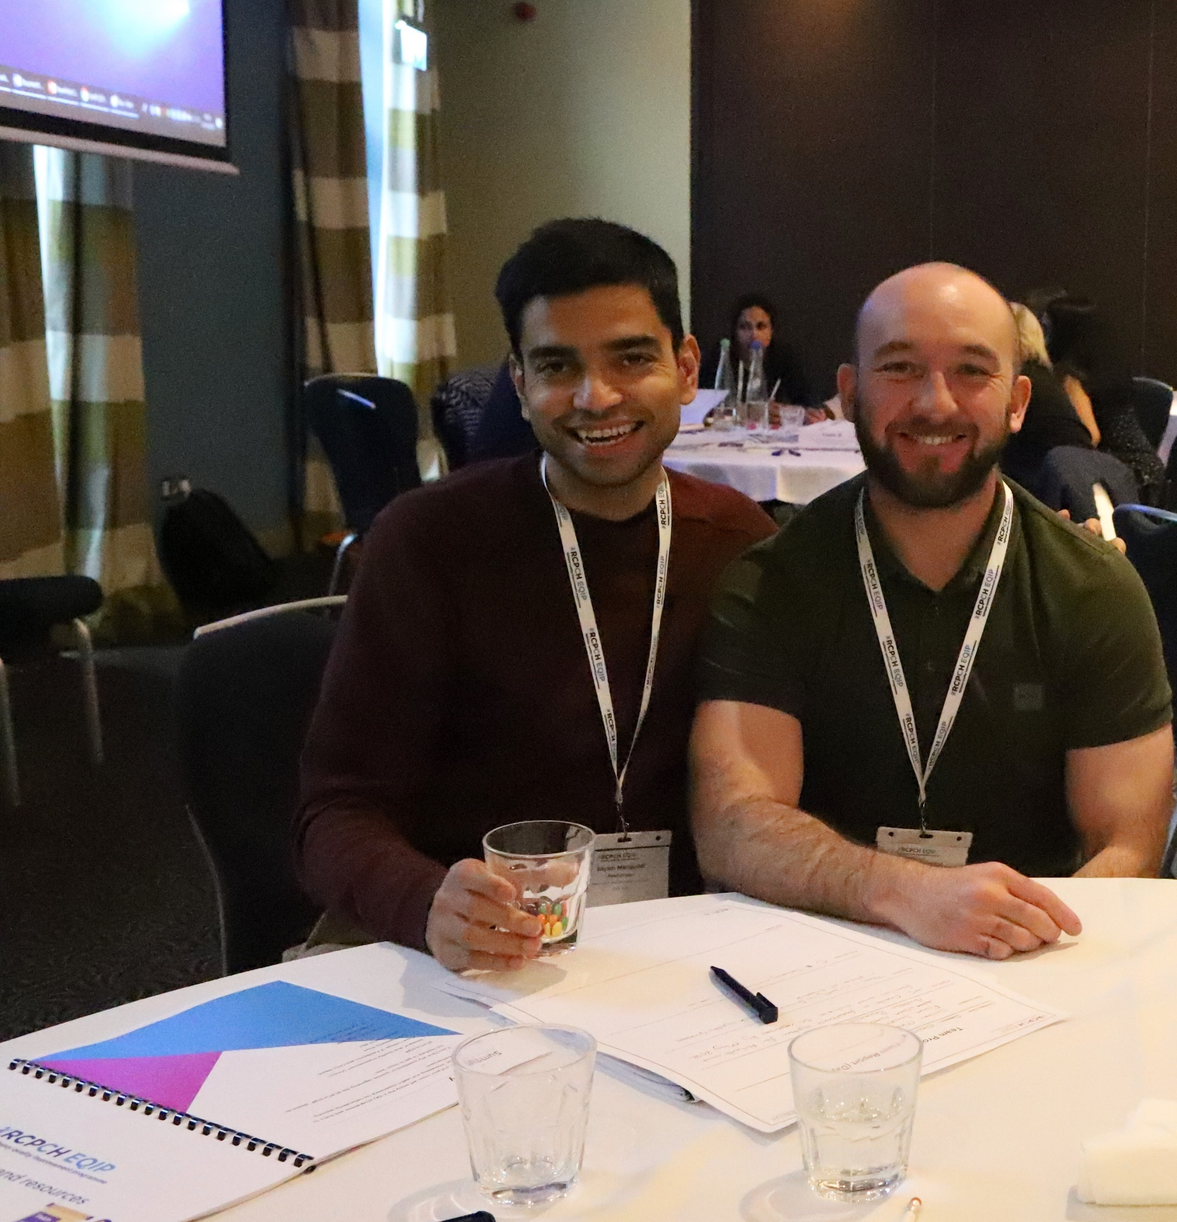
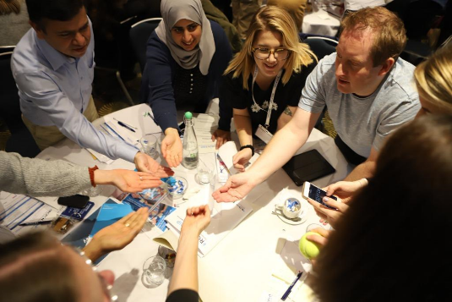
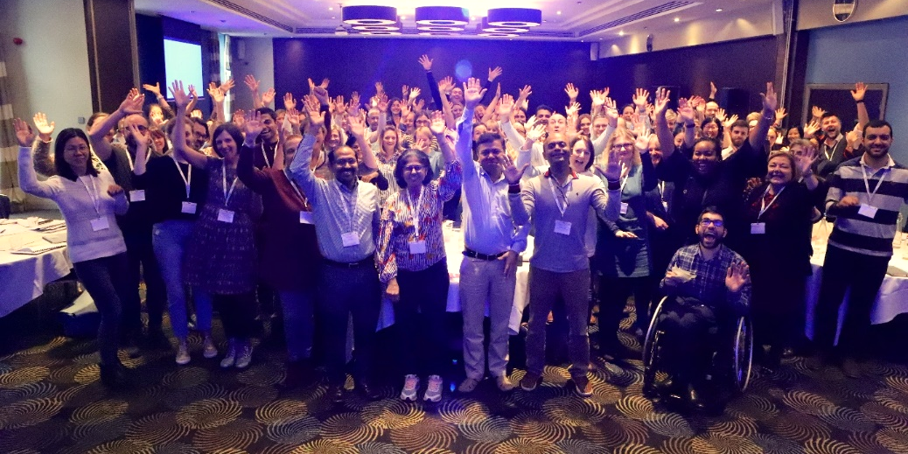
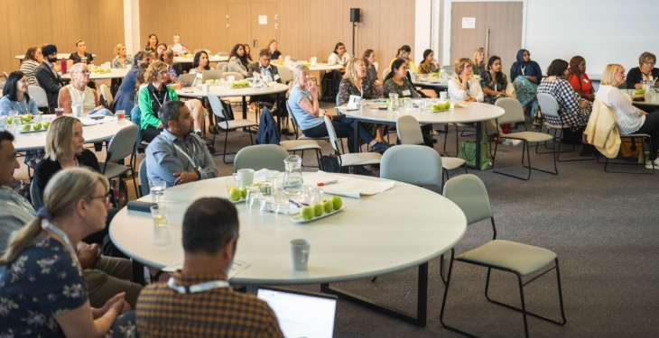
RCPCH EQIP participation 2019 to date
49 NHS hospital Trusts in England and Wales, 3 ICB’s, 222 NHS members of staff
Notes:
Since the launch of the pilot in 2019 to date, the EQIP has seen the participation of up to 49 NHS hospital Trusts in England and Wales, including three integrated care structures (ICS) and trained 222 NHS members of staff within paediatric epilepsy services.
Our intentions is to build from the frontline up enabling microsystem teams with the capability to lead and develop their own improvement work with core skills in:
• Change programme design
• Person centred care
• Measurement for improvement
• Team coaching
• Values based practice

Slide 5
2023-2024 project topics
East Sussex Healthcare | Improving mental health support
Great Ormond Street Hospital | Reducing variation - medication
Hillingdon - Central and North West London | Reducing variation in SUDEP discussion
Isle of wight NHS Trust | Improving mental health support
Northern Care Alliance (Oldham) | Transition
Northern Care Alliance (Salford Royal) | Improving mental health support
Hull University Teaching Hospitals | Improving transition pathways
West Hertfordshire University Trust | Improving transition pathways
York and Scarborough ICB | Improving CYP engagement across ICB
Notes:
These are the project topics so far so please network we are a collaborative swop email addresses and support each other on the journey as multiple of you are working on the same project topics.

Slide 6
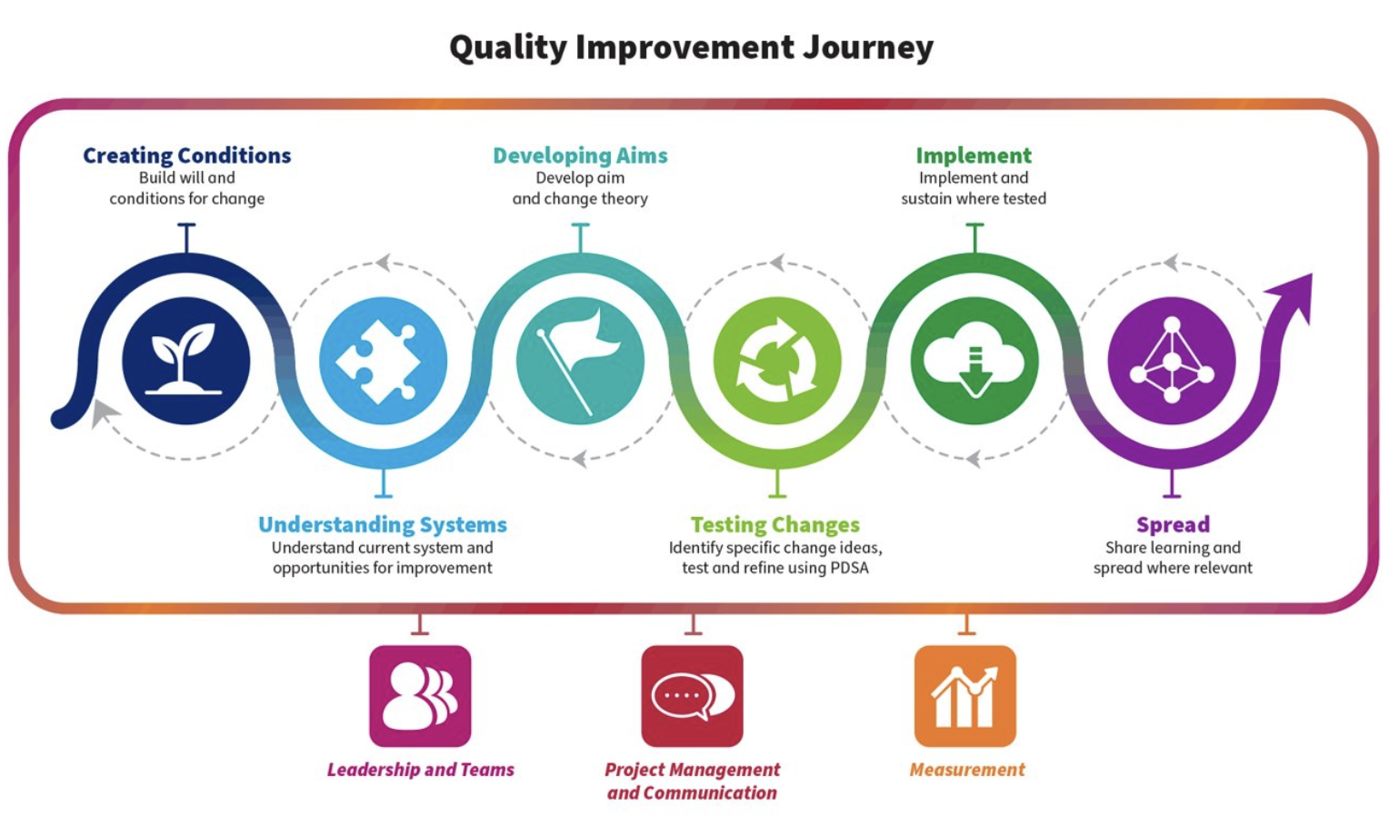

Slide 7







The Key Elements of Breakthrough Improvement
Will
Ideas
Execution

Slide 8


Objectives
Have fun
Share how you built the will for change in your system by making sure people are at the centre of your healthcare systems…. patients and families and healthcare teams
Sharing and learning by building on what we have
Share and exchange what you learned along the way –the good the bad and the ugly

Slide 9
Framework for Improvement
O’Connor 2015
Context
Is everything ....islands of excellence
Making Change Happen
Understanding self and others-Team dynamic
Mindfulness, emotional intelligence: FEELINGS matter at work
Where are the bright spots and how do we build on these?
Strong and loose ties
Measuring Results
Methods tools and techniques
Improvement science e.g. Model for improvement, lean
Triple aim (patient experience, ROI, improved clinical outcomes)
Dash board of measures- Run and control charts
Deep and broad understanding of what it takes to sustain change... reliability and resilience in care delivery ..Sensitive to operations (Safety II )
Acknowledge and monitor spread
Make the right thing easy to try, easy to do and easy to try!
Community asset management
Measurement MATTERS
Info graphics
Generate light not heat! Measures for improvement
Holding the Gains
Celebrate Success

Slide 10
EQIP Improvement Engine and Timeline
Self Assessment
Selection
P
P
P
P
P
A
D
A
D
A
D
A
D
A
D
S
S
S
S
S
Launch
afternoon
Monthly
Check in
EQIP festival celebration event
Alignment with national work
Monthly
Check in
Monthly Check in
Supports
Expert faculty
Network Web
Monthly Phone conf Assessments
Monthly Reports via web
Key Changes
Improvement
Measures
Aug/Sept 23
Oct 23
May 2024
Notes:
10
4
4
4
Site visits, technical assistance to build capability in measurement and improvement
Virtual community – conference calls, email, listserv, monthly progress reports using web based system

Slide 11
What did we do ?
Build QI expertise
Build Improvement into daily work
Reducing waste and variation improving reliability
Prevent harm
Focus on the national priorities of
    Reducing variation/ improving reliability
    Mental health and well being
    Transition pathways

Slide 12
What Changes Can We Make?
A Theory of How to Improve a System
outcome of the improvement effort (measurable)
system components that contribute directly to the chosen aim or goal. Processes, rules of conduct, structure (The What)
elements of the primary drivers and which can be used to create change projects. Components and activities (The How)
Relationship arrows
Drives
Effect
Cause

Slide 13
Sequence for improvement
Make part
of routine
operations
Sustain & spread
a change to other
locations
Test under a
variety of
conditions
Implement
a change
Theory &
prediction
Test
a change
Support with data and consideration of people
Act
Plan
Develop
a change
Study
Do
Based on slide © IHI 2009

Slide 14
Smaller Scale Tests: Shrink It! rapid cycles of learning
Drop down next “two levels” to plan test cycle!
Years
Quarters
Months
Weeks
Days
Hours
Minutes
Notes:
Northwest Improvement Initiative
© R. Scoville & I.H.I.

Slide 15
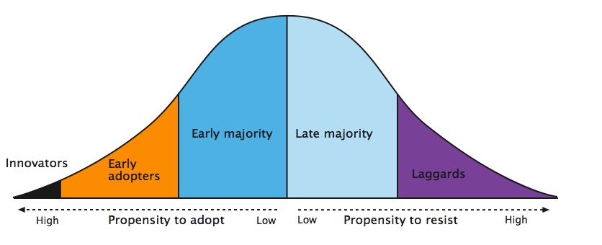
Everett Rogers Diffusion of Innovation Curve
2.5% | 13.5% | 34% | 34% | 16%
Rogers 2003

Slide 16
Seek Usefulness Not Perfection

Slide 17
100
90
80
70
60
50
40
30
20
10
0
Cycle Time (min.)
Unit 1
Change Made
Cycle time results for units
1, 2 and 3
date
Jan
Feb
Mar
Apr
May
Jun
Jul
Aug
Sep
Oct
Nov
Dec
100
90
80
70
60
50
40
30
20
10
0
Cycle Time (min.)
Unit 2
Change Made
date
Jan
Feb
Mar
Apr
May
Jun
Jul
Aug
Sep
Oct
Nov
Dec
100
90
80
70
60
50
40
30
20
10
0
Cycle Time (min.)
Unit 3
Change Made
date
Jan
Feb
Mar
Apr
May
Jun
Jul
Aug
Sep
Oct
Nov
Dec
R Lloyd, Institute for Healthcare Improvement

Slide 18
SIX Fundamental questions we must as of all changes we are trying to make
1
2
3
AIM
Is there an agreed aim that is understood by everyone in the system?
CORRECT CHANGES
Are we using our full knowledge to identify the right changes and prioritising those likely to have the biggest impact on our AIM?
CLEAR CHANGE METHOD
Does everyone know and understand the method(S) we will use to improve?
4
5
6
MEASUREMENT
Can we measure and report prgress on our improvement aim?
CAPACITY AND CAPABILITY
Are people and other resources being deployed and developed in the best way to enable improvement?
SCALE UP AND SPREAD
Have we set out our plans to test implement and scale up, innovate and share new learning to spread improvement everywhere its needed?

Slide 19
What Prevents Action
Let’s Change the Conversation
Everyone knows what they don't want
Let’s start to focus and describe what we want
What would be happening if things were going great and what behaviours get results?
Need to be specific when solving people problems
Create opportunities for teams to describe and develop their own solutions
Subject Matter Knowledge
Profound Knowledge

Slide 20

RCPCH EQIP Visual assets
Access what teams have done via their posters, videos presentation slides to get an understanding of their journey available on the EQIP microsite.
https://eqip.rcpch.ac.uk

