Slide 1
​
RCPCH Epilepsy Quality Improvement Programme
August 2021 – April 2022
Time since first referral to first paediatric assessments
Salisbury NHS Foundation Trust​
RCPCH Epilepsy Quality Improvement Programme project team:
Dr Jim Baird, Paediatric consultant
Vanessa Hayden’s, Junior Paediatric consultant
Natalie Morabito, Paediatric Epilepsy nurse Specialist
National audit results included within this case study acts as a guide only to performance standards. The service improvements made during the EQIP cannot be entirely attributed to the reported results in the Epilepsy12.

Slide 2
​
Time since first referral to first paediatric assessments - Salisbury NHS Foundation Trust​
Project aim:
Improve first seizure pathway with key aim to ensure 75% or more of first seizure patients are seen within 2-4 weeks.
Background:
Salisbury NHS Foundation Trust is a DGH with a 16-bed inpatient unit and a paediatric epilepsy service team for 160 patients - one paediatrician with epilepsy interest, ESN, and admin support. The team actively takes part in Epilepsy12 data submission, with data returns that are well above the regional and national average. Previous audit results for patients with a first seizure seen by a paediatrician with an interest in epilepsy within 2 weeks revealed some patients were waiting over 16 weeks to be seen in clinic. Epilepsy12 data: Quality statement 1: Are patients with suspected seizures seen within 2 weeks? 2019: 50% seen in 2–6 weeks, 25% >16 weeks; 2020: 30% in <4 weeks, 40% in 6–12 weeks, 25% >14 weeks.
Area of focus:
The team plans to map the patient journey to uncover the barriers and help reduce waiting time by developing/changing their referral process and improving their first seizure advice and information for patients and their families.

Slide 3
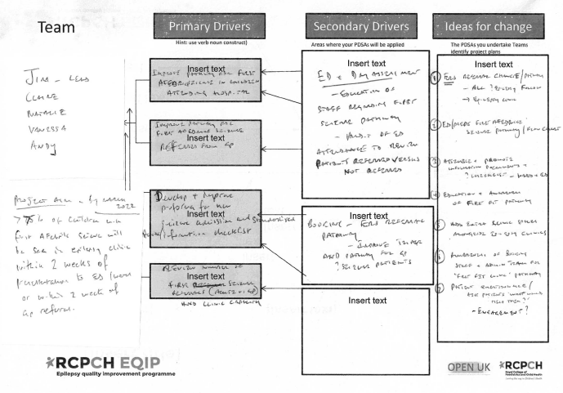
Time since first referral to first paediatric assessments - Salisbury NHS Foundation Trust​
Driver Diagram

Slide 4
Time since first referral to first paediatric assessments - Salisbury NHS Foundation Trust​
Changes
Created clinic space; added extra patient(s) as needed to clinics.
Altered GP referral review and case triage; electronic referral system done by two consultants; pathway altered for new seizure referrals by easy access to contact ESN.
Designed and hung posters providing information on the new pathway and information for the paediatric and ED teams to email referrals to the admin/ESN team.
Produced a flow chart that maps out the pathway of what should happen when a patient is admitted with a first seizure and displays it for DSU staff to refer to first.
Reviewed the data collected on the time taken from the referral for the team to see them in clinic and developed a new first seizure pathway using this baseline data.
Continued to develop and standardise improved information shared with parents and patients.

Slide 5
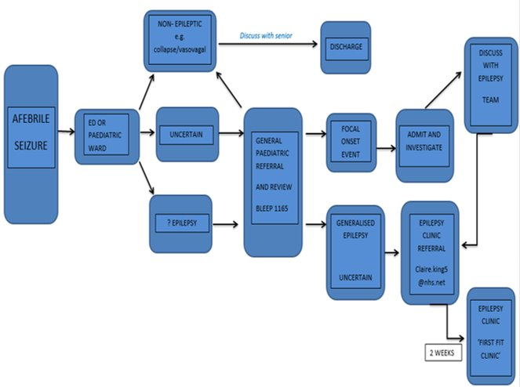
Time since first referral to first paediatric assessments - Salisbury NHS Foundation Trust​
Mapping Improvement pathway

Slide 6
Time since first referral to first paediatric assessments - Salisbury NHS Foundation Trust​
Results
Simple baseline data collected by ESN ​
Monthly data review by the team
October – March: 33 new patients seen in clinic
All were seen within 7 weeks​
Approx 80% seen within 4 weeks
Created discharge pack for first seizure patients, contents include:
Electronic discharge summary
What happens next?
Seizure recording chart
RCPCH First seizure leaflet
Fits, Faints and funny turns leaflet (Wessex Healthier Together)
Open access
Other resources

Slide 7
Audit results cohort 3/4 – Professional input - Salisbury NHS Foundation Trust​
NICE recommends that children and young people presenting with suspected seizure are seen by a specialist in the diagnosis and management of epilepsies within 2 weeks of presentation (Quality statement 1).
The percentage of CYP with input from a paediatrician with expertise in the first year of care was 100% in 2021 above regional and national average. In 2022, this figure was 86% . Additionally, the percentage of CYP with input from an epilepsy specialist nurse in their first year of care has decreased to 50% in 2021 then increased to 91% in 2022 above national and regional averages.
Percentage of CYP with input from:​ | 2019​ | 2020​ | 2021​ | 2022​ | 2021 – WPNN​ | 2021 – England & Wales​ | 2022 – WPNN​ | 2022 – England & Wales​
Paediatrician with expertise OR paediatric neurologist (PI.1)​ | 100%​ | 100%​ | 100%​ | 86%​ | 94%​ | 88%​ | 90%​ | 91%​
Paediatrician with expertise​ | 100%​ | 100%​ | 100%​ | 95%​ | 93%​ | 85%​ | 94%​ | 89%​
Paediatric neurologist​ | 50%​ | 24%​ | 0%​ | 23%​ | 20%​ | 25%​ | 33%​ | 20%​
Epilepsy specialist nurse​ | 100%​ | 94%​ | 50%​ | 91%​ | 61%​ | 80%​ | 83%​ | 80%​

Slide 8
Audit results cohort 3/4 – Time since first referral - Salisbury NHS Foundation Trust​
The Salisbury paediatric epilepsy service are able to provide some level of input from a paediatric consultant with ‘expertise in epilepsy.
The percentage of CYP that were seen by a paediatrician with expertise in epilepsy within 2 weeks of first referral increased to 36% and 2-4 weeks of first referral in 2022, above regional and national averages.
Time since first referral to first paediatric assessment​ | 2019​ | 2020​ | 2021​ | 2022​ | 2021 – WPNN​ | 2021 – England & Wales​ | 2022 – WPNN​ | 2022 – England & Wales​
0 – 2 weeks​ | 0%​ | 24%​ | 0%​ | 36%​ | 31%​ | 23%​ | 23%​ | 21%​
2 – 4 weeks​ | 25%​ | 6%​ | 0%​ | 14%​ | 14%​ | 12%​ | 8%​ | 11%​
4 – 6 weeks​ | 25%​ | 0%​ | 0%​ | 9%​ | 4%​ | 9%​ | 10%​ | 11%​
6 – 8 weeks​ | 0%​ | 29%​ | 0%​ | 14%​ | 6%​ | 7%​ | 10%​ | 8%​
8 – 10 weeks​ | 0%​ | 6%​ | 50%​ | 5%​ | 10%​ | 5%​ | 6%​ | 7%​
10 – 12 weeks​ | 0%​ | 6%​ | 0%​ | 0%​ | 0%​ | 3%​ | 2%​ | 5%​
12 – 14 weeks​ | 0%​ | 0%​ | 0%​ | 0%​ | 4%​ | 3%​ | 2%​ | 3%​
14 – 16 weeks​ | 0%​ | 6%​ | 50%​ | 0%​ | 6%​ | 2%​ | 2%​ | 2%​
16 + weeks​ | 25%​ | 18%​ | 0%​ | 18%​ | 14%​ | 13%​ | 29%​ | 13%​

Slide 9
Audit results cohort 3/4 – Time since first referral - Salisbury NHS Foundation Trust​
Graph showing Trust level, regional and national results on Time since referral to first paediatric assessment in 2022
*RNZ represents Salisbury NHS Foundation Trust​

Slide 10
Time since first referral to first paediatric assessments - Salisbury NHS Foundation Trust​
Challenges
The team previously found patient engagement challenging, but participating in the EQIP provided training and guidance on the simplicity of the approach to patients and families.
There has been no funded uplift in service yet.
The team identified the need to improve clinic efficiency.
The team struggled at times with progressing the project due to staff absences.
Challenges to finding team time to plan activities and engage in EQIP events.
The team reflected and acknowledged that patient engagement could have done better.

Slide 11
Time since first referral to first paediatric assessments - Salisbury NHS Foundation Trust​
Outcomes
Monitored the improvements against Epilepsy12 audit results and already achieved a reduction in waiting times from 16 weeks to less than six weeks.
Improvements have been made in waiting times in outpatient clinics over a period of four weeks by increasing access to patient slots for around three more patients per week.
Between October and March, the team added 33 new patients, and 80% were able to see them within 4 weeks.
100% of new patients were seen within 7 weeks.
Improved first seizure and initial referral review times.
Continued to see 1 extra patient (or 2) per clinic.
The epilepsy team will take on the booking process for all patients.
In the future, we will test other engagement methods because the questionnaire method is not the best tool for patient feedback.
Improved (standardised) information pack for patients and families and will continue to develop our patient engagement using simple approaches and activities.

Slide 12
Time since first referral to first paediatric assessments - Salisbury NHS Foundation Trust​
National audit results
The percentage of CYP with input from a paediatrician with expertise in the first year of care was 100% in 2021 above regional and national average. In 2022, this figure was 86% . Additionally, the percentage of CYP with input from an epilepsy specialist nurse in their first year of care has decreased to 50% in 2021 then increased to 91% in 2022 above national and regional averages.
In 2022, the percentage of CYP that were seen by a paediatrician with expertise in epilepsy within 2 weeks of first referral increased to 36% and 2-4 weeks of first referral in 2022, above regional and national averages.

Slide 13
Time since first referral to first paediatric assessments - Salisbury NHS Foundation Trust​
Lessons learnt
We can make simple improvements as a team
Start small and try something new.
The team worked well together as a small team.
Improved team understanding of QI methodology.
Patient engagement can be simple, and we can do this more and even better.
Just do it!
Visual presentation of team project intervention
Team video presentation

Slide 14
https://eqip.rcpch.ac.uk
eqip@rcpch.ac.uk
@RCPCHEQIP

