Slide 1
RCPCH Epilepsy Quality Improvement Programme
November 2019 – July 2020
Implement integrated care pathway
Luton and Dunstable University Hospital
RCPCH Epilepsy Quality Improvement Programme project team:
Dr Tekki Rao, Consultant paedtiatrician, Clinical lead
Dr Vipin Tyagi, Consultant paedtiatrician with interest in epilepsy
A. Joshi, Consultant paedtiatrician with interest in epilepsy
Liz Stevens, Epilepsy Specialist nurse
Vandna Gandhi, Consultant paedtiatrician with interest in epilepsy
Hannah Goodge, Epilepsy Specialist nurse
National Audit results included within this case study acts as a guide only to performance standards. The service improvements made during the EQIP cannot be entirely attributed to the reported results.

Slide 2
Implement integrated care pathway - Luton and Dunstable University Hospital
Project aim
To develop and implement an integrated care pathway for children admitted to hospital with seizures in 6 months.
Background:
The team observed a lack of uniformity in the acute care received by children admitted with suspected epileptic seizures to the paediatric ward, particularly outside of normal working hours. The areas that particularly required improvement were history-taking, arranging appropriate investigations, safety advice for parents/carers and patients Confirming the need for an integrated care pathway that provides children and young people and their carers with a standardised approach to providing high-quality care.
Area of focus
Prior to developing the pathway, the team engaged parents/carers with a survey to obtain feedback on how they felt about the care received during hospital admission. As expected, the response suggested inconsistency in the quality of care. Similarly, a survey taken by staff nurses and junior doctors suggested that an integrated care pathway for seizures would be beneficial in providing a high level of consistent care.

Slide 3
Implement integrated care pathway- Luton and Dunstable University Hospital
Changes
Updated the template for a document that is kept in the same place as the acute admission document in the acute paediatric assessment unit with modifications and additions specific to seizures in children.
Hot clinics were introduced once a week to see patients who were required to be seen in person.
The introduction of virtual clinics was useful for straight-forward new and follow-up patients.
Virtual MDT meetings increased team members participation.
The team found some of the new practices adopted during the pandemic were useful and efficient and will be continued post-pandemic (e.g., virtual meetings, working from home with IT-enabled services).

Slide 4
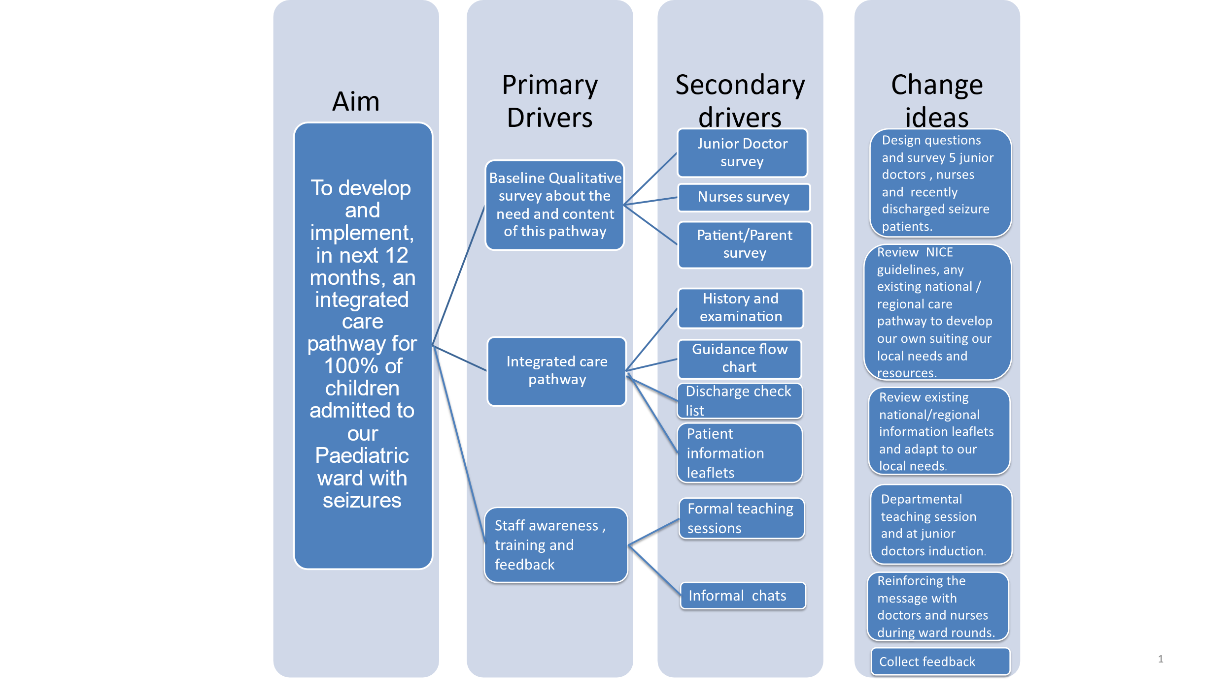
Implement integrated care pathway- Luton and Dunstable University Hospital
Project Driver diagram​

Slide 5
Implement integrated care pathway- Luton and Dunstable University Hospital
Team improvement journey ​
Idea
Initial Survey
History and examination
Flow chart
Discharge check list
The whole pathway ready
Plan
Do
Study
Act
Nov 2019 Nov 2019 Dec 2019 Jan 2020 Mar 2020 Apr 2020

Slide 6
Implement integrated care pathway- Luton and Dunstable University Hospital
PDSA process​ of testing, measuring and making changes to the PAU documentation
History and examination section of the pathway
Initial draft
Testing in the PAU
Feedback – History taking prompts useful but need to reduce text and change the layout
Implementable changes incorporated and cycle repeated
Seizure flow chart
Initial draft
Testing in the PAU
Feedback – congested format, reduce text, user friendly
Implementable changes incorporated and cycle repeated
Discharge check list
Initial draft
Testing in the PAU
Feedback – too generic, include a patient check list, update format
Implementable changes incorporated and cycle repeated

Slide 7
Implement integrated care pathway- Luton and Dunstable University Hospital
Results:
The team agreed to divide the document into three broad sections to be tested:
History and examination
An initial draft was prepared, which included prompts for the history taker to use the document to cover important points in a good seizure history. This was tested with junior doctors in the acute admission unit. Feedback on improvements consisted of reducing text for the prompts in a user-friendly format and applying a uniform colour. The document went through several PDSA cycles until the changes were approved.
Flow chart for different types of seizures to guide doctors
An initial draft was prepared for children and young people admitted with different types of seizures. This was tested again by junior doctors on patients admitted with seizures. Constructive feedback received consisted of reducing the volume of text and redesigning a user-friendly layout.
Discharge check list for safe discharge
The initial draft for the discharge check list was prepared and tested before the flow chart. This chart is generic for all types of seizures. Feedback received consisted of changes to content and a more user-friendly format, e.g., incorporating a patient discharge checklist to ensure parents are happy with the information and training provided. The form was then re-tested until the changes were approved.

Slide 8
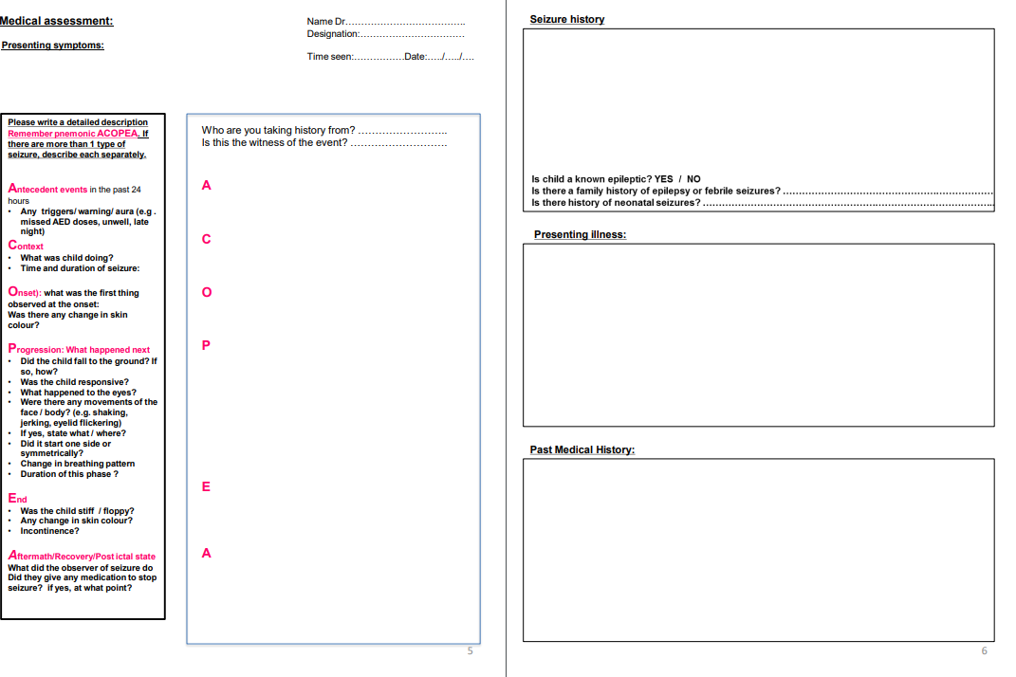
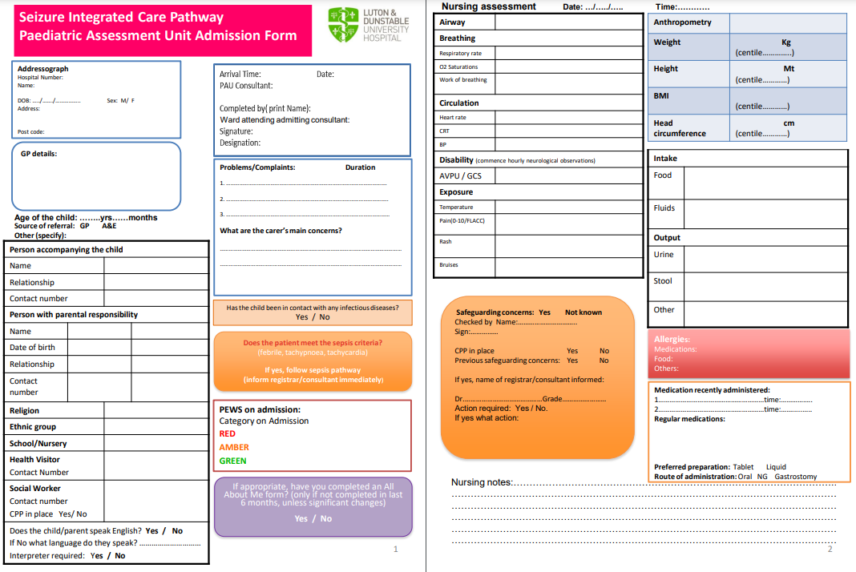
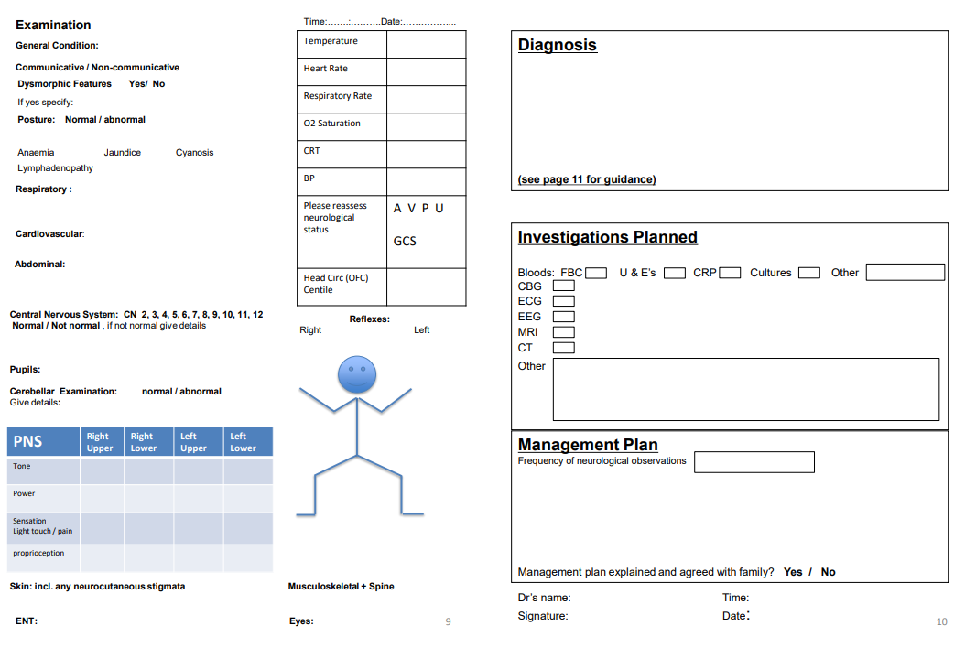
Implement integrated care pathway- Luton and Dunstable University Hospital
Example of history and examination document

Slide 9
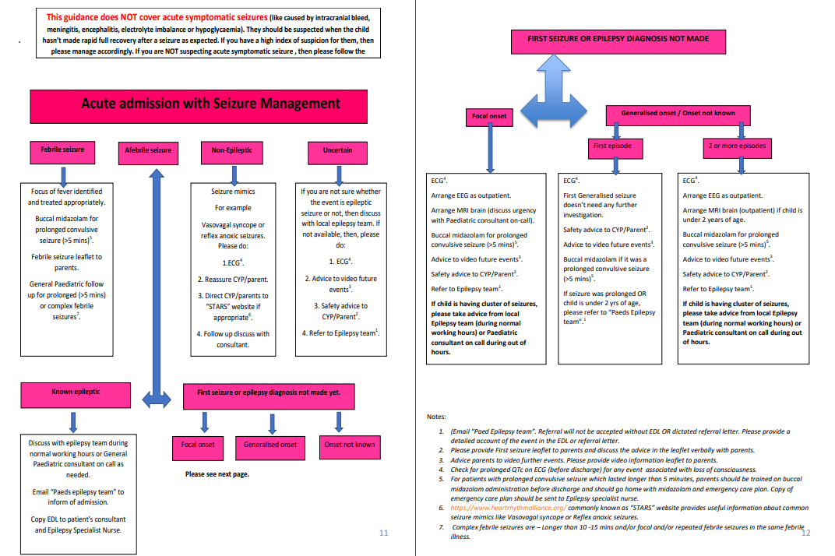
Implement integrated care pathway- Luton and Dunstable University Hospital
Example of flow chart document for different type of seizures to guide doctors

Slide 10
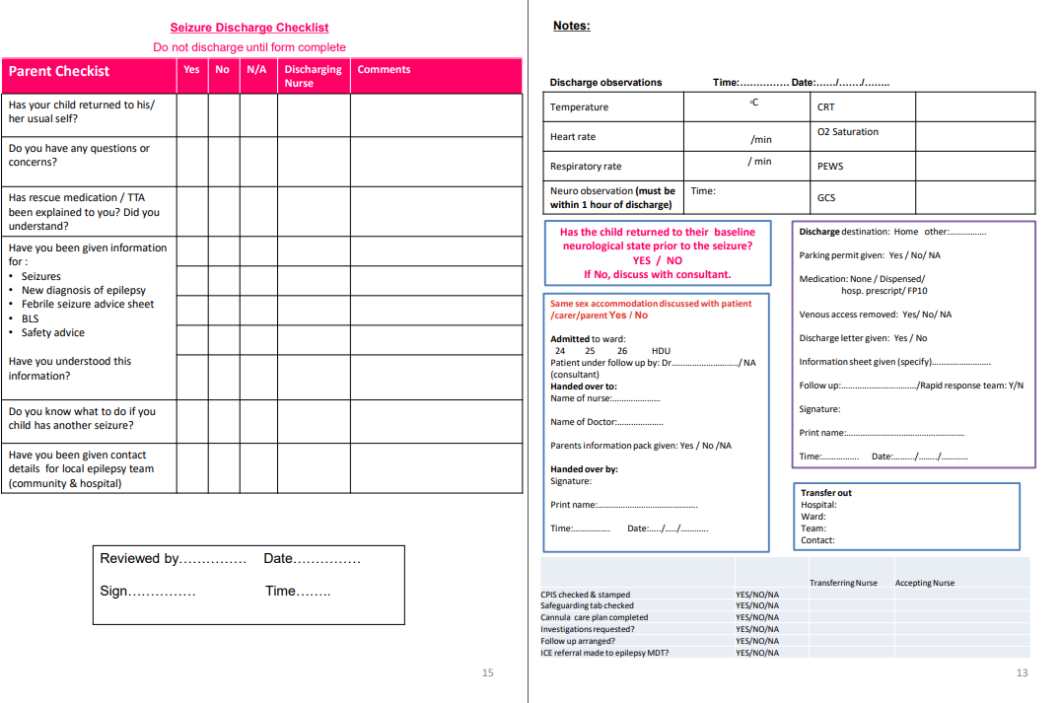
Implement integrated care pathway- Luton and Dunstable University Hospital
Example of discharge check list for safe discharge

Slide 11
Audit results for cohort 3 - Performance indicators - Luton and Dunstable University Hospital
In 2021, Luton and Dunstable University Hospital increased the percentage of children and young people receiving an appropriate paediatric assessment (63%), achieving above regional average and equalling national average results.
Performance indicators | 2019 | 2020 | 2021 | Regional network - EPEN | Overall England & Wales
4. Appropriate first paediatric assessment | - | 54% | 63% | 61% | 63%

Slide 12
Audit results for cohort 3 - Performance indicators - Luton and Dunstable University Hospital
In 2021, Luton and Dunstable University Hospital increased the percentage of children and young people with evidence of description of episodes (100%), description of age and timing of first episode (93%), description of neurological examination (91%), description of developmental, learning or schooling, achieving above regional and national average results.
Performance indicators | 2019 | 2020 | 2021 | Regional network - EPEN | England & Wales
% of all children and young people with evidence of appropriate first paediatric clinical assessment | - | 54% | 63% | 61% | 63%
% children and young people with evidence of descriptions of episode | - | 96% | 100% | 99% | 99%
% children and young people with evidence of descriptions of age of child//timing of the first episode | - | 81% | 93% | 87% | 83%
% children and young people with evidence of descriptions of frequency | - | 92% | 91% | 90% | 95%
% children and young people with evidence of descriptions of general examination | - | 96% | 95% | 93% | 92%
% children and young people with evidence of descriptions of neurological examination | - | 88% | 91% | 90% | 89%
% children and young people with evidence of description of developmental, learning or schooling progress | - | 77% | 79% | 77% | 85%
% children and young people with evidence of description of developmental, learning or schooling progress | - | 58% | 60% | 61% | 73%

Slide 13
Implement integrated care pathway- Luton and Dunstable University Hospital
Challenges
Developing a whole pathway document was time-consuming, but through the support provided on the EQIP programme, the team used the advice to break the tasks into small parts, developing and testing them individually rather than waiting for the whole document to be developed before testing it, which was a game-changing suggestion.
It has been a challenge to adapt to a new way of working under the pressures of the pandemic, but the team worked well together. Most of the patients and their families have been understanding of the sudden changes.

Slide 14
Implement integrated care pathway- Luton and Dunstable University Hospital
Outcomes
Achieved project aim to develop a standardised integrated pathway in the form of a document that has been tested with NHS colleagues.
Changes are being incorporated as feedback is received on the new documentation and embedded in the processes within the acute paediatric assessment unit.
National audit results revealed that in 2021, Luton and Dunstable University Hospital increased the percentage of children and young people receiving an appropriate paediatric assessment (63%), achieving above regional average and equalling national average results.
Increased the percentage of children and young people with evidence of description of episodes (100%), description of age and timing of first episode (93%), description of neurological examination (91%), description of developmental, learning or schooling, achieving above regional and national average results.

Slide 15
Implement integrated care pathway- Luton and Dunstable University Hospital
Lesson learnt
To avoid feeling overwhelmed, divide tasks into smaller parts. Develop and test the individual small parts to improve efficiency and expedite the process.
Taking small steps at a time and setting deadlines or milestones increases the chances of achieving improvements on a large-scale project.
Organising team members to meet to work on the project was a challenge due to the various other commitments team members may have; however, the use of virtual meetings has helped with this issue.
Making small changes at a time, continuously testing those changes, collecting feedback, and incorporating them into service improvement is crucial to making sustainable change.
The whole team felt their EQIP experience had been a great journey because they were able to conceive an idea and then witness it take physical shape, which was a very satisfying experience that cannot be described in words.
This project provided great team building and helped the team members get to know one another.
The biggest challenge while participating in the programme has been the COVID-19 pandemic, which had a very disruptive effect on the project, the effects of which are still being felt.
Visual presentation of team project intervention
Video presentation Video presentations 2 Team poster

Slide 16
https://eqip.rcpch.ac.uk
eqip@rcpch.ac.uk
@RCPCHEQIP

