Slide 1
RCPCH Epilepsy Quality Improvement Programme
November 2019 – July 2020
Development of signposted information pack
Doncaster and Bassetlaw Teaching Hospitals NHS Foundation Trust
RCPCH Epilepsy Quality Improvement Programme project team:
Dr Vivek Desai, Consultant paediatrician special interest in epilepsy, Doncaster
Dr Suhail Habib, Consultant paediatrician special interest in epilepsy, Doncaster
Dr Bhupendra Singh, Consultant paediatrician special interest in epilepsy, Bassetlaw
John Monaghan, Epilepsy specialist nurse, Doncaster
Carys Amies, Epilepsy specialist nurse, Bassettlaw
Jeanette Goodwin, Secretary Admin/Support for epilepsy
Natasha Lloyd, Dietician, Doncaster
Gemma Wilson, Physiotherapy, Doncaster
Emma Cribb, Dietician Bassetlaw
Kerry Jackson, Occupational Therapy, Doncaster
National Audit results included within this case study acts as a guide only to performance standards. The service improvements made during the EQIP cannot be entirely attributed to the reported results.

Slide 2
Development of signposted information pack - Doncaster and Bassetlaw Teaching Hospitals NHS Foundation Trust
Project aim
To develop a signposted information pack about the children’s epilepsy service, by involving the patients and parents in the whole process. 50% of patients will be signposted to the pack which would be available both electronically and in printed copies by May 2020.
Background:
The onset of a seizure in children generates extreme anxiety in the whole family, which is augmented by the complex diagnostic path of epilepsy. Although seizures may be non-epileptic, the general population can have different beliefs about convulsions, and the enormous pool of information on the internet can increase their worries. A signposted information pack would address these concerns and create opportunities for staff to increase communication and working relationships with patients and their families. As a team working in geographically distant areas, there are limited opportunities to meet, but the team shares a desire to improve services across the board.
Area of focus
Develop a signposted information pack in hard and digital copy about the children’s epilepsy service by involving the patients and parents in the whole process..

Slide 3
Development of signposted information pack - Doncaster and Bassetlaw Teaching Hospitals NHS Foundation Trust
Changes
Developed draft leaflets for internal information packs.
Engaged with stakeholders and presented on the project at the Trust paediatric clinical governance meeting. Discussions included involving them in the decisions on the most suitable location to display the information packs that are accessible to patients and their families.
Introduction of telephone clinic consultations and virtual clinics.
Implementing the use of digital platforms meant that service teams could use systems such as ‘Doctor-Doctor’ software for the virtual consultations and MS Teams for team meetings because of the pandemic.

Slide 4
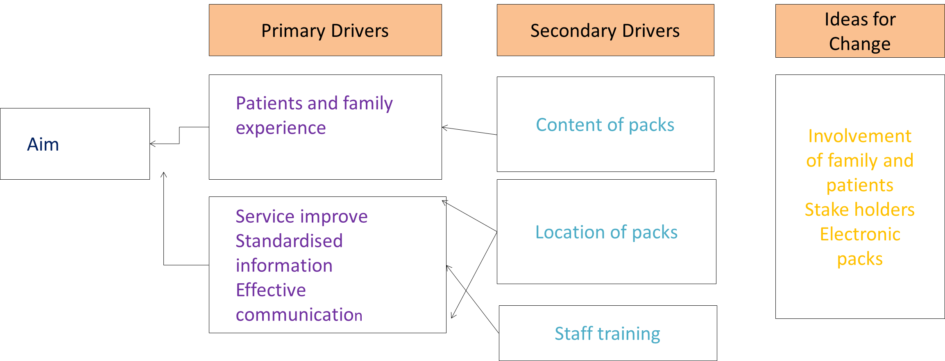
Development of signposted information pack - Doncaster and Bassetlaw Teaching Hospitals NHS Foundation Trust
Project Driver diagram
Primary Drivers
Secondary Drivers
Ideas for Change
Patients and family experience
Content of packs
Involvement of family and patients
Stake holders
Electronic packs
Aim
Location of packs
Service improve
Standardised information
Effective communication
Staff training

Slide 5
Development of signposted information pack - Doncaster and Bassetlaw Teaching Hospitals NHS Foundation Trust
Results
December 2019: Each member of staff asked their patients and families two questions. Based on the first test, the patients were asked the following questions:
Have you received any written information about the service? Yes/No
What information would have helped you? Please list below.
Completion and analysis of one patient and two questions were successful.
During the project, the feedback results fell within eight different types/groups of information or advice, which would be included in the proposed information pack.
In February 2020, the exciting and long-awaited pasta voting engagement method took place, and it was agreed to extend the collection of responses for staff working on acute admissions who directly provide care for patients with a suspected or confirmed diagnosis of epilepsy on a regular basis.
Tests were conducted in three different clinics. An instructional leaflet was provided to the patients and families at the start of the consultation that showed them how to use the voting system with up to four pasta pieces on the chart in 4/8 sections.
For the staff engagement, the chart was left in the staff coffee room using four different colour star stickers provided.
March 2020: begun drafting an info pack based on evaluation results from both staff and patients and their families.

Slide 6
Development of signposted information pack - Doncaster and Bassetlaw Teaching Hospitals NHS Foundation Trust
Results
The results of both the patient and staff polls revealed they wanted to know the following:
‘What is epilepsy’ in the majority and similarly 'safety measures’, advice was asked by both groups.
‘Contact details of the team’ didn’t matter for patients.
There was a lack of interest in ‘location of clinic’ and ‘website details’.
Other questions included ‘how can we get counselling support’, ‘how long will be the treatment’, ‘will the child be cured completely', and ‘what are the prospects of other siblings getting epilepsy’.
The results revealed what the team felt mattered to patients as a healthcare professional did not align with the feedback results of patients and families. Patients were more interested in their day-to-day management of their medical condition.
Engagement feedback with patients and families using the pasta poll techniques fell within the following four topics:
What is Epilepsy?
First aid training
Details of support groups
How to inform schools

Slide 7
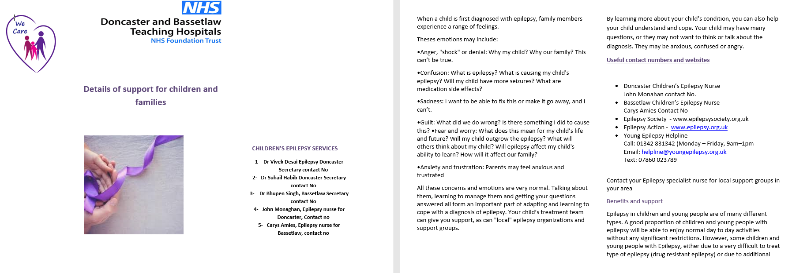
Development of signposted information pack - Doncaster and Bassetlaw Teaching Hospitals NHS Foundation Trust
The team created information leaflets on ‘what to do if your child has a seizure’ and details on areas of support for patients and families when a child is first diagnosed with epilepsy which covers info on the following:
Worries and anxieties,
Disability Living Allowance (DLA),
VAT relief,
NHS low-income scheme (LIS),
Free prescriptions,
Support organisations,
Blue badge,
Contact details of the healthcare team.

Slide 8
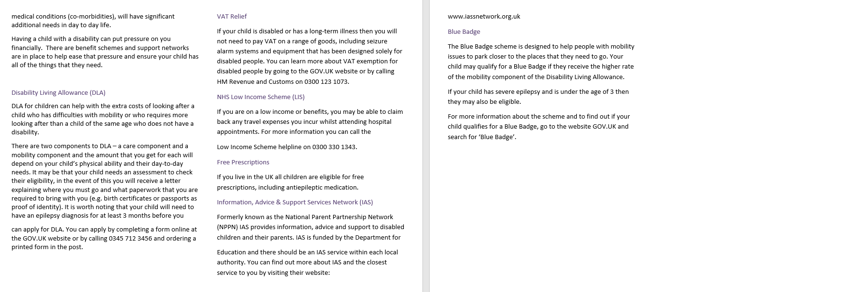
Development of signposted information pack - Doncaster and Bassetlaw Teaching Hospitals NHS Foundation Trust
Page two and three of ‘what to do if your child has a seizure leaflet.

Slide 9
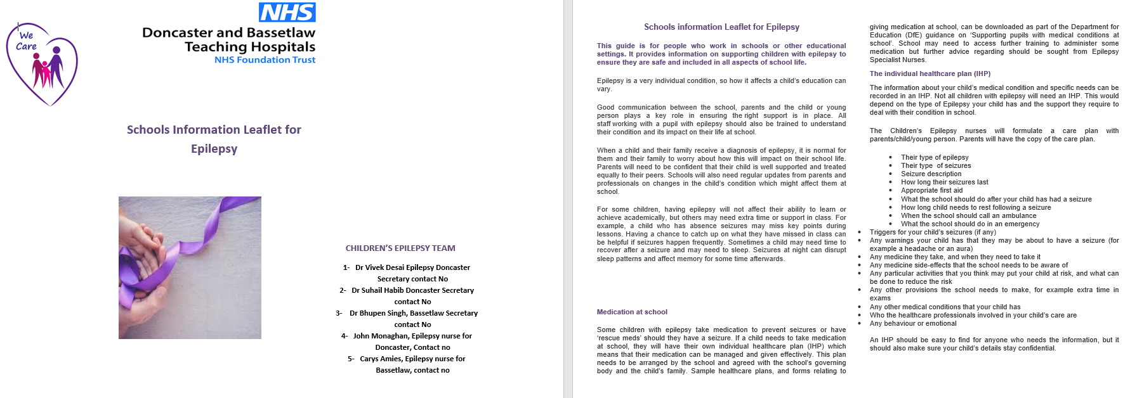
Development of signposted information pack - Doncaster and Bassetlaw Teaching Hospitals NHS Foundation Trust
The team also prepared a leaflet for schools. The guide is for people who work in schools or other educational settings. It provides information on supporting children with epilepsy to ensure they are safe and included in all aspects of school life.
The leaflet covers info on:
Medication in school
Individual Healthcare Plan (IHCP)
Exam times in school
How to make other pupils aware of epilepsy

Slide 10
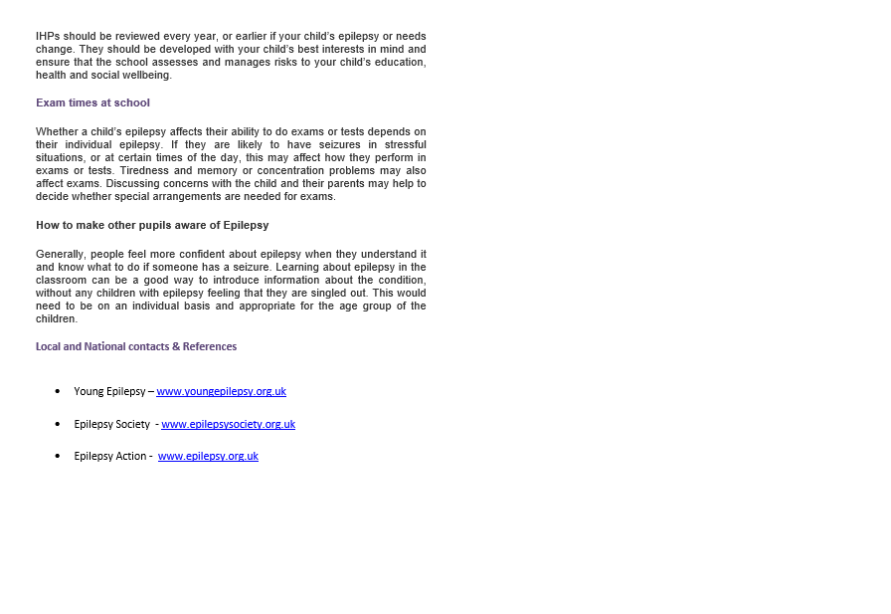
Development of signposted information pack - Doncaster and Bassetlaw Teaching Hospitals NHS Foundation Trust
Page two of leaflet for schools.

Slide 11
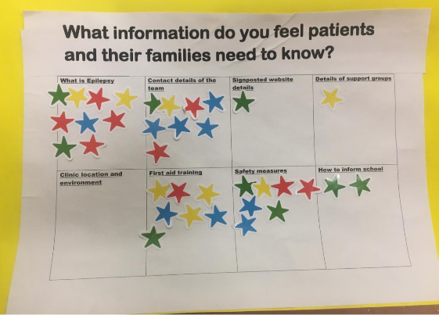
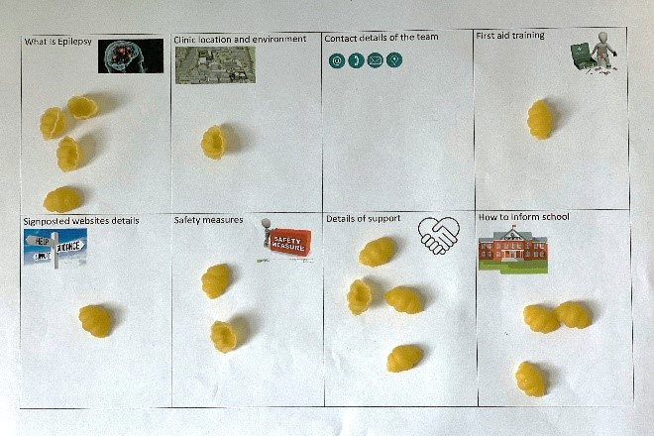
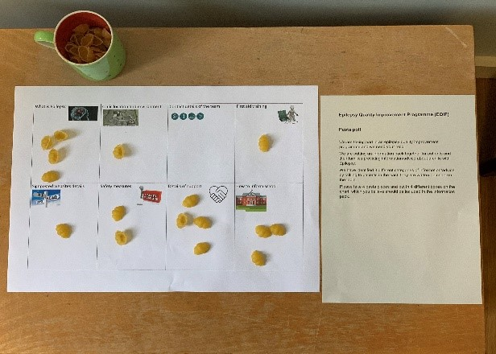
Development of signposted information pack - Doncaster and Bassetlaw Teaching Hospitals NHS Foundation Trust
Patients voting results
What is Epilepsy 10 | Clinic location and environment 4
Contact details of the team 0 | First aid training 8
Signposted websites details 3 | Safety measures 6
Details of support groups 8 | How to inform school 9
Staff star voting results
What is Epilepsy 9 | Clinic location and environment 0
Contact details of the team 9 | First aid training 7
Signposted websites details 1 | Safety measures 7
Details of support groups 1 | How to inform school 2
A variety of interesting responses from patients included:
Don’t know what epilepsy is
Would like first aid training
What will happen at the clinic and what questions will be asked
Who will be seeing us in the clinic
Is there any counselling service
Who should we contact if the child’s seizures are getting worse

Slide 12
Audit results for cohort 3 - Comprehensive care planning content - Doncaster and Bassetlaw
91% of children and young people diagnosed with epilepsy in Doncaster and Bassetlaw Teaching Hospitals Foundation Trust had documented evidence of communication regarding relevant core elements of care planning.
​Performance Indicators | 2019​ | 2020​ | 2021​ | 2021 - TEN | 2021- England & Wales​
10. Comprehensive Care Planning agreement | 60% | 82% | 76% | 79%​ | 70%​
11. . Comprehensive Care Planning content | 93% | 82% | 91% | 88% | 75%​
Performance indicator 10: Comprehensive Care Planning agreement​ | 2019​ | 2020​ | 2021​ | 2021 - TEN​ | 2021 – England & Wales​
% of children and young people with epilepsy after 12 months where there is evidence of a comprehensive care plan that is agreed between the person, their family and/or carers and primary and secondary care providers, and the care plan has been updated where necessary​ | 60% | 82% | 76% | 79% | 70%​
% of children and young people with epilepsy after 12 months that had an individualised epilepsy document with individualised epilepsy document or a copy clinic letter that includes care planning information​ | 93% | 100% | 97% | 96% | 91%​
% of children and young people with epilepsy after 12 months where there was evidence of agreement between the person, their family and/or carers as appropriate​ | 80% | 100%​ | 94% | 88% | 79%​
% of children and young people with epilepsy after 12 months where there is evidence that the care plan has been updated where necessary​ | 60% | 82% ​ | 76% ​ | 82%​ | 75%​

Slide 13
Audit results for cohort 3 - Comprehensive care planning content - Doncaster and Bassetlaw
The percentage of CYP with documented evidence of communication regarding core elements of care planning has increased in 2021 and more specifically achieving 100% in Prolonged seizures, first aid, service contact. Additionally, the percentage of CYP with documented evidence of communication regarding core elements (91%) increased above national (75%) and regional (88%) averages in 2021.

Slide 14
Improving patient engagement- Doncaster and Bassetlaw Teaching Hospitals NHS Foundation Trust
Challenges
Prior to the EQIP, there was no information pack available locally; the team normally relied on national information sources from Epilepsy Action and Epilepsy.org.uk for general information, including safety advice for parents and patients. The contact details of the team and signposting of the team would be communicated verbally or within the patient's EHCP. Therefore, it was crucial that the teams' contact details were included on each leaflet.
There has been a considerable change in service provision with the progression of the pandemic.
Collectively, the team noticed that there was lots of duplicate information in the leaflets.
It became a challenge to decide whether to reduce the number of leaflets to two instead of four. Eventually, it was agreed that, per the results of the engagements, it is better to design four small leaflets because they would address the different concerns and provide information that can be used separately, if not together.

Slide 15
Development of signposted information pack - Doncaster and Bassetlaw Teaching Hospitals NHS Foundation Trust
Outcomes
Achieved their project aim to develop an information pack containing four leaflets covering the following information:
‘What is Epilepsy’, ‘Support available’, ‘How to inform School’ and ‘First Aid Training’.
Increased engagement amongst fellow paediatric and emergency department colleagues who welcomed the newly created information leaflets.
The team's confidence increased when engaging with children and young people and parent/carers.
National audit results revealed
91% of children and young people diagnosed with epilepsy in Doncaster and Bassetlaw Teaching Hospitals Foundation Trust had documented evidence of communication regarding relevant core elements of care planning.
The percentage of CYP with documented evidence of communication regarding core elements of care planning has increased in 2021 and more specifically achieving 100% in prolonged seizures, first aid and service contact. Additionally, the percentage of CYP with documented evidence of communication regarding core elements (91%) increased above national (75%) and regional (88%) averages in 2021.

Slide 16
Development of signposted information pack - Doncaster and Bassetlaw Teaching Hospitals NHS Foundation Trust
Lessons learnt
Engaging with patients and families helped to eliminate the teams' assumptions on what they thought were the concerns of their patients and discovered they wanted information on the diverse aspects of epilepsy care, including a greater understanding of ‘what is epilepsy’ or ‘long-term effects of epilepsy on lifestyle and health’.
Quality improvement is a continuous process that uncovers more areas for improvement along the way.
Pasta voting was an interactive, entertaining, and informative method, offering the opportunity for participants to express their views and increase engagement in a more effective way.
Although there are lots of opportunities for improvement, the team had to focus on achievable tasks.
The team learned how to organise and reduce the number of diverse questions that can be addressed in a systematic process.
Asking simple and easy questions provides speedier feedback to act on, providing confidence about the service provision.
An essential part of the quality improvement experience was to improve the perception and experience of their patients and families.
Although it has been a difficult and challenging time during the pandemic, the team felt they had provided the same level of care and learned new skills in the process, which will have an everlasting effect on the way the team practices and cares for their patients.
Visual presentation of team project intervention Team poster

Slide 17
https://eqip.rcpch.ac.uk
eqip@rcpch.ac.uk
@RCPCHEQIP

