Slide 1
Gabriel Whitlingum - Consultant in Paediatric Neurodisability
Evelina London Children’s Hospital/ Hampshire hospitals NHS trust
British Paediatric Epilepsy Group
17th March 2023
CHECC - Child and Young person Epilepsy Concerns Checklist. Information gathering to explore wider needs

Slide 2
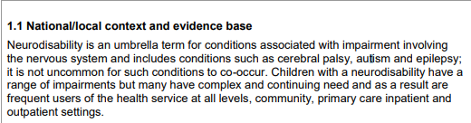
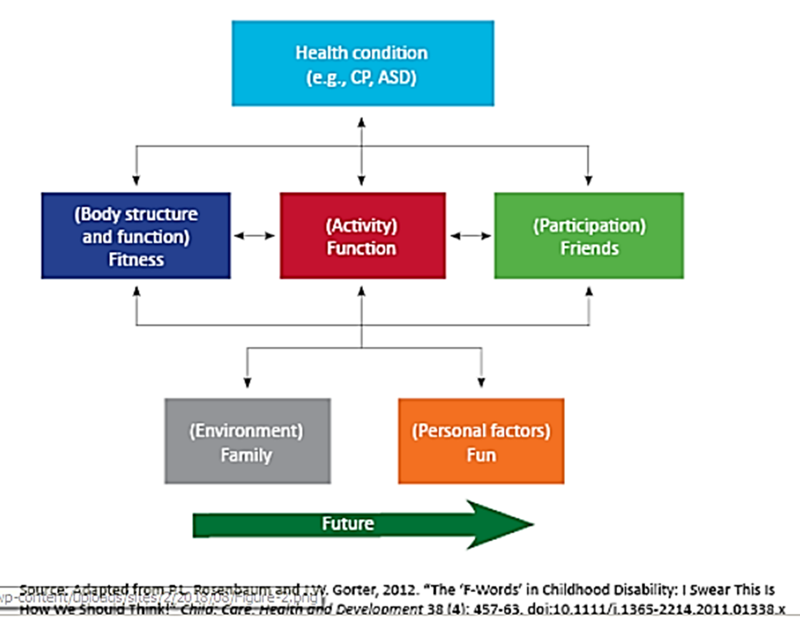

https://www.england.nhs.uk/wp-content/uploads/2013/06/e09-paedi-neurodisability.pdf
DESSCRIBE

Slide 3
Towards a definition of neurodisability: a Delphi survey
Morris C , Janssens A , Tomlinson R , et al Dev Med Child Neurol 2013;55:1103–8.
doi:10.1111/dmcn.12218 pmid:http://www.ncbi.nlm.nih.gov/pubmed/23909744
'Neurodisability describes a group of congenital or acquired long-term conditions
Attributed to impairment of the brain and/or neuromuscular system
A specific diagnosis may not be identified.
Create functional limitations.
Conditions may vary over time, occur alone or in combination
Include a broad range of severity and complexity.
May include difficulties with movement, cognition, hearing and vision, communication, emotion, and behaviour'.

Slide 4

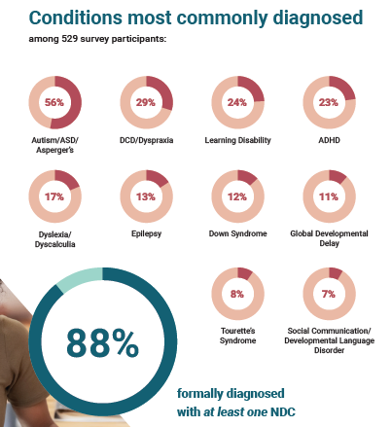
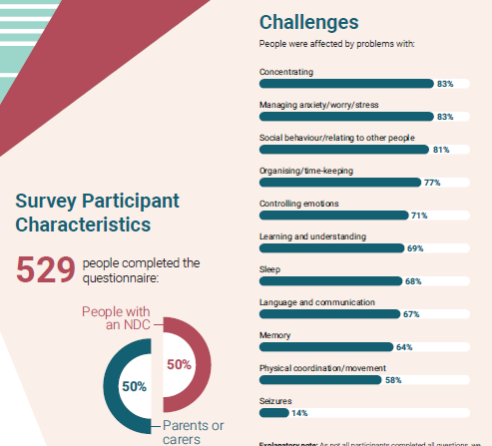

Slide 5
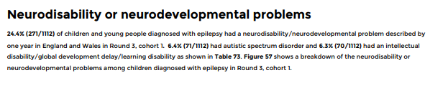
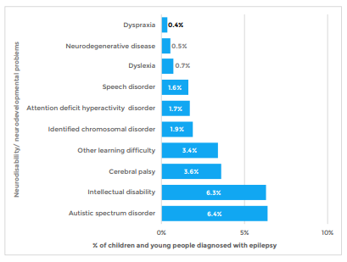


Slide 6
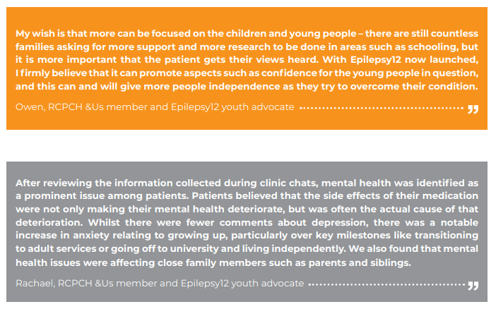

Slide 7

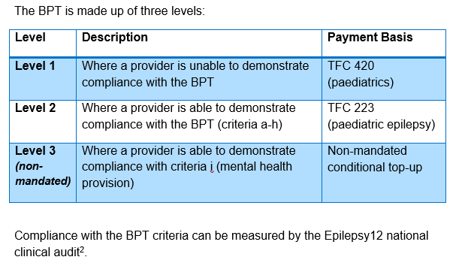
Best practice tariff

Slide 8
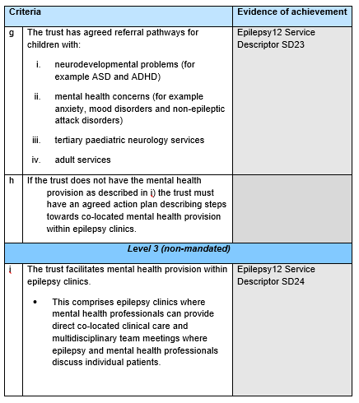



Slide 9
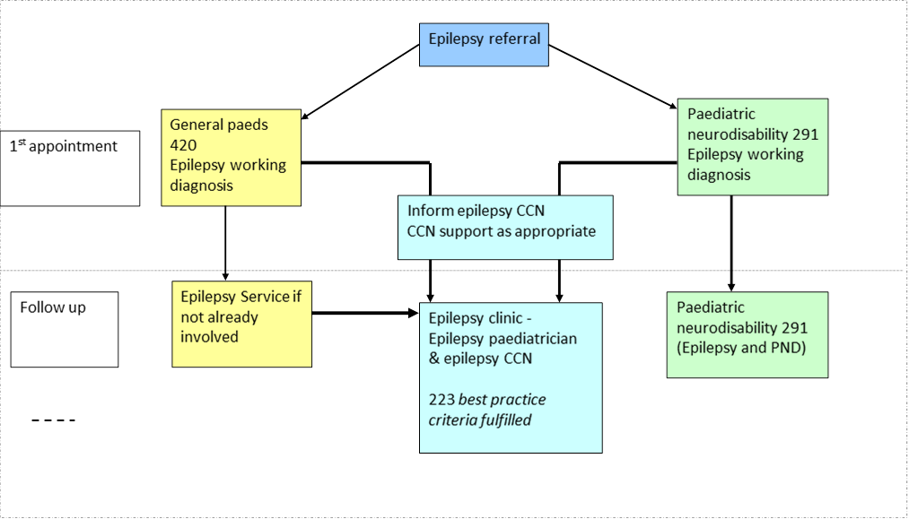
Paed epilepsy and paed Neurodisability TFC

Slide 10
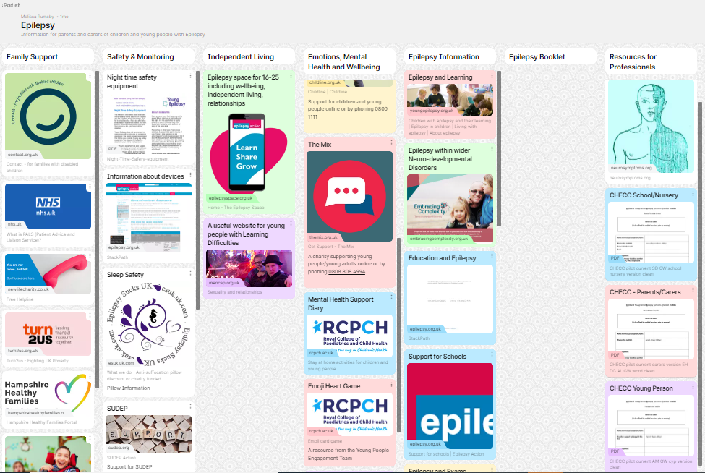

Local resource - Epilepsy (padlet.com)
)

Slide 11




MICE
Paves
ABLE
SDQ
DAWBA
RCADS
CONNERS
CCC

Slide 12
CHECC (Child and young person Epilepsy Concerns Checklist) to identify wider needs of epilepsy patients
CHECC was developed with input from parents, epilepsy charities and professionals including paediatric neurologist, neuropsychiatrist, psychologist, epilepsy nurse, general and neurodisability paediatrician .
Three different versions of the checklist were created (parent/carer, education and young person version).
Different questions were included in each version. All checklists had a specific space to set their top three goals.
Sent to certain families and education providers for children and young people with epilepsy.
Seen in a DGH epilepsy clinic supported by a neurodisability epilepsy paediatrician and epilepsy nurse.
Facilitate information sharing between education and epilepsy services
Identify concerns relating to epilepsy, neurodevelopment and mental health.
Confirm support such as special educational needs provision.
Highlight areas that require further evaluation such as (ID/LD), (ASD), (ADHD) (DCD) as well as mental health or epilepsy treatment concerns

Slide 13




CHECC (Child and young person Epilepsy Concerns Checklist) to identify wider needs of epilepsy patients
Dr Gabriel Whitlingum et al – Consultant in Paediatric Neurodisability Evelina London Children’s Hospital & HHFT
CHECC aims to facilitate information sharing between education and epilepsy services to identify concerns relating to epilepsy, neurodevelopment and mental health..
Carer, young person and school/nursery versions have been developed to include neurodevelopment, emotion and behaviour concerns as well as safety, general health transition and goal setting.
41 children had the CHECC completed by their teachers and or SENCOs. Emotional or behaviour concerns were reported in 20, social interaction and/or communication concerns in 25 , attention and concentration 32 and Special Educational Needs in 16.
29 had concerns with the core skills e.g reading, writing, spelling and/or maths and 22 indicated concerns with overall cognitive skills with 8 indicating that further cognitive evaluation would be helpful.
There were no reported concerns re safety, supervision or care plans in general,. All of the 12 respondents who gave feedback on education CHECC, indicated that it was potentially helpful.. 2 were unclear – though this was an earlier version of the checkilst
This pilot study indicates that he CHECC may be an acceptable and effective tool for collating education professional concerns about the child or young person with epilepsy.
HHFT Epilepsy Padlet resource
“The more people that can use it the quicker the treatment can be accessed….. they can then send the information to the specialist if they are in an area with a long waiting list or very few epilepsy nurses.” Parent of child with early onset epilepsy, global delay and asd
With thanks to:
Dr Ashley Liew – Consultant Neuropsychiatrist Evelina/GSTT
DR Elaine Hughes – Consultant Paediatric Neurologist Evelina /GSTT ans SETPEG chair
Dr Dionysious Grigoratas – Consultant paediatrician spec interest in epilepsy
Helen Evans - Dravet Syndrome UK
Amy MuggeridgeLara Carr - Young Epilepsy
Medicines in schools alliance
Experts by experience (RCPCH & Us) – Emma Sparrow and parent representative Venner Turner
Sharon Seton CCN sister and Paediatric Epilepsy nurse specialist HHFT
Dr Brigitte Vollmer Consultant Paediatric Neurologist Neonatal neurologist University Hospitals Southampton (UHS)
Dr Alice Lording Consultant Paediatric Neurologist –UHS
Dr Danielle McLymont – Principal Clinical Psychologist HHFT
Rebecca Case Epilepsy Nurse specialist – Portsmouth HFT
Melissa Dean SALT – Hampshire HHFT
“I wish I had this when my child started nursery”
Parent of child with SCN1a epilepsy now a teenager
How parents and voluntary organisations contributed
Discussion with colleagues–evaluation tool for children with wider needs in the context of epilepsy
Combined Tool developed in consultation and shared with local working group – epilepsy nurse x 2, psychologist, educational psychologist
Shared with Dravet UK,– supportive though commented that some families may prefer to discuss family /parental stress of parental mental health with gp rather than paediatrician.
Shared with BACD and BACCH
Feedback from RCPCH &Us/Experts by experience and epilepsy programme board parent/care reps, as wlell as schools and parents
Pilot tools refined following initial feedback with development of separate schools version, young person’s version, parents version
£ versions – Care, education, cyp developed
CYP versionFeedback from Young Epilepsy group
concerns – reading, writing, spelling, , maths 29
Wider cognitive concerns 22
10 significant impact 6/8 +
Formal assessment results
5 confirming ld , (2 awaited).
5 ASD , 2 in progress
6 ADHD/ADD
2 DCD both with ld or adhd
3 low mood/depression
“We went through CheCC form together. It helped spotlight what were thought to be minor longstanding issues about social anxiety and routines noted from about 4 years which were having a real impact.” Parent 15 year old with anxiety and possible features of ASD & ADHD

Slide 14
41 children had the CHECC completed by their teachers and or SENCOs.
Emotional or behaviour concerns were reported in 20,
social interaction and/or communication concerns in 25 ,
attention and concentration 32 and Special Educational Needs in 16.
29 had concerns with the core skills e.g reading, writing, spelling and/or maths and 22 indicated concerns with overall cognitive skills with 8 indicating that further cognitive evaluation would be helpful.
There were no reported concerns re safety, supervision or care plans in general,. All of the 12 respondents who gave feedback on education CHECC, indicated that it was potentially helpful.. 2 were unclear – though this was an earlier version of the checkilst

Slide 15
Nursery/School CHECC
Early years
National Curriculum attainment
Parent/carer CHECC
Milestones
Emotional well-being
Young person CHECC
Transition to adult services
Lifestyle concerns
Reasonable adjustments
Medication side effects
Sleeping issues
Barriers regarding driving and employment

Slide 16
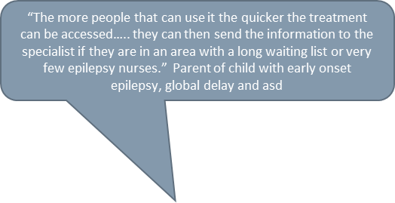
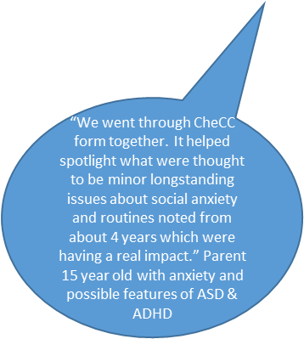
Concerns -
Concerns reading, writing, spelling, , maths 29
Wider cognitive concerns 22
10 significant impact 6/8 +
Formal assessment results
5 confirming ld , (2 awaited).
5 ASD , 2 in progress
6 ADHD/ADD
2 DCD both with ld or adhd
3 low mood/depression
“I wish I had this when my child started nursery”
Parent of child with SCN1a epilepsy now a teenager

Slide 17
8 yo male cp
Bilateral pvl and Mts
Seizure stable 1.5 years
Transition y6 to yr 7 difficult
Increased seizures focal motor circling arm, unilateral face twitching, abdo aura
24hr eeg – abdo episodes not eeg changes but fronto temporal changes (previously reported occipital change)
Cbz, lev max
Plan vt cess?
Reduce cbz ?lmt/zns/vpa

Slide 18
Sib 7 year old asd assement camhs –ot met awaiting adhd,
Parent long dw paed neuro re cess and rx
Follow up to discuss neuro dev
“School asked if he was having autism assessment” Did they send you anything
Academically always behind, always shy, socially immature/awkward, play by self even before epilepsy and during remission period
Time staring school – cluster of seizures with post ictal aura few/week. Even when nil seizures seemed fatigued after school.
Checc school Dec 2021

Slide 19
Senco name plus email
Behaviour
  Anxiety, mood swings, low mood
  Vulnerable and easily led
  Comm and interaction
    Lack of social chat
    Difficulties getting on with peers
    Ot like change – middle
    Attn/conc –
    Acting as if not heard
    Impulsivity/butting in
    School difficulties – r,w,s,m,breaks,friendships
    Has SEN support with pupil plan and medical care plan (midazolam)
    Cats year 6
    Verbal 78
    Non verbal 81
    Quantative r 91
    Spatial 63
Memory
No concerns re epilepsy care /support, school trips, managing seizure/staff training
7/8 barrier to participation
Top 3
Social communication
Understanding of needs and difficulties and what relate to seizurres, meds, anxiety, sleep
Referral to ot

Slide 20
Comments
Useful. Length – just right
When – before appointment
Completion preference paper , weblink, app – website
Expectations support, suggestions, possible cog assessment
Plan ados, nice asd signs and symptoms, Connors, joint psychology review
Cog likely by neuropsych cess. Vt listed
Ot referral
Explain formulation - likely additional neurodev

Slide 21
6 yo female
Scn1a dravets
Cbd weaning
Top, stp, clb,
To start fenfluramine
Jan 2021
Checc

Slide 22
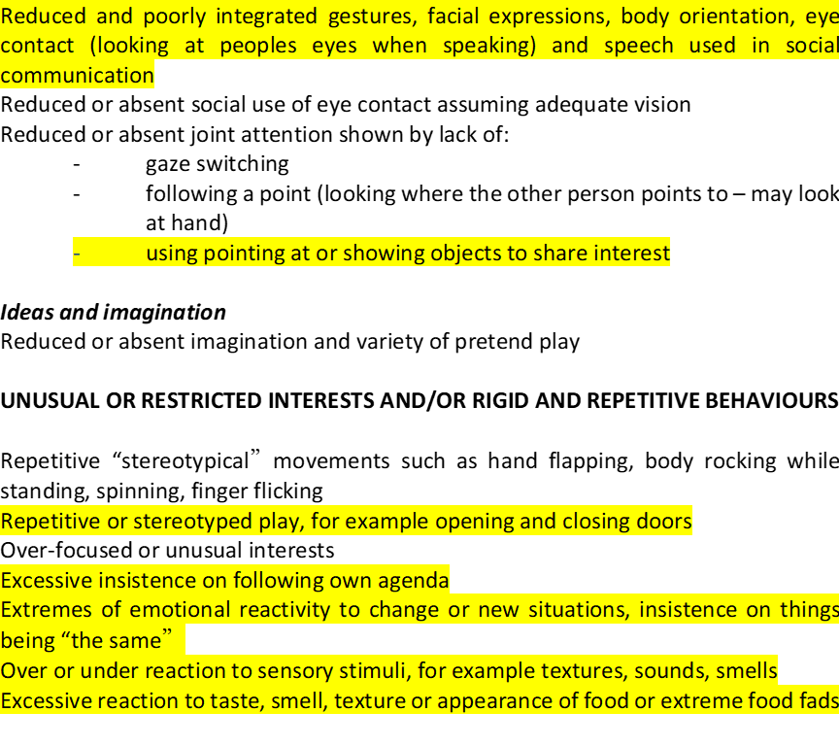

Slide 23
As this is a draft tool please comment on whether you found this checklist helpful and how?
The checklist is helpful as it allows you to identify areas of difficulty in your child and areas which you should perhaps pay more attention too
If you did not feel it was useful at this moment when do you feel is the best time to complete this?
Reflecting on some of the early milestones is quite difficult to remember. The questions are quite open and don’t allow for elaboration but it’s a nice starting point.
Was this about right or too short or too lengthy to complete?
Yes about the correct length. Any longer and it requires too much time to complete
When do you think this questionnaire would be useful? For example, before the clinic appointment, in the waiting room, after meetings with school, concerns in-between appointments?
Before appointments or after concerns raised would be helpful to allow services/hospital/neuro to see gap/problems in areas that are of importance. Preferably Not whilst waiting for an appointment- it requires too much thought (I certainly don’t have that time whilst watching O in a hospital/unfamiliar setting!) and you wouldn’t think that your answers/responses had been considered if the person just skimmed it during an appointment but if it is used as a discussion tool then it could be helpful prior to an appointment if given to complete before.
How would you like to complete this checklist? For example, on paper, using a website link or app?
Through email- open and complete in word as can do on the phone/computer or can print if required.
What are your expectations after completing this?
That it is used to highlight gaps in support the child is receiving and highlights areas of difficulty that are on interest and could be early warning signs that a child is going to have difficulty
Do you have any other comments to help us develop this further?
O had continuous evaluation and dialogue revolving around potential ASD symptoms from an early age during epilepsy clinic appointments. This continued with pre school making observation; portage and onto school. Whilst we didn’t complete this exact check list for the purposes of assessment we have completed similar previously and they’re very helpful in helping to notice the gaps and highlight the areas of difficulty that our children with epilepsy have. Creating a working diagnosis of ASD previously helped to cement the diagnosis received during an ADOS assessment that was requested due to services and people involved with O’s care being aware of the difficulties and Barriers she has faced. The diagnosis is really important to help people better understand O and support her better even though people were already aware that due to her epilepsy/medication/dravet diagnosis she had lots of cormobidities that made life more difficult for her she could still be seen as being difficult or resistant but there is a reason for that behaviour.
Overall, Os development has always been a priority whilst balancing seizures and behaviour/mood/cognitive changes from medication and I have always felt that her development has been prioritised. I feel, perhaps due to covid, it took a long time to get to the point of an ADOS assessment but appreciate the difference in children becomes more obvious the older they get.

Slide 24
Goal-setting
Of all the concerns listed above, what are your top priorities to work on next?
1. Reslience and growth mindset
2. Acquisition of social skills to support interaction
3. Language - receptive and undertaking adult directed tasks
As this is a draft tool please comment on whether you found this checklist helpful and how?
Yes
If you did not feel it was useful at this moment when do you feel is the best time to complete this?
Was this about right or too short or too lengthy to complete?
Fine
When do you think this questionnaire would be useful? For example, before the clinic appointment, in the waiting room, after meetings with school, concerns in-between appointments?
N/A
How would you like to complete this checklist? For example, on paper, using a website link or app?
Website link
What are your expectations after completing this?
Information will be used to inform research
Do you have any other comments to help us develop this further?
For clinicians/epilepsy team.
Do you think you will use this information? How?
For our school records as a snapshot of where the child is.
Do you think there will be useful outcomes as a result, such as signposting for further assessment or exploration or support of particular difficulties or conditions?
Sign posting would be useful.

