Slide 1
Hampshire Hospitals NHS Trust Improving Care for Children with Epilepsy RCPCH EQIP QI Project

Slide 2
HHFT Paediatric Epilepsy Team
Dr. Gabriel Whitlingum (Consultant Community Paediatrician)
Dr. Danielle McLymont (Principal Clinical Psychologist)
Sharon Seton (Children’s Epilepsy Nurse)
Dr. Michelle Medalla (Associate Specialist Community Paediatrician)
Dr. Deb Pathak (Consultant Paediatrician)
Pauline Seaton (Children’s Epilepsy Nurse)
Notes:
Say why you have selected the individuals and what influence they have on your project

Slide 3
Aim
To better understand the wider educational and psychological needs of children and young people with epilepsy (cypwe) under the care of BNHH by piloting a measure to capture this, called the CHECC.
To improve our knowledge about the wider needs of 10 patients with Epilepsy under the care of the BNHH paediatric epilepsy team by April 2023.
Spread good and newly developed practice from one hospital to the other hospital in the Trust.
Notes:
Remember how good my when within this project lifetime

Slide 4
Background Rationale
This project was chosen to develop our HHFT epilepsy service across two DGH hospital sites because the Trust has a different service provided re different historical funding patterns.
RHCH had begun trialing the use of this measure to help provide better care to our epilepsy patients. In RHCH have some psychology input 0.2 wte for assessment of children with epilepsy (including cognitive assessments) BNHH does not.
We have regular HHFT epilepsy service meetings where we discussed the enhanced service at RHCH and decided as a team it was important to begin to replicate the work being done at RHCH to BNHH.
Team part of Epilepsy 12 audit- enhanced service by introducing an epilepsy nurse to HHFT for BNHH in 2019.
To capture the needs of the BNHH cypwe whose needs were unknown/uncaptured.
CYPwE have significantly increased risk of developing emotional, learning, mental health and behavioural difficulties, compared to their peers and other children with chronic health conditions.
We used a driver diagram to help us focus on where the problems lay.
Patients and families were involved in the development phases of the tool and asked if the measure was helpful, and for example, if it was too long or complicated to complete and revisions made.

Slide 5
Driver Diagram
Primary Drivers
Secondary Drivers
Change ideas
Improve targeted assessment e.g. ASD, ld, ADHD and/or anxiety /moods​
where specific concerns lie, e.g. learning vs mental health
Children and Young people with epilepsy have CHECC sent and reviewed by paediatrician
3 versions: carer, school version and yp version as appropriate.
Spread best practice trust-wide, in line with NHS long term plan
Limited psychology provision for this population
HHFT – mental health screening and support:
AIM: Scope the unknown wider needs of 10 BNHH paediatric epilepsy patients
Long waiting list for psychology - tiny resource 0.2 wte
Gather information about functioning to improve the quality of referrals to Trust (in-house) psychology team ​
Gather information about functioning to improve the quality of referrals to CAMHS
No clear tool
Notes:
Keep it simple
You wont be doing everything on the diagram
It creates a 1 page plan

Slide 6
Stakeholder Map
High
HHFT Epilepsy Team HHFT paediatric epilepsy patients and their families Young Epilepsy charity
 | Trust management Local commissioners
Interest
Low
Low Influence High
Notes:
Use the previous template to map the key stakeholders for your AIM.
Map your stakeholders
Identify stakeholders require attention

Slide 7
First site: RHCH early testing CHECC developer
AREA OF CONCERN | Of 41 children (school completed) | Percentage
Emotion or behaviour concerns | 20 | 49%
Social interaction and/or communication concerns | 25 | 61%
Attention and concentration | 32 | 78%
SEN | 16 | 39%
Difficulties with Core learning skills | 29 | 71%
Concerns with overall cognitive skills | 22 | 53%
Cognitive assessment would be useful | 8 | 20%
Significant impact rated 6/8 | 10 | 24%

Slide 8
Patient and Family Engagement
We engaged a variety of sources in this project, namely,; parents, and the Young Epilepsy Charity who liaised with their connected group of young people. We are also looking to develop the tool as an app- to appeal more to young people then a paper form.
At the end of each checklist we asked them for feedback on us using this measure in clinic, with questions such as whether this 6-page form was too long, too short or about right. There were a wide range of responses. As a team we felt it was an okay length to be used, given the spread of responses.
Other feedback was that it was helpful to highlight concerns that schools and some families held.
All of the 12 respondents who gave feedback on education CHECC, indicated that it was potentially helpful.. 2 were unclear – though this was an earlier version of the checklist
After seeking families and school’s views on the measure, we revised the questions.
Planning to develop an app for the next stage of the project in connection with Young Epilepsy charity.
Methods:
The CHECC measure was developed with input from parents, epilepsy charities and professionals including paediatric neurologist, neuropsychiatrist, psychologist, epilepsy nurse, general and neurodisability paediatrician.
Three different versions of the checklist were created (parent/carer, education and young person version).
Different questions were included in each version. All checklists had a specific space to set their top three goals.

Slide 9
Our PDSA cycles
A P
Cycle 5
S D
Cycle 4
A P
S D
Cycle 3: Send out with deadline for return and chase families – forms returned
A P
S D
Aim of the test
How can we get schools and parents to return completed forms?
Cycle 2: Send CHECC out by email from psychology coordinator- small return: 2/10
Cycle 1 Secretary send out CHECC forms by post- none returned
Notes:
You can insert text in the aim box and the cycle text boxes

Slide 10
Data/Results
Pilot in BNHH: CHECC Forms sent to the families of 21 patients. School/nursery, parents’ version and self-report versions.
Outcome: Forms received regarding 12 patients, a 57% response rate.
Respondents:
30% from parents
40% from schools
30% from young people
Notes:
Some call PDSA’s learning cycles
What did you learn?
Often the test either confirm your hunches or assumptions or you find out what does NOT work.
Everything you discover helps to move your thinking and planning for change

Slide 11
Data/Results 2
75% of returned questionaries showed having epilepsy was perceived as having a significant impact on their life
George et al. (2021) PAVES study quoted 56% increased risk- we chose certain families to send CHECC to
Area of Concern | % Identified this as area of concern
Mood/Mental health/Behavioural issues | 75%
ASD/Social interaction | 80%
ADHD Symptoms | 80%
School difficulties | 70%
Accessing additional SEND support at school | 45%
Epilepsy having significant impact | 75%
Accessing additional psychology or counselling support, NHS, charity or private | 30%
Attending SEND school or SEND provision | 10%
Notes:
Some call PDSA’s learning cycles
What did you learn?
Often the test either confirm your hunches or assumptions or you find out what does NOT work.
Everything you discover helps to move your thinking and planning for change

Slide 12
What did your test reveal?
Despite people presenting in clinic with concerns, that contacting them “cold” with a form to complete does not get us the information sought. This did not work. In the original RHCH pilot, the form was mentioned in a clinic and this got much better response- 41 patients responded.
Abandoned sending it cold in the post, needed to email it and chase people- more proactive.
Feedback from the forms suggested sending it before the clinic would be of most benefit.
Feedback was also to make it digital- next step via Young Epilepsy.
Ideally would upload to EPR- electronic patient record so Paediatrician can review before brining into the clinic room, or whilst they are there.
Notes:
Some call PDSA’s learning cycles
What did you learn?
Often the test either confirm your hunches or assumptions or you find out what does NOT work.
Everything you discover helps to move your thinking and planning for change

Slide 13
Successes
Challenges
We achieved the project aim and scoped wider needs of 12 children/young people
Paediatrician will have information to draw on to discuss with the family at the next appointment including information from education, which previously would not have been available
Initial attempts to get data were completely unsuccessful.
Very difficult to bring together the whole team to make a team effort.
The team member’s timelines didn’t work out, e.g. having trainee support
In reality was difficult to implement this change within the team who wanted more understanding of the patient group.
What we would have done differently:
Brought more epilepsy-focused admin staff in sooner.
Financially- business case not yet supported, wanting more psychology and SLT- ASD assessment
Notes:
Some call PDSA’s learning cycles
What did you learn?
Often the test either confirm your hunches or assumptions or you find out what does NOT work.
Everything you discover helps to move your thinking and planning for change

Slide 14
Team learning highlights
We’ve learned about the challenges of changing practice of clinicians particularly at times of great challenge and trust under increasing financial scrutiny.
Usefulness of having one form to send people to capture concerns.
We’re beginning to scope the size of the unmet need within our trust, where two trusts became one, but years later there’s still huge differences in service provision.
We’ve been harmonising service delivery across both hospital teams and sites, but still more improvement is needed.

Slide 15
Next Steps
Discuss EQIP outcome at next epilepsy service meeting.
Develop Padlet further- more self-help resources, e.g. anxiety, anger, low mood.
Wider Child Health: Present at Child HHFT Health clinical governance meeting and introduce the measure to be used by non epilepsy specific paediatricians who may see epilepsy patients too- big challenge.
Develop the app- most appeal to young people and more efficient way of getting the information into the paediatrician’s hand in clinic. More environmentally and young-people friendly.
Have form on a device in waiting room

Slide 16
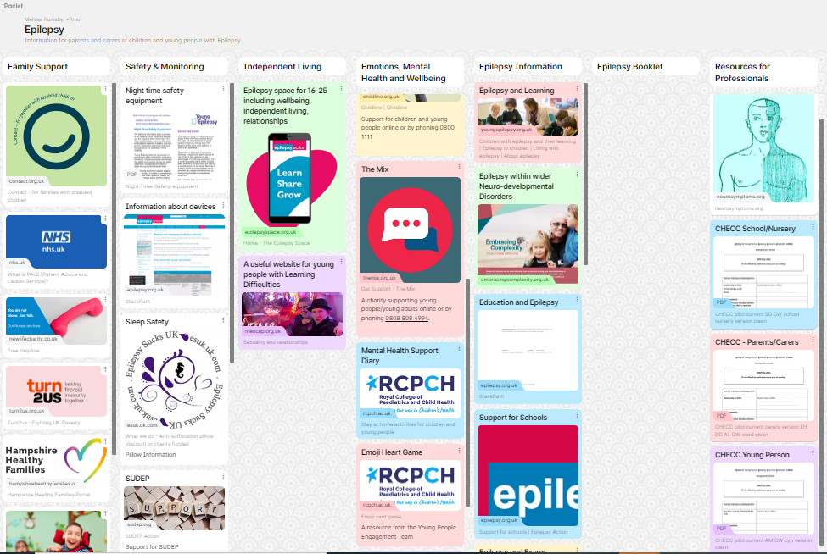
HHFT Epilepsy Padlet

