Slide 1
Medway NHS Foundation Trust Improving Care for Children with Epilepsy RCPCH EQIP QI Project

Slide 2
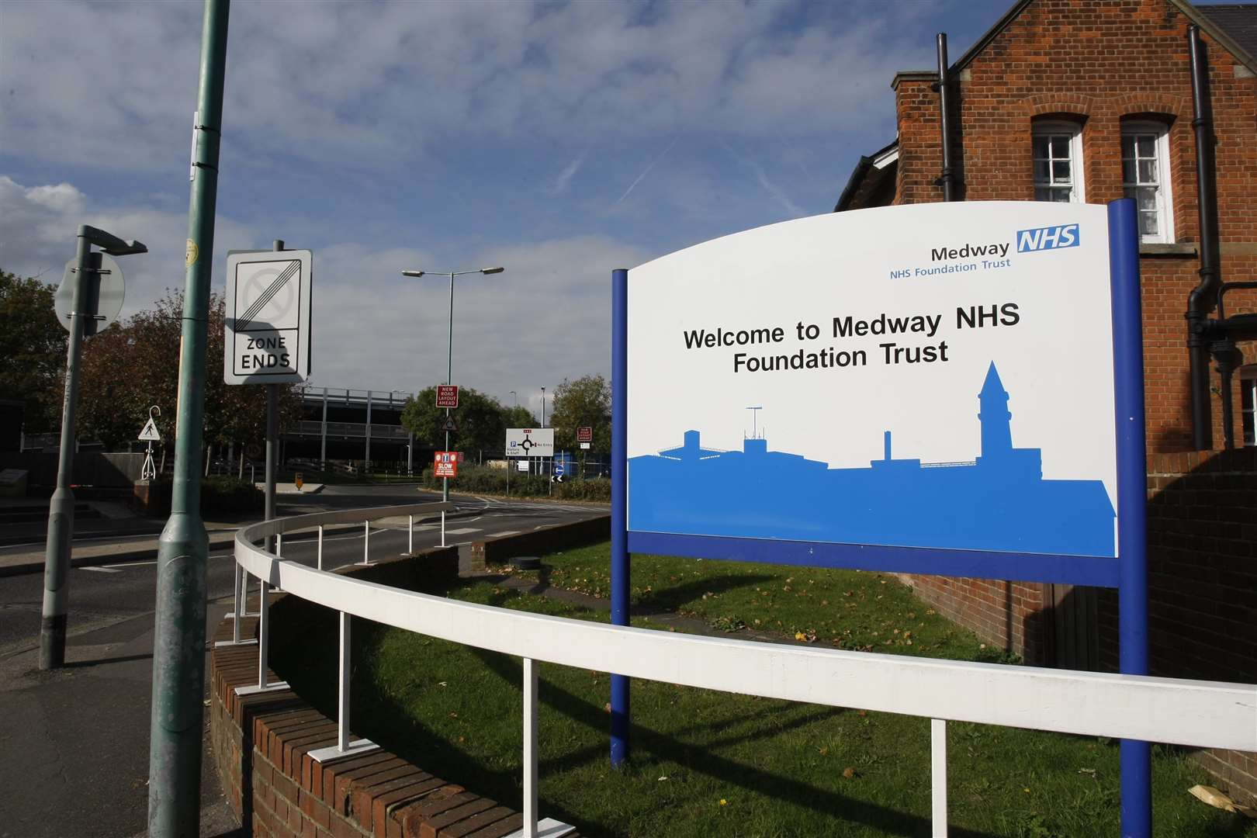
Our Team
Ms. Teresa McIntyre
Roald Dahl Epilepsy Nurse Specialist
Dr Mercedes Munteanu
Consultant Paediatrician
Dr Faisz Mohamed
Consultant Paediatrician

Slide 3
Aim
60% of first seizure referrals are seen within 2 weeks by May 2023
Notes:
Remember how good my when within this project lifetime

Slide 4
Background Rationale
Local service newly created - capacity and process issues emerging as service evolving:
No first seizures clinics/ slots
Increasing wait times as caseload grew
Referring and triaging too complicated
Great variation in practice for in-hospital referrals
Change necessary in order to improve patient journey and comply with National guidance

Slide 5
How did we identify the issues?
Clinic data showing an increase in waiting times
Process Mapping of the referral/ triage systems
Patients and Families telling us of difficulties in being seen

Slide 6
Process mapping: ‘Before’ referral/ triage pathway

Slide 7
Patient and Family Engagement
Two methods used
Questionnaires for patients and families (wait time, who referred)
Patients and families asked of their experience of waiting to be seen by the Epilepsy team
Referral source
Wait time
Informed
of wait time
Expectation of wait time

Slide 8
Patient and Family Engagement
‘When we left ED we were told to go to our GP to get a referral to the epilepsy team at the hospital which did not make sense.’
‘We knew we had been referred to the epilepsy team but we did not hear anything for over a month and did not know who to contact to find out more information.’
Patient and Family Feedback
‘We were told when he was discharged that the epilepsy clinic was very busy but we met with the nurse before our appointment and she gave us training on the emergency medication and a contact number so this helped a lot.’
‘We were referred by the Community doctor but it seemed to take ages before someone got in touch about an appointment.’

Slide 9
Stakeholder Map
High
Patients and families | Epilepsy Team Service Manager
ED and Paediatric teams | Secretarial/Admin staff IT team
Interest
Low
Low Influence High
Notes:
Use the previous template to map the key stakeholders for your AIM.
Map your stakeholders
Identify stakeholders require attention

Slide 10
Driver Diagram
Primary Drivers
Secondary Drivers
Change ideas
1.First seizure pathway and SOP with clear instructions on how to refer
2.Easy/quick referring: email EDN, EPR form
3.Visual prompts in clinical areas
1.Reduce time to triage – daily review/ common end-point for All referrals
2.Dedicated Epilepsy Pathway Coordinator
3.One Consultant to action All referrals in 24-48h
1.‘Reserve’ 2 week wait appt., only fill 1-2 weeks before each clinic
2.Weekly reviews of available slots
3.Fill in all cancellations
4.Ad-hoc New two week appt./ move some follow-up patients in PENS led clinics
Patients & Families feedback
Involve Management
Education and training for all staff (ED & Paed teams/ Admin staff)
Develop First seizure referral
pathway
SOP to clarify process
Create electronic referral form
Simplify referral process
60% first seizure referrals to be seen within two weeks by
May 2023
Streamline triage
Revise clinic capacity
Re-design triage process
New clinic template
Monitor demand/ capacity
Maximise capacity
Notes:
Keep it simple
You wont be doing everything on the diagram
It creates a 1 page plan

Slide 11
Examples of our PDSA cycles
A P
Cycle 5: First seizure referral pathway completed. Education sessions, visual prompts to reinforce learning.
Goal to see 60 % first seizure referrals within two weeks achieved!
S D
A P
Cycle 4: Epilepsy Pathway coordinator appointed. Regular contact, weekly meetings with Consultant. Issues: Ongoing delay in hospital referrals.
S D
A P
S D
Cycle 3: One Consultant to triage and keep records of 2 week wait referrals. 24-48h review and action of First seizure referrals.
Issues: improved triaging & matching demand/capacity; variability in referring practice
Cycle 2: ‘Reserve’ First seizure (2 week wait) slots each clinic. Continue to record data on referrals (demand) and capacity. Start revision of referral pathway.
Issues: multiple people involved, recording of referrals inconsistent - duplication/ missed appointments
60% first seizure referrals to be seen within two weeks by May 2023.
Cycle 1: First seizure (2 week wait) slots introduced. Separate waiting lists for ‘New’ appointments – First seizure (2 weeks) and Routine (4 months).
Issues: multiple sources for referrals, multiple people involved in triage and keeping the lists - variation in practice; 2 week wait slots not ‘reserved’ so other patients also booked in these slots.
Notes:
You can insert text in the aim box and the cycle text boxes

Slide 12
What did our PDSA testing reveal?
Referral process tests
First seizure pathway/ EPR referral form/ guidance - all took
longer than expected
Education sessions time consuming
Once up and running, working well!
Visual prompts in clinical areas helpful

Slide 13
What did our PDSA testing reveal?
Triaging process tests
Triaging by both Epilepsy Consultants – variation in practice, duplications
One Secretary to deal with Epilepsy referrals – workload too high
Two Secretaries – variation in practice, duplications
What worked well?
One end point for all referrals and record keeping (one Epilepsy Pathway Coordinator, one Triaging Consultant)
24-48h review and acting on all referrals

Slide 14
What did our PDSA testing reveal?
Clinic tests
Introducing First seizure slots using prior clinic templates – only worked when
slots ‘reserved’
Waiting list of all First seizure referrals – only worked when done by one
person
Match capacity to demand – only worked once daily review of referrals by
Pathway Coordinator & Triaging Consultant
Weekly reviews of available slots - helped

Slide 15
Process mapping: ‘After’ referring/triage pathway
All referrals
First seizure clinic
One entry point

Slide 16
Number of First seizure referrals seen in 2 weeks Sep-22 to May-23

Slide 17
% Referrals seen in 2 weeks Sept-22 to May-23

Slide 18
Days wait from referral to First seizure clinic Sept-22 to May-23

Slide 19
Successes
Challenges
We have achieved our goal!
Improved safety at discharge
Listened to our patients and their families
Enlisted our Service Manager’s support early on
Consulted and collaborated well with other teams
Kept everybody updated and informed
Consolidated our service and showcased our success within the Trust
First seizure pathway/ electronic referral form and disseminating information took longer than estimated
Project aim changed part way through the programme meaning we lost some time in the initial stage
Patient and family feedback should have been gained throughout the process
Ambitious to undertake project whilst setting up new service
Notes:
Some call PDSA’s learning cycles
What did you learn?
Often the test either confirm your hunches or assumptions or you find out what does NOT work.
Everything you discover helps to move your thinking and planning for change

Slide 20
Team learning highlights
We are a newly formed team; the EQIP project brought us together quicker - we have learned each other’s strengths and worked well to complete the project
Wide consultation at the beginning and close collaboration with all the interested parties through the project was key
Breaking down our task in to manageable pieces using a structured framework, setting specific timelines to review changes and being disciplined in doing it helped us achieve our goal
Feedback from our patients and their families and seeing that we are making a difference motivated us to keep going

Slide 21
Next Steps
Include information on expected wait time in discharge packs as this was something highlighted as lacking in our questionnaire response
Gain ongoing feedback from patients and families
Ongoing education
Roll out electronic referral pathway to all areas when available
Continue to audit our referrals and wait times
Present project to our colleagues in Trust meetings and at local Epilepsy networks

