Slide 1

Paediatric Epilepsy Team
Improving Care for Children with Epilepsy
RCPCH EQIP QI Project

Slide 2
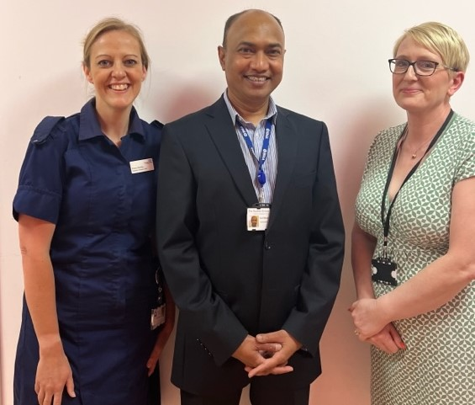
Our Team
Dr More,
Consultant Paediatrician with
Specialist interest in Epilepsy
Fiona Wortley
Paediatric Epilepsy Clinical Nurse
Specialist
Jane Dudley
Epilepsy Team Secretary
Notes:
Say why you have selected the individuals and what influence they have on your project

Slide 3
Aim
To reduce patient waiting times for first appointment in Epilepsy clinic by 50% from 12 weeks to 6 weeks by May 2023
Notes:
Remember how good my when within this project lifetime

Slide 4
Background Rationale
We were very aware that new patients were waiting up to 4 months for an initial appointment in the Epilepsy Clinics.
We were conscious of NICE recommendation that patients who had experienced a first seizure should be seen within 2 weeks of referral.
Recognised that 2 weeks is not achievable at this stage but needed to still work towards reducing our waiting times. We felt 6 weeks would be more of a realistic target.
We are only a team of 2 (1 Consultant, 1 Nurse) so this would be a challenge to achieve given our other clinical commitments.
Gathered data from informatics team who looked at; Consultant Led Epilepsy clinics, between 1st Feb 22 and 31st Jan 23. There were 166 attendances for new appointments with average wating period of 12 weeks.
Initial monitoring in clinic showed the waiting times for first appointment in epilepsy clinic was averaging 12 weeks.

Slide 5
Driver Diagram
Primary Drivers
Secondary Drivers
Change ideas
Streamline process of clinic allocation appointment via GP. ED and inpatient ward
Standardise pathway and documentation
Engage with ward Clerk on children's ward who books appointments
Map patient referral pathway via Acute (ward, ED) and GP
Identify the barriers and bottlenecks with the current pathway
Met as a team to screen referrals and prioritise
Increase patient and family engagement through obtaining their views and concerns on waiting times and support required whilst awaiting appointment.
Allocated extra clinic slots for new referrals
Initial appointment letter to contain advice leaflet to help with patient and families anxieties whilst waiting to be seen.
Develop efficient first seizure pathway
To reduce waiting times for first appointment by 50% from 12 weeks to 6 weeks by April 2023
Explore consultant triage
Sourcing appropriate clinic space
Clinician’s time
System to send Information leaflet to parents after triage
Involving admin staff in above work
Patient engagement
Engaged patients in service design
Gained feedback from Families, Patients
Service team contact team details clearly visible and accessible for patient and families
Provide patients and families with RCPCH first seizure leaflet, First aid information, Epilepsy Education
Notes:
Keep it simple
You wont be doing everything on the diagram
It creates a 1 page plan

Slide 6
Stakeholder Map
High
Patients Families | Consultant Epilepsy CNS
Matron Appointment booking team Clinic staff | Clinical lead Service manager Epilepsy team secretary
Interest
Low
Low Influence High
Notes:
Use the previous template to map the key stakeholders for your AIM.
Map your stakeholders
Identify stakeholders require attention

Slide 7
Patient and Family Engagement
We involved patients and their families who were being seeing for the first appointment.
We also involved patients who were attending follow up appointments
Consultant and nurse led clinics
We asked them to reflect on their experience when they were waiting for their initial appointment.
We saw most patients in face-to-face clinic and some we spoke to in telephone clinics.
We kept it simple by asking the following questions;
How long did you wait from being referred to your first consultant appointment?
Did you feel this wait was too long? Too short? Or just right?
Is there anything that you feel would have helped you whilst you were waiting for your initial appointment?
Feedback
Most families felt the waiting time was far too long which we very much expected
They felt very anxious during the wait and felt they would have benefitted from more information on what to do whilst waiting for appointment. Safety, first aid, etc.
Change
As a result of engagement with our patients we then implemented sending them the RCPCH first seizure leaflets with the appointment letter.

Slide 8
PDSA cycles
Cycle 5:
Create new patient slots in consultant led clinic
A P
S D
Cycle 4:
Triage the e-referrals more frequently to keep referral flow
A P
S D
Cycle 3:
Once screened send RCPCH first seizure leaflet to patient/family
A P
S D
Aim of the test
Reduce waiting times for new referrals to Epilepsy clinic
Cycle 2:
Engage with patients and families in clinic to obtain feedback on their waiting times
Cycle 1
Referral screening team meeting – Meet to screen new GP referrals and allocate to correct pathway. Liaise with ward clerk to see how patients are booked from the ward onto clinics.
Notes:
You can insert text in the aim box and the cycle text boxes

Slide 9
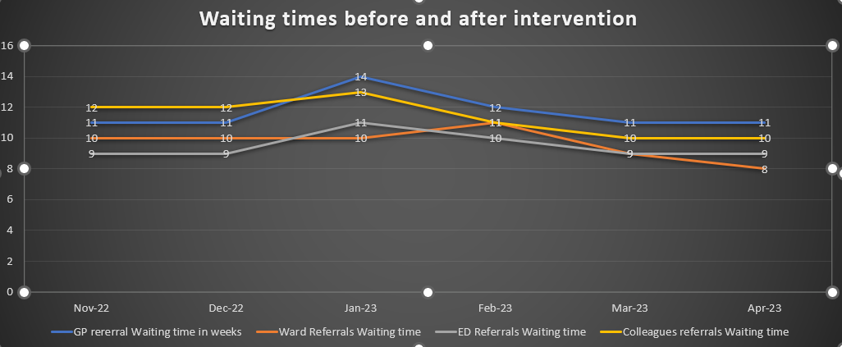
Notes:
Some call PDSA’s learning cycles
What did you learn?
Often the test either confirm your hunches or assumptions or you find out what does NOT work.
Everything you discover helps to move your thinking and planning for change

Slide 10
What did our test reveal?
Regular referral screening as a Team helped to understand the pathway and ensuring correct allocation into the most appropriate clinic.
We learnt that doing this more frequently as a team prevented a bottleneck where patients were being referred into the service but were not being screened timely and therefore appointment allocation delayed.
From the referral screening some health information can be sent to the appropriate patients whilst they wait to be seen in clinic.
Patients fed back that the information contained in the RCPCH leaflet helped them to understand what they should do prior to the appointment. They said they hadn’t considered some of the safety advice in regards to baths. A young person said she was able to show her friends the leaflet so they could see what they would need to do to help .
We attempted to create a first seizure clinic with the clinic coordinator but no free clinic room availability.
Creating new slots will make difference but we needed more clinic time to make more of an impact.
Notes:
Some call PDSA’s learning cycles
What did you learn?
Often the test either confirm your hunches or assumptions or you find out what does NOT work.
Everything you discover helps to move your thinking and planning for change

Slide 11
Successes
Challenges
Patient wait time reduced to 9 weeks
Patients and families are now provided with more safety net advice
Patients more prepared in clinic with diary and video’s of any seizures that have happened whilst they have been waiting. This can aid earlier diagnosis.
Better team working to improve patient experience
Patient engagement helped us identify worries whilst waiting for appointment
Locum consultant now doing more weekly clinics which will help reduce waiting times further.
We did not achieve our ultimate goal of reducing waiting times to 6 weeks.
Poor engagement with the improvement team. Prior to the project they had expressed they wanted to be involved but during the project were not returning calls email when we attempted to engage with them.
Recruitment to vacant post of 1 consultant.
No capacity for clinic room availability to hold the first seizure clinic and availability of both nurse and consultant.
Staff sickness/leave/ clinical commitments
Notes:
Some call PDSA’s learning cycles
What did you learn?
Often the test either confirm your hunches or assumptions or you find out what does NOT work.
Everything you discover helps to move your thinking and planning for change

Slide 12
Team learning highlights
Even small changes can make improvements
Things can be done in routine working hours
Patient/family engagement can show what the service users really needs
Invaluable learning taken from EQIP journey to give us the skills to make other quality improvements in other areas
Service has become even more patient orientated.
This project has added to our voice of team needing more support from management

Slide 13
Next Steps
Keep working on the development of a first seizure clinic to add to existing Epilepsy clinics
Utilise ‘Hot Clinics’ on General Paediatric side to get some simpler epilepsy referrals seen sooner
From patient feedback and our study, we know that follow up waiting times need to be reduced further
Continue to seek feedback from patients/families on their service experience.
Consolidate skills and knowledge gained to make other improvements.
Share our project poster at our hospital charity funday, share success in Hospital areas

