Slide 1

Melatonin EEG Process
Barnet Hospital
Royal Free London NHS Foundation Trust

Slide 2

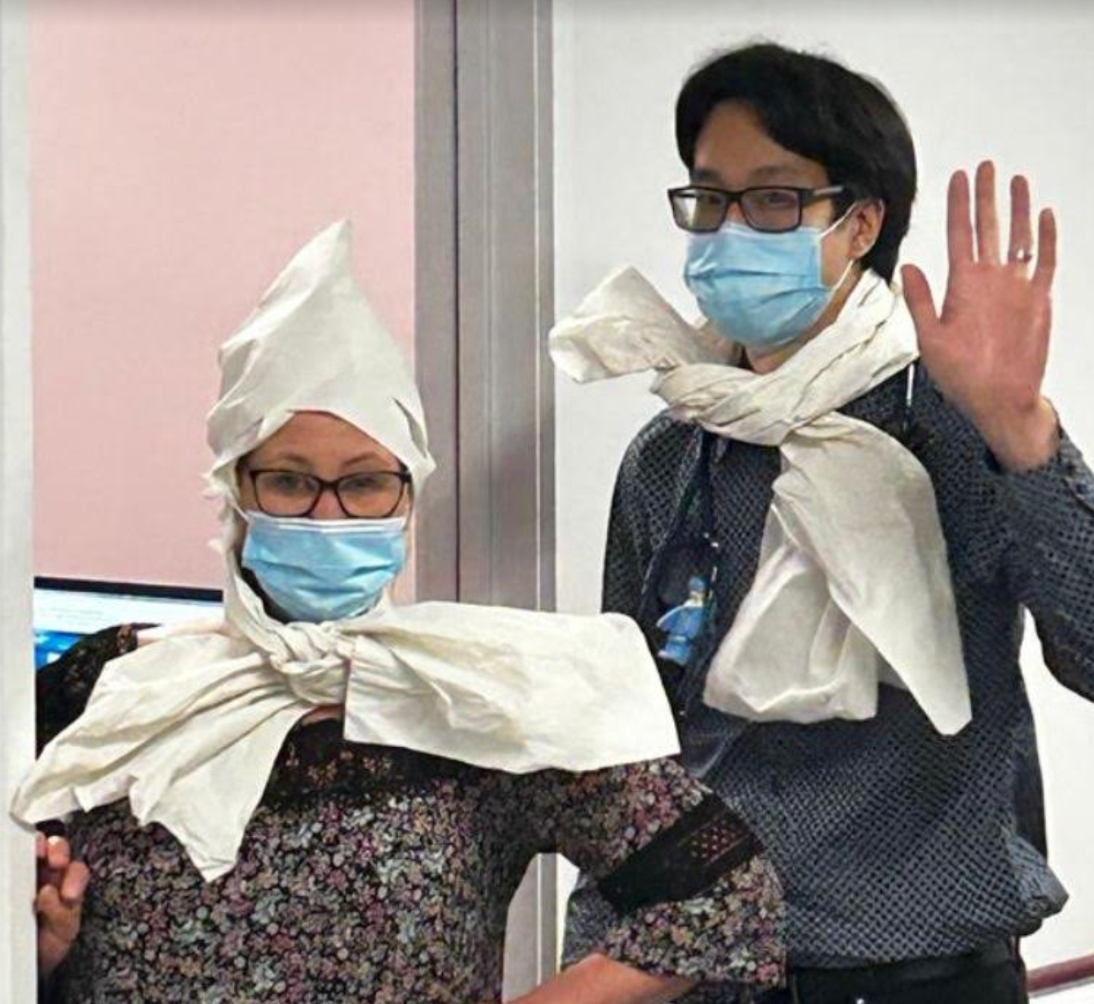

Slide 3
AIM
To develop and implement a pathway for melatonin EEGs in co production with neurophysiology and pharmacy at the Royal Free site by May 2023

Slide 4
Background
Unhappy patients, ESN Workload, Failed tests, Waste of Resource
No clear process
Too many variables
  inconsistent information
  varied prescription and dispensing
Across 2 sites & 3 departments

Slide 5
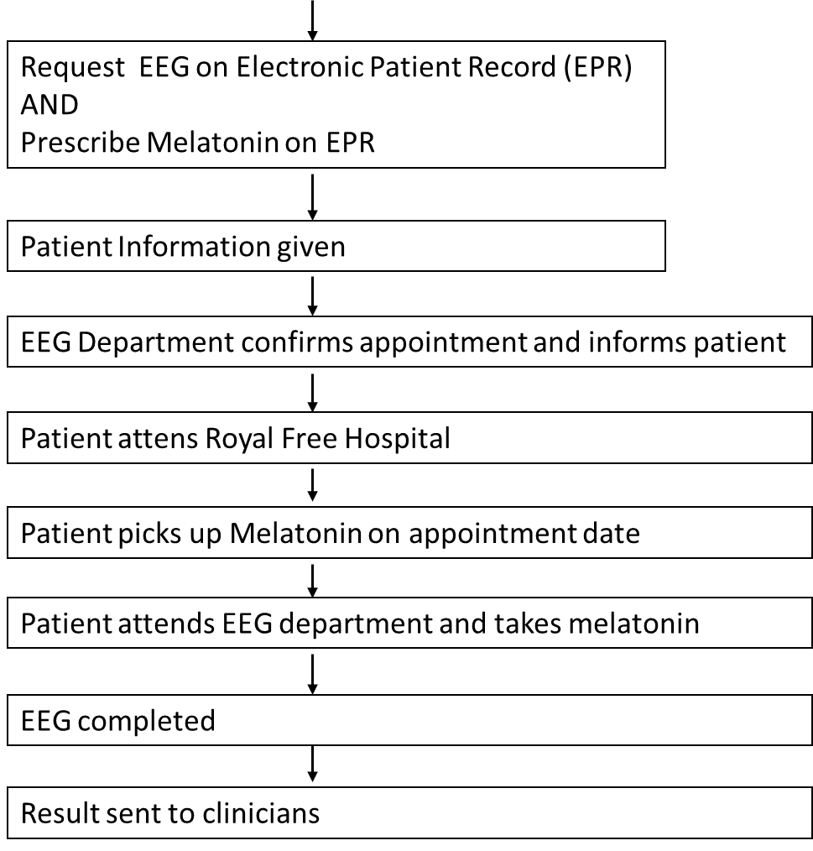
Identify need for melatonin EEG

Slide 7
Stakeholder map
EEG Department Pharmacy | Doctor | Epilepsy Nurse
 |  | Patients
High
Medium
Low
Influence on success
Low Medium High
Impact on stakeholder

Slide 8
PDSA cycles
Cycle 5
New process, new leaflet
A P
S D
Cycle 4
Review of information to families
A P
Cycle 3:
Collaboration with EEG
Aim of the test
Identify the details within the process that need changing
S D
A P
S D
Cycle 2:
Pharmacy process
Cycle 1
Feedback from family
Notes:
You can insert text in the aim box and the cycle text boxes

Slide 9
PDSA Cycle 1-Patient & Family Engagement Tool
First 5 patients attempted questionnaire- who/ how/ change
Engagement from 2/5 with persistence
Change of engagement to direct calls after test asking for feedback
Engagement from 5/5
Identification of issues-missing information- ie Map, pharmacy waits
Additional issues were highlighted too- environment of EEG, neurodiversity

Slide 10
PDSA 2 Pharmacy process
Agreement to prescribe on EPR system to be collected at the site of the EEG
Test of prescribing- by ticking a box determined when the prescription was dispensed- if it was dispensed at the time, it would then be out of date for the date of the EEG- process changed- agreement with pharmacy on details of the prescription order
Agreement to be available for collection 1 hour before EEG appointment
Lack of information to patient- parent arrived for EEG without the Melatonin, queue for medication resulted in late arrival for EEG, and EEG then cancelled- process changed. The patient engagement tool highlighted changes needed in the information

Slide 11
PDSA 3 EEG Collaboration
Discovered patient information given and what was required
Agreed for EEG to liaise directly with pharmacy regarding appointment date
Met with EEG management to increase stakeholder engagement
Further meeting ongoing- to discuss additional issues

Slide 12
PDSA 4- Information to families
Family feedback enabled changes in information given
eg confirmation that tablets can be crushed
eg add video link
eg map

Slide 13
Identify need for Melatonin EEG
No agreed process
Request EEG on Electronic Patient Record (EPR)
AND
Prescribe Melatonin on EPR
Inconsistencies in request
Not always completed in clinic
Difficult to be dispensed at a different site
2 journeys for patient
Dispensing issues:
Out of date
Not ready
Patient Information given
EEG Department confirms appointment and informs patient
No liaison with pharmacy
Nurse needing to coordinate
Patient attends Royal Free Hospital
Told not to crush
Long waits
Had to collect from Barnet/Enfield site
Patient picks up Melatonin on appointment date
Patient attends EEG department and takes melatonin
Inadequate information
Delays and cancellations
EEG completed
Or cancelled/inadequate
Result sent to clinicians
Not informed

Slide 14
What did the tests reveal?
Assessed Information from 16 patient events
Were not sure of what data we were collecting
Prescribing of Melatonin- when where how- issues Y/N
Assigning a measure of resource allocation to the ESN input

Slide 15
Data- Medication
KEY:
*1 | Changed info for pharmacy-Don't tick telephone consultation add Please don't dispense until date of EEG is made available- to collect 1 hour before EEG time
*2 | Add to information-Inform parent to attend Pharmacy 1 hour before EEG
*3 | Add tablets can be crushed to information

Slide 16
Data- ESN Contacts
KEY:
*1 | Changed info for pharmacy-Don't tick telephone consultation add Please don't dispense until date of EEG is made available- to collect 1 hour before EEG time
*2 | Add to information-Inform parent to attend Pharmacy 1 hour before EEG
*3 | Add tablets can be crushed to information

Slide 17
Patient Feedback
Information
Before Changes
Didn’t know where to go
A bit unprepared
Video Would've helped
Was told not to crush tablets
After Changes
Well Prepared
Advice from ESN brilliant
Nothing else to add
Sufficient information given
Pharmacy
Collection of Medication difficult
Long wait
Confusing
Busy
Delayed
A big problem
Environment difficult for neurodiverse
Stressful
No instructions given

Slide 18
Identify need for melatonin
With additional comment to inform pharmacy when date confirmed
With additional comments to dispense when date is confirmed
AND
Tablet formation can be crushed
AND
Not a telephone consultation
Trust agreed
And pharmacy
One hour before appointment

Slide 19
Success and Challenges
Overall happier families- better informed & prepared
Better understanding of the process and how to improve
Better collaboration with EEG department
EEG Staffing- increased time for change to be implemented
EEG waiting time very long- low numbers to study
Working across multiple sites- challenges with stakeholder engagement and patient information

Slide 20
Team Lessons Learned
1 change per patient
Not audit
Engagement with other teams- and how it will help with other aspects of the service
Needs to be done as a whole team
Advice- make it part of the day- devote 1 hour per week

Slide 21
Next Steps
New information to be trust agreed and printed
Continue with EEG meetings to improve other aspects of the service
To look at other issues highlighted by families eg provision for neuro diverse patients
Use EQIP in other areas
To complete the process map and publish as an SOP
To create a bundle of care
To look at other sources of patient engagement for future projects

