Slide 1
Tameside Paediatric Epilepsy Team Improving Care for Children with Epilepsy RCPCH EQIP QI Project

Slide 2
Our Team
Consultant Paediatricians with specialist interest in epilepsy- Dr Dhorajiwala, Dr Massarano, Dr Haider
Epilepsy Nurse Specialist- Lianne Fielding
Epilepsy Transition Nurse Specialist- Claire Palmer (new within the team when starting EQIP)
Notes:
Say why you have selected the individuals and what influence they have on your project

Slide 3
Aim
To develop and implement by Summer 2023 a mental health guide for all children and young people 11 to 17 focused on understanding and managing emotions.
Notes:
Remember how good my when within this project lifetime

Slide 4
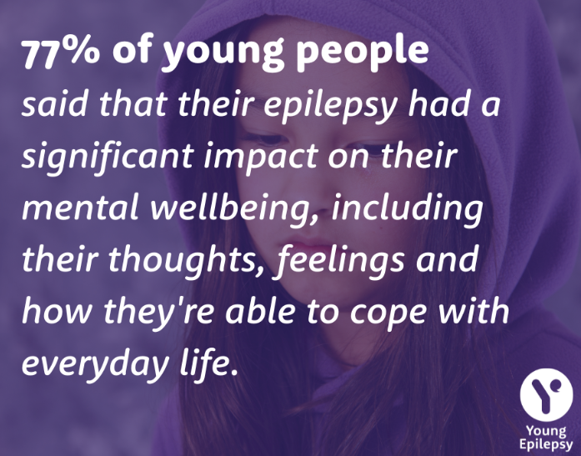
Background Rationale
Many of our children are struggling with MH & wellbeing and not getting the appropriate help they require in a timely manner.
Often are not aware until they are really struggling and their school attendance and QOL is significantly affected
CAMHS referrals are a minimum of a 12m wait at present
Children are deteriorating with school attendance and learning being affected whilst awaiting initial CAMHS assessment

Slide 5
Background
What did it show?
What tools did we use?
Results from the screening tools were not as expected. Did not meet criteria for CAMHS referral/ assessment
Indicated 3rd sector information & signposting not CAMHS referral
Reinforced the need for a wellbeing booklet- understanding & managing emotions
Reinforced early intervention before progressing
How did we involve YP & families?
Established screening tool (WHO) in the small group workshop
Feedback from post it notes, marbles/ counters in jars and Mentimeter
Invited a small group of YP with a parent/ carer to a 6 week course with myself and a consultant clinical psychologist
Patient & parent/carer voice at clinic appointments and home visits

Slide 6
Driver Diagram
Primary Drivers
Secondary Drivers
Change ideas
Implementing a screening tool- Quality Of Life(QOL) questionnaire, Strengths and difficulties questionnaire ., Child Outcome Rating Scale (CORS)
Smiley face tool, thermometer, emojis- sad, happy, anxious angry for younger children
ABLE tool- Assessment of behaviour and learning in Epilepsy- parents and teachers
6-week FTF or teams' course with 6-8 children (yr 10,11 or first year college) with Consultant clinical psychologist
Our Kids Eyes (OKE) Parent event- 2 events day & evening and/or Youth in Mind- Parent/ child event-
CAMHS Supervision and parent workshop
Explore engagement tools
Create mental wellbeing guide- Understanding and managing emotions
Social prescribing- holistic family centred care (over 16 years) so 16+ and parents
Identifying patients at risk
Screening tools
Patient and family empowerment
Empowering families and communities to support each other
Early identification of mental health disorders such as anxiety & depression
To develop and implement by summer 2023 a mental health guide for all children and young people 11 to 17 focused on understanding and managing emotions
Effective intervention/ early intervention
Timely mental health input and support
Person and community centred approaches- word maps, 3 questions
Youth advocates
Linking with other professionals- Commissioners,, charity's (YIM/ OKE), schools- SWO,
Effective referral and/ or signposting
Staff/ patient/ family engagement
Staff, Patient and family awareness of mental health and anxiety including physical symptoms of anxiety
Awareness of the link between epilepsy and mental health disorders
Holistic family centred care
Notes:
Keep it simple
You wont be doing everything on the diagram
It creates a 1 page plan

Slide 7
Stakeholder Map
High
Patients & families
Consultant Clinical Psychologist
Interest
HOPE Parent support group
CAMHS
OKE
Clinic staff
Admin
Low
Low Influence High
Notes:
Use the previous template to map the key stakeholders for your AIM.
Map your stakeholders
Identify stakeholders require attention

Slide 8
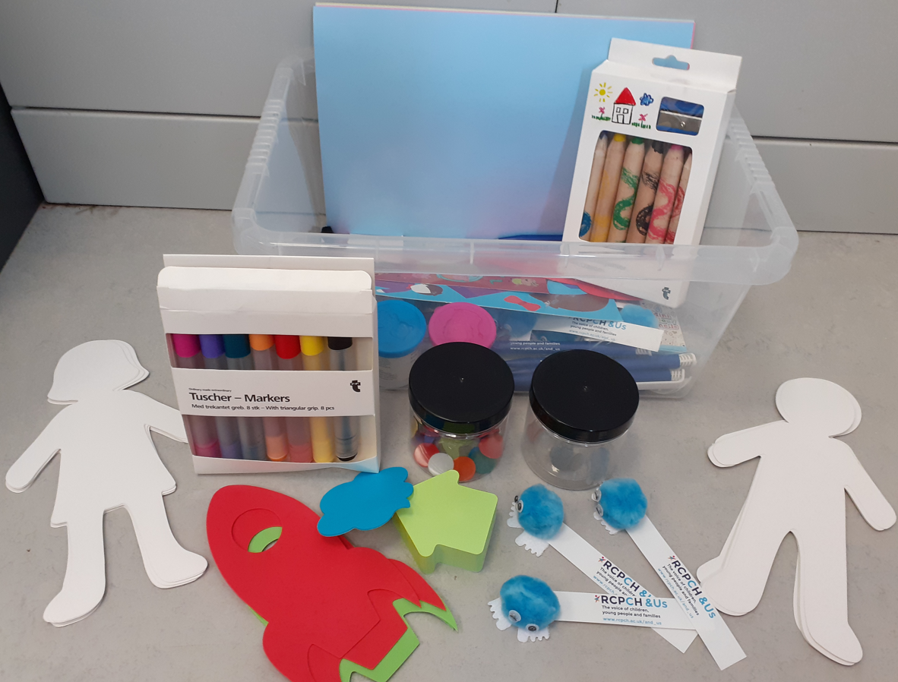
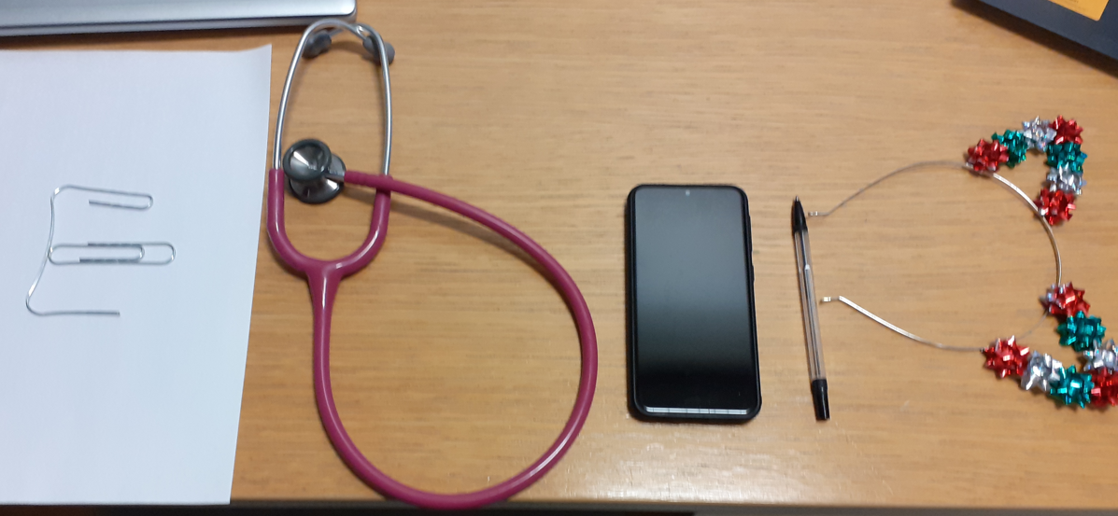
Patient and Family Engagement
How did we involve?
Who was involved?
Feedback received
Asking before/ after clinic a few questions that they jotted on a post it and folded up and put in the jar
Marbles/ counters in a jar for Yes and No
Children & parent/ carers
Myself & Consultant clinical psychologist
CAMHS
Feedback results have covered themes such as general worries Same theme coming from the focus group where we reviewed the screening tools.
Can be addressed in terms of the content in the well-being booklet.

Slide 9
What did we change?
Not making assumptions
Involving children, YP & families more
Understanding that parents and children/ YP often have very different worries. Often parental worries are worse and need addressing to ensure it doesn’t impact the child/ YP
Working with CAMHS to look at a parent/ carer session to address common worries and fears and how to manage
Working with CAMHS to develop social stories

Slide 10
Our PDSA cycles
Cycle 5: Share booklet with the patients to obtain feedback. Add anything/ take anything out
OUTCOME: Make alterations, change wording, add/ delete content
A P
S D
Cycle 4:Try the techniques in the group for feedback- progressive muscle relaxation, 5 finger breathing, 5 things
OUTCOME: Add relaxation techniques into booklet
A P
S D
Cycle 3:Techniques to obtain quick feedback about what patients worry about to help with what to inc in the booklet- Counters in jars, Postets & menti
OUTCOME: Add in fist aid, info on sleep, SUDEP, transition info
A P
S D
Aim of the test
Understand the required support our children & YP require and what to include in our booklet
Cycle 2: Completing a MH screening tool with a small cohort of children
Identified the children did not meet the criteria for CAMHS referral and required support not intervention
OUTCOME: Ascertained wellbeing support rather than CAMHS intervention.
Cycle 1: Ascertain face to face or teams? For the small group with Consultant Clinical psychologist
OUTCOME: Not to make assumptions! Group to be FTF
Notes:
You can insert text in the aim box and the cycle text boxes

Slide 11
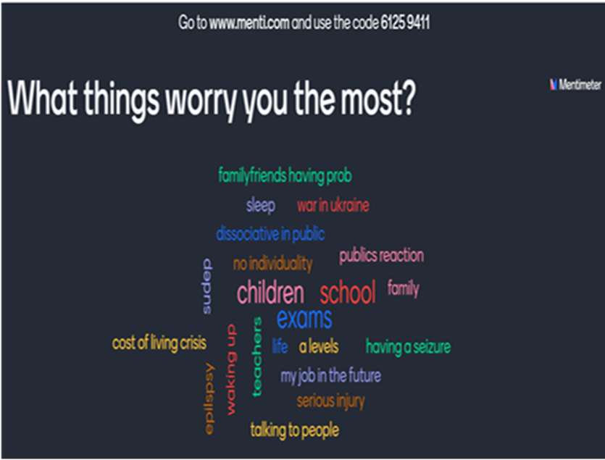
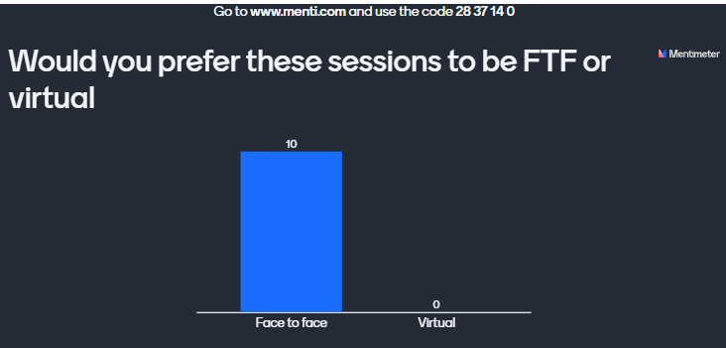
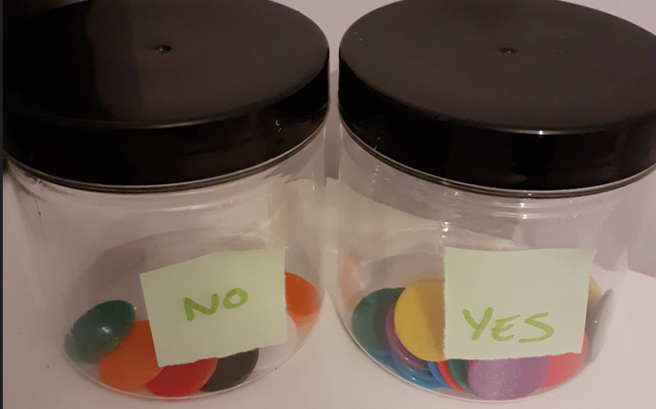
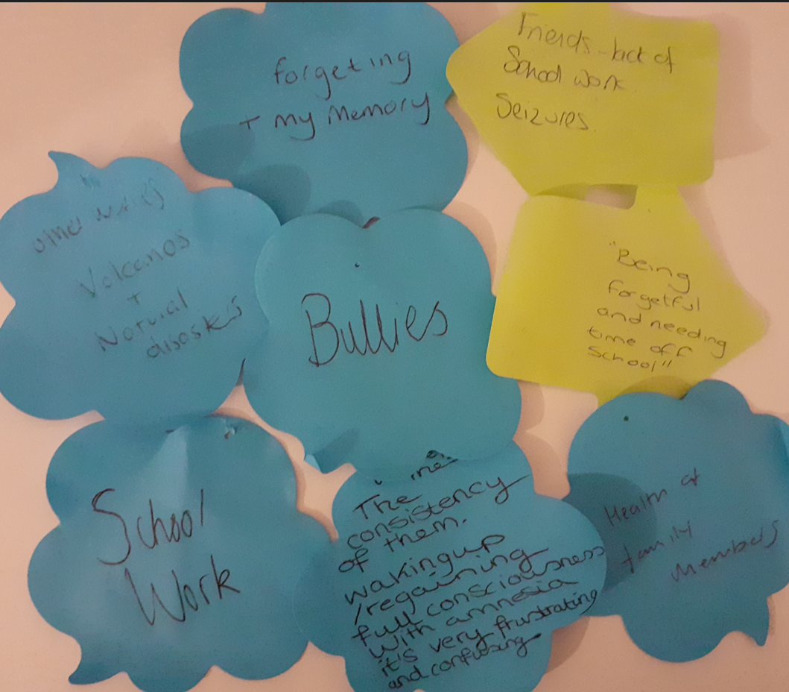
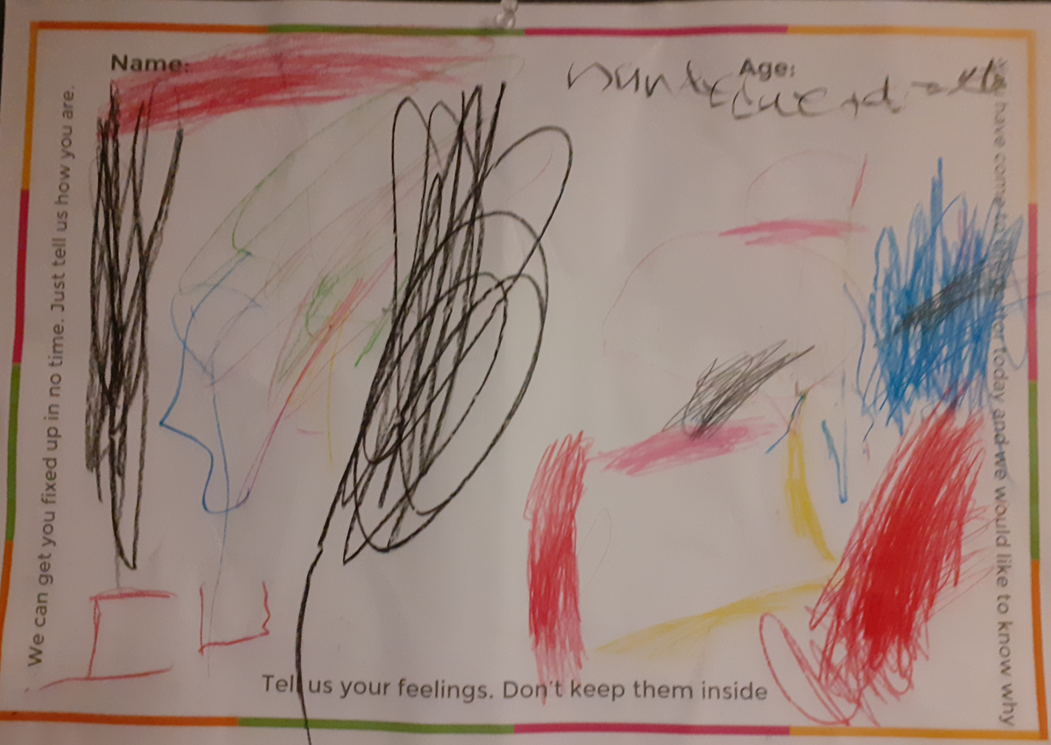
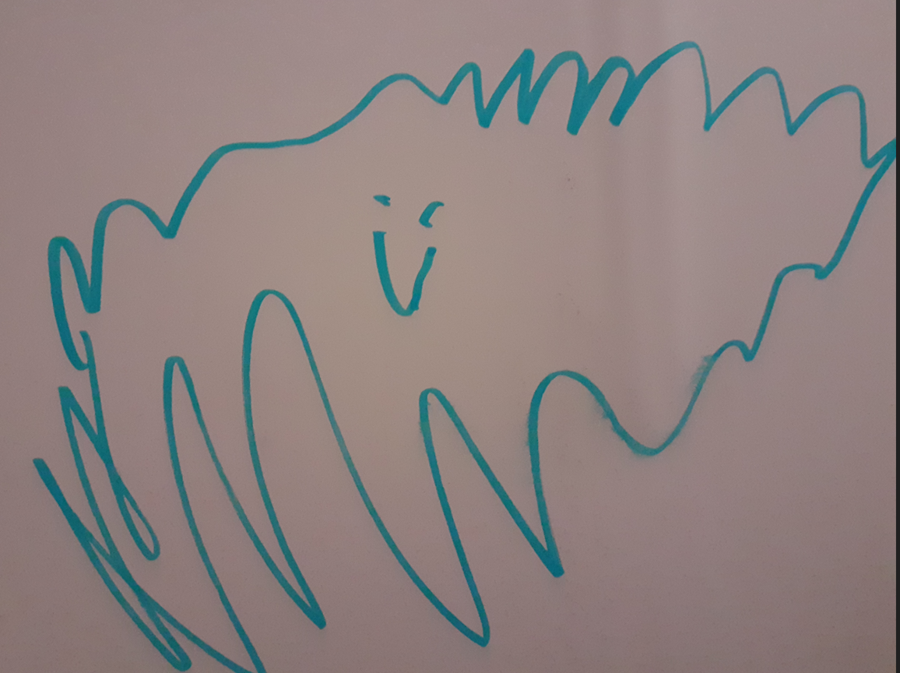
Data/Results
Notes:
Some call PDSA’s learning cycles
What did you learn?
Often the test either confirm your hunches or assumptions or you find out what does NOT work.
Everything you discover helps to move your thinking and planning for change

Slide 12
What did our tests reveal?
Children/ YP wanted FTF not virtual/ teams for the intervention group
Majority of children/ YP required support rather than CAMHS intervention
A lot of general worries- school, friendships & exams
Patients/ YP worry most about school, safety, investigations, and transition related issues such as exams, college, how to deal with parents
Parents worry most about SUDEP, after school
Parents need help and support about getting a healthy balance with encouraging independence whilst ensuring children’s/ YP safety
A lot of children fed back that they would like to meet other children with epilepsy
Helped us ascertain what children/ YP would like including in the wellbeing booklet
Screening tool prior to each consultations on hold for now
Confirmed that children/ YP did need support in relation to their wellbeing
Notes:
Some call PDSA’s learning cycles
What did you learn?
Often the test either confirm your hunches or assumptions or you find out what does NOT work.
Everything you discover helps to move your thinking and planning for change

Slide 13
Successes
Challenges
Great opportunity to be able to produce a booklet to help children, YP and families
No clinical psychology in the team but as a result of reaching out, sparked the idea and managed to secure monthly/ bi monthly supervision.
Fantastic involvement and support from Consultant clinical psychologist and CAMHS for a brief spell.
Support and patience from EQIP including great lectures and great insight into patient engagement
Appointing a transition nurse within the team is a positive step in improving this area. The worries highlighted around transition can be addressed
Had involvement from a clinical psychologist from CAMHS but unfortunately left mid EQIP. Although brief was very useful to both. No replacement as of yet
This has been undertaken at a time of significant staff change within the team
Impact of nursing and doctor strikes, strep surge on staff & the service
Our epilepsy consultants having to cover colleagues sickness
Monthly team meetings on hold
Time constraints
Same time as NMP course
Not ideal time of year for the groups
Notes:
Some call PDSA’s learning cycles
What did you learn?
Often the test either confirm your hunches or assumptions or you find out what does NOT work.
Everything you discover helps to move your thinking and planning for change

Slide 14
Team learning highlights
The importance of our monthly epilepsy team meetings!
The importance of both child/ YP and parent/ carer voices/ feedback
Majority of our caseload can benefit from adequate signposting and early intervention rather than a CAMHS referral
Trying different techniques such as QR codes and menti meter
Changed how we interact and engage with children/ YP.
Not making assumptions!!
Now have a clearer plan, process and support for children/ YP
Putting into place the feedback received for children & YP to improve their wellbeing and QOL
Lots of ideas for our new transition service
As a result- working with CAMHS to devise social stories for bloods, MRI scan and EEG
Re advertising the HOPE group

Slide 15
Next Steps
Changing our practice and potentially other teams practice by sharing
Once in post can reinstate work with CAMHS- Monthly/ bi monthly supervision where we can discuss cases and where best to signpost
Set up a parent/ carer event with CAMHS/ OKE about managing parents/ carers emotions/ worries/ fears
Transition & teenage groups to meet peers with epilepsy and cover worries that were addressed around school, friendships, exams, college and employment
With CAMHS devising social stories to help with worries around blood tests, EEGS and MRIS
Locally
Share at the HOPE group (monthly child/ YP & parent/ carer support group)
Local specialty/ governance/ team meeting
Share our experience- Possibly at the NWEIG
Consider implementing screening tool to highlight MH concerns at clinic

