Slide 1
Integrating QI and Sustaining Change Improving Care for Children with Epilepsy 11 February 2022 Dr Pat O’Connor, QI trainer, CEO QI Discovery

Slide 2
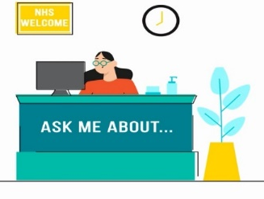
Having a good virtual meeting
Have slides
Stay on topic in the chat & use inclusive language
Don’t take screen grabs/record it
respect
each other
HERE TO HELP
Different ways to share views
Be kind, supportive and fair
We may follow up
Mute yourself if there is background noise
Share what you feel safe to do so and keep things confidential
Notes:
Em

Slide 3
Agenda
12:30 – 12:35 | Welcome Introductions, outline for the session | Pat/Melanie
12:35 – 12:50 | Integrating Care and Sustaining change | Pat
12:50 – 13:15 | Breakout Activity: Sharing your learning from EQIP and promoting your project outcomes. Go to your separate break-out rooms for 25 min | Pat and Steering group
13:15 – 13:40 | Feedback on discussions all teams | All teams
13:40 – 14:00 | • March Shared learning event instructions • Preparing your final story board and poster | Melanie/Events team Pat
14:00 | Next steps / take home task Evaluation of session | Pat

Slide 4
The Key Elements of Breakthrough Improvement
Will
Ideas
Execution

Slide 5
“All Teach… All Learn”
We’re here to join together to find new ways and best practices,
Our assets will be curiosity and generosity,
We share a commitment to best care for our patients, and better healthcare for all,
How are your patients and families an integral part of your developments and changes.

Slide 6
How can we do this?
Building QI expertise.
Building Improvement into daily work.
Reducing waste and variation improving reliability.
Learning we can prevent harm.

Slide 8
Spread and Sustainability

Slide 9
Putting everyone to work
Every employee is responsible to improve within their own workplace
That means everyone has two jobs:
95% of the time: do their regular job,
5% of the time: improve how they do their regular job.
Management is responsible to provide
the tools (training and technical support),
the time (structured as part of work assignments),
the resources (as part of a local budget), and
the vision (focus).
so that local teams can improve

Slide 10
Persuading others
Clear advantage compared to current ways,
Compatibility with current systems and values,
Simplicity of change and its implementation,
Ease of testing before making a full commitment, and
Observability of the change and its impact.

Slide 11
Psychology of change
A compelling story, because employees must see the point of the change and agree with it,
Role modelling, because they must also see senior colleagues they admire behaving in the new way,
Reinforcing mechanisms, because systems, processes, and incentives must be in line with the new behaviour, and,
Capability building, because employees must have the skills required to make the desired changes.
Lawson and Price 2003

Slide 12
Leading Change
https://www.youtube.com/watch?v=fW8amMCVAJQ

Slide 13
Practical Approach
Work closely with those that offer resistance- they’re sending you a signal
Try to understand other people’s resistance to change.
They may know something you need to understand!
Notes:
Kristi

Slide 14
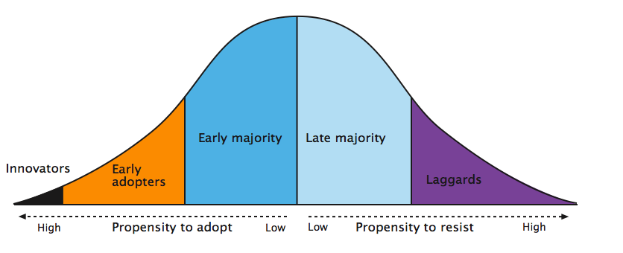
Everett Rogers Diffusion of Innovation Curve
2.5% | 13.5% | 34% | 34% | 16%
Rogers 2003

Slide 15
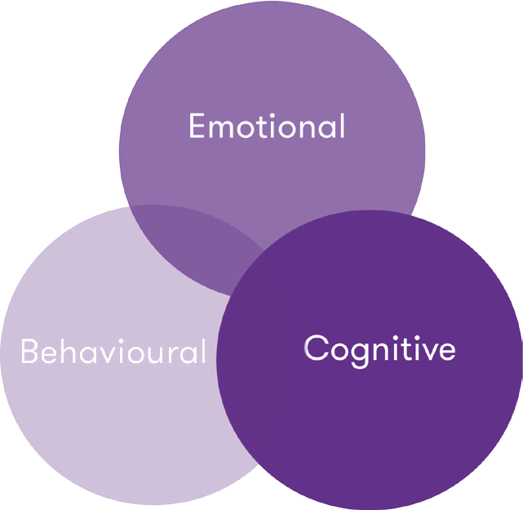
Social Movement Theory
Four sources of organisational energy :
Connection refers to how far people see and feel alink between
what matters to them and what matters to the organisation
Content refers to how far the actual tasks people do are enjoyable and challenge them
Context is how far the way the organisation operates and the physical environment in which people work make them feel supported
Climate refers to how far the way we do things around here encourages people to give of their best
To spread and sustain QI, it is vital to engage people by explaining why the issue is important and continually articulate the positive impacts on patient care. explains that ideas that help both staff and patients spread quickest. Gawande 2014

Slide 16
Set up for Spread
Social System: Understanding the relationships among the people who will be adopting the new ideas
Knowledge Management: Observing and using the best methods for spread as they emerge from the practice of the organisation
Measurement and Feedback: Collecting and using data about process and outcomes to better monitor and make adjustments to the spread progress

Slide 17
Leadership
-Topic is a key strategic initiative
-Goals and incentives aligned
-Executive sponsor assigned
-Day-to-day managers identified
Measurement and Feedback
Set-up
-Target population -Successful sites -Key groups that will make adoption decision
-Initial strategy to reach all sites
Social System
-Key messengers
-Communities
-Transition issues
-Technical support
Better Ideas
-Develop the case
-Describe the ideas
Successful Sites
Communication Strategies
Knowledge Management
A Framework for Spread

Slide 18
7 Spreadly Sins
Start with Large Pilots
Find one person to do it all
Use Vigilance and hard work
If a pilot works spread it unchanged
Get the successful team to spread organisation wide
Look at defect quarterly
Expect marked improvement in outcomes without attention to reliability

Slide 19
Spreading and integrating success
Three different levels of knowledge use that are necessary within a system:
Acquisition is the creation of skills, insights and relationships
Sharing is the dissemination of what has been learned
Utilisation is the integration of learning into practice
Huber 1991
Need an aim which goes beyond accessing and organising information to enable practitioners to apply knowledge to frontline practice to deliver better healthcare and embedding the use of knowledge in quality improvement.

Slide 20
Aim for High Reliability
Preoccupation with failure
Regarding small errors as a symptom that something is wrong
Sensitivity to operations
Encouraging diversity in experience, perspective, and opinion
Capabilities to detect, contain, and bounce-back from events that do occur
Deference to expertise
Pushing decision making down to the front line
Reluctance to simplify
Commitment to resilience
Paying attention to what’s happening on the front-line
Notes:
20

Slide 21
Integrating QI and Sustaining Change Improving Care for Children with Epilepsy Break-out room team task

Slide 22
Breakout Activity Team Breakout 30 mins
Starting with you AIM and the OUTCOMES of your project
Discuss how you will SHARE your QI journey and outcomes,
Include wider learning locally with other teams, managers and the wider organisation for example the Clinical Governance,
Include details of co-production with patients and families and patient engagement teams,
Design a 5-point plan.

Slide 23
Integrating QI and Sustaining Change Improving Care for Children with Epilepsy March Event instructions

Slide 24
17 March Shared learning event
Event begins 12:30pm – 16:00pm (Speakers will need to login early to address any technical issues that may occur on the day),
All teams to select speakers rep for their team submit their names and a signed media consent form,
Speakers will be sent a different joining link than the rest of the team
Everyone else will join via the promoted link,
All media consent forms, presentations and posters must be submitted by 11 March 2022,
Invite your colleagues/management to the event hear about your QI journey and what they could learn from your experience and outcomes to improve the care for CYP.

Slide 25
17 March Shared learning event
1 | 12:30 PM | Chair’s Welcome | Mark Devlin, Chief Executive, Young Epilepsy
2 | 12:40 PM | Reduce waiting times for first seizure referrals Presentations and Q&A | Salisbury NHS Foundation Trust North Tees & Hartlepool NHS Foundation Trust
3 | 13:00 PM | Digitalization of Epilepsy passport Q&A | University hospitals of Morecambe Bay NHS Foundation Trust
4 | 13:10PM | SUDEP risk Q&A | Oxford University Hospitals NHS Foundation Trust
5 | 13:20 PM | Establishing a Transition Service Presentations and Q&A | Croyden Health Service NHS Trust East Lancashire Hospital Trust
6 | 13:50 PM | Mental health pathways Presentations and Q&A | Epsom and St Helier University NHS Trust North-West Anglia Foundation Trust Warrington and Halton Teaching Hospitals NHS Foundation Trust
7 | 14:15 PM | BREAK
8 | 14:35 PM | Welcome back | Mark Devlin, Chief Executive, Young Epilepsy
9 | 14:40PM | Patient and family engagement Presentations and Q&A | Barts Health NHS Trust Doncaster and Bassetlaw NHS Foundation Trust
10 | 15:00 PM | First year of care/ Q&A | West Yorkshire & Harrogate Health and Care Partnership - ICS
11 | 15:25 PM | Sustainable QI – EQIP pilot teams Presentations and Q&A | Royal united Bath Hospitals NHST Trust York Teaching hospitals NHS Trust
12 | 15:45 PM | Closing remarks | Dr Colin Dunkley, Epilepsy12 clinical lead and Mark Devlin, Chief Executive, Young Epilepsy
 | 16.00 | Close

Slide 26
Integrating QI and Sustaining Change Improving Care for Children with Epilepsy Preparing your final Poster and Storyboard

Slide 27
St Andrews Hospital

Slide 28
Your Team
Meet our team
Dr R Burns, Consultant Paediatrician
Dr Mary Smith, Specialist Practitioner
Ms Susan Black, Clinic admin support
Mrs Sofie Malik, Epilepsy Specialist Nurse
We are a small team with a large case load,
We also have support form the community teams.
Notes:
Say why you have selected the individuals and what influence they have on your project

Slide 29
Aim
To reduce the 1st referral waiting time (16 weeks) by 50% to 8 weeks for children referred from the ward by March 2022.
Notes:
Remember how good my when within this project lifetime

Slide 30
Background
We know that the waiting time is 16 weeks from local and national data
Our patients complain
We have had patient safety issues and adverse events as a consequence of the long wait time

Slide 31
Driver Diagram
Primary Drivers
Secondary Drivers
Change ideas
Understand the specific details of the patient journey create a map.
Identify bottle necks.
Patient family feedback.
Identify stakeholders.
Test the admin process.
Review the diagnostic tests and confirmed diagnosis.
Clearly identify the options for follow-up.
Test change in referral Communications.
Attend the ward to observe the referral process.
Admin process
Admission process
To reduce the 1st referral waiting time (16 weeks) by 50% to 8 weeks for children referred from the ward by March 2022
Diagnosis
Tests completed
Referral pathway
Ward staff understanding
of follow-up options and
arrangements.
Notes:
Keep it simple
You wont be doing everything on the diagram
It creates a 1 page plan

Slide 32
Stakeholder Mapping
Patients and families Performance manger | Clinic consultant Clinic staff
 | Ward administrator Ward staff
High
Interest
Low
Low Influence High
Notes:
Use the previous template to map the key stakeholders for your AIM.
Map your stakeholders
Identify stakeholders require attention

Slide 33
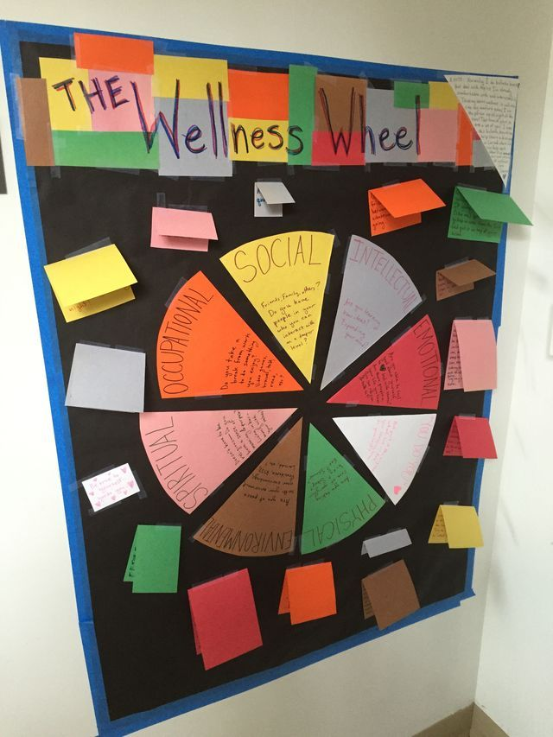
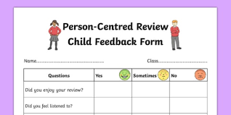
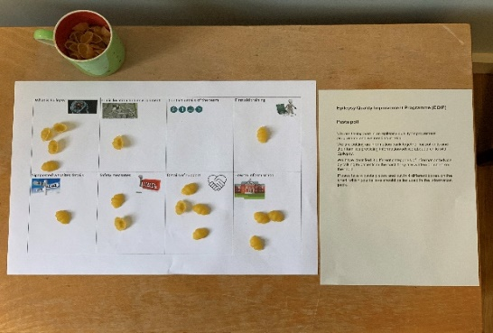
Patient and Family Engagement
Led by nurse in clinic.
Created a mood board for patients and family to stick post-its on while attending and waiting in the clinic.
Gathered feedback.
Analysed suggestions with young people attending.
Involved Trust patient involvement teams.
3 Teenagers created podcasts as key messaging for patients before their clinic appointment.

Slide 34
Process Map

Slide 35
Examples of your PDSA cycles
A P
S D
Cycle 5 test new system in all clinics for 1 week
A P
Cycle 4 Test family feedback at 1 clinic
S D
A P
S D
Cycle 3: test referrals for 2 clinics
Aim of the tests To identify all steps in the referral pathway
Cycle 2: amend the ward documentation
Cycle 1 Create an overall patient journey map following 2 patients
Notes:
You can insert text in the aim box and the cycle text boxes

Slide 36
What did your test reveal?
Our theory and prediction before the tests did not always work.
We forgot the post-its and feedback board before the clinic sometimes.
Staff in the ward had really good ideas to change the admin side of the process and support the follow-up pathway after all diagnostics tests were complete.
Children, teenagers in-particular were clear about what they needed before the clinic visit and wanted to create resources themselves to help others.
We discovered a range of variation in practice, different processes were at play in the one ward and the 3 clinics that we run!
We learned a lot about our system that we thought we knew.
Notes:
Some call PDSA’s learning cycles
What did you learn?
Often the test either confirm your hunches or assumptions or you find out what does NOT work.
Everything you discover helps to move your thinking and planning for change

Slide 37
Data/Results
Please call me by my middle name
We would like more toys and games while waiting
Need more information about the tests
testing changes daily to referalprocess
I liked pre appointment leaflet it was helpful
Can we get at 2pm appointment as that’s when the bus arrives 🚌
Can we get more links and information about what tests to expect
The staff are lovely always smiling and happy 😀

Slide 38
Successes
Challenges
Average waiting time is 8 weeks now for a specific cohort of patients we achieved our goal
Created cohesion in the team both at the clinic and in the ward
Patients and families are engaging with the service and suggesting changes we have implement some of the simple changes they have asked for
Time
Motivation
Maintaining focus on our goal
The impact of Covid -19 on staff and the service
Ensuring our changes stick and are sustained

Slide 39
Team learning highlights
Learning to take small steps -the power of 1 1patient, 1 family,1 nurse, 1 step at a time
Maintain rhythm and test often and quickly
Learning to use the improvement tools gave greater understanding of our system
Reconnecting to the work with the ward and clinic staff
Families were a huge source of knowledge

Slide 40
Team lessons learnt
Connecting and over communication played a big part in our success with staff, managers patients and families
Involvement of the stakeholders in the design and decisions in where and what to test is key
Test test test test
Don’t worry when things don’t go to plan tweak the process and test gain
Make all steps in the process useful they don’t need to be perfect
Have a plan and a method

Slide 41
Next Steps
Keep working on our waiting time for this group of patients best we can probably do is shave another two weeks off in next 4 months
Pursue additional resources for the clinic and follow-up requirements
Work with the trust engagement teams to enhance our engagement resources
Share our success within the Trust both within and out-with epilepsy services and paediatric services
Present our work formally at regionally and nationally through RCPCH EQIP conference

Slide 42
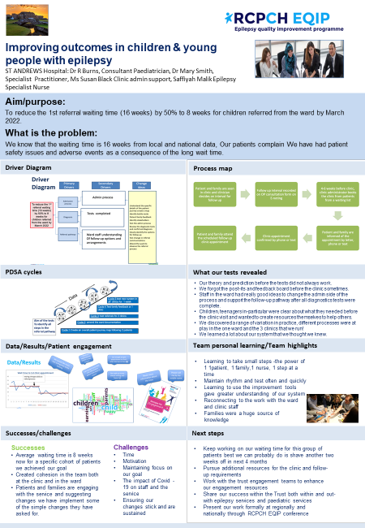
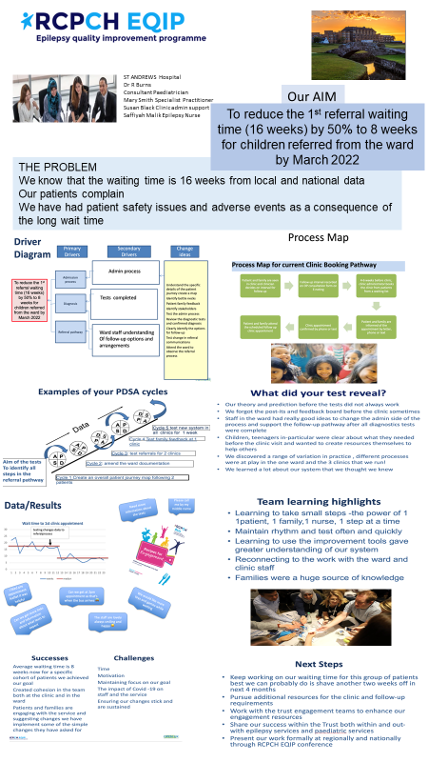

Slide 43
Next steps/Take home tasks
Final thoughts provided by Pat Take home tasks
Ensure you capture the reflections of the team members as you progress,
Include examples of narrative dialogue from the patients and families you have engaged with,
Continue to gather data about your improvement project,
Revisit the EQIP materials and tools to begin to frame your final poster and story board,
Consider in your team and add your reflections to your progress report and your call this month.

