Slide 1
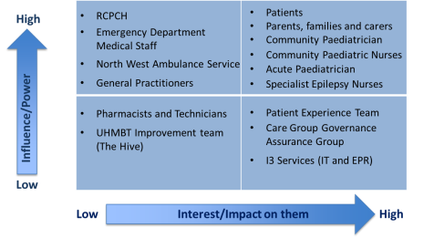
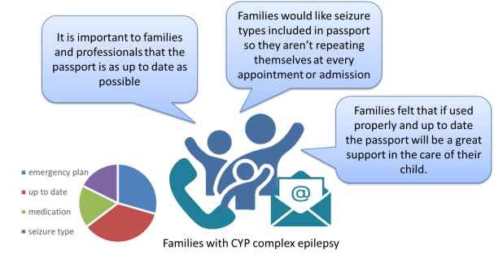
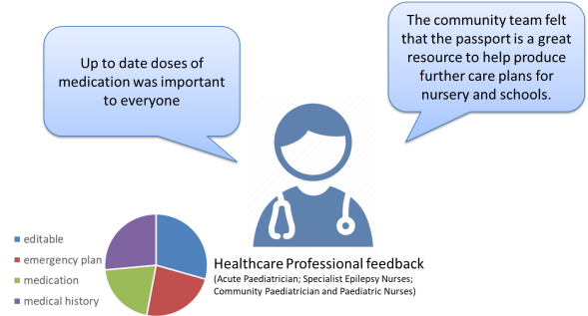
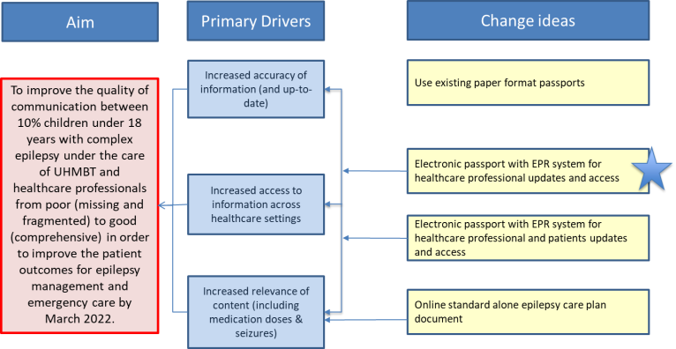
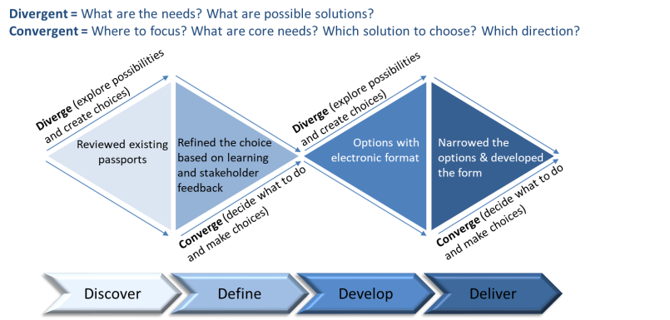
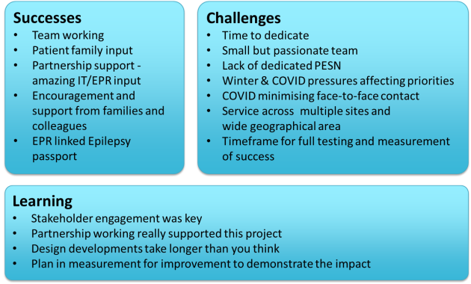
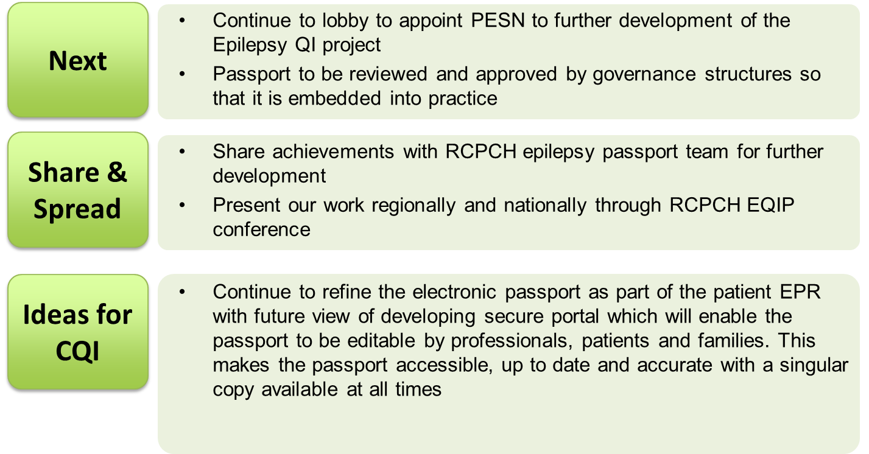
Dr Anas Olabi, Consultant Paediartrcian Sara Richardson, Staff nurse
[insert team pic]
Aim/purpose:
To improve the quality of communication for 10% of CYP with complex epilepsy amongst healthcare professionals from poor (missing and fragmented) to good (comprehensive and uptodate) to improve the patient outcomes for epilepsy management and emergency care by March 2022.
September 2021
Our improvement journey
September-November 2021
Understand the problem, engage with stakeholders to decide on change ideas
December 2021-March 2022
Design Epilepsy EPR linked passport, PDSA test cycles to adapt
March 2022 onwards
Continue to develop and embed
Stakeholder Engagement
Driver Diagram
Design Process
Reflections
Next Steps

