Slide 1
Epsom EQIP Project
Storyboard of slides

Slide 2
Problem statement
The epilepsy team don’t know which children are struggling.
Mental health problems don’t get picked up until very severe.
This is too late and leaves children in pain for too long.

Slide 3
Process map
Epilepsy
diagnosis
Clinic
appointment
Epilepsy Nurse
Support
Patients ask for help
CAMHS
NHS Apps and websites
TREATMENT

Slide 4
Cause and effect fishbone
Equipment
Process
People
Epilepsy nurses not always able to come to clinic
Focus on only severe cases
No psychologist in our hospital(s)
We don’t know who needs mental health support
No screening tool in use
Staffing levels very stretched
Child might not want to talk with parent present
CAMHS support only available for most severe cases
Clinics very busy
Materials
Management
Environment

Slide 5
Aim statement
What are we trying to accomplish?
To develop a standardised screening tool to identify the mental health status of ALL new patients by February 2022
SPECIFIC
MEASURABLE
ACHIEVABLE
RESULTS FOCUSSED
TIME-BOUND
To create a standardised screening tool for assessing mental health that will identify children in need of help.
An iterative process
Notes:
You could use this QIClearn™ AIM template in a number of ways
This is an iterative process. As you gain more information you will get closer to a SMART aim.
You may need to have established your baseline measure before you can get really SMART.
Your specific ambition will reflect the starting point and the time you have to work on achieving this aim.

Slide 6
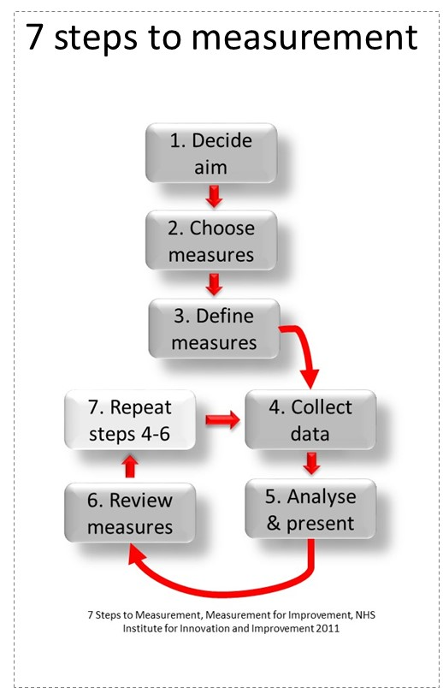
Your measurement ideas…
YOUR AIM
To develop a standardised screening tool to identify the mental health status of all new patients by February 2022
A list of measures you COULD choose from
Numbers of patients who were screened using HEADS-ED tool
□ Easy
□ Reliable
□ Reproducible
□ Meaningful
□ Informing
Notes:
You can use this QIClearn™ Measurement Idea template to help you generate ideas BEFORE you choose ONE:
If you have reviewed and tightened your aim a little and done some more detailed diagnostics
you should now be able to now create your own ideas about measures.
Think of ALL the things you can easily observe and measure.
Check out your histograms from your diagnostic phase – are there any clues there to what you can easily observe and measure on a regular basis?

Slide 7
Choose & define your baseline measures
Aim
To develop a standardised screening tool to identify the mental health status of all new patients by February 2022
Chosen measure
Numbers of patients who were screened using HEADS-ED tool
Inclusions
All NEW epilepsy patients who are >5 or school age (as starting school can often be a trigger for issues with anxiety)
Exclusions
Children <5 years old or in pre-school
Those patients with severe neurodisability who are unable to communicate
Sampling method & frequency
Count and analysis of completed HEADS-ED forms on a 2-weekly basis.
Can you do this for cases retrospectively? – no forms can’t be filled out retrospectively as the information has not been routinely gathered prior to this project.
Sense check!
How long would it take to generate 20 data points for your baseline?
Notes:
You can use this QIClearn™ Define baseline template to help you think about:
Ensure your measure relates to your aim
Any inclusion and exclusions
Your sampling method… (small and frequent wins the day).

Slide 8
PDSA 1a:
Abandon the “Strengths and Difficulties” tool
Contact other teams and research existing screening tools for mental health in children.
Epilepsy team reviewed this tool and discussed as a team. Consensus was that the tool was too long and wouldn’t work for routine clinic appointments.
Contacted St George’s Neuro team and asked if they could send us the screening tool that they use. They sent across the “Strengths and Difficulties” tool.
Notes:
QIClearn® PDSA quadrant graphic
Edit each box
Keep descriptions clear and minimal as they need to be able to be read quickly and understood easily

Slide 9
PDSA 1b:
Adopt the HEADS-ED tool
Research existing tools that are validated for use in children to screen for mental health concerns.
Epilepsy team reviewed the various tools mentioned in the article and discussed which might work. HEADS-ED tool chosen as best for inclusion in existing clinic/community appointments.
Internet search for existing screening tools showed a useful article on “Don’t forget the bubbles” website discussing several screening tools available for use in children.
Notes:
QIClearn® PDSA quadrant graphic
Edit each box
Keep descriptions clear and minimal as they need to be able to be read quickly and understood easily

Slide 10
PDSA 2:
Adapt the tool to show:
What help is already in place
Where the patient might go for additional support.
To see if HEADS-ED works for use in existing clinic appointments.
Discussion of how the team found using the tool showed that it was simple and easy to use in clinic appointments. Noted that it would be useful to add in additional information.
Start using the HEADS-ED tool in clinic and trial it in clinic appointments for new epilepsy patients.

Slide 11
PDSA 3:
Click here to edit text box
To see if adapted HEADS-ED tool works better for use in routine clinic appointments.
Click here to edit text box
Click here to edit text box
Notes:
QIClearn® PDSA quadrant graphic
Edit each box
Keep descriptions clear and minimal as they need to be able to be read quickly and understood easily

Slide 12
Quadrant graphic
Click here to edit text box
Click here to edit text box
Click here to edit text box
Click here to edit text box
Notes:
QIClearn® PDSA quadrant graphic
Edit each box
Keep descriptions clear and minimal as they need to be able to be read quickly and understood easily

